Slide 1
Bankruptcy & Restructuring @
Marvel Entertainment Group
Notes:
Here are some further notes on bankruptcy in the United States:
http://en.wikipedia.org/wiki/Bankruptcy_in_the_United_States

Slide 2
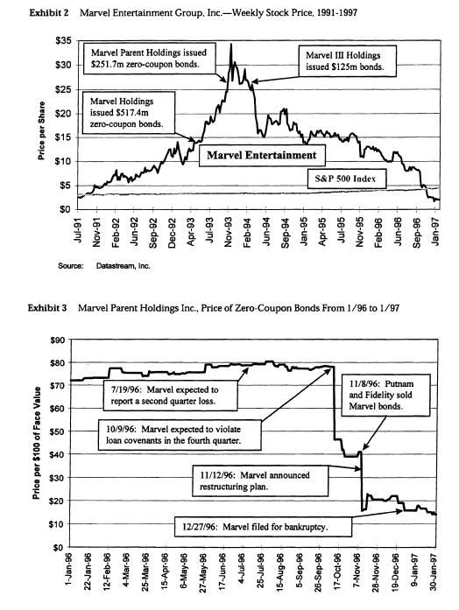
Perelman
Repurchases
Stock to 80.6%
Why would a bond holder ever take as collateral equity???

Slide 3
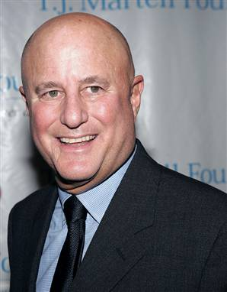
THE EQUITY HOLDER:
RON PERELMAN
Became wealthy by purchasing weak businesses & turning them around
Examples include: Revlon, Marvel, Consolidated Cigars, Coleman …etc.
Active in Democratic Politics
Won famous lawsuit against Morgan Stanley & against Revlon & Forstmann Little
Famous for multiple marriages & divorces include his most recent divorce from Ellen Barkin

Slide 4
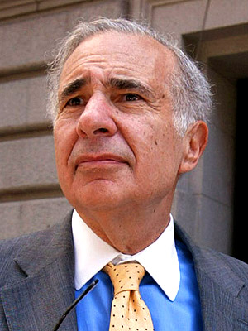
THE BOND HOLDER:
CARL ICAHN
2008 net worth of $14billion
Has taken substantial/ control positions in various corporations: RJR Nabisco, TWA, Texaco, Viacom, Revlon, Marvel
Famous shareholder rights advocate & corporate raider
Notes:
He has taken substantial or controlling positions in various corporations including: RJR Nabisco, TWA, Texaco, Phillips Petroleum, Western Union, Gulf & Western, Viacom, Uniroyal, Dan River, Marshall Field, E-II (Culligan and Samsonite), American Can, USX, Marvel Comics, Revlon, Imclone, Federal-Mogul, Fairmont Hotels, Kerr-McGee, Time Warner and Motorola. Source: Wikipedia.

Slide 5
Part I
Why did Marvel file for Chapter 11?
Violated bank loan covenants due to decreasing revenues & profits
Price of zero-coupon bonds down 41%
Bad luck or bad strategy?
Notes:
1. Why did Marvel file for Chapter 11? Were the problems caused by bad luck, bad strategy, or bad execution?
What circumstances led Marvel Entertainment Group (MEG) to file for bankruptcy through Chapter 11? Was that due to bad luck (i.e., coincidence)? Or, was that due to bad corporate strategy (both financially and operationally) adopted by the owners, MacAndrews & Forbes Holdings Inc?

Slide 6
MEG Capital Structure
Debt & holding structure
Two types of debt
Public Bonds face value $894M
Perelman issued debt to purchase public shares of Marvel Entertainment Group (MEG), operating company to go to 80% stake
Allowed to incorporate Marvel into MacAndrews & Forbes Group for tax purposes
Were public bonds collateralized?
What is collateral value?
77% of $3.3B total market value of MEG
Bank Debt in MEG of around $750M

Slide 7
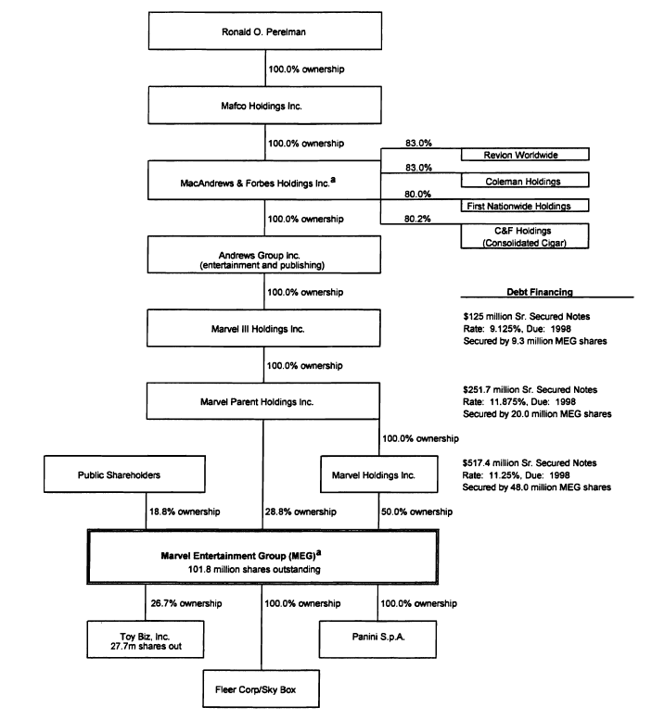

Slide 8
Perelman Strategy: Diversified Company?
MEG made several large acquisitions
Fleer (1992, $296M): second largest manufacturer of sports & entertainment trading cards
Toy Biz (1993): minority position
Panini Group (1994, $150M): Italian producer of sports & entertainment stickers
Skybox (1995, $150M): maker of trading cards
Acquisitions increased MEG leverage to over 60%!!!

Slide 9
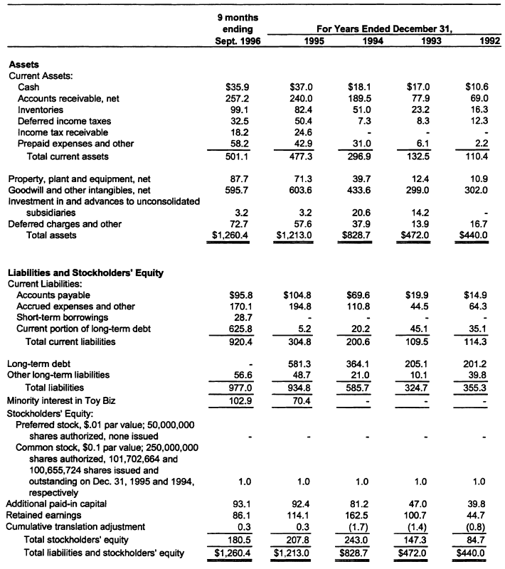
Exhibit 4

Slide 10
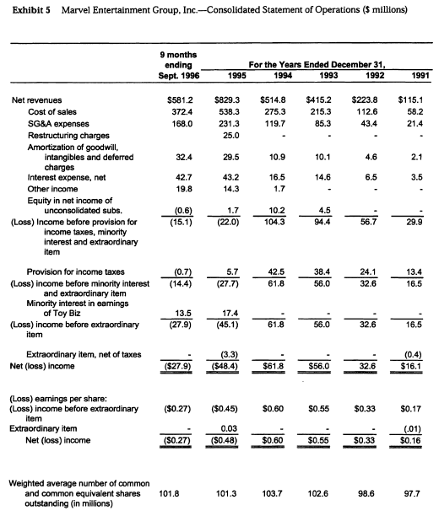
Exhibit 5

Slide 11
Part II
Evaluate the proposed restructuring plan.
Will it solve the problems that caused Marvel to file for chapter 11?
Notes:
Show what happened at the announcement.
First, start by briefly describing the plan. Please focus on the restructuring plan proposed by Ron Perelman on January 28th 1997. In discussing the plan, please address the following questions. Is Ron Perelman discriminating among the various classes of creditors? What is he trying to achieve? Would his plan be likelier to succeed if disagreement exists among the classes of creditors? To answer that question, please refer to the HBS note on bankruptcy (note # 9-292-062) that I will distribute in class on Thursday (you can consider this note part of the case). It would further help you to examine carefully the structure of MEG's debt, as shown in Exhibit 1.
Second, will the proposed restructuring plan resolve the causes to file bankruptcy in the first place? In answering this question you may want to analyze at some length the benefits of such resolution to MEG and to the issuers of the defaulted-upon debt, i.e., Marvel Holdings, Marvel Parent Holdings and Marvel III Holdings. Who would benefit the most among these from the proposed plan? Moreover, does the plan offer any changes in the top management of Marvel Entertainment? You may also want to consider other available restructuring options (beyond the bankruptcy in Chapter 11) for MEG: are these better than the bankruptcy process in Chapter 11? Worse?
Third, comment on the decision of the public debt holders whether to approve the reorganization plan offered by Ron Perelman and his investment banker, Bear Stearns. To do so, please compute the payoffs to the public debt holders under three scenarios: first, based on the prices of their corresponding debt claims in the market as of the day of the announced violation of a bank debt covenant (10/8/96). You can use for that purpose the data provided in Exhibit 6. Second compute the value of the claim of the public creditors based on a successful completion of the reorganization plan, as offered by Ron Perelman (notice here that you would have to compute the price per share offered by him, and then multiple that price by the number of shares that would be given to the public creditors, post the reorganization - these are all given to us by the case writer). Third, and last, compute the value of the public debt holders claim as of 1/31/97, i.e., the date after the announcement of the reorganization plan.
Then, comment of the extent of loss in value of public debt during the period from 10/8/96 to 1/31/97. Subsequent to that, compare the value offered to the public debt creditors through the reorganization plan and through the open market as of 1/31/97. Which one is more favorable? Would your decision change if you have purchased, just like Mr. Carl Icahn and other vulture investors have had, a dollar worth of distressed debt at 0.20$ to 0.22$ on it?
To conclude, in general, what are the options available to the public debt holders? Accept the reorganization offer? Sell their bonds in the open market? Other options (hint: what did Mr. Icahn do, and how)? Which is the best course of action, in your opinion? You can base your discussion on your reading of the case, as well as on the note on bankruptcy that I will distribute in class on Thursday, 4/9.

Slide 12
Marvel’s Proposed Restructuring
Proposed restructuring (January 28, 1997)
Invest $365M in exchange for 427M new shares
Marvel acquire Toy Biz for $326.8M
Public debtholders would exchange debt with face value of $894M for equity
They would seize collateral shares & hold 77M shares
Marvel would repay secured creditors
What would be Andrews Group stake post-restructuring?
Why maintain such equity stake?
Marvel: > $100M in net operating losses (NOLs). W/out 80% ownership, Andrews Group could not use NOLs
Value of Perelman’s holding company investments in Marvel when stock worth $4.6, November 1996?

Slide 13
Exhibit 8
 |  | Proposed | Proposed | Projected Pro
 | Projected | Toy Biz | Bank Debt | Forma as
 | Preconfirmation | Investment | Agreement | Reorganized
ASSETS
Current assets:
Cash | $13.3 | $33.5ª | $52.0^{c} | $98.8
Accounts receivable, net | 210.0 |  |  | 210.0
Inventories, net | 77.5 |  |  | 77.5
Deferred income taxes | 40.1 | 48.5^{b,2} |  | 88.6
Income tax receivable | 11.1 |  |  | 11.1
Prepaid expenses and other | 55.0 |  |  | 55.0
Total current assets | $407.0 |  |  | $541.0
Property, plant and equipment, net | 78.7 |  |  | 78.7
Goodwill and other intangibles, net | 317.4 | 202.3^{b} |  | 519.7
Deferred charges and other | 65.9 |  | 8.0^{c} | 73.9
Total assets | $869.0 |  |  | $1,213.3
LIABILITIES AND STOCKHOLDERS’ EQUITY
Current liabilities:
Accounts payable | $99.4 |  |  | $99.40
Accrued expenses and other | 143.1 | 10.0^{b,1} |  | 153.1
Short-term borrowings | 40.0 |  |  | $40.0
DIP financing | 50.0 |  | (50.0)^{c} | —
Current portion of long-term debt | 635.4 |  | (624.7)^{d} | $10.7
Total current liabilities | $967.9 |  |  | $303.2
Long-term debt | — | 20.0^{b} | 624.7^{d} | $754.7
 |  |  | 110.0^{c}
Other long-term liabilities | 49.7 | (1.7)^{b} |  | 48.0
Total liabilities | $1,017.6 |  |  | $1,105.9
Minority interest in Toy Biz | $109.0 | (109.0)^{b}
Stockholders’ equity:
Common stock | 1.0 |  |  | 1.0
Additional paid-in capital | 93.1 | 365.0ª |  | 458.1
Retained earnings | (351.7) |  |  | (351.7)
Total stockholders’ equity | ($257.6) |  |  | $107.4
Total liabilities and stockholders’ equity | $869.0 |  |  | $1,213.3

Slide 14
Perelman’s Other Options?
Raise new cash?
Out-of-court reorganization?
Why? Cheaper, quicker
Similar plan, but creditors rejected
Had to file for Chapter 11 or Chapter 7
Chapter 7 liquidation?
Bear Stearns mid-value estimate $590M ($520M-$660M)
Liquidation not attractive because Marvel had intangible assets (>$300M, 40% of assets) & hence high going concern value
No incentive for equity holders to liquidate & get zero by exercising liquidation option
Chapter 11?
Why did Perelman keep the company debtors separate in the 1st Amended Joint Plan of Reorganization?

Slide 15
Exhibit 7
Exhibit 7 Liquidation Analysis ($ millions)
Gross proceeds from disposition of operating assets ª |  | $447.0
Chapter 7 costs
Transaction costs^{b} |  | 4.5
Case related administrative expenses^{c} |  | 6.0
Total Chapter 7 costs |  | 10.5
Net proceeds from disposition of operating assets |  | 436.5
Less Panini debt |  | 192.1
Net proceeds available for other creditors |  | 244.4
Net proceeds available for other creditors from sale of Toy Biz shares ^{d} |  | 124.7
Total net proceeds available for other creditors |  | 369.1
Secured claims^{e} |  | 535.4
Percent recovery against secured claims (mainly debt) |  | 68.9%
Proceeds available for other claims |  | 0.0%
Other administrative claims^{f,g} |  | 94.1
Percent recovery against other administrative claims |  | 0%
Unsecured deficiency claims |  | 166.3
Percent recovery against unsecured deficiency claims |  | 0%
Proceeds available for common equity shareholders |  | $0.0
Notes:
Go over the slide on the liquidation analysis

Slide 16
Part III
As Carl Icahn, the largest unsecured debt holder, would you vote for the proposed restructuring plan? Why or why not?
How much is Marvel’s equity worth per share under the proposed restructuring plan assuming it acquires Toy Biz as planned?
What is your assessment of the pro-forma financial projections & liquidation assumptions?
What bias one should be aware of in financial projections & liquidation assumptions?
Notes:
Here we would conduct a DCF valuation of MEG. First, we would compute the cost of capital. Please use the data provided in Exhibit 10 for that purpose. You are given an asset beta. Choose the appropriate risk-free rate. You can also assume (as suggested by Ben Esty, the case writer) that the market premium is 7.50%. Note that we would be preparing an APV valuation, hence you would need not compute WACC, rather compute the return on assets (i.e., use the asset beta directly into a CAPM model).
Second, we would value MEG under the assumptions that it successfully acquires (under the terms of the reorganization agreement) the Biz Toy company.
Please use the projections offered in Exhibit 9 for that purpose. Start with the net revenue. Use the projections for 1997-2001
Subtract from these COGS and SGA. That would produce the EBITDA projections.
Adjust EBITDA with depreciation to obtain EBIT.
Use the income tax provisions in the case to obtain EBIT(1-T). Since the tax rate is not given to us, you can simply compute EBIT – Tax Provisions, in lieu of the EBIT(1-T).
Adjust EBIT(1-T) with depreciation, capital expenditure, change in net working capital, all provided in Exhibit 9, to obtain the free cash flow. Note that there is an additional item that need be accounted for: the Toy Biz expense in 1999. Reflect that as well.
Compute the continuation value of the FCFF in 2001. You will have to make an assumption regarding the anticipated growth rate in perpetual of the FCFFs.
Please discount all cash flows as of Dec 31st 1996.
Subtract from the resulting value of the firm the value of the pro-forma total debt as shown in Exhibit 8. Furthermore add back the non-operating cash that is recorder in the same exhibit. That is the value of the equity.
Divide the equity value by the number of the MEG shares, after the reorganization plan is completed.
Third, please comment on the MEG price per share that you have obtained. How sensitive are these to the main assumptions of your analysis (which in part is based on the analysis of Bear Stearns, whose estimates are shown in Exhibits 8, 9, and 10)? In particular, please prefer two-way sensitivity tables with respect to the assumed growth rate of the continuation value in perpetuity and the assumed asset beta. Comment on the reliability of these assumptions. You may also want to choose some further sensitivity tests, based on what you believe to be a key assumptions.
Lastly, note that in the above we did not account for interest tax shields and cost of financial distress over the evaluation period, post-reorganization. While I do not require these, I encourage you to value them, based on the data provided in this case (note that if you choose to make these valuations, you would have to make a number of assumptions concerning the interest rates paid over time, as well as the default probability over time). How would that change your conclusions above? Again, doing that part is entirely optional.

Slide 17
Valuation: Bond Holders Claim Value
 |  |  | Price per $ | Price per $ | Market Value | Market Value |  |  | Recovery %
 | Face Value | Promissed Interest Rate | 10/8/1996 | 1/31/1997 | 10/8/1996 | 1/31/1997 | Collateral Shares (m) | Value of Shares (m) | 10/8/1996 | 1/31/1997
Marvel Holdings | $ 517.40 | 11.25% | $ 0.77 | $ 0.18 | $ 400.47 | $ 90.55 | 48.0 | $ 40.80 | 10.19% | 45.06%
senior secured notes
Marvel Parent Holddings | $ 251.70 | 11.88% | $ 0.78 | $ 0.14 | $ 196.58 | $ 35.24 | 20.0 | $ 17.00 | 8.65% | 48.24%
senior secured notes
Marvel III Holdings | $ 125.00 | 9.13% | $ 0.90 | $ 0.14 | $ 112.38 | $ 17.38 | 9.3 | $ 7.91 | 7.03% | 45.50%
senior secured notes
Total | $ 894.10 |  |  |  | $ 709.42 | $ 143.16 | 77.3 | $ 65.71 | 8.62% | 46.27%
Break-Even Stock Price |  | $ 9.18 |  | Value of debt claim in reorganization |  |  | $65.7
These are huge losses to the bond holders!!!

Slide 18
Valuation: Cost of Capital
Unlevered Cost of Capital | 11.8%
Risk-free rate | 6.89% | <== Ex. 10
Asset Beta | 0.65 | <== Ex. 10
Risk-Premium | 7.50%

Slide 19
Valuation: Unlevered FCFF
Terminal Growth Rate |  | 3%
r_{A} |  | 11.8%
Cash Flows to Firm |  | 1997 | 1998 | 1999 | 2000 | 2001
Net Revenue |  | $929.8 | $1,128.3 | $1,155.8 | $1,200.6 | $1,247.5
COGS |  | $550.4 | $647.2 | $666.9 | $694.9 | $724.2
SGA expense |  | $262.4 | $305.4 | $313.4 | $324.5 | $336.0
EBITDA |  | $117.0 | $175.7 | $175.5 | $181.2 | $187.3
Depreciation |  | $34.5 | $43.4 | $44.1 | $44.8 | $45.9
Amortization of goodwill |  | $30.5 | $21.8 | $21.5 | $21.2 | $21.5
Operating Profit (EBIT) |  | $52.0 | $132.3 | $131.4 | $136.4 | $141.4
Taxes |  | $6.9 | $24.8 | $4.6 | $29.8 | $34.1
NOPAT (EBIT*(1-T)) |  | $45.1 | $107.5 | $126.8 | $106.6 | $107.3
Depreciation |  | $34.5 | $43.4 | $44.1 | $44.8 | $45.9
Amortization of goodwill |  | $30.5 | $21.8 | $21.5 | $21.2 | $21.5
CAPEX |  | $83.0 | $67.4 | $47.4 | $46.7 | $45.1
Ch NWC |  | $75.4 | $11.5 | ($44.3) | $42.0 | ($2.0)
Toy Biz Expense |  |  |  | $55.0
Free Cash Flow |  | ($48.3) | $93.8 | $134.3 | $83.9 | $131.6
Terminal Value |  |  |  |  |  | $ 1,546
Unlevered Cash Flows |  | $ (48) | $ 94 | $ 134 | $ 84 | $ 1,678
Unlevered Value of Firm |  | $1,144

Slide 20
Valuation: Leverage
Leverage |  | 1997 | 1998 | 1999 | 2000 | 2001
Assets |  | $ 1,214 | $ 1,235 | $ 1,230 | $ 1,207 | $ 1,192
Interest Expense |  | $ 71 | $ 68 | $ 65 | $ 61 | $ 57
EBITDA |  | $ 117 | $ 176 | $ 176 | $ 181 | $ 187
EBITDA/Interest Expense |  | 1.65 | 2.58 | 2.72 | 2.97 | 3.31
Long-term debt |  | $ 770 | $ 744 | $ 612 | $ 390 | $ 120
Refinanced Long-term debt |  | $ - | $ - | $ 66 | $ 281 | $ 493
Short Term debt |  | $ 33 | $ 29 | $ 41 | $ 37 | $ 37
Total Debt |  | $ 803 | $ 773 | $ 719 | $ 708 | $ 650
Debt to Total Capital |  | 66% | 63% | 58% | 59% | 55%
Cost of Debt |  | 8.85% | 8.80% | 8.99% | 8.61% | 8.71%

Slide 21
Valuation: S&P Credit Week
Total Debt as % of Market Cap | EBIT Interest Coverage | Rating | Yield | Probability Default | ΔYield/ ΔDebt | ΔProb. Default/ ΔDebt
3.7% | 17.5 | AAA | 7.01% | 0.0% | 2.4% | 0.0%
9.2% | 10.8 | AA | 7.14% | 0.0% | 2.4% | 1.4%
16.4% | 6.8 | A | 7.31% | 0.1% | 2.9% | 2.1%
30.4% | 3.9 | BBB | 7.72% | 0.4% | 8.5% | 5.8%
47.5% | 2.3 | BB | 9.18% | 1.4% | 10.7% | 39.8%
59.3% | 1.0 | B | 10.44% | 6.1% | -69.6% | 165.3%
74.3% | 0.2 | CCC |  | 30.9%

Slide 22
Valuation: TS & CFD
ACCOUNTING FOR TAX SHIELDS |  | 1997 | 1998 | 1999 | 2000 | 2001
Unlevered Value of Firm |  | $1,144
Tax Rate |  | 35% | 35% | 35% | 35% | 35%
Probability of Default |  | 17.39% | 11.60% | 5.74% | 5.86% | 4.20%
Interest Expense |  | $ 71 | $ 68 | $ 65 | $ 61 | $ 57
Cost of debt |  | 8.85% | 8.80% | 8.99% | 8.61% | 8.71%
Interest Tax Shield |  | $ 21 | $ 21 | $ 21 | $ 20 | $ 19
Terminal Value TS |  |  |  |  |  | $ 147
Total TS |  | $ 21 | $ 21 | $ 21 | $ 20 | $ 166
PV of Tax Shields |  | $158.52
Total Firm Value |  | $1,302.60
ACCOUNTING FOR DISTRESS COST
 |  | 1997 | 1998 | 1999 | 2000 | 2001
LGD |  | 50% | 50% | 50% | 50% | 50%
Probability of Default |  | 17.39% | 11.60% | 5.74% | 5.86% | 4.20%
Cost of debt |  | 8.85% | 8.80% | 8.99% | 8.61% | 8.71%
Cost of financial distress |  | $113 | $76 | $37 | $38 | $27
Terminal value CFD |  |  |  |  |  | $212
Total CFD |  | $113 | $76 | $37 | $38 | $239
PV CFD |  | $350.28
Total Firm Value |  | $952.32

Slide 23
Valuation: Equity Values
Net Debt Value |  | $ 707
Long Term debt |  | $ 755 | <= Ex. 8
Short Term Debt |  | $ 40 | <= Ex. 8
Current portion Long Term debt |  | $ 11 | <= Ex. 8
Cash |  | $ 98 | <= Ex. 8
Equity Value (no TS & no CFD) |  | $436.68
Equity Value (TS & CFD) |  | $244.92
Number of shares (million) |  | 528.8
Per Share Value (no TS & no CFD) |  | $0.83
Per Share Value (TS & CFD) |  | $0.46

Slide 24
Valuation: Sensitivity Analysis (w/out TS&CFD)
 |  |  |  | Terminal Value Growth Rate
 | $0.83 | -1% | 0% | 1% | 2% | 3% | 4%
 | 8% | $1.08 | $1.33 | $1.66 | $2.10 | $2.71 | $3.62
 | 9% | $0.80 | $1.00 | $1.24 | $1.55 | $1.97 | $2.56
 | 10% | $0.57 | $0.72 | $0.91 | $1.15 | $1.45 | $1.86
Discount rate | 11% | $0.38 | $0.50 | $0.65 | $0.84 | $1.06 | $1.36
 | 12% | $0.22 | $0.32 | $0.44 | $0.59 | $0.76 | $0.98
 | 13% | $0.08 | $0.17 | $0.27 | $0.38 | $0.52 | $0.69
 | 14% | -$0.03 | $0.04 | $0.12 | $0.21 | $0.32 | $0.46
 | 15% | -$0.14 | -$0.08 | -$0.01 | $0.07 | $0.16 | $0.27
 | 16% | -$0.23 | -$0.18 | -$0.12 | -$0.05 | $0.02 | $0.11

Slide 25
Valuation: Sensitivity Analysis (w/ TS & CFD)
 |  |  |  | Terminal Value Growth Rate
 | $0.46 | -1% | 0% | 1% | 2% | 3% | 4%
 | 8% | $0.60 | $0.77 | $1.00 | $1.31 | $1.74 | $2.38
 | 9% | $0.41 | $0.55 | $0.72 | $0.95 | $1.25 | $1.66
 | 10% | $0.26 | $0.37 | $0.51 | $0.68 | $0.89 | $1.18
Discount rate | 11% | $0.13 | $0.22 | $0.33 | $0.46 | $0.63 | $0.84
 | 12% | $0.02 | $0.10 | $0.18 | $0.29 | $0.42 | $0.58
 | 13% | -$0.07 | -$0.01 | $0.06 | $0.15 | $0.25 | $0.38
 | 14% | -$0.16 | -$0.10 | -$0.04 | $0.03 | $0.11 | $0.21
 | 15% | -$0.23 | -$0.19 | -$0.13 | -$0.08 | -$0.01 | $0.07
 | 16% | -$0.30 | -$0.26 | -$0.21 | -$0.16 | -$0.11 | -$0.04

Slide 26
Vultures (Investors)
Vultures’ strategy: buy significant stake (potentially undervalued) public debt
Goal: profit by influencing restructuring in ways that benefit public bondholders
Carl Icahn (vulture): bought 25% of bonds @ 20c to 22c per dollar
Proposed alternative plan (Dec 22 1996)
$350M cash infusion through rights offerings
No Toy Biz acquisition
Will fight plan proposed by Marvel management

Slide 27
Marvel in bankruptcy
By filing for bankruptcy protection under Chapter 11 Marvel became eligible for Debtor-in-Possession (DIP) financing
Got $100M in DIP financing from Chase Manhattan Bank to insure it had cash to pay current & expected trade & employee obligations & meet investment operating needs
Marvel’s management have an exclusive 120-day period (automatic stay) to make restructuring proposals
BUT WHY DO CREDITORS TOLERATE THAT?
WHY CREDITORS DO NOT SEIZE COLLATERIAL & VOTE MANAGEMENT & BoD OUT?

Slide 28
Alternative valuation: Equity as a Call Option
Maturity date of (asset) option expiration extended
Equity holders have incentives to prolong bankruptcy proceeding or
Reduce exercise price (reduce face value of debt claims – e.g., debt forgiveness or debt equity swap)
Why Perelman is willing to invest equity into company w/ negative equity???
Only senior claimants such as DIP lenders are willing to invest funds
Any other investment just serve to bail out more senior claimants
Timing is of essence:
Perelman willing to invest AFTER restructuring occurs
Debt holders claims will be substituted for equity stake

Slide 29
Carl Icahn vs. Ron Perelman
March 7, 1997: vote to approve reorganization plan
Creditors grouped into classes
Class accepts the plan if 2/3 of the class in value and 1/2 in number vote in favor
If plan accepted by at least some creditor classes, court can approve plan
Court can “cram down” dissenter classes provided that they get > what they could get in liquidation
Cram-down as long as plan is not discriminating unfairly against non-accepting classes & provided that it is fair & equitable to all classes

Slide 30
What Happened?
Judge Bernard Balick lifted automatic stay
Allowed public debt holders to seize collateral shares
Public bondholders got FULL control
They replaced BoD w/ new slate of directors & replaces senior executives
June 12, 1997: bondholder proposed reorganization plan
Marvel divested Fleer, Skybox, & Panini into separate companies owned by bank debt holders
In exchange, bank bond holders would forgive debt w/ face value $385M
$365M rights offering: each share gets the right to buy 1.93 shares at $1.858/shares
Jefferies & Company advised debt holder group & determined value of Marvel ($2.00 and $2.50 share) >> Perelman investment offer $0.85/share

Slide 31
Part IV
The reputation effects in debt markets
Will it be difficult for Marvel or other companies in the MacAndrews & Forbes Holding Inc to issue debt in the future?
Insider trading of debt instruments
Why did the price of Marvel’s zero-coupon bonds drop on Tuesday, November 12, 1996?
Why did portfolio managers at Fidelity and Putnam sell their bonds on Friday, November 8, 1996?
Does BoD owe fiduciary duty to debt holders? How about in bankruptcy?
Chiarella vs. United States (1980)
Notes:
4. Will it be difficult for Marvel or other companies in the MacAndrews & Forbes Holding Inc to issue debt in the future?
I am interested in your view on the effects of that transaction on the forthcoming ability of MacAndrews & Forbes Holdings Inc to borrow in debt markets. Would the fact that the latter defaulted upon their debt influence the market's willingness to lend to them in the future? If yes, how and why? If not, why?
5. Why did the price of Marvel’s zero-coupon bonds drop on Tuesday, November 12, 1996? Why did portfolio managers at Fidelity and Putnam sell their bonds on Friday, November 8, 1962?
What is the perceived value of the zero-coupon bonds in the market upon the initial announcement of the reorganization plan drafted by Ron Perelman? Given this perceived valuation, and taking into account the fact that Fidelity & Putnam did receive a tip from MacAndrews & Forbes Holdings Inc on the upcoming announcement of such a plan, can you reason through their decision to sell?
Now, as a side observer, was that a legitimate decision: shouldn't they be concerned about insider trading allegations? Here, you can also refer to the fact that following the seminal case of Chiarella vs. United State in 1980, the court established that insider trading regulation, such as Section 10b of the Securities Exchange Act of 1934 is applicable only when there exists fiduciary duty and hence, when no such duty is due there is no violation of the Section 10(b) on insider trading from this Act. That being said, do we owe any fiduciary duty to the bond holders?

Slide 32
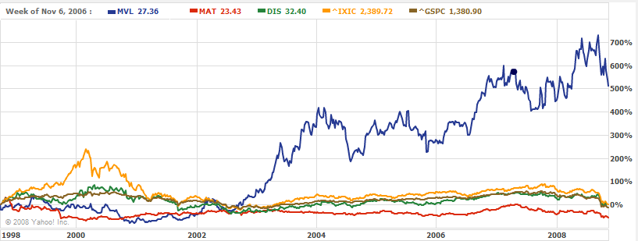
MVL’s performance subsequent to Chapter 11

Slide 33
A Note on Bankruptcy

Slide 34
Financial distress
Financial distress
OCF not sufficient to pay obligations (flow-based insolvency)
Net worth<0, assets value < debt value (stock-based insolvency)
Firms deal w/ financial distress by
Restructuring assets: selling major assets, merging, cutting expenses
Financial restructuring: issue new securities, exchanging debt for equity, negotiating reduction in interest rate & maturity
Financial distress resolved w/ either:
informally in private workout
formally under bankruptcy code: either liquidation or reorganization
Notes:
Bankruptcy is the formal or legal mechanism to deal with a firm that does not satisfy its contractual obligations with creditors
Administratively insolvent: assets are not enough even to pay legal expenses with bankruptcy procedure

Slide 35
Private workouts vs. bankruptcy
Most of restructurings: private workouts
Exchange of new financial claims for old ones: e.g., senior debt replaced w/ junior, junior debt replaced for equity
Less expensive & faster than formal bankruptcy
Why then file for formal bankruptcy???

Slide 36
Why file for formal bankruptcy??? (cont)
Complexity
Variety of claims including banks loans, senior subordinated debt, secured creditors, junior subordinated debt, trade credit
Very difficult getting all claimholders to agree to out-of-court settlement b/c conflicting interests of claimholders
Holdout problem (free ridership)
Reorganizations involve write down of debt/ reduction of interest payment
Creditors gain if they refuse to restructure own claims while other creditors restructure & take firm out of distress (free-riders)
Asymmetries in information
Creditors, CEOs & shareholders, have different incentives & different information about going concern & liquidation values
Tax advantages of bankruptcy
Firms do not lose tax carry forwards & tax treatment in cancellations of indebtedness
DIP
Formal bankruptcy allow firm to issue new senior debt (“debtor-in-possession”)
Notes:
Private workouts are by far more important in most countries.
In most countries companies that file for formal bankruptcy end up being liquidated.
It is important to understand the bankruptcy code also to understand private workouts. Bankruptcy code provide the threat point or the minimum that parties are willing to accept in private negotiations.

Slide 37
Bankruptcy
Bankruptcy laws provide framework to facilitate:
Reorganization of viable firms in financial distress
Liquidation of firms in financial distress that are not viable
Criteria for judging efficiency of bankruptcy law
Achieve liquidation & reorganization @ lower possible direct costs & as fast as possible
Adherence to terms of debt contract w/ no violation of priority
Reduce ex-ante under-investment/over-investment
Notes:
Factors that complicate situation of a firm facing financial distress
Information asymmetries where the different parties have access to different sets of information
Conflicts among the claimants
The familiar holdout problem (or free rider problem)

Slide 38
Chapter 7
Bankruptcy liquidation
Corporation or creditors file petition (voluntary or involuntary)
Trustee elected by creditors to control firm assets w/ objective to liquidate firm
Proceeds distributed following absolute priority rule (APR)
Ranking: secured claims (first), administration expenses, employee compensation, customer claims, tax claims, unsecured claims, preferred stockholders and common stockholders (last)

Slide 39
Chapter 11
Bankruptcy reorganization
General objective is to restructure firm
Manager usually retains control
Manager has exclusivity in formulating reorganization plan in first 120 days (automatic stay)
Plan proposed to creditors & shareholders for vote
Creditors grouped into classes & class accepts plan if 2/3 of class in value & 1/2 in # vote in favor
If plan accepted by some classes of creditors, court can approve it:
can “cram down” dissenter classes if they get > could get in liquidation
Notes:
Most firms enters Chp. 11 only after attempting an informal reorganization or workout outside of the bankruptcy process.
A workout can take the form of an exchange offer for outstanding debt, renegotiation of bond covenant or the negotiation of a reduction in interest payment and extension of loan maturity.
Workout involves lower direct cost than Chp. 11 cases because time spent in reorganization is much shorter.
In workout, court does not supervise the affairs of the company in contrast to Chp. 11, where the day to day affairs of the company are under scrutiny of court & creditors

Slide 40
Chapter 11 (continued)
U.S. Chapter 11
Lengthy & expensive
Lead to changes in priority of claims & lack of adherence to original terms of debt contracts
CEO: strong incentives to overinvest
Use of workouts & prepackaged bankruptcy have increased
“pre-packs”: 43% of filings for Chapter 11 for firms w/ assets > $100m
Benefits of prepackaged bankruptcies
Can alleviate problems w/ creditor holdouts who interfere w/ informal reorganizations
Tax benefit can be secured under prepackaged plan that are not available under informal reorganization
Notes:
“Prepacks” attempt to combine the lower administrative costs of a workout with the non-unanimity requirements and tax benefits of Chp. 11
A plan of reorganization is arranged with the main creditors outside formal bankruptcy, then the firm enters Chp. 11 and the plan is immediately submitted for approval
Under most bond indenture agreements 90% or more must approve terms of change.
Alternatively the firm can propose an exchange offer of some of the old debt for new debt . The problem with the exchange offer is that it may strengthen the position of bondholders that do not participate .
This leads to a holdout problem. In brief each bondholder has incentive to reject restructuring of his claim even though restructuring collectively benefits all bondholders.
This hold out problem can be mitigated by choosing prepackaged bankruptcy.
A plan of reorganization becomes effective if it is approved by 50% of the creditors by number in each class and two thirds by dollar amount. Thus plan of reorganization can be forced upon a set of recalcitrant creditors.
Taxes also play a role.
NOL are treated differently in Chapter 11 than in workout.
In a workout or informal reorganization firm might lose its NOLs if old equity holders hold less than 50% of their original stake.
For companies that have accumulated losses over a large number of years the loss carry forward can have significant effect on future cash flows.
In bankruptcy in contrast firms do not lose their carry forward and thus conceivably file for bankruptcy to keep NOL intact.
The second tax reason is cancelation of indebtedness (COD)
In an informal workout if debt with face value of $1000 is exchanged for debt with face value $500 the reduction of 500 in the firm debt is considered to be income for tax purposes. A similar exchange under Chapter 11 does not lead to income tax liability.

