Slide 1
GE Quick Hits
By Dr. Terry R. Adler, PMP

Slide 2
Company History
Began in 1889 by Thomas Edison
Originally Edison General Electric Company.
Became General Electric Company after merger with competitor
One of the original 12 companies listed in the Dow Jones Industrial Avg.

Slide 3
Who is GE?
Mission: “We rise to the challenge of building a world that works”
Vision: “To focus on businesses that connect to its core competencies and is a market leader in.”

Slide 4
Accomplishments
Many Inventions: electric fan, stove, design for modern fridges, “invisible lens” used for cameras, jet engine
Pioneers of radio broadcasting, commercial use of radar, and labs purely for scientific research

Slide 5
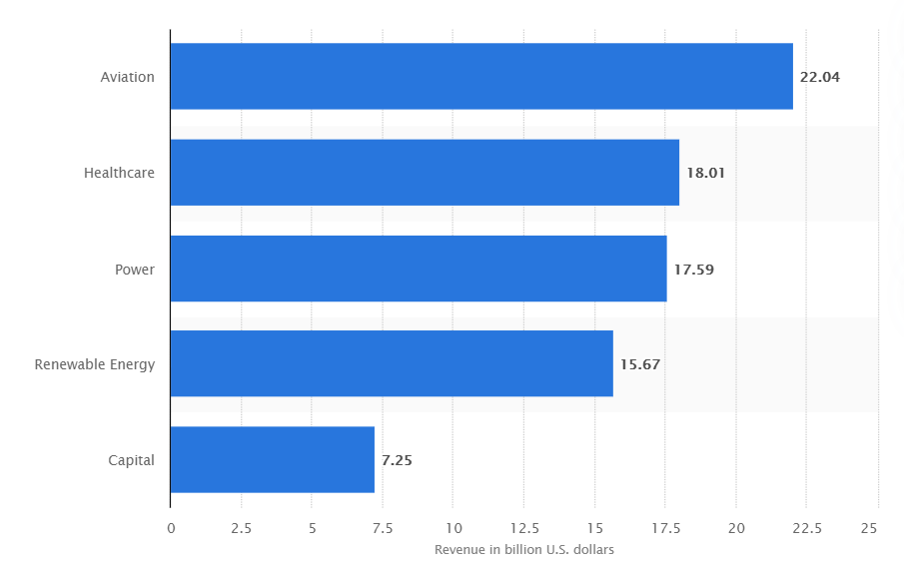
GE Overview
“Global digital industrial company”
~200,000 employees (2020)
Conglomerate with several divisions
Aviation
Healthcare
Power
Renewable energy
Capital

Slide 6
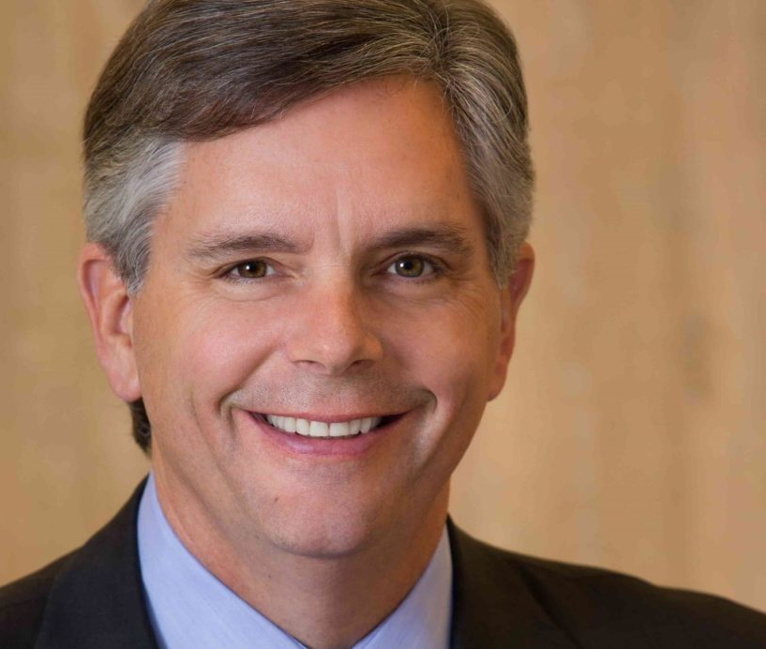
GE leadership history and impact
Jack Welch: 1981-2001
Jeff Immelt: 2001-2017
John Flannery: 2017-2018
Larry Culp: 2018-Present
Notes:
WILL

Slide 7
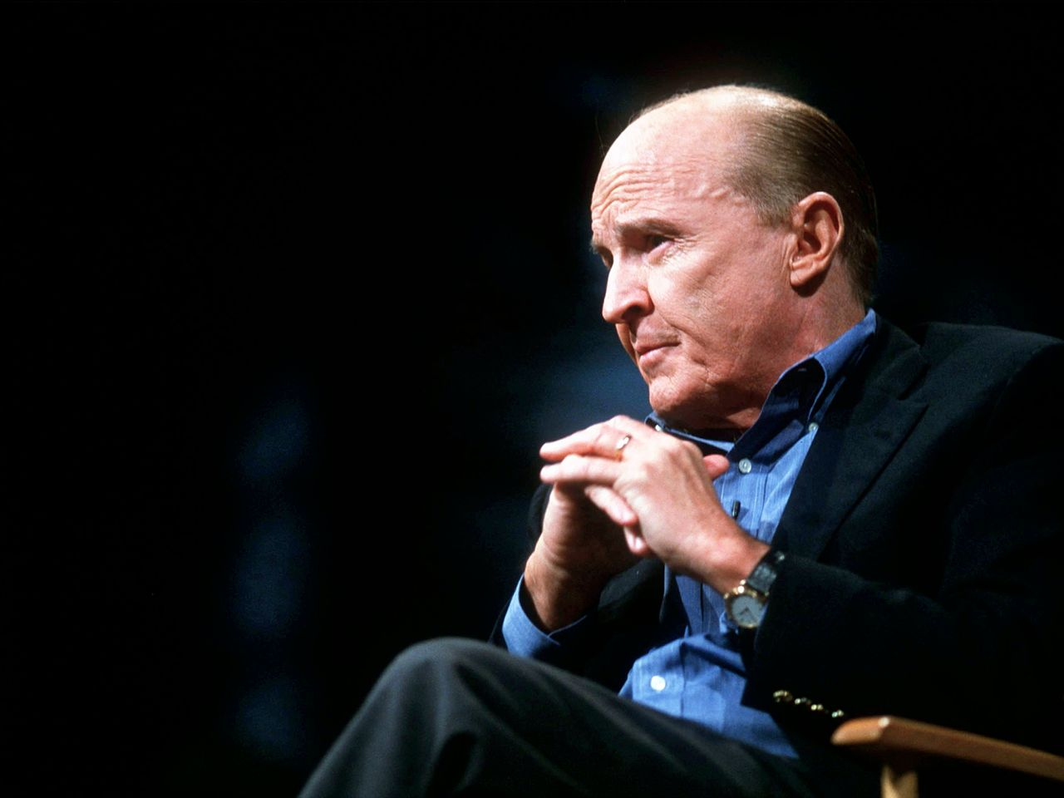
The Welch era
CEO from 1981-2001.
Jack Welch developed “Boundarylessness” in the late 1980’s / early 1990’s.
Pioneer of Six Sigma.
Notes:
CHRIS
GE's diversity creates a huge laboratory of innovation and ideas that reside in each of the businesses, and mining them is both our challenge and an awesome opportunity. Boundaryless behavior is what integrates us and turns this opportunity into reality, creating the real value of a multi-business company -- the big competitive advantage we call Integrated Diversity – Jack Welch
Remarkable profit throughout his 20 years with GE as CEO.

Slide 8
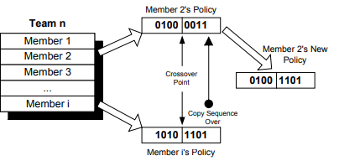
Organizational structure:
“Boundarylessness”
4 dimensions :
Vertical Boundaries
Horizontal Boundaries
External Boundaries
Geographical Boundaries
Eliminate chain of command
Replace departments with teams.
Boundaryless organizations have learned to permeate the 4 dimensions.
Reward system
Competitive Advantage
Notes:
CHRIS
Vertical boundaries divide management from employees and divide layers of management from each other.
Horizontal boundaries divide divisions and departments within a corporation from each other.
External boundaries divide a company from others in its value chain.
Geographic boundaries are a special form of horizontal boundary.
Vertical and Horizontal are most important because they involve the day to day interactions amongst co-workers.
Reward system recognizes the adapter or the implementer of an idea as much as its originator.
Competitive advantage because this streamlines more ideas to come together from different businesses within GE.

Slide 9
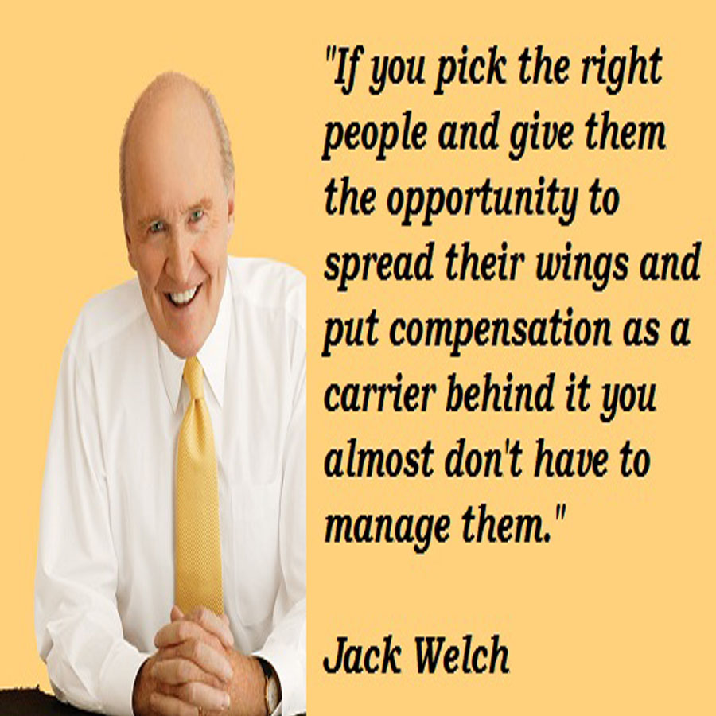
Town Meetings / Workouts
“Boundary-breaking” program of the early 1900’s.
Multiple perspectives
Notes:
CHRIS
People from throughout the organization, regardless of status were able to voice their opinions at these Town Meetings which GE called Workouts.
The format provided safe ways for anybody’s ideas to be challenged by anybody.
These meetings were used to generate and implement new ideas, and it was to educate people on their degrees of freedom.
These meetings encouraged people to formulate their own ideas and to make decisions by themselves.
Town meetings really influenced people to voice what they considered to be correct, and they could do so safely in this enviornment.
Allowed for integration between different status’ to come together and formulate solutions for problems throughout many different businesses.

Slide 10
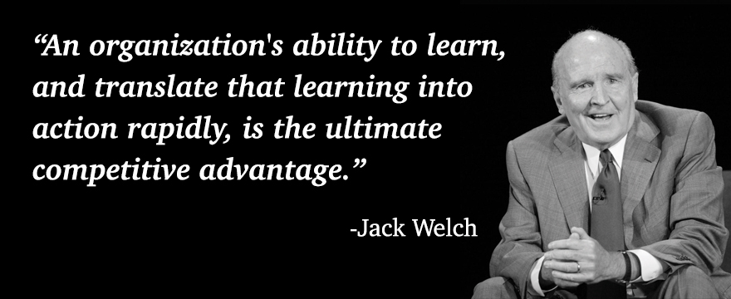
Six Sigma
Six Sigma was a crucial goal for GE in the early 1990’s.
Six Sigma council composed of quality experts from different businesses.
Councils met quarterly to share information in the quest for quality.
Good ideas in use in one area of GE was then incorporated into other areas in GE.
Council’s purpose was to allow information sharing, not to make policies and impose them on other businesses.
Notes:
CHRIS
Six Sigma is a method that provides organizations tools to improve the capability of their business processes. This increase in performance and decrease in process variation helps lead to defect reduction and improvement in profits, employee morale, and quality of products or services.

Slide 11
Six Sigma Implementation
Trained managers in Six Sigma by requiring them to complete a Six Sigma project.
Managers learned about DMAIC ( Define, Measure, Analyze, Improve, Control)
Six Sigma Mentoring (Six Sigma Master Black Belts)
Strong Leadership
Implementation took 5 years with an end result of 12 billion dollars in savings.
Notes:
CHRIS
This training taught managers how to evaluate a process, identify areas where mistakes are being made and create long-lasting solutions.
Six Sigma Mentoring - 4 month training in which employees learned to apply Six Sigmas techniques into their work.This then allowed for GE to generate a team of Black Belts that would help implement projects.
Strong leadership - Jack Welch supported GE’s Six Sigma implementation through ensuring fundamental commitment from both his senior executives and employee population. He would then link opportunities for promotion and
Bonuses for quality improvement.

Slide 12
Moving Around at GE
Position changes at GE were very common.
New ideas
Provided leaders broader networks at GE.
Notes:
CHRIS
Leaders were moved around frequently at GE in order for new ideas and new policies to be formulated throughout the transitions.
Business leaders compensation was dependent on the overall financial performance of GE as well as their own performance with their respected business.
The motivation for moving leaders around was to share ideas and resources.

Slide 13
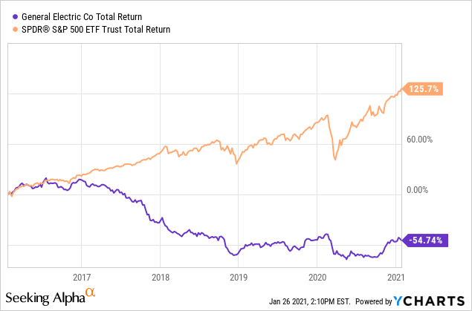
GE due for a rebound?

Slide 14
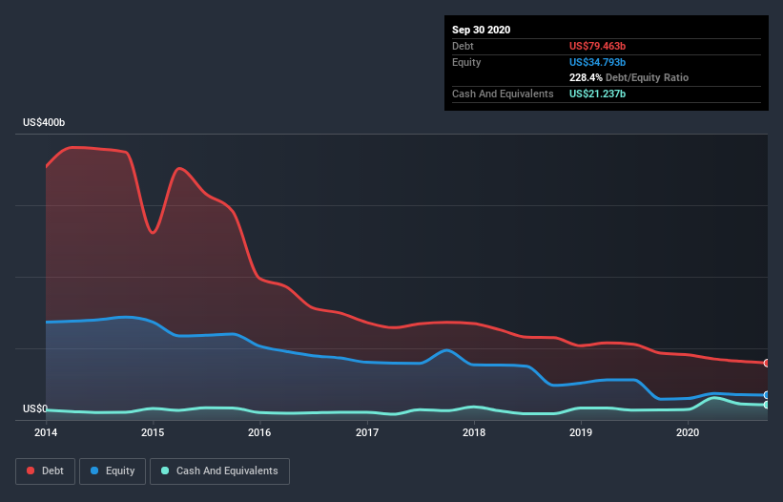
The Bear’s fundamental based argument
Underfunded pension obligations
1.7 Billion in pension liabilities transferred to Athene
Significant debt load
Undeniable, but trending in the right direction
Long term insurance obligations
Culp on recent earnings report notes that only 100M required in additions over the next year based on cash flows
Dividend woes
Prudent moves to keep company solvent

Slide 16
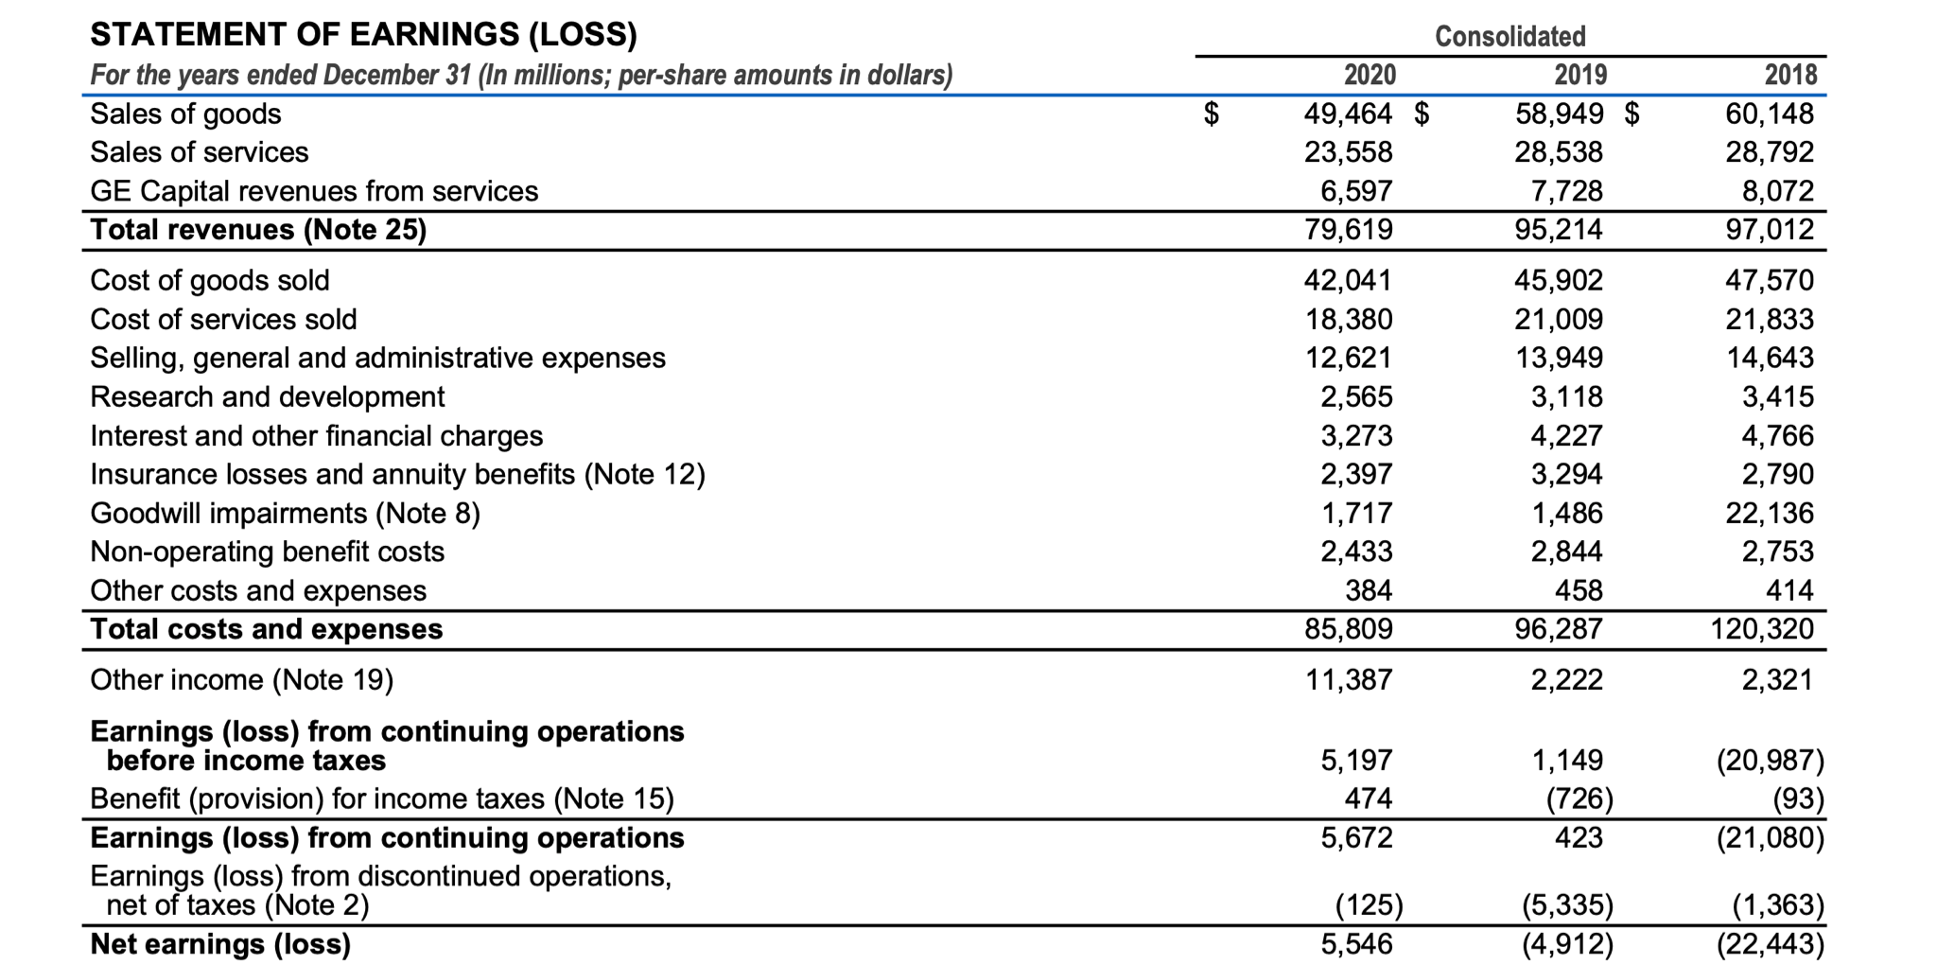
Income Statement
0.58
Notes:
GE reported first positive earnings since 2017 last year. However, it wasn’t necessarily because their business did good or they were even profitable. The only reason they had positive earnings was because of “Other Income”, which was GE selling their stake in BioPharma for a pretax gain of $12.3 billion. So while at first glance it is good news to have positive earnings finally, GE can’t go sell BioPharma gain this year. That huge gain in other income is a one time thing that can’t come back into play to boost their earnings.

Slide 17
The future for GE
Aviation business is strong and should be experiencing tailwinds
Tourism/travel picking up as COVID 19 situation improves
Power demand is likely to continue to grow and global energy demand continues to increase
Renewable energy is well-positioned with the current administration
Stability returning with Culp at the head
Experience with Danaher bodes well for the Healthcare side of the business
Emphasis on “lean” bodes well for managing costs

Slide 18
References
http://web.mit.edu/org-ev/www/documents/samthesis.pdf
http://panmore.com/general-electric-ge-organizational-structure-diversification-analysis
https://hbr.org/1992/05/the-new-boundaries-of-the-boundaryless-company
https://www.6sigma.us/ge/six-sigma-case-study-general-electric/
https://www.corporateculturepros.com/leadership-at-ge-redefining-culture/#:~:text=The%20GE%20Beliefs%20are%3A%20Customers,results%20in%20an%20uncertain%20world.
https://hbr.org/2015/01/ges-culture-challenge-after-welch-and-immelt
https://www.reuters.com/companies/GE.N

