Slide 1
Market Research Study Proposal – Boeing
EMAD 5402 Marketing in Aerospace and Defense
Group Project – Scott Collins, Everett Eugenio, Martin Howell, Marc Sica, Zechariah Smith
Notes:
NOTE:
To change the image on this slide, select the picture and delete it. Then click the Pictures icon in the placeholder to insert your own image.

Slide 2
BOEING MARKET RESEARCH PROPOSAL - OVERVIEW
INDTRODUCTION / HYPOTHESIS
BOEING - BACKGROUND
737 MAX AIRPLANE – BACKGROUND
BOEING SWOT ANALYSIS
THE 737 MAX PROBLEM
PROPOSAL: REBRANDING THE BOEING 737 MAX
IMPACTS OF MARKETING SHIFTS
CONCLUSION

Slide 3
INTRODUCTION / HYPOTHESIS
737 Max accidents
Boeing losing to Airbus narrow body market share
Issues in design process
Hypothesis:
Boeing will continue to improve the 737 MAX market performance by shifting the market strategy and subtly rebranding the 737
Three Questions that the team asked:
What did Boeing change in their marketing strategies related to the 737?
How did they subtly rebrand?
What was the impact of the shifting marketing strategies on the intermediary client and passenger client sentiments?

Slide 4
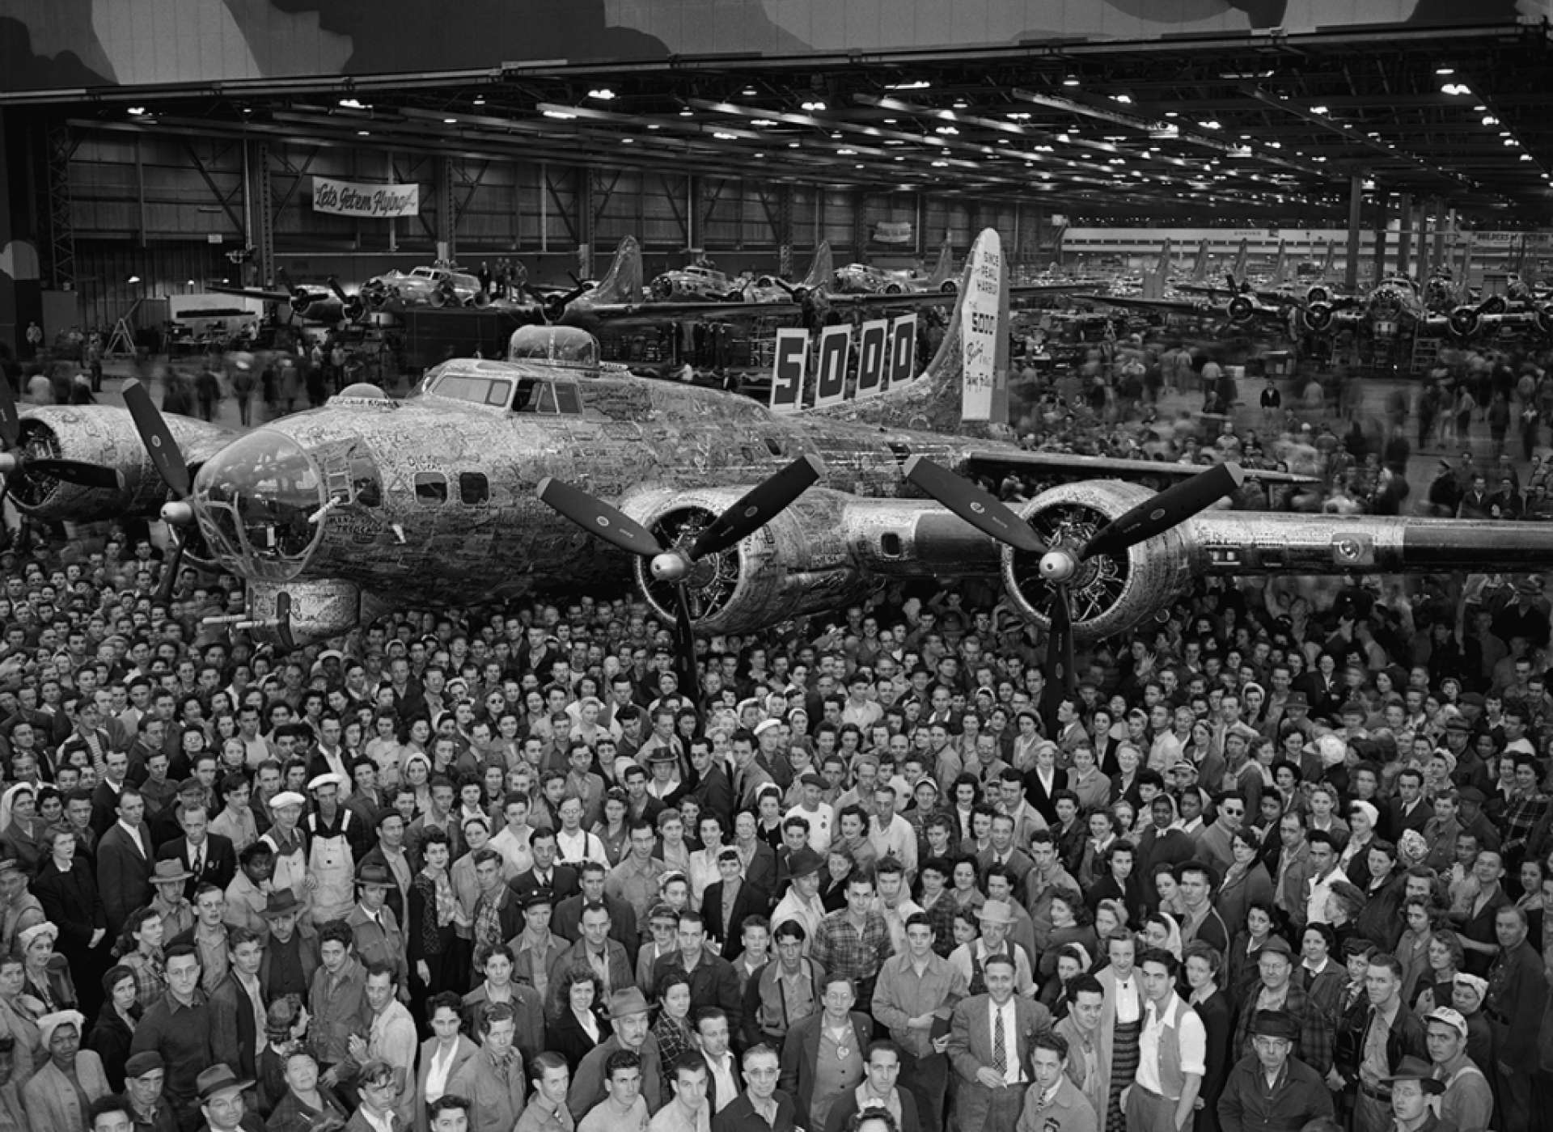
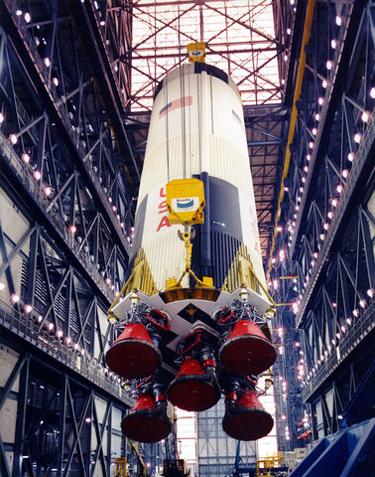
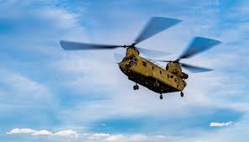
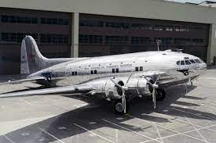
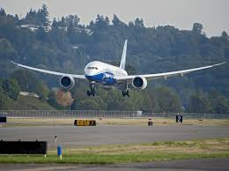
BOEING - BACKGROUND
Who is Boeing?
WWI
Air Mail Act 1934
WWII
1950's
The Jet Age – 1950's
B-47 and 52
707
1960's
Vertol Aircraft Acquistion
727
S-IC
747
737
1990
767
777
2000
787
737 MAX

Slide 5
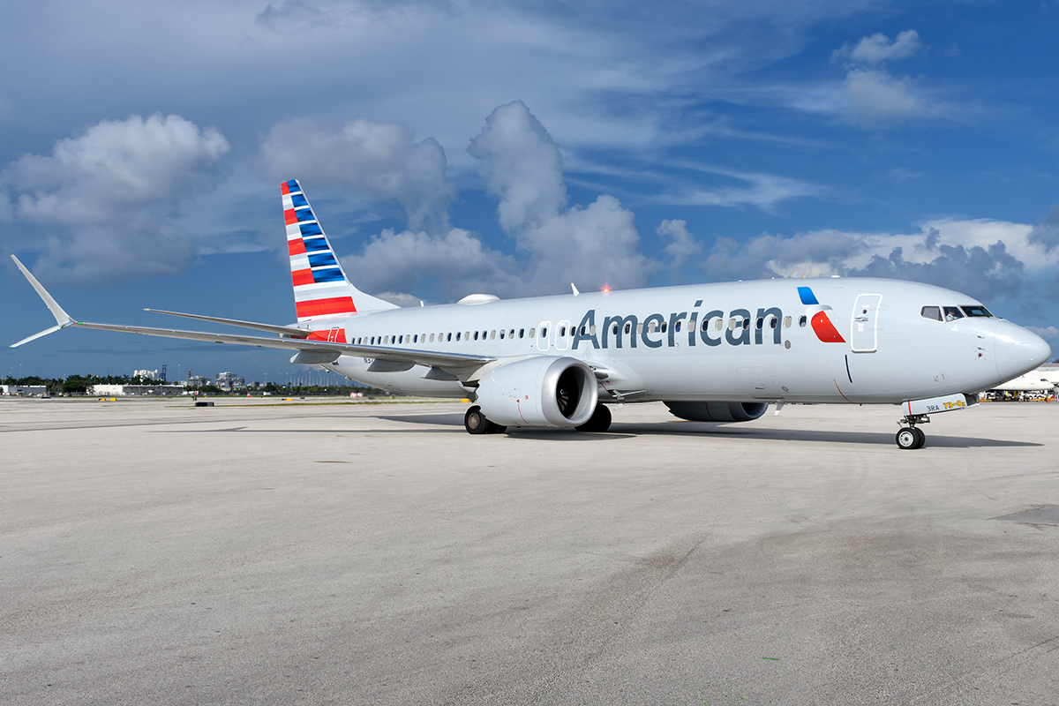
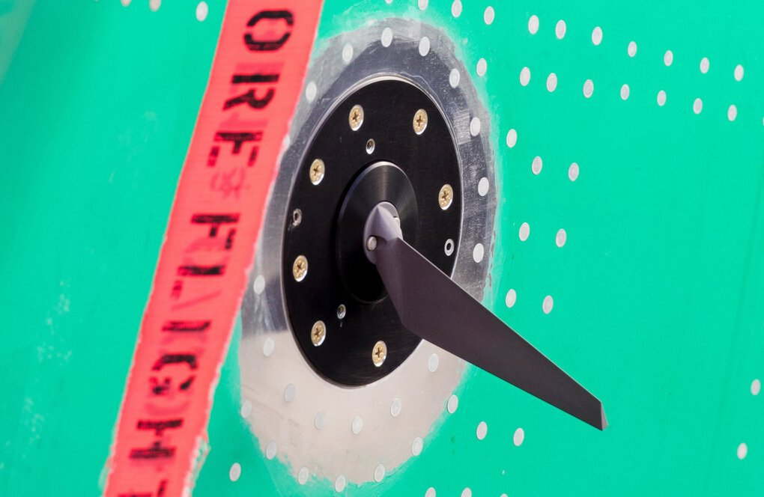
737 MAX AIRPLANE - BACKGROUND
The Brith of the 737 MAX Family
Re-engineering decision
Development
Certification Issues
“as a betting man, I think that’s where we’re going to end up.” (Jim McNerney, 2011)

Slide 6
SWOT Analysis
Strengths
Range of Products
Supply Chain
Partnerships
Innovation
Weaknesses
Poor Labor Management
Outsourcing
Safety Concerns
Opportunities
Use of Innovation
Threats
Safety Image
Environmental Techniques
Post Covid Market
Competitive Market
Upcoming Recession

Slide 7
The Problem
The accidents
MCAS – fails
Boeing blames pilots, issues flight operations manual bulletin
FAA grounds, expands safety analysis
Fined for quality checks
Reputation damaged - quality, safety
MCAS function (Tangel and Paszter, 2019)
“There is nothing more important than safety” (Boeing, 2020)
Notes:
Tangel, A., & Pasztor, A. (2019, July 31). Regulators Found High Risk of Emergency After First Boeing MAX Crash. The Wall Street Journal. Retrieved June 23, 2021, from https://www.wsj.com/articles/regulators-found-high-risk-of-emergency-after-first-boeing-max-crash-11564565521?mod=searchresults&page=1&pos=1&mod=article_relatedinline
Boeing. (2020). Safety at Boeing. Retrieved June 23, 2021, from Boeing.com: https://www.boeing.com/principles/safety.page

Slide 8
PROPOSAL: MARKETING SHIFT
What did Boeing change in Marketing strategies?
Challenge: Cause and Effects, COVID or the accidents, A321neo
Did Boeing discount the 737 MAX?
Press, financial statement, list prices, quantity of aircraft Analysis on reported sales
Pricing objectives before and after the tragedies
Was the price change justified?
Defining Boeing’s expected values
Boeing and Airbus Orders (Statista Research Department 2021)
“At every stage of every program — from design and manufacturing to sales and marketing, and everything beyond and between — we will know who is responsible for every aspect of the work”
(Boeing, 2020)
Notes:
Statista Research Department. (2021, January 15). Airbus and Boeing: aircraft orders 2006-2020. Retrieved Jul 3, 2021, from Statista: https://www.statista.com/statistics/264492/aircraft-orders-from-airbus-and-boeing/
Boeing. (2020). Our Values. Retrieved June 23, 2021, from Boeing.com: https://www.boeing.com/principles/values.page

Slide 9
PROPOSAL: REBRANDING
How did they subtly rebrand?
What is a brand and a rebrand?
Scholars, Journals, research studies, historical comparisons
What was the Boeing 737 MAX brand after the accidents?
Public opinion – Polls, social media, traditional media, sales trends, official statements
How did Boeing subtly rebrand?
Press releases, articles
New Orders of Boeing 737 (Wall, 2019)
“Successful rebrands are grounded in business logic and are not exercises in vanity”
(Viswanathan, 2021)
Notes:
“name awareness, brand loyalty, perceived quality, and brand associations” (Peter & Donnelly, p. 93)
Viswanathan, G. (2021, January 27). Successful rebrands are grounded in business logic and are not exercises in vanity. Adgully; Mumbai. Retrieved June 27, 2021, from https://www-proquest-com.ezproxy.lib.ou.edu/docview/2481015397?pq-origsite=primo
Wall, R. (Director). (2019). How Boeing’s 737 MAX Troubles Ripple Through the Industry [Motion Picture]. Retrieved June 23, 2021, from https://www.wsj.com/video/how-boeings-737-max-troubles-ripple-through-the-industry/ADD2E438-A213-482E-A519-5DC7771D5549.html

Slide 10
IMPACTS OF MARKETING SHIFTS
General market changes
Historical data and projections
Airline demand
Mid-range aircraft market
Airline customer demand
Does demand drive airline purchases
Ticket sales affected by sentiment
Demand before and after marketing changes

Slide 11
SUMMARY / CONCLUSION
Hypothesis: “Boeing will continue to improve the 737 MAX market performance by shifting the market strategy and subtly rebranding the airplane and name.”
Background – Boeing / 737 MAX
SWOT Analysis
Problem – Catastrophic crashes, MCAS, brand reputation
Rebranding
Marketing Shifts

Slide 12
BOEING MARKET RESEARCH PROPOSAL
QUESTIONS?

