Slide 1
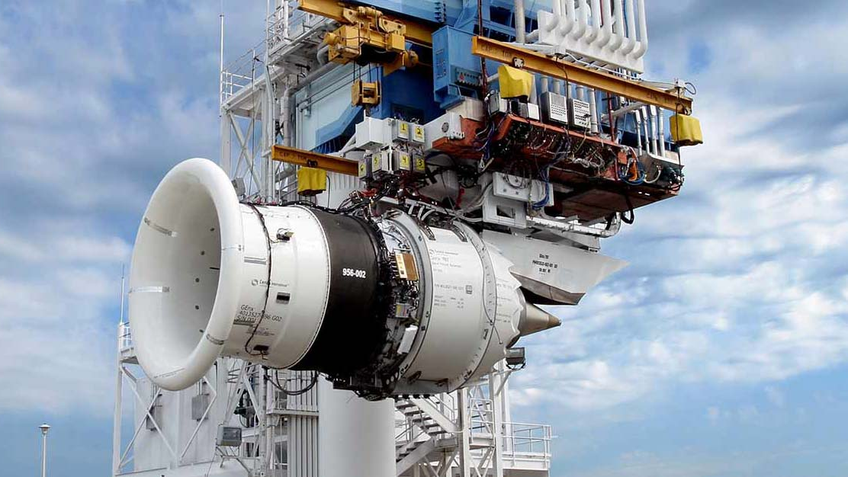
Market Research Proposal – GE Aviation
Farshad Rabib, Cyrus Haines, Eric Campbell,
Matt Williams, and Martell Davis

Slide 2
Overview
History
Hypothesis
Situational Analysis
Marketing Strategies
Conclusion
Notes:
Matt

Slide 3
History of
Company Overview
Aircraft
Leadership
Debt issue
Impact of Boeing 737 MAX
Current Situation
Notes:
Company Overview
General Electric began in 1889 by one Thomas Edison as part of a merger of Edison’s own companies and companies with ties to J.P. Morgan – the original two plants continue to operate as GE to this day. In 1896 GE went public, becoming one of the original 12 companies listed on the Dow Jones Industrial Average, where it has been a part of the index for 122 years (though not continuously). In the 132 years since its inception, GE owned or continues to own brands including RCA, NBC, GE Energy, Vivendi (which owns Universal Pictures), it produced a line of computers, and in 1917 it formed GE Aviation which is among the top aircraft engine suppliers.
GE Aviation, originally called General Electric Aircraft Engines until 2005, currently employees 48,000 people, had 30.566 billion revenue in 2018 with more than $6 billion in operating income. GE Aviation’s main competitors are Rolls-Royce and Pratt & Whitney.
Aircraft
GE Aviation designs and manufacturers a number of engines for a variety of aircraft, though the most relevant engine for today’s discussion is the GEnx, which powers the Boeing 787 Dreamliner. The GEnx is the fastest-selling engine in GE Aviation history, though the pandemic, and the recent cuts to the 787 Dreamliner, may affect the future of this engine. GE Aviation also produces the CFM International LEAP, engine that powers the 737 Max. in a joint venture with French manufacturer Safran Aircraft Engines – more on that later.
Leadership
GE’s most prominent leadership includes Jack Welch, who served as the CEO of GE Electric from 1981 to 2001. When Mr. Welch retired from GE he received a severance payment of $417 million, the largest such payment in business history. At the time of his death in 2020 he was estimated to be worth $750 million. Mr. Welch was succeeded by Jeff Immelt, who served as CEO until 2017. During this time GE shares dropped 30% while the rest of the S&P 500 rose 134%. Mr. Immelt was succeeded by John Flannery, who served just one year as CEO before being fired by the Board of Directors. He was succeeded by current GE CEO H. Lawrence Culp Jr, the first “outsider” to serve as CEO in the company’s 126 year history.
The current CEO of GE Aviation is John Slattery, no relation to the actor.
Debt
On the next slide you will see GE’s financial debt, which has steadily decreasing to now 71 billion dollars, as it has been paying down that debt over a number of years. This has been positive for its stock, though as you will see on the slide following, nowhere near the company’s heights in the last 90s / early 2000’s under Jack Welch.
Impact of Boeing 737 Max
Prior to the pandemic, GE Aviation was GE’s most profitable sector. GE was making steady improvements in cutting debt and stock prices were slowly rising. As the provider of the 737 Max’s LEAP engine, GE’s value took a significant hit by the Max’s initial safety issues, which lead to the healthcare division emerging as GE’s top earner. Expectations were high that coming out of the pandemic, with the 737 Max and 787 Dreamliner production ramping up again, GE Aviation was poised for a rebound.
Current Situation
And then, this Tuesday, Boeing announced that it was cutting 787 production after finding another production-related structural issue, and a major customer cancelled a 737 Max order, a move than an analyst said “to us this is more significant than the cut to the delivery forecast, as it ripples down through the supply chain. The supply chain cannot just be turned on and off like a switch.” So now, what is GE Aviation to do?

Slide 4
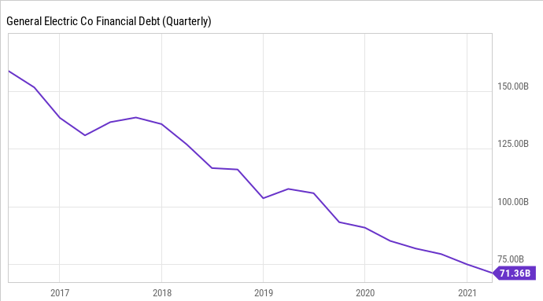

Slide 5
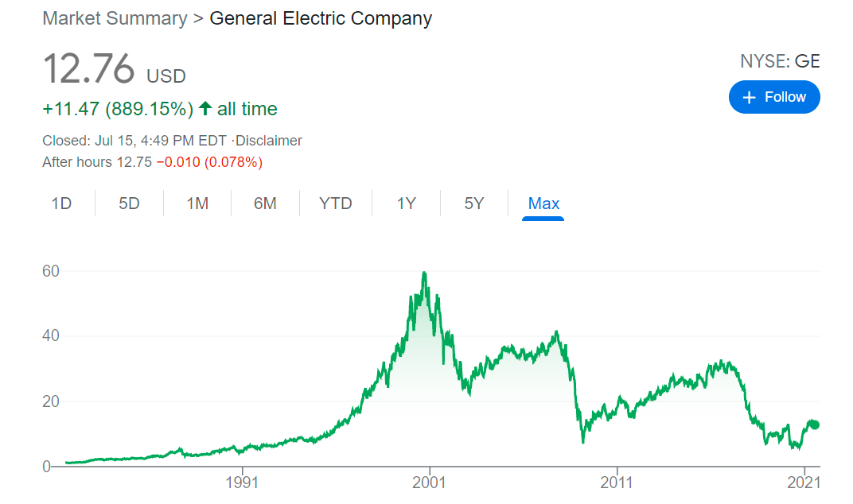

Slide 6
Hypothesis
B. Problem Solving
2. Price
d. As production costs decline, should we lower our prices or try to develop higher-quality products?
The focus of GE is cost minimization; with production costs down during COVID-19, should GE lower its prices or keep them the same?
Notes:
https://simpleflying.com/ge-rolls-royce-pratt-whitney/
https://www.t4.ai/industry/aircraft-engine-market-share
https://www.statista.com/statistics/1099835/global-aircraft-engine-manufacturer-market-share/
https://www.thomasnet.com/articles/top-suppliers/aircraft-engine-manufacturers-suppliers/

Slide 7
GE Research Study Elements
What is the purpose of your research
Understand GE's focus – cost minimization
Impact of Pandemic on GE
Assess risk of reducing prices
Maintain or increase market share
What is your research question? (i.e., hypothesis)
The focus of GE is cost minimization; with production costs down during COVID-19, should GE lower its prices or keep them the same?
What does the literature say about your research context & question? Experience?
GE currently supporting demand for affordable, quality engines
Shift to development of higher quality product drives cost increase
Cost increase often passed to consumer, reducing sales
Higher quality products drive higher maintenance costs, conflicting with GE's cost minimization strategy
What are the key elements necessary to answer your research question? (i.e., research model)
Secondary Data – Articles, journals, Open-Source data
Quantitative Data – Market Research, Sales, Production Forecast, Competitor Pricing & Sales
Notes:
The purpose of our research is to understand GE's focus – cost minimization in the field of selling cheap, state-of-the-art engines, to gain a historical perspective on how COVD affected GE Aviation – workforce reduction, to identify competitors and strategies GE aviation uses in business space, ultimately to determine if, due to the cost minimization that GE has achieved, prices should be adjusted (as Boeing is doing) and how any adjustment would affect sales – all as an aid to our decision making.

Slide 8
Key Research Study Elements
How are you going to gather data to analyze? (i.e., quantitative, qualitative or both)
Should primary or secondary data be used? - Quantitative; secondary data -> list examples?
What results do you expect?
GE – As costs have been reduced due the actions that GE has taken to mitigate the risks of COVID-19, lowering prices will only lower revenue; business relationships and prices are established, and GE's already low prices, coupled with lower costs, will increase its overall revenue as it works its way out of the pandemic.
Customer – Potentially acquire future contracts due to minimized costs
B-52 Re-Engining
International commercial market
What limitations are evident in your design?
Pushback - Customer(s) may state you lowered your costs, why not ours
How do you expect A&D organizations will respond?
Boeing 737 MAX Family – nothing customers only have one engine option; Boeing may elect to add another engine option, but this would require additional time and money
Potential competitor bids (P&W, Rolls Royce)
AirBus 320Neo Family – customers may be inclined to select GE Aviation (CFM) engine option over P&W option
P&W may reduce price of engines for Airbus 320Neo Family to compete
Rolls Royce
Can't do a damn thing
Notes:
Hypothesis
The focus of GE is cost minimization; with production costs down during COVID-19, should GE lower its prices or keep them the same.
No. As costs have been reduced due the actions that GE has taken to mitigate the risks of COVID-19, lowering prices will only lower revenue; business relationships and prices are established, and GE's already low prices, coupled with lower costs, will increase its overall revenue as it works its way out of the pandemic.

Slide 9
Market Strategy
Proposed Plan
Reduce Costs
Limitations
Reducing Costs
Expected Results
Increase Revenue
Data Collection
Quantitative
Primary & Secondary
Market
Increase Market Share
Maintain Sells Price
Notes:
Proposed Plan – short term thinking that may have positive long term effects
Reduce Costs
Maintain sells price
Allows us to maximize profit & payoff debt
Question – Can you we do this?
Data Collection
Quantitative
Primary – can we continue to reduce costs without effecting efficiency, cost, schedule, quality, etc.?
Secondary Data:
Determine market share in commercial market (domestic & international)
Determine need for engines for aircraft; more specifically for the Boeing 737 MAX & Airbus 320neo families
Internet (i.e. Statisa for marketing share, etc.)
Customers (i.e. Boeing Orders & Deliveries)
Expected Results – Why?
As stated previously we already have reduced our costs & maintain sells price
Business relationships and GE's already low prices; if we lowered our sells price will only lower our revenue
What Else?
Customer – Potentially acquire future contracts due to minimized costs
B-52 Re-Engining
International commercial market
Limitations
Reducing – Reducing your costs are finite; does this effect efficiency, quality, time; all of these have an impact to cost
Market
Need – Completely Dependent on customer’s customer (i.e. Market) – COVID 19
Recovery Time – estimate 4-5 years for commercial aviation industry to recover; can GE Aviation last that long

Slide 10
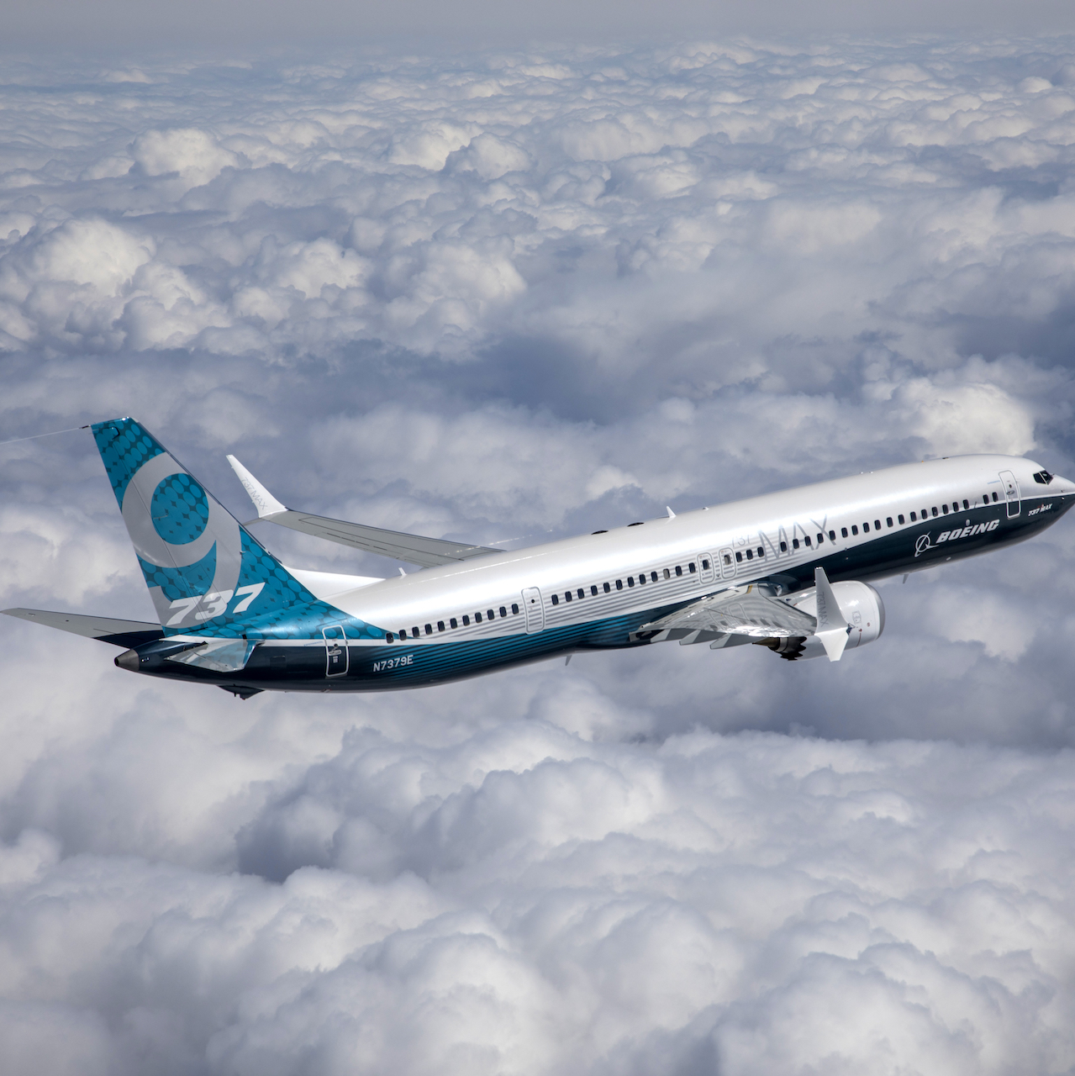
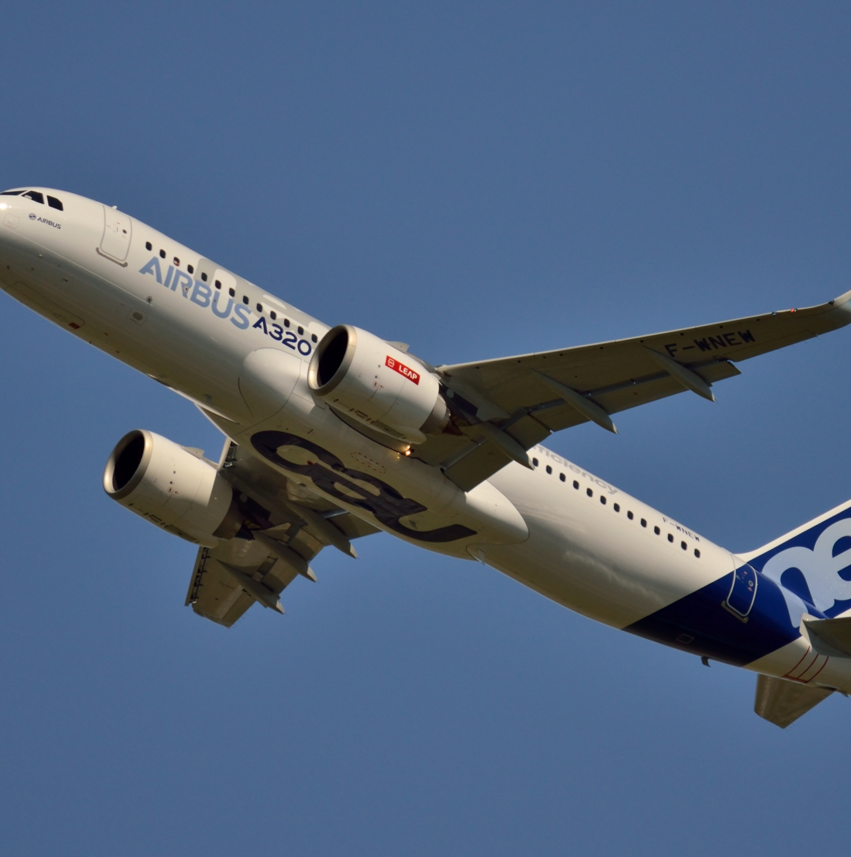
Reactions
Airbus – 320neo
Pratty & Whitney engine option vs. GE Aviation (CFM) engine option
Boeing – 737 MAX
Pushback – Reduce Price
May submit RFP from competitors for additional engine options
Enormous Cost & Risk – development, testing, qualification, etc.
Pratt & Whitney – PurePower PW1100G-JM
Reduce price for Airbus 320neo (only other engine option)
Submit bid to Boeing
Rolls Royce - ???
Submit bid to Airbus and/or Boeing
Pushback – Reduce Price
GE Aviation (CFM) engine option vs. Pratty & Whitney engine option
Only engine option is GE Aviation (CFM) engine – LEAP-1B
Notes:
Customers
Airbus
May be inclined to select GE Aviation (CFM) engine option vs. Pratty & Whitney engine option
May be inclined to select Pratty & Whitney engine option vs. GE Aviation (CFM) engine option
CFM – LEAP-1A
Pratt & Whitney – PurePower PW1100G-JM
Boeing
Only engine option is GE Aviation (CFM) engine – LEAP-1B (only engine option)
Market Power
May request RFP from aircraft engine competitors for additional engine options;
Huge costs for Boeing (development, testing, qual/cert, etc.); may be able to perform research on how much something like this will cost and the duration required
How do you expect A&D organizations will respond?
Boeing 737 MAX Family – nothing customers only have one engine option; Boeing may elect to add another engine option, but this would require additional time and money
Pushback - Customer(s) may state you lowered your costs, why not ours
Potential competitor bids (P&W, Rolls Royce)
Airbus 320neo Family – LEAP-1A
PurePower PW1100G-JM other option
AirBus 320Neo Family – customers may be inclined to select GE Aviation (CFM) engine option over P&W option
P&W may reduce price of engines for Airbus 320Neo Family to compete
Rolls Royce
Can't do a damn thing

Slide 11
Focus, Research, Content
The focus of GE is cost minimization; with production costs down during COVID-19, should GE lower its prices or keep them the same?
The research study proposal should identify a customer need that is going unanswered that needs to be addressed by the A&D industry
the need for affordable engines
Provide context on how best to promote a new good, service or idea to meet A&D objectives based on the results of this research (if it were carried out)
Cheap, state of the art engines

Slide 12
Conclusion
As production costs decline, we should not lower our prices or try to develop higher-quality products.
Cheap, state of the art engines are being produced currently and available for current demand
Developing higher quality products will increase costs and be passed on to the consumer, thus reducing sales.
Higher quality products require higher maintenance costs and will offset income.
More investment in GE Health and other non-aviation industries encouraged

Slide 13
Questions

Slide 14
BACKUP

Slide 15
Proposal
In an effort to make up for what GE Aviation may have lost during the COVID-19 Pandemic, GE should change their market strategy by leveraging the successes of its joint venture with Safran Aircraft Engines (CFM International) to:
Improve the image (brand) of the GE Aviation
Environmental – LEAP Engines have lower emissions (Lean burn)
Technology – 3D printed parts; lighter and stronger
Social – additional career opportunities for employees (international)
Prove GE Aviation is the best choice for the B-52 Re-engining – Can utilize the expertise and experience in commercial (domestic and international) and US Defense market
Potential reduce bids on contracts – economies of scale
Leverage Resources – utilize and access to additional resources and processes
Continue to expand outside of the continental US
Notes:
https://www.investopedia.com/terms/j/jointventure.asp

Slide 16
Situational Analysis
SWOT
PESTLE
Porter's Five Forces
Competitors

Slide 17
SWOT
Strengths
Commercial & Defense market
Boeing 737 MAX Family
Airbus Neo320 Family
Joint venture with Safran Aircraft Engines – CFM International LEAP; LEAP-1A & LEAP-1B
B-52 Re-Engine Bid
Supplying both narrow-body aircraft power houses: Boeing & Airbus
Weaknesses
Enormous amount of debt
Opportunities
Exploiting successes of CFM International (50/50 joint venture with Safran Aircraft Engines)
Increased market share in international aircraft engine market
History of Re-engining bombers: KC-135R, C-5M, U-2S
Threats
COVID-19
737 MAX incidents & issues
Notes:
https://www.geaviation.com/military/engines/b-52
https://www.cfmaeroengines.com/engines/fleet-statistics/
https://www.fool.com/investing/2021/05/22/ge-aviation-just-won-a-huge-order/

Slide 18
PESTLE
Political
Economic
Social
Technological
Legal
Environmental
https://www.ge.com/news/reports/the-future-of-flight-engine-maker-unveils-new-technology-development-program-to-cut-co2

Slide 19
Porter's Five Points
Bargaining power of Supplier
Bargaining power of Buyer
The threat of New Entrants
Theat of Substitutes
Existing Rivalry

Slide 20
Competitors
Commercial
Pratty & Whitney – Airbus 320neo Family
Rolls Royce
Defense
B52 Re-Engine Contract
Pratt & Whitney
Rolls Royce
Net Earnings (Loss)
Market Cap

Slide 21
Marketing Strategies
Vertical Integration
Differentiation
Marketing Mix
Ansoff Matrix
Notes:
https://www.fool.com/investing/2021/05/22/ge-aviation-just-won-a-huge-order/
https://www.ge.com/news/reports/the-future-of-flight-engine-maker-unveils-new-technology-development-program-to-cut-co2

Slide 22
Marketing Mix
Product
50/50 joint venture with Safran Aircraft Engines (formerly Snecma), a division of Safran of France
CFM Engines
Airbus 320neo Family – LEAP-1A
PurePower PW1100G-JM other option
Boeing 737 MAX Family – LEAP-1B (exclusive – no other engine available)
Place
Promotion
Notes:
https://en.wikipedia.org/wiki/CFM_International_LEAP
https://www.fool.com/investing/2021/05/22/ge-aviation-just-won-a-huge-order/
https://www.geaviation.com/military/engines/b-52
https://www.cfmaeroengines.com/engines/fleet-statistics/

Slide 23
Ansoff Matrix
BCG Model or GE Model (pg. 28-29)
Market Penetration
Market Development
Product Development
Diversification

Slide 24
Vertical Integration
If applicable for presentation

Slide 25
Differentiation
If applicable for presentation

