Slide 1
UCOL 1523: GATEWAY TO BELONGING
Week 8 – October 11 – 15, 2021
Understanding Collective Experiences and Cultivating Belonging at the OU Library

Slide 2
UNDERSTANDING COLLECTIVE EXPEREIENCES LEARNING OBJECTIVES (LO)
LO Wk 8.1: Explain the connection between the THREE phases covered in this course.
LO Wk 8.2: Describe resources available to OU students from the library.
LO Wk 8.3: Identify the steps for calculating your midterm grades and preparing for Exam .

Slide 3
Explain the connection between the THREE phases covered in this course.
LO
Wk 8.1

Slide 4
The THREE Phases of Belonging Covered in this Course
Phase I - Self-Awareness about Belonging
Students are introduced to the concept of belonging, the tools that contribute to a sense of belonging, and apply their new tools in the grassroot groups assignment.
We complete Phase 1 with Exam 1.

Slide 5
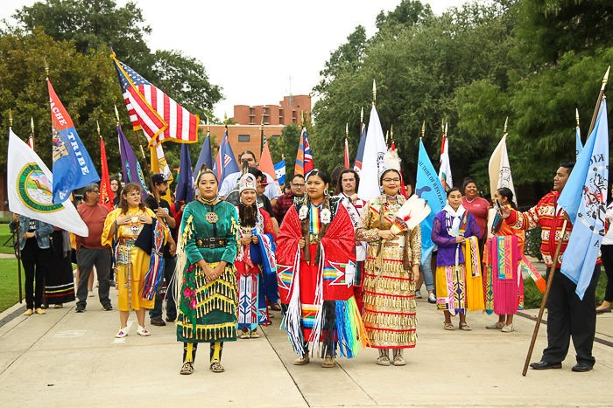
The THREE Phases of Belonging Covered in this Course
Phase II – Group-Level Belonging
Students connect the tools that contribute to a sense of belonging to understand collective experiences.
We start Phase 2 today.
Indigenous Peoples Day at OU
October 11, 2021

Slide 6
The THREE Phases of Belonging Covered in this Course
Phase III – Belonging based Behavior
Students connect the tools that contribute to a sense of belonging with their understanding of the experiences of others to extend intentional helping rather than hurting behaviors to build community at OU.
We will start Phase 3 during Week 11.

Slide 7
Describe resources available to OU students from the library
LO
Wk 8.2

Slide 8
Cultivating Belonging at the OU Library with the staff
Kristal Boulden
Brent Tweedy
Megan Bednar
Claire Curry
Cheryl McCain Karie Antell
Patrick Wright Jay Edwards

Slide 9
Cultivating Belonging at the OU Library with the online course guide
https://guides.ou.edu/ucol1523

Slide 10
Cultivating Belonging at the OU Library with spaces, services and resources
Group Study Spaces in OU Libraries
https://www.youtube.com/watch?v=8n7zkdMSPk8

Slide 11
Identify the steps for calculating your midterm grades and preparing for Exam
LO
Wk 8.3

Slide 12
Exam 1 for on campus sections
Exam 1 occurs during class meetings on Tues./Wed. of this week, see the instructor for details.
Exam 1 covers the readings from Modules 5, 6, and 7 in the Heinzen & Goodfriend text, lectures slides, class activities, and group discussions.
Exam 1 occurs in person, without the use of outside resources or notes, and during class time.
Students must confirm any accommodation plans BEFORE Week 8.
Students need to bring a pencil(s) and student ID to complete the multiple-choice exam.
Scantrons are provided to students, free of charge, to complete the exam.
You can earn up to 75 points on Exam 1.

Slide 13
Exam 1 for remote sections
Exam 1 occurs during class meetings on Tues./Wed. of Week 8, see the instructor for details.
Exam 1 covers the readings from Modules 5, 6, and 7 in the Heinzen & Goodfriend text, lectures slides, class activities, and group discussions.
Exam 1 occurs in person, without the use of outside resources or notes, and during class time.
Students must confirm any accommodation plans BEFORE the test date.
Students will complete the multiple-choice exam as an online test.
Students will only have ONE attempt to complete the exam during to the scheduled test time.
You can earn up to 75 points on Exam 1.

Slide 14
Steps for calculating your midterm grades
Students’ scores for the online, open book, Toolbox Test 1 are posted in Canvas. To calculate your grade…
A = 50 - 45 points or at least 90% of 50 total points.
B = 44 - 40 points or at least 80% of 50 total points.
C = 39 - 35 points or at least 70% of 50 total points.
D = 34 - 30 points or at least 60% of 50 total points.
F = 29 points and below or at least 59% of 50 total points.

Slide 15
Steps for calculating your midterm grades
Students’ scores for the Gateway to Grassroot Groups Presentation Assignment 1 are posted in Canvas. To calculate your grade…
A = 75 - 67 points or at least 90% of 75 total points.
B = 66 - 60 points or at least 80% of 75 total points.
C = 59 - 52 points or at least 70% of 75 total points.
D = 51 - 45 points or at least 60% of 75 total points.
F = 44 points and below or at least 59% of 75 total points.

Slide 16
Class Wrap Up…
Questions and Answers

Slide 17
That’s all folks…
Thanks for your attention!
Stay Well…

