Slide 1
Cultivatating Belonging & Aggression

Slide 2
What Is Aggression? (1 of 11)
Aggression: behavior intended to harm others
Cyberbullying: aggression through electronic outlets
Notes:
Learning Objective 11-1 Use typologies and the General Aggression Model (GAM) to define and describe how humans harm one another.
What Is Aggression?
Aggression: Behavior intended to harm others who do not wish to be harmed.
Excludes scenarios like child vaccinations and wrestling competitions
Cyberbullying: Aggression through electronic outlets, like social media.

Slide 3
What Is Aggression? (2 of 11)
Typologies Help Define Aggression
Typologies: categorical systems that help us organize events
Typology 1: aggression content
Notes:
Learning Objective 11-1 Use typologies and the General Aggression Model (GAM) to define and describe how humans harm one another.
Typologies Help Define Aggression
Typologies: Categorical systems that help us organize complex but related events.
Typology 1: Aggression Content
Organizes aggression into three content areas
Physical aggression: Intentionally causing harm to someone’s body or property.
Verbal aggression: Using communication to cause harm.
Relational aggression: Harming others by damaging their social networks.

Slide 4
What Is Aggression? (3 of 11)
Typologies Help Define Aggression
Typology 2: forms of aggression
Typology 3: aggressive motivations
Typology 4: microaggressions
Notes:
Learning Objective 11-1 Use typologies and the General Aggression Model (GAM) to define and describe how humans harm one another.
Typologies Help Define Aggression
Typology 2: Forms of Aggression
Describes how humans are aggressive
See Table 11.1
Typology 3: Aggressive Motivations
Recognizes motivations for aggression
Hostile-reactive aggression: An impulsive, emotion-based reaction to perceived threats.
Instrumental-proactive aggression: A thoughtful, reason-based decision to harm others to gain resources such as territory, money, self-esteem, or social status.
See Figure 11.1
Typology 4: Microaggressions
Divides controversial microaggressions into subtypes
Microaggressions: Subtle behaviors or insults that marginalize or negatively stereotype group members. They include microinsults, microassaults, and microinvalidations.
Three forms
Microinsults: rude statements that demean a person's heritage
Microassaults: behaviors meant to psychologically harm and/or insult someone
Microinvalidations: statements or behaviors that invalidate the target's feelings on an individual or group level
Controversy over characteristics, effects, and interventions for microaggressions
Putting Them Together: The General Aggression Model (GAM)
General Aggression Model (GAM): The theory that aggression is a developmental process including biological responses to the environment, cognitive processing, and decisions about how to behave.
Three planes of development for an episode of aggression
Inputs
Routes
Outcomes
See Figure 11.2

Slide 5
What Is Aggression? (4 of 11)
TABLE 11.1 Buss’s Typology of Eight Different Forms of Aggression
 | DIRECT |  | INDIRECT
 | ACTIVE | PASSIVE | ACTIVE | PASSIVE
Physical aggression | Hitting, stabbing, beating, etc. | Positioning your car to prevent someone else from changing lanes | Cheating in a competition or hiring a “hitman” | Refusing to stop the bleeding of an enemy soldier
Verbal aggression | Putdowns and insults | Giving someone the silent treatment to punish that person | Spreading mean rumors or negative gossip | Failing to defend someone who you know is being accused unfairly
Source: Adapted from Buss (1961).
Notes:
Learning Objective 11-1 Use typologies and the General Aggression Model (GAM) to define and describe how humans harm one another.
Table 11.1: Buss’s Typology of Eight Different Forms of Aggression

Slide 6
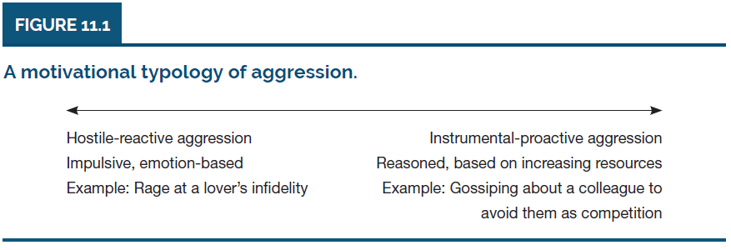
What Is Aggression? (5 of 11)
Notes:
Learning Objective 11-1 Use typologies and the General Aggression Model (GAM) to define and describe how humans harm one another.
Figure 11.1: A motivational typology of aggression

Slide 7
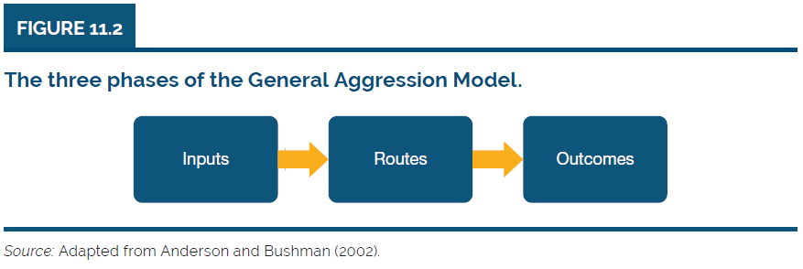
What Is Aggression? (6 of 11)
Notes:
Learning Objective 11-1 Use typologies and the General Aggression Model (GAM) to define and describe how humans harm one another.
Figure 11.2: The three phases of the General Aggression Model

Slide 8
What Is Aggression? (7 of 11)
The Persistence of Aggression
Ancient aggression
Efficiency of modern weapons
Notes:
Learning Objective 11-1 Use typologies and the General Aggression Model (GAM) to define and describe how humans harm one another.
The Persistence of Aggression
Ancient Aggression
Religion and the justification of violence
Archeological discoveries of weapons and tombs
The Efficiency of Modern Weapons
In 1863, it required 3 days to kill approximately 8,000 soldiers.
In 1916, it required 1 day to kill approximately 19,000 soldiers.
In 1945, it required less than 1 s to vaporize 75,000 soldiers.

Slide 9
What Is Aggression? (8 of 11)
Aggression Tends to Escalate: Stages of Provocation
Escalation of aggression effect: tendency for aggression to spiral
Stages of provocation model
Notes:
Learning Objective 11-1 Use typologies and the General Aggression Model (GAM) to define and describe how humans harm one another.
Aggression Tends to Escalate: Stages of Provocation
Escalation of aggression effect: The tendency for aggression to spiral and increase in a situation.
Stages of provocation model: Proposes that thoughts, feelings, and behaviors collectively contribute to the escalation of aggression in three stages.
Stage 1: provocation doesn’t lead to particularly aggressive responses
Stage 2: experience angrier thoughts, mild physiological and emotional arousal
Stage 3: biased perceptions and overreactions, surge of adrenaline and rage, explosive physical or verbal attack
See Table 11.2

Slide 10
What Is Aggression? (9 of 11)
TABLE 11.2 Zillmann’s Stages of Provocation
 | STAGE 1 | STAGE 2 | STAGE 3
Cognition | Irritated, but capable of good judgment | Angry thoughts and less empathic | Biased conclusions, no empathy, with illusions of power
Emotional arousal | Low to moderate | Moderate to high | Extremely high
Behavior | Cautiously assertive with self-control | Strongly assertive, unyielding, hostile | Impulsive, explosive, and irresponsible
Source: Adapted from Zillmann (1994).
Notes:
Learning Objective 11-1 Use typologies and the General Aggression Model (GAM) to define and describe how humans harm one another.
Table 11.2: Zillmann’s Stages of Provocation

Slide 11
What Is Aggression? (10 of 11)
The Statistical Surprise: The Decline of Worldwide Aggression
Persistent, long-term decline in worldwide violence
Possibly related to increased human intelligence
Notes:
Learning Objective 11-1 Use typologies and the General Aggression Model (GAM) to define and describe how humans harm one another.
The Statistical Surprise: The Decline of Worldwide Aggression
Persistent, long-term decline in worldwide violence
Research suggests with increased human intelligence over time comes less aggression

Slide 12
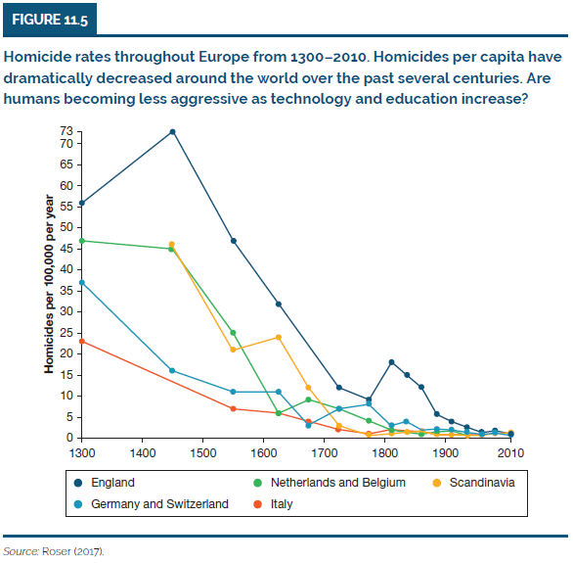
What Is Aggression? (11 of 11)
Notes:
Learning Objective 11-1 Use typologies and the General Aggression Model (GAM) to define and describe how humans harm one another.
Figure 11.5

Slide 13
Why Are Humans Aggressive? (1 of 6)
Biological Influences on Aggression
Genetic determinism: idea that genetic influence alone determines behavioral outcomes
Four biological responses to threat
Low heart rates
Notes:
Learning Objective 11-2 Distinguish among biological, cultural, and situational explanations of human aggression.
Why Are Humans Aggressive?
Biological Influences on Aggression
Genetic determinism: The idea that genetic influence alone determines behavioral outcomes.
Four Responses to Threat: Fight, Flight, Freeze, Befriend
Low Heart Rates
Strong predictor of delinquency: low resting heart rate at age 11
Less sensitive to the negative consequences of behavior or to the environment
Possible link to antisocial personality disorder

Slide 14
Why Are Humans Aggressive? (2 of 6)
Biological Influences on Aggression
Alcohol
Testosterone
Interactions: aggression is the result of multiple influences
Notes:
Learning Objective 11-2 Distinguish among biological, cultural, and situational explanations of human aggression.
Biological Influences on Aggression
Alcohol
Alcohol disinhibition hypothesis: The idea that alcohol interferes with the brain’s ability to suppress violent behavior by lowering anxiety and harming the ability to accurately assess a situation.
Effects of alcohol on the brain during disagreements
Strong predictor of physical or sexual violence
Testosterone
Influences aggression
Stronger connection among nonhuman animals
Gender differences
Early in life, boys tend to be more physically aggressive
Aggression peaks in both men and women in the 20s
Changing effect throughout the lifespan
Testosterone and competitiveness
Interactions: Aggression Is the Result of Multiple Influences
Interactions between nature and nurture
Cultural differences
Age differences

Slide 15
Why Are Humans Aggressive? (3 of 6)
Cultural Influences on Aggression
Group differences in aggression
Cultures of honor
Gender roles and aggression
Sports culture
Notes:
Learning Objective 11-2 Distinguish among biological, cultural, and situational explanations of human aggression.
Cultural Influences on Aggression
Helps explain group differences in aggression
National scale or smaller
Cultures of Honor
Culture of honor: A culture where individuals, especially men, tend to perceive insults as a threat to their masculinity and often engage in aggression.
Promoted by personal and cultural values
See Table 11.4
Physical aggression as a response to threats to masculinity
Gender Roles and Aggression
Link between female empowerment and the frequency of female victimization from aggression
Decrease in female victimization as gender equality and individualism increased
Case study: Sweden
Influences from status and mating motives
Sports Culture
Requirements of participants to risk serious injury
Perpetrators and Targets
Creation of a dangerous subculture of aggression
The Color Black: A Cultural Cue for Aggressive Behavior
Loading of the word "black" with negative prejudices
High penalties for teams using black uniforms
Cultural meanings from black cues in the environment
Dehumanize: When a human is perceived as lacking positive human qualities and is seen more like an animal or object.
Dehumanization of Black children
Sports Can Be a Humanizing Influence
Trench football during World War I
Christmas Truce of 1914
Idealistic view of the Olympics

Slide 16
Why Are Humans Aggressive? (4 of 6)
TABLE 11.4 Values in a Culture of Honor
Masculine courage (e.g., men should be able to take pain)
Pride in manhood (e.g., men should be independent)
Socialization (e.g., men with honor stand up to bullies)
Virtue (e.g., fighting is admirable if done out of honor)
Protection (e.g., men should protect women)
Provocation/insult (e.g., men should not accept insults)
Family and community bonds (e.g., family is a man’s first priority)
Source: Adapted from Saucier et al. (2016).
Notes:
Learning Objective 11-2 Distinguish among biological, cultural, and situational explanations of human aggression.
Table 11.4: Values in a Culture of Honor

Slide 17
Why Are Humans Aggressive? (5 of 6)
Situational Influences on Aggression
Situation 1: war hysteria & moral panic
Situation 2: modeling aggressive role models
The Bobo Doll studies
Notes:
Learning Objective 11-2 Distinguish among biological, cultural, and situational explanations of human aggression.
Situational Influences on Aggression
Situation 1. War Hysteria & Moral Panic
Societal pressure in Britain before WWI
Situation 2. Modeling Aggressive Role Models: The Bobo Doll Studies
Fear of television in America after WWII
A Familiar Problem: Correlation Does Not Imply Causation
Alternative explanations for violent behaviors and seeing violence on TV
A Familiar Solution: Controlled Experiments
Use of experiments with control groups, random assignment to condition, etc.
Bandura's experiments
Replication
Study 1: Imitating Adults
Study 2: Imitating Adults on Television
Study 3: Imitating Children on Television
Contrasting Experimental Conditions Lead to a Better Hypothesis
Conflict between Rocky and Johnny
Gender identification
Insights From Qualitative Interviews
See Figure 11.9
When aggression is rewarded
Aggression works
Victim is to blame

Slide 18
Why Are Humans Aggressive? (6 of 6)
Situational Influences on Aggression
Situation 3: media violence
Situation 4: environmental cues
GAM: environmental cues promote aggression
Notes:
Learning Objective 11-2 Distinguish among biological, cultural, and situational explanations of human aggression.
Situational Influences on Aggression
Situation 3. Media Violence: Starting With The Great Train Robbery
The Great Train Robbery
Violent movie and positive response
Media Violence: Do You Really Want to Know?
Violent video games as the reason for mass shootings
Transient, Short-Term Effects of Media Violence
Priming that activates existing memories and mental connections
Mimicking or imitation of others’ aggressive responses
Changes in physiological arousal
Conditions of the arousal experience
Unpleasant
Focuses attention on the aggressive cues
Triggers a dominant response
Perceived as proactive
Enduring, Long-Term Effects of Media Violence
Observational learning
Desensitization
Decreased empathy
Video game contributions to education
Situation 4: Environmental Cues: Why the GAM is a Good Theory
The GAM: Environmental Cues Promote Aggression
The Weapons Effect
Weapons effect: The tendency for the presence of weapons to prime aggressive thoughts, feelings, and behaviors.
Alcohol
Prevalence of images of alcohol in society
Heat
Association between hot temperatures and violence

Slide 19
How Can We Manage or Reduce Aggression? (1 of 7)
Catharsis: A Tempting But Bad Idea
Catharsis hypothesis: engaging in small aggression will reduce larger aggressive behaviors
Catharsis: popular and dangerous belief
Notes:
Learning Objective 11-3 Analyze ideas for managing aggression.
How Can We Manage or Reduce Aggression?
Catharsis: A Tempting But Bad Idea
Catharsis hypothesis: The idea that purposefully engaging in small aggression will reduce larger aggressive behaviors overall.
Catharsis is a Popular—and Dangerous Belief
Increase in anger and aggression from catharsis
Includes violent acts, ranting, venting, and violent games

Slide 20
How Can We Manage or Reduce Aggression? (2 of 7)
Catharsis: A Tempting But Bad Idea
Revenge is sweet, but only briefly
Creating cultures of peace
Cultures of peace are possible
Notes:
Learning Objective 11-3 Analyze ideas for managing aggression.
Revenge Is Sweet, but Only Briefly
Creating Cultures of Peace
Cultures of Peace Are Possible
See Table 11.5

Slide 21
How Can We Manage or Reduce Aggression? (3 of 7)
TABLE 11.5 Relatively Peaceful Societies
SOCIETY | LOCATION AND TYPE OF SOCIETY | CONFLICT MANAGEMENT TECHNIQUES
Balinese (Belo, 1935; Howe, 1989) | Agricultural and commercial on the Indonesian island of Bali | Use self-control to suppress conflicts, usually successfully
Birhor (Adhikary, 1984a, 1984b; Bhattacharyya, 1953) | Nomadic hunters, gatherers, and traders in the forests of central India | Rarely fight, do not commit crimes, and have harmonious relations with neighboring Hindu villagers
Chewong (Howell, 1984) | Agricultural communities in the mountains on the Malay Peninsula | Have no mythology of violence or words for quarreling, fighting, aggression, or warfare
(Continued)
Notes:
Learning Objective 11-3 Analyze ideas for managing aggression.
Table 11.5: Relatively Peaceful Societies

Slide 22
How Can We Manage or Reduce Aggression? (Cont.)(4 of 7)
(Continued)
SOCIETY | LOCATION AND TYPE OF SOCIETY | CONFLICT MANAGEMENT TECHNIQUES
Hutterites (Bennett, 1967; Deets, 1931; Van den Berghe & Peter, 1988) | Communal farmers on the central plains of the United States and Canada (unlike Amish, they use modern farming equipment) | Believe that their Anabaptist faith promotes resolving conflicts without open disagreement
Inuit (Briggs, 1994) | Fishing and hunting communities in northern Alaska, Canada, and Greenland | Fear interpersonal aggression, perhaps because murder had been frequent in some Inuit societies
(Continued)
Notes:
Learning Objective 11-3 Analyze ideas for managing aggression.
Table 11.5: Relatively Peaceful Societies

Slide 23
How Can We Manage or Reduce Aggression? (Cont.)(5 of 7)
(Continued)
SOCIETY | LOCATION AND TYPE OF SOCIETY | CONFLICT MANAGEMENT TECHNIQUES
Piaroa (Overing, 1986, 1989) | Native Americans of Venezuela formerly living in forest villages | Are appalled by aggression and treat disease as a sorcery attack from another village deserving a counterattack using sorcery
Tahitians (Levy, 1973, 1978) | Fishing and farming in the Society Islands of Tahiti | Behave with gentleness even during festivals; although alcohol occasionally contributes to hitting within a family
Notes:
Learning Objective 11-3 Analyze ideas for managing aggression.
Table 11.5: Relatively Peaceful Societies

Slide 24
How Can We Manage or Reduce Aggression? (6 of 7)
Catharsis: A Tempting But Bad Idea
Constructive journalism: promoting cultures of peace
MAD wisdom and game theory: prisoner’s dilemma
Notes:
Learning Objective 11-3 Analyze ideas for managing aggression.
Constructive Journalism: Promoting Cultures of Peace
Peace journalism: News reporting focused on ending conflict and its causes, instead of emphasizing aggression and injury.
MAD Wisdom and Game Theory: The Prisoner’s Dilemma
Mutually assured destruction and nuclear war
Experiments on the Prisoner's Dilemma

Slide 25
How Can We Manage or Reduce Aggression? (7 of 7)
Catharsis: A Tempting But Bad Idea
Bobo doll wisdom and role modeling
Media violence: fight false fairness with facts
Notes:
Learning Objective 11-3 Analyze ideas for managing aggression.
Bobo Doll Wisdom and Role Modeling
Lower possibility of aggression from role models showing nonaggression and punishing aggression
Media Violence: Fight False Fairness With Facts
Media as role modeling
Overemphasis on violence in media

