Slide 1
Research Methods
Steps for Recognizing Trustworthy Research

Slide 3
Land Acknowledgement
At the University of Oklahoma, we gather on, teach, learn, and engage with scholarship on land placed by its Creator in the care and protection of the Hasinai (Caddo) and Kitikiti’sh (Wichita) peoples and originally shared by many Indigenous Nations—including the Cáuigù (Kiowa), Nʉmʉnʉʉ (Comanche), Na i sha and Ndee (Apache), and Wahzhazhe (Osage) —as a place of gathering and exchange. Today, 39 Tribal Nations reside in what is currently known as Oklahumma (Oklahoma), many as a result of settler colonial policies of removal that were designed to erase Indigenous people. We acknowledge the University of Oklahoma’s historical connection to Indigenous peoples and its responsibility to the 39 sovereign Tribal Nations in this state. We acknowledge our connection to place and honor the land as a relative.

Slide 4
Trustworthy Research - Key Terms
Correlations
True Experiments
Random Sampling
IRB

Slide 5
Trustworthy Research– Learning Objectives
Describe the role of variables in a research study.
01
Understand how ethical guidelines and oversight prioritize respect for participants.
02
Identify the steps needed for trustworthy research outcomes.
03

Slide 6
Recognizing Trustworthy Research
You’ll find claims of facts on…
TV and online
Food and drink packages
Vitamins and supplements
Beauty and fitness products
Car and electronic comparisons

Slide 7
Steps to Recognizing Trustworthy Research
Activity - Elements of Trustworthy Research:
Correlation v. causation
Internal validity
Construct validity
Generalizability
Reliability

Slide 8
Steps to Recognizing Trustworthy Research
Trustworthy Research with Correlational Analyses:
Researchers can study two areas of information, also known as variables, per participant.
Researchers can use random assignment to place participants into various conditions of a study using a chance method, to eliminate confounding variables by making the groups as equal to each other as possible.
Researchers analyze the data set to find associations, also known as correlations for the two variables.
This findings represent the participants’ positions to see if the two variables are related.
Ex: Participants’ hours of study and GPA.

Slide 9
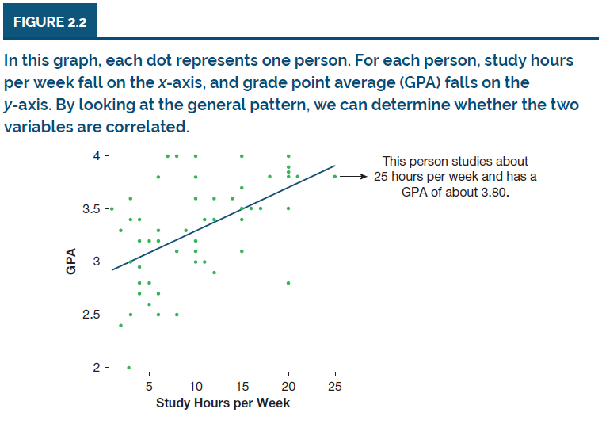
Steps to Recognizing Trustworthy Research
Trustworthy Research with Correlational Analyses:
Correlations always range from -1.00 to +1.00.
If a correlation is zero, it means there is no pattern or association between the two variables.
Positive correlations: variables move in same direction
Negative correlations: one variable increases, the other decreases

Slide 10
Steps to Recognizing Trustworthy Research
Trustworthy Research with True Experiments:
Researchers design true experiments to compare two or more groups that have been created with random assignment.
Random assignment occurs when researchers place participants into various conditions of a study using a chance method, to eliminate confounding variables by making the groups as equal to each other as possible.

Slide 11
Steps to Recognizing Trustworthy Research
Trustworthy Research with True Experiments:
Researchers study specific variables in true experiments, including:
Independent variable: A variable that is manipulated at the beginning of an experiment to determine its effect; it’s how the groups are different from each other at the start of the study. Ex: If an independent variable is music type, one group may listen to classical music, one to rock music.
Dependent variable: The measured outcome at the end of an experiment that is affected by the independent variable. Ex: Anything you want to measure for a possible effect, like performance on a test after listening to either classical or rock music.
Control group: A group of participants in a true experiment that serves as a neutral or baseline group that receives no treatment. Ex: A group of students who takes the test without having listened to any music at all.

Slide 12
Steps to recognizing trustworthy research
Partner Conversation:
You’re planning to conduct a survey of fellow students in order to petition OU for to change a specific policy.
What ethical questions do you need to consider in the following:
Designing your survey
Selecting your participants
Conducting the survey
Interpreting the results
Using your conclusions to petition for policy change

Slide 13
Steps to Recognizing Trustworthy Research
Trustworthy Research with guidance form the Ethics and Institutional Review Board (IRB):
Researchers have a responsibility to treat people with respect.
Institutional review boards (IRBs): Committees of people who consider the ethical implications of any study before giving the researcher approval to begin formal research.
Typically composed of representatives from different departments in a college, university, research institute, or corporation; sometimes even a blend of organizations contributes representatives.
Often includes a lawyer and occasionally a member with no research background to represent an “average” perspective.

Slide 14
Steps to Recognizing Trustworthy Research
Trustworthy Research with Ethics and authorization from the IRB:
Researchers have a responsibility to treat people fairly.
Institutional review boards (IRBs) oversee compliance with
Informed consent: Participants’ right to be told what a study will involve, including potential dangers, before the study starts.
Right to withdraw: Participant’s right to stop being in the study.
Debriefing: Researchers offering additional details given after participation.
Protecting and respecting participants is the highest priority.

Slide 15
Wrap-up and Summary
All research methods are NOT equal.
Researchers design studies to examine variables of interest.
Researchers analyze data to understand associations among selected variables.
Trustworthy research is the result of specific steps and recognized governance.

Slide 16
Thank you for your attention and participation. Class is adjourned!
Keep OU Together and see you next time…

