Slide 1
UCOL 1523: GATEWAY TO BELONGING
Week 4 – September 13-17, 2021
PRACTICE COMPASSION
CHAPTER 3

Slide 3
Land Acknowledgement
At the University of Oklahoma, we gather on, teach, learn, and engage with scholarship on land placed by its Creator in the care and protection of the Hasinai (Caddo) and Kitikiti’sh (Wichita) peoples and originally shared by many Indigenous Nations—including the Cáuigù (Kiowa), Nʉmʉnʉʉ (Comanche), Na i sha and Ndee (Apache), and Wahzhazhe (Osage) —as a place of gathering and exchange. Today, 39 Tribal Nations reside in what is currently known as Oklahumma (Oklahoma), many as a result of settler colonial policies of removal that were designed to erase Indigenous people. We acknowledge the University of Oklahoma’s historical connection to Indigenous peoples and its responsibility to the 39 sovereign Tribal Nations in this state. We acknowledge our connection to place and honor the land as a relative.

Slide 4
Announcements
This is Week 4 of the academic term. Gateway to Grassroot Groups Presentation Assignment is due during Week 5.
For this assignment, each student will create a PowerPoint presentation of 10-12 slides that properly identifies and critically evaluates a student organization, campus event, or community group that is meaningful to you, suits your schedule, and occurs during the current semester.

Slide 5
Announcements
Gateway to Grassroot Groups Assignment is due during Wk. 5
Additional information will be made available in class and under the Assignments tab on Canvas.
On the due date, students should upload and submit a copy of your FINAL set of PowerPoint slides assignment via the course website.

Slide 6
Announcements
Toolbox Open Book Online Test 1 is due during Week 6.
Test 1 covers Chapters 1, 2, 3, and 4 in the AW text, including the AW readings, lecture slides, Belonging Toolbox Activities, Journal Prompts, and in class activities.
Also, the Test 1 covers the Research Methods module, including the readings, lecture slides, and class activities.

Slide 7
Announcements
Office Hours (OH) are provided weekly and by appointment.
Students are encouraged to use office hours (OH) in person and/or remote.
During OH, students can ask UCOL 1523 course related questions.
During OH, students can discuss course content in detail.
During OH, students can get feedback on draft assignments.

Slide 8
Chapter 3 (AW) Learning Objectives
Compare and contrast the need for external and self compassion.
Explain the degree to which sympathy and empathy are core elements of compassion.
Consider connection between core values and offering more compassion.

Slide 9
What is Compassion?
“The feeling of concern or care that we feel for others or for ourselves, and the urge to decrease their (or our) pain and suffering” (p. 38).
Sympathy and empathy are necessary for compassion.

Slide 11
Sympathy vs. Empathy
How would you differentiate between sympathy and empathy? Can you think of an example for each?

Slide 12
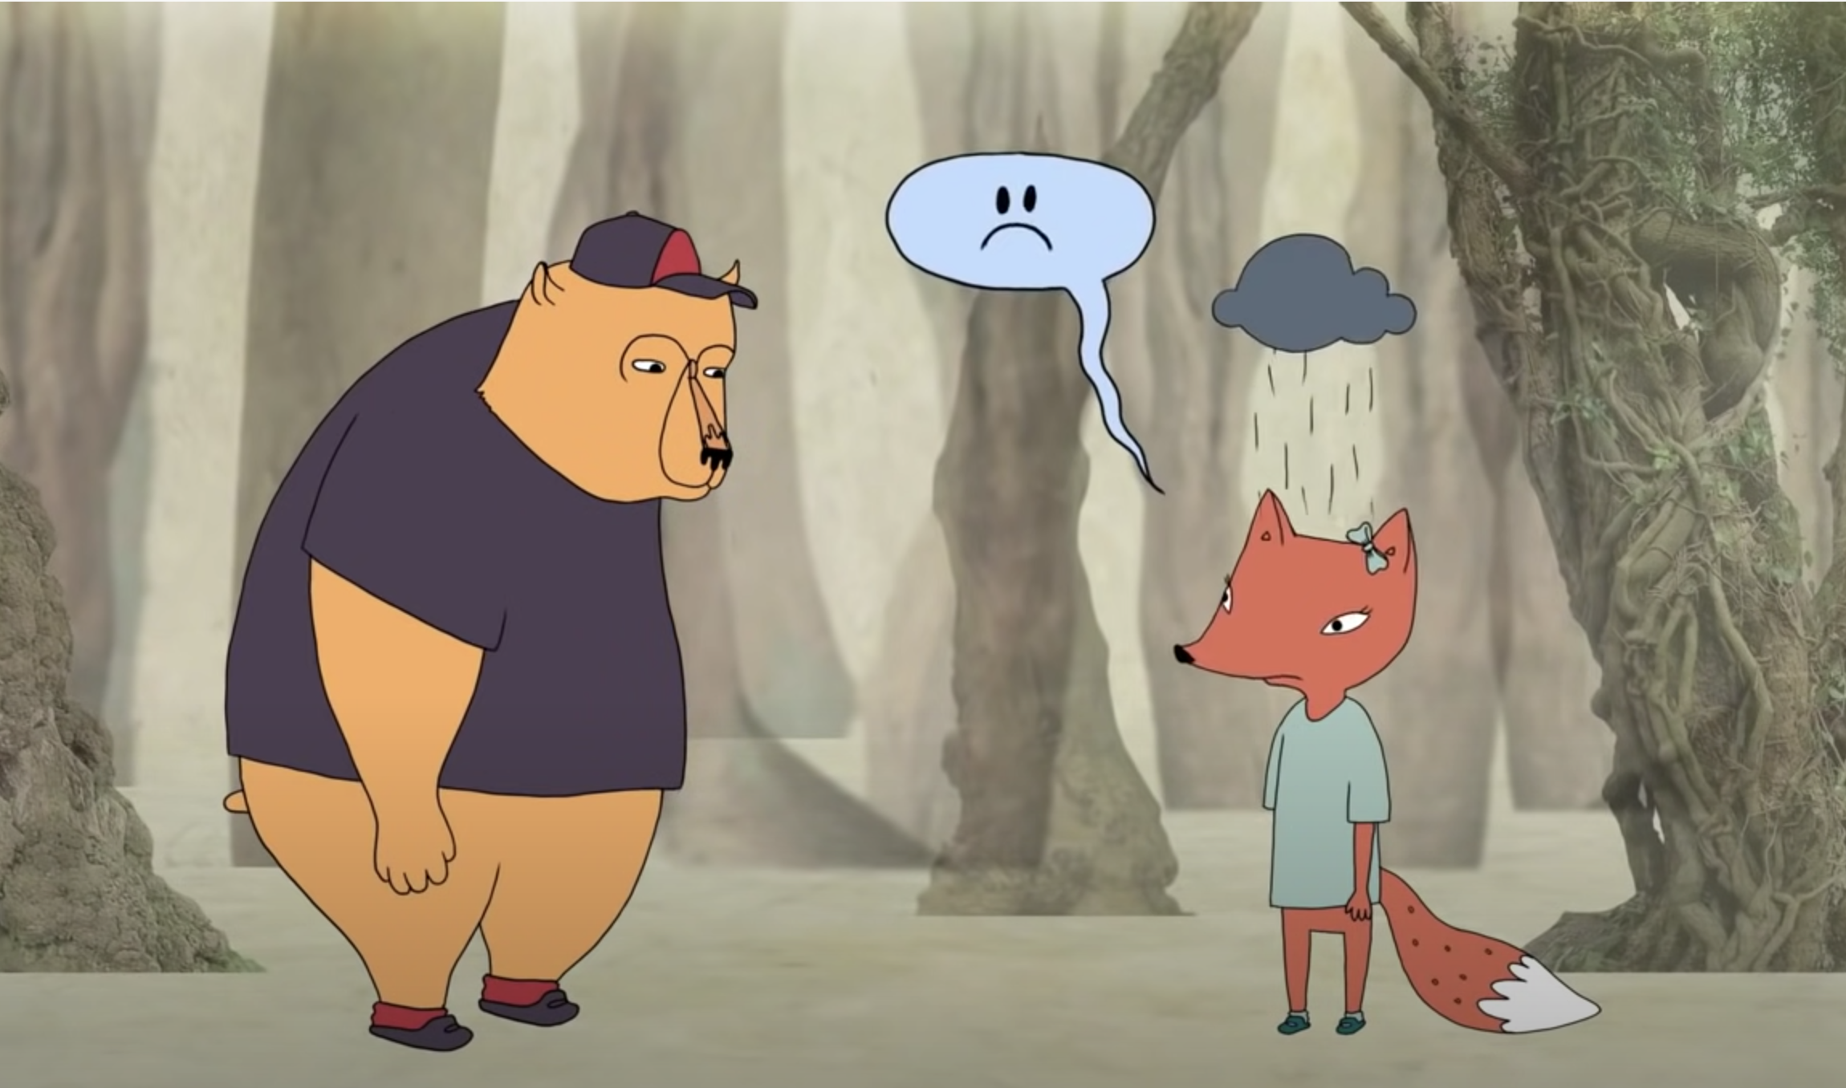
\
Brené Brown on Empathy vs Sympathy
Notes:
Brene’ Brown video

Slide 13
Qualities of Empathy
Perspective taking
Staying out of judgement
Recognizing emotion in other people and then communicating that
Feeling with people

Slide 14
Practicing Compassion Towards…
Ourselves
Others
Can be more difficult than compassion towards others
Set healthy boundaries
Try talking to yourself like you would your friend
You are always deserving of compassion!
Can be more difficult for unfriendly people
Offer a shoulder to cry on
Challenge your automatic thoughts about others
Everyone is deserving of compassion!

Slide 15
Belonging Toolbox: Determining Core Values
It is important for us to recognize our core values, because they direct the choices that we make.
What is one of your core values that help you to practice compassion towards others?
Are there any values that you wish were more important to you than they are? What are some things you can do to make those values more important to you?

Slide 16
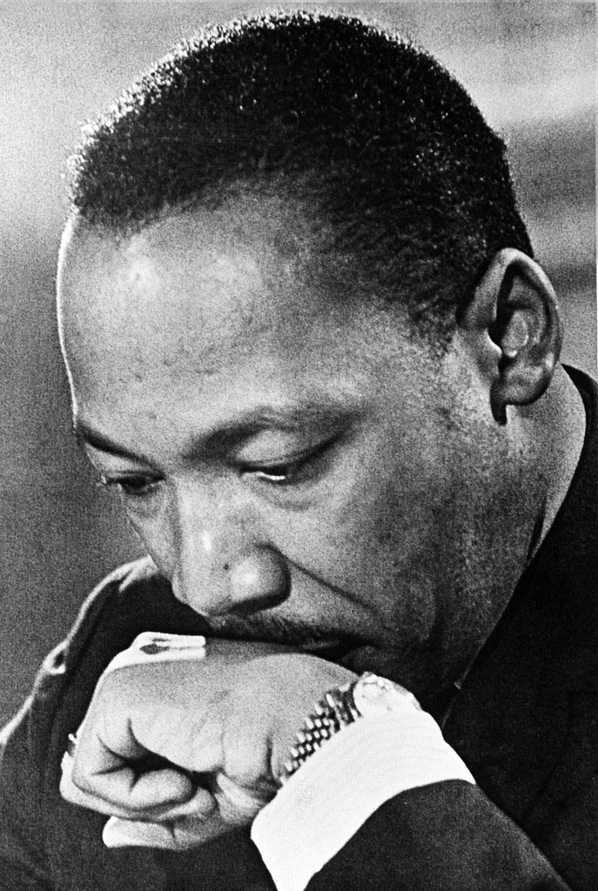
How External Compassion Increases Belonging
It can help create a global community where everyone supports each other. External compassion has birthed the civil rights movement, feminism, and fight for climate change among other efforts to create a world that works for all of us.
It can create a domino effect leading others to act in compassionate ways.

Slide 17
Sustained Compassion
It takes commitment to remain compassionate despite the opportunities to respond otherwise.
By acting with compassion toward others, regardless of their behavior, we do not continue the negativity cycle; instead, we show ourselves and others that we are to be treated with kindness.
With compassion, we show that we value ourselves and others for being our true, authentic selves—whether good, bad, ugly or anywhere in between.

Slide 18
Belonging Toolbox: Loving-kindness Meditation
Meditation can help you improve your own emotional well-being and to generate kindness towards others.
A loving-kindness meditation is a great way to practice this compassion towards yourself and others.
May I be _______________________
May I be _______________________
May I be _______________________
May you be ____________________
May you be _____________________
May you be _____________________

Slide 19
What are some ways we can practice compassion for others here at OU? What are some ways we can practice compassion for ourselves while here at OU?
Practicing Compassion at OU

Slide 20
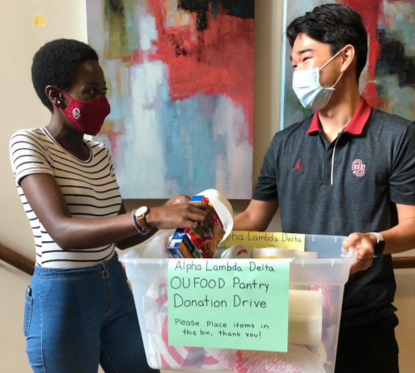
In addition to the everyday actions you can take to show compassion to others in the university community, there are many ways you can join others in showing compassion. Some examples include: Giving to the OU Food Pantry Giving to Sooners Helping Sooners Volunteering at Big Event every spring
Opportunities to Practice
Compassion at OU

Slide 21
Class Wrap-up…
Questions and Answers

Slide 22
That’s all folks…
Thanks for your attention!
Stay Well…

