Slide 1
UCOL 1523: GATEWAY TO BELONGING
Week 7 – October – 8, 2021
Attitudes and Persuasion
HEINZEN & GOODFRIEND CHAPTER 6

Slide 3
Land Acknowledgement
At the University of Oklahoma, we gather on, teach, learn, and engage with scholarship on land placed by its Creator in the care and protection of the Hasinai (Caddo) and Kitikiti’sh (Wichita) peoples and originally shared by many Indigenous Nations—including the Cáuigù (Kiowa), Nʉmʉnʉʉ (Comanche), Na i sha and Ndee (Apache), and Wahzhazhe (Osage) —as a place of gathering and exchange. Today, 39 Tribal Nations reside in what is currently known as Oklahumma (Oklahoma), many as a result of settler colonial policies of removal that were designed to erase Indigenous people. We acknowledge the University of Oklahoma’s historical connection to Indigenous peoples and its responsibility to the 39 sovereign Tribal Nations in this state. We acknowledge our connection to place and honor the land as a relative.

Slide 4
ANNOUNCEMENTS
Exam 1 occurs during class meetings on Tues./Wed. of Week 8, see the instructor for details.
Exam 1 covers the readings from Modules 5, 6, and 7 in the Heinzen & Goodfriend text, lectures slides, class activities, and group discussions.
Exam 1 occurs in person, without the use of outside resources or notes, and during class time.
Students must confirm any accommodation plans BEFORE Week 8.
Students need to bring a pencil(s) and student ID to complete the multiple-choice exam.
Scantrons are provided to students, free of charge, to complete the exam.
You can earn up to 75 points on Exam 1.

Slide 5
ANNOUNCEMENTS
Students’ scores for the online, open book, Toolbox Test 1 will be posted in Canvas by Tuesday, October 5, 2021. To calculate your grade…
A = 50 - 45 points or at least 90% of 50 total points.
B = 44 - 40 points or at least 80% of 50 total points.
C = 39 - 35 points or at least 70% of 50 total points.
D = 34 - 30 points or at least 60% of 50 total points.
F = 29 points and below or at least 59% of 50 total points.

Slide 6
ANNOUNCEMENTS
Students’ scores for the Gateway to Grassroot Groups Presentation Assignment 1 will be posted in Canvas by Wednesday, October 6, 2021. To calculate your grade…
A = 75 - 67 points or at least 90% of 75 total points.
B = 66 - 60 points or at least 80% of 75 total points.
C = 59 - 52 points or at least 70% of 75 total points.
D = 51 - 45 points or at least 60% of 75 total points.
F = 44 points and below or at least 59% of 75 total points.

Slide 7
ANNOUNCEMENTS
Students can calculate their approximate UCOL 1523 Midterm grade with Exam 1 (up to 75 points) + Presentation Assignment (up to 75 points) + Toolbox Test (up to 50 points) = up to 200 total points possible to date.
A = 200 - 180 points or at least 90% of 200 total points.
B = 179 - 160 points or at least 80% of 200 total points.
C = 159 - 140 points or at least 70% of 200 total points.
D = 139 - 120 points or at least 60% of 200 total points.
F = 119 points and below or at least 59% of 200 total points.

Slide 8
ATTITUDES & PERSUASION LEARNING OBJECTIVES
Module 7.1: Explain how attitudes are based on underlying beliefs that help predict behavior.
Module 7.2: Describe difficulties in measuring attitudes and theories regarding whether they really predict human behavior.
Module 7.3: Analyze how paths to persuasion can change attitudes.

Slide 9
Explain how attitudes are based on underlying beliefs that help predict behavior.
LO M7.1

Slide 10
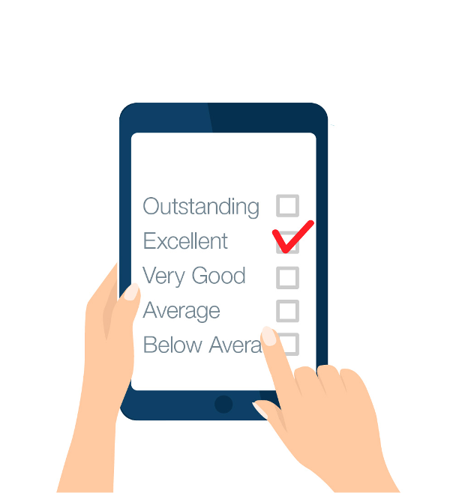
WHAT ARE ATTITUDES?
An attitude is an inner evaluation or judgment of something or someone.
Attitude object refers to the ”target” of an attitude. These “targets” can be a person, political policy, sports team, television series, painting, or even an abstract idea.
Have you ever left a review for an online purchase?
What other attitude objects “targets” can you think of?

Slide 11
Quickwrite:
Cowboy

Slide 12
WHAT ARE IMPLICIT ATTITUDES?
Attitudes based on automatic, unconscious beliefs about an attitude object.
Our thoughts and feelings toward a target that are automatic and unconscious.

Slide 13
WHAT ARE EXPLICIT ATTITUDES?
Attitudes that are the product of controlled, conscious beliefs about an attitude object.
Our thoughts and feelings toward a target that are created by our conscious processes.

Slide 14
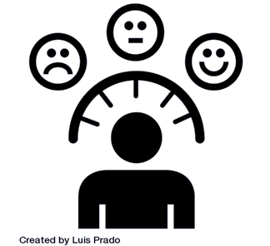
WHERE DO THEY COME FROM?
The ABCs of attitude formation come from three different sources:
Affect (emotional, gut reactions to things)
Behavior (like habits)
Cognition (thoughtful, logical reactions to things)
The problem is that A, B, and C don’t always align/come to the same conclusions.

Slide 15
WHAT ARE ATTITUDES AND WHERE DO THEY COME FROM?
Attitudes are inner evaluations or judgments of something or someone, either in a positive or negative direction.
Implicit attitudes are automatic, unconscious reactions toward an attitude object, while
Explicit attitudes are controlled, conscious, reasoned evaluations.

Slide 16
social learning theory
The idea that individuals observe what others do and copy them, particularly when those behaviors lead to success or rewards.
Learning attitudes and behaviors through observation and social interactions.

Slide 17
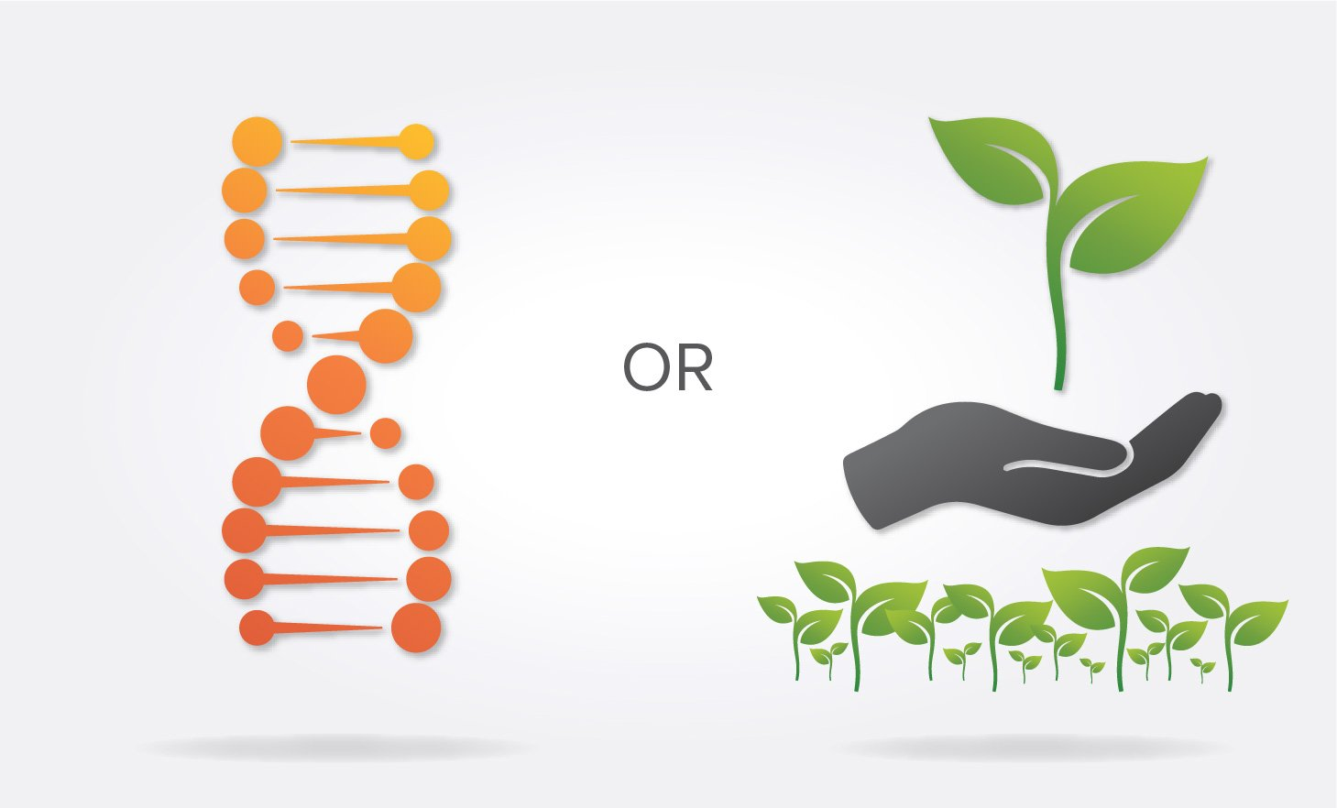
WHERE DO ATTITUDES COME FROM?
Do your attitudes come from nature (your inherited biology, genes, hormones, etc.)?
Or do attitudes come from nurture (your social environment, how you were raised, and your life experiences)?

Slide 18
WHAT ARE ATTITUDES AND WHERE DO THEY COME FROM?
Attitudes are formed by the interaction of nature (biological influences) and nurture (experiences formed through social learning).
Select two of the following attitude objects and describe how both nature and nurture might influences its development?
Binge drinking
Studying statistics
Flying in an airplane
Participating in extreme sports
Desire to have children
How might this understanding influence your own involvement in groups, clubs, activities, and classes?

Slide 19
Describe difficulties in measuring attitudes and theories regarding whether they really predict human behavior.
LO M7.2

Slide 20
DO ATTITUDES PREDICT BEHAVIOR?
Which came first – the attitude or the behavior?
Discuss.

Slide 21
DO ATTITUDES PREDICT BEHAVIOR?
Self-Perception Theory:
Which came first: The Attitude or the Behavior?
The assumption was always that attitudes came first and would predict behavior.
You decide which candidate you like, then you vote.
You decide which soap you like, then you buy it.
When have your attitudes predicted your behavior?
Can you think of times when advice tells you to flip it— that is the behavior comes first?
Have you heard the phrase, “Fake it ‘til you make it?”
Notes:
Page 137: Have students do the Facial Feedback and get their thoughts. If wearing masks in class, this would be a great activity to do outside of class to connect to concepts in class.

Slide 22
DO ATTITUDES PREDICT BEHAVIOR?
The direct, explicit approach to measuring attitudes can be summed up in two words: ”Just ask.”
Remember that explicit attitudes are the:
ones we are aware of
ones that are available to our conscious minds
ones based on reasoned decisions
Great if people are aware of what they think and willing to be honest.

Slide 23
Research on Attitudes with Bogus Pipeline
A fake lie detector machine used to circumvent social desirability bias.
A method of deception that encourages participants to provide honest self-reports.

Slide 24
DO ATTITUDES PREDICT BEHAVIOR?
The Implicit Association Test (IAT)
The test was developed to measure our automatic, unconscious, implicit associations, and attitudes.
It might not be our “fault” if we have these associations.
We might have picked them up from a biased culture.
Just having a mental association doesn’t mean you agree with it or act on it.
It just means you’re aware of a cultural stereotype or bias.

Slide 25
Research on Facial Feedback Hypothesis
The idea that individuals infer their own emotions based on the facial expression they are making.
The prediction that your facial expressions can influence your mood, like feeling more positive when we bite a pencil because that induces a smile.
Do you think that smiling helps to put you in a better mood?

Slide 26
self-affirmation theory
The idea that individuals try to preserve their sense of worth and integrity; they focus their thoughts and attitudes on what makes them feel good about themselves.
The positive inner dialogue we have about ourselves so we can feel good about who we are and what we are worth.

Slide 27
perceived control
The amount of control individuals believe they have over themselves and their environment, which, in combination with attitudes and social norms, predicts intended behavior.
The amount of control we believe we have that contributes to whether or not we actually perform the behavior.

Slide 28
Analyze how paths to persuasion can change attitudes.
LO M7.3

Slide 29
HOW DO ATTITUDES CHANGE?
How are you potentially persuaded to be part of a group that you initially did not like?

Slide 30
Attitude Change and Self-Justification
The desire to explain one’s actions in a way that preserves or enhances a positive view of the self.
The excuses we make to feel good about our questionable behaviors.

Slide 31
Attitude Change from Lowball Techniques
A persuasion technique where an incentive is offered at the beginning of a deal, such as a low price, but then is later removed due to the terms of the agreement being changed. Despite the change, cognitive and emotional commitment to the item from the original deal often leads to acceptance of the new, less attractive deal.
No longer honoring an agreement and offering a worse deal, with the knowledge that the deal will probably be accepted.

Slide 32
Attitude Change from Norms of Reciprocity
The idea that individuals respond in kind to courtesies and concessions from others.
When someone is helpful, or engages in a kind behavior to another person, the receiver feels indebted to repay that act in kind.

Slide 33
Attitude Change from Foot-in-the-Door
A persuasion technique that occurs when agreeing to a small, initial request makes an individual more likely to later agree to a much larger request.
Asking for small favors at first, knowing that you are working your way up to ask for a big favor.

Slide 34
Attitude Change from Door-in-the-Face
A persuasion technique that occurs when compliance is gained by first making a large request, which is usually refused, and then following it with a smaller request, which is usually accepted.
Asking for a big favor you know will get rejected so you can follow it with asking for the favor you really wanted, which is very small in comparison.
When have you used this technique?

Slide 35
HOW DO ATTITUDES CHANGE?
Brining together the techniques: lowball, norm of reciprocity, foot-in-the-door, door-in-the-face.
Imagine that you want to convince a professor to offer you an extra credit assignment. How might you use all four techniques in this section to persuade them to do so?
Now imagine that you would like to encourage people to be part of your study group, new club, or event that you are planning. How might you use one or all of the techniques to encourage them to do so? Are there techniques that you would not use? Why?

Slide 36
Class Wrap Up…
Questions and Answers

Slide 37
That’s all folks…
Thanks for your attention!
Stay Well…

