Slide 1
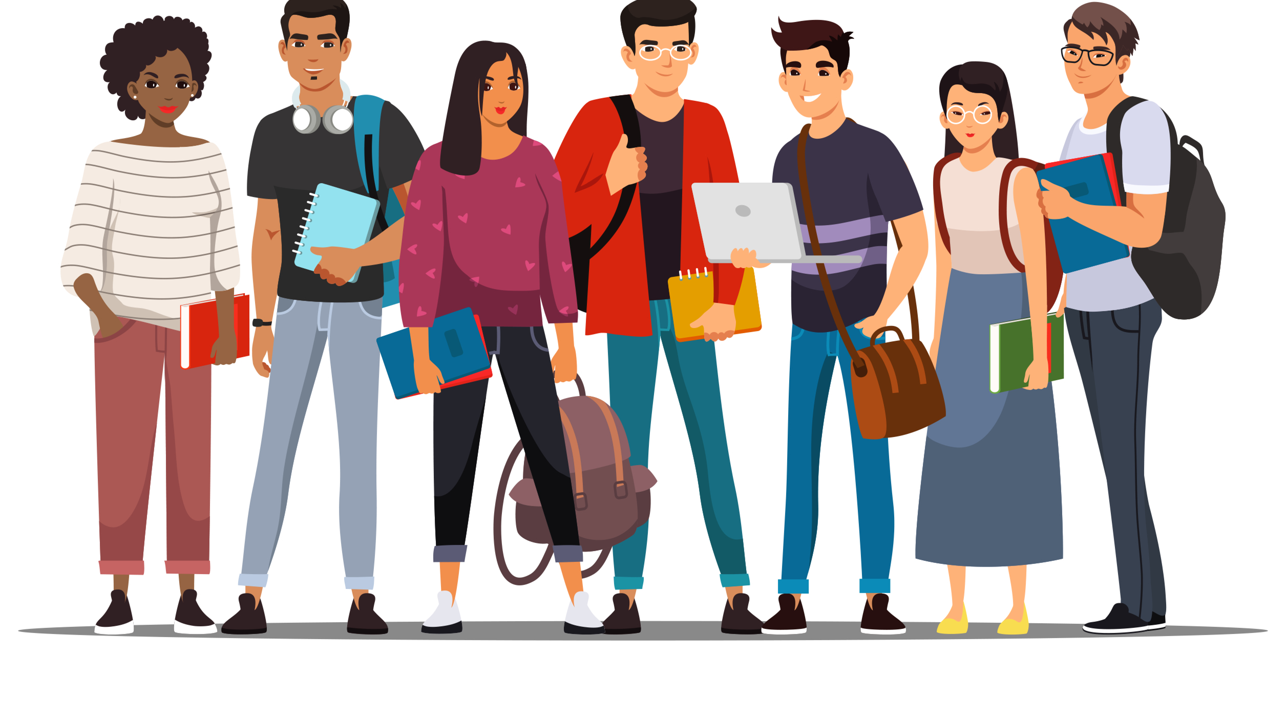
UCOL 1523: GATEWAY TO BELONGING
Week 9 – October 18 – 22, 2021
Stereotypes, Prejudice, and Discrimination
HEINZEN & GOODFRIEND CHAPTER 9

Slide 3
Land Acknowledgement
At the University of Oklahoma, we gather on, teach, learn, and engage with scholarship on land placed by its Creator in the care and protection of the Hasinai (Caddo) and Kitikiti’sh (Wichita) peoples and originally shared by many Indigenous Nations—including the Cáuigù (Kiowa), Nʉmʉnʉʉ (Comanche), Na i sha and Ndee (Apache), and Wahzhazhe (Osage) —as a place of gathering and exchange. Today, 39 Tribal Nations reside in what is currently known as Oklahumma (Oklahoma), many as a result of settler colonial policies of removal that were designed to erase Indigenous people. We acknowledge the University of Oklahoma’s historical connection to Indigenous peoples and its responsibility to the 39 sovereign Tribal Nations in this state. We acknowledge our connection to place and honor the land as a relative.

Slide 4
CHAPTER 9 LEARNING OBJECTIVES
9.1: Identify why we seem to have stereotyping instincts and the dangers they can lead to.
9.2: understand types of prejudice and explain the motivation behind it.
9.3: Compare research-based interventions to reduce prejudice and discrimination.

Slide 5
Identify why we seem to have stereotyping instincts and the dangers they can lead to.
LO 9.1

Slide 6
ingroup
Any group in which an individual is a member; these groups can be based on chosen or nonchosen characteristics such as race, nationality, sex, sexual orientation, club membership, favorite sports team, or where an individual went to college.
Group that a person is member of (“us”).
You may have head the phrase, “Birds of a feather flock together.”
We like spending time with people who are similar to ourselves, and that tendency reinforces stereotypes.

Slide 7
outgroup
Any group in which an individual is not a member.
Group that a person is not a member of (“them”).
What may be some perceived benefits to labeling members of an outgroup as “lesser”?

Slide 8
culture
A collection of shared beliefs, customs, attitudes, values, social norms, and intellectual pursuits that distinguishes one group of people from another.
The specific beliefs and practices shared by a group that are passed from one generation to the next.

Slide 10
WHY DO WE KEEP USING STEREOTYPES?
Each of these terms (stereotyping, prejudice, and discrimination) is sometimes used to describe the combined effects of all three.
However, more precisely:
Stereotyping usually refers to how we think (cognitive)
Prejudice refers to our feelings (the affect or emotion)
Discrimination refers to our actions (behavior)
Combined, we have the ”ABCs” of intergroup relations (affect, behavior, and cognition).

Slide 11
stereotype
A type of oversimplified and overgeneralized schema that occurs when an individual assumes that everyone in a certain group has the same traits.
Positive or negative preconceived notions about a person based on their group membership that are somewhat based on truth such as all women like pink.
Notes:
Page 213: Term is not bold and blue like prejudice and discrimination but is included in the same paragraph.

Slide 12
prejudice
Emotion-centered judgments or evaluations about people based on their perceived membership in a particular group.
It means that you have “pre-judged” someone without knowing much, if anything, about them.

Slide 13
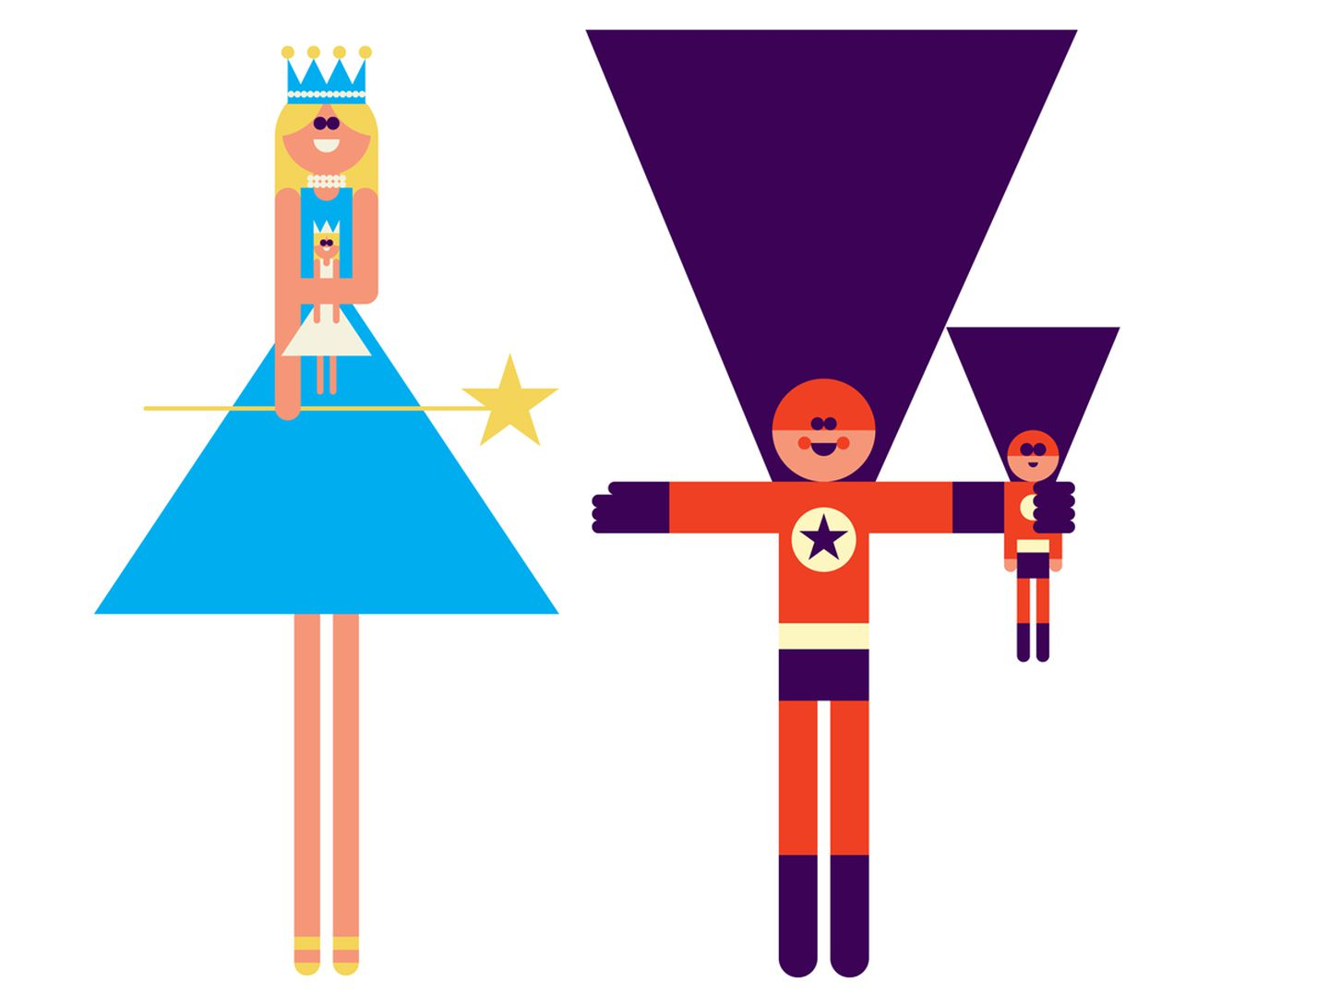
WHY DO WE KEEP USING STEREOTYPES?
Toys are frequently marketed toward boys versus girls – and they often send messages about what each sex should be learning and practicing for adulthood.
How might toys plant a seed about what groups girls and boys might join when they are older?
Notes:
Page 218

Slide 14
discrimination
Behaviors toward a people because of their perceived membership in a group.
A prejudicial behavior that results in unfair treatment.

Slide 15
institutional discrimination
Unfair treatment of individuals or certain groups by society or organization through unequal selection, opportunity, or oppression.
In the United States, some people believe that institutional discrimination occurs throughout many layers of the culture, including the legal system, healthcare, social services, political representation, media representation, and more.
Its bias that is built into the system itself.

Slide 16
WHY DO WE KEEP USING STEREOTYPES?
Stereotypes are beliefs about members of a group. (schema)
Prejudice is evaluations of the group. (attitude)
Discrimination is unfair behaviors toward someone based on their group membership. (behavior)
Examples of stereotypes, prejudice, and discrimination often focus on either race or sex.
What other important categories or group labels and assumptions about groups affect your own life?
Notes:
Page 224 You might think of religion, people in your major, people in your chosen extra curriculars, or any of your other interesting ingroups.

Slide 17
WHY DO WE KEEP USING STEREOTYPES?
Culture and institutional discrimination endorse stereotypes by setting up structures that continue these beliefs over time and across individuals.
Specific examples come from social learning theory (that we copy what we observe in others) and from group privilege).
Identify three specific ways that growing up in a certain culture led you to learn stereotypes about different groups (for example, media messages, how you were treated in various settings).
Looking back on these messages now, can you identify any negative influences they had on your perceptions or behavior regarding yourself or people from your outgroups?

Slide 18
Understand types of prejudice and explain the motivation behind it.
LO 9.2

Slide 19
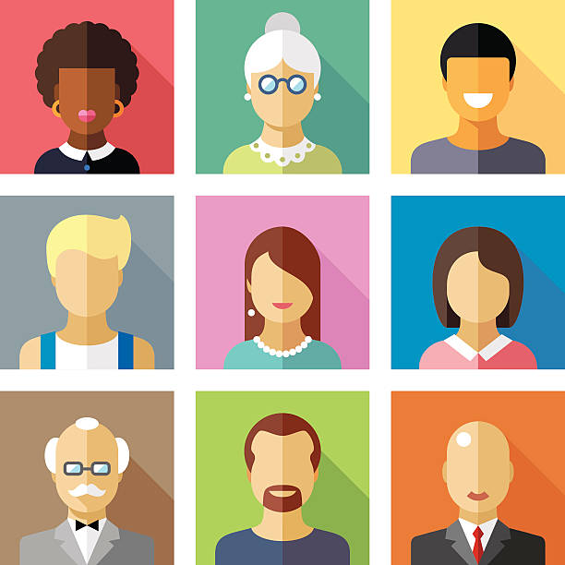
HOW DO STEREOTYPES TURN INTO PREJUDICES?
Explicit prejudice is much less likely to be seen today. Does that mean prejudice has decreased – or simply that it has changed to more subtle forms? Discuss.

Slide 20
HOW DO STEREOTYPES TURN INTO PREJUDICES?
Let’s Review:
We categorize in ways that produce stereotypes. It seems to be an automatic behavior.
We prefer to live in groups. It’s safer, is more comfortable, and provides many benefits, including an integrated identity.
Cultures teach the next generation how to think about one group versus another.
But those three characteristics don’t make us prejudiced – or do they?
Notes:
PAGE 225

Slide 21
old-fashioned prejudice
Obvious, overt prejudice that is considered inappropriate by most social standards today, such as forcing people of a specified race to drink only from a certain water fountain.
Forms of prejudice that are based on outdated ideals.
Notes:
Page 225

Slide 22
modern-symbolic prejudice
A form of prejudice where individuals think of themselves as valuing equality and respect for all people while they simultaneously oppose social change that would allow equality to occur.
Believing you are a supporter of equality when your behaviors are in opposition.
Notes:
Page 225

Slide 23
benevolent prejudice
The perception that members of certain groups have positive qualities that should be praised and valued; however, this positive evaluation typically includes condescending attitudes that result in unfair standards and maintain oppression of the outgroup.
A positive form of prejudice that is superficial to maintain the disliked group’s oppression.
Notes:
Page 226

Slide 24
hostile prejudice
Negative judgments of people who do not fit prescribed group stereotypes or push boundaries of what people in their group “should” do.
A problem with a stereotype of what people in that group “should” be still restricts opportunities for the group.

Slide 25
scapegoat theory
The idea that prejudice is the result of one group blaming another innocent group for its problems (see frustration-aggression theory).
When an innocent outgroup gets blamed for the plight of the ingroup, which often results in prejudice.

Slide 26
HOW DO STEREOTYPES TURN INTO PREJUDICES?
Realistic conflict theory proposes that prejudice results from the justification we create to determine that our ingroup deserves limited resources.
What historical events may have been caused, at least in part, by realistic conflict over limited resources (such as land, jobs, oil, gold, etc.)
How could this conflict lead to prejudice between the parties involved?

Slide 27
Compare various research-based interventions to reduce prejudice and discrimination.
LO 9.3

Slide 28
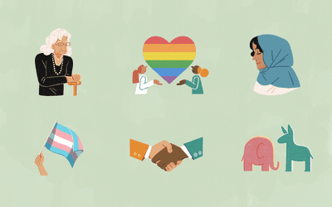
HOW CAN WE REDUCE PREJUDICE AND DISCRIMINATION?
Can we reduce prejudice and discrimination just by getting to know people? Discuss.
Allport (1954) said, “If you hate people because you don’t know them, then the solution is to get to now them.”

Slide 29
contact hypothesis
The idea that increasing contact or exposure may reduce prejudice if the groups’ members perceive themselves to be of equal status, group members interact on an individual level, authority figures appear to be supportive, and the groups have common goals.
The idea that groups who discriminate against one another can reduce prejudice if they have a common goal, work together, and have leaders that demonstrate acceptance.

Slide 30
friendship contacts
Individual, positive, personal interactions that reduce prejudice.
The reduction of prejudice through positive interactions.

Slide 31
HOW CAN WE REDUCE PREJUDICE AND DISCRIMINATION?
Not all forms of contact will be positive. Allport specified that interaction between two hostile groups would, in fact, only lead to decreased prejudice if four criteria were met:
Groups had to be of equal status (one group couldn’t have more power than the other).
Group members had to be able to get to know each other on an individual level.
Any authority figures in the situation had to support the groups’ positive change.
The groups had to work together, cooperatively on a common goals.
They had to need each other to succeed.

Slide 32
Class Wrap Up…
Questions and Answers

Slide 33
That’s all folks…
Thanks for your attention!
Stay Well…

