Slide 1
UCOL 1523: GATEWAY TO BELONGING
Week 9 – October 18 - 22, 2021
Introduction to Historical Thinking

Slide 2
What is History?
We use the word “history” to describe many different ways of thinking about the past.
As an academic field, history has specific methodologies and criteria for verifying claims.
All forms of history are an ongoing conversation.
Popular (non-academic history) changes over time based on a variety of factors: pop culture, local politics, market interest, changing [feelings]
Academic history changes over time through peer review, uncovering new evidence, or reconsidering the ways scholars interpret historical evidence.
Notes:
The key here is that ”history” is not something settled. We are constantly discovering new evidence that changes how we understand the past, asking new questions about how we think about it. Even in popular history, it functions much like memory. We don’t replay movie reels in our heads: we recreate events as we remember them. As we remember the past, we fold our present into the story, and the story changes.

Slide 3
How Historians Examine the Past
If historians “fish” for sources:
Research isn’t dragging a net and pulling up all the creatures of the ocean to arrange them in order
It’s standing on a boat in the middle of one of many oceans with a single line, pulling fish up one by one.

Slide 4
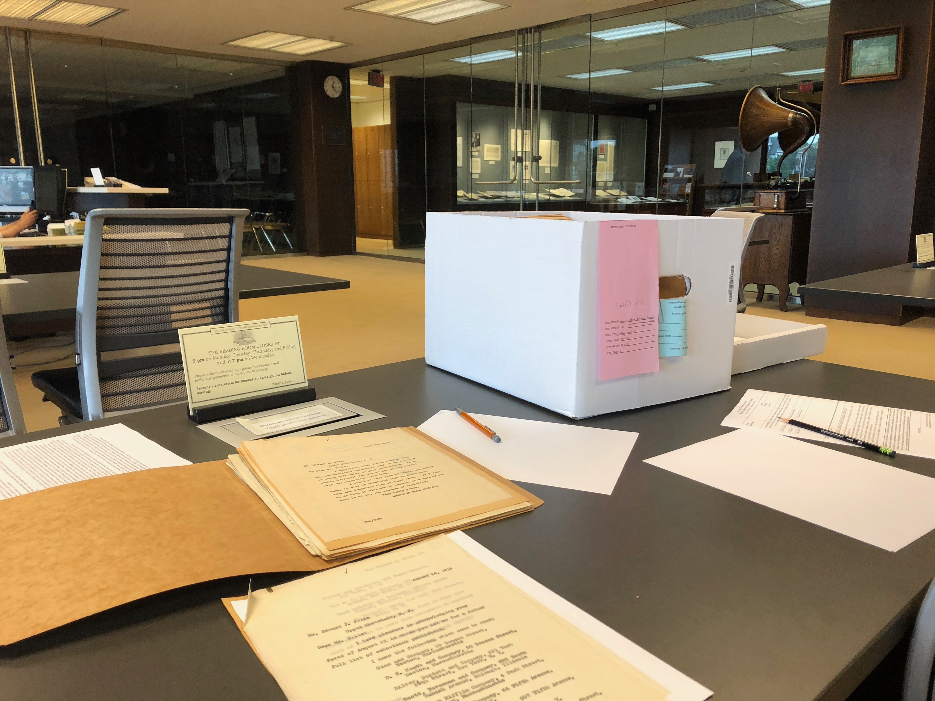
Analyzing Historical Evidence
Every source has at least three dimensions for analysis:
The event it describes
The time, circumstances, and reasons why it was made/recorded
How we approach it now
This is just the first step in analyzing historical sources.
Notes:
This formula comes from the late James Loewen’s work on historical monuments in Lies Across America. To engage with historical items, we need to acknowledge that they exist in three times: the time described, the time recorded, and the time we look from. Understanding all those lenses at once helps us ask better questions about how they build our historical memory.

Slide 5
Where History Comes From: Oversimplified
Primary Sources
Documents
Timeline
Resolving conflicts in sources
Narrative
Settled narrative
Artifacts
Interviews
Imposing order on events
Competing narratives
Notes:
Most of us assume that historians collect evidence, put it in order, then tell a story about it. When we think about history this way, we look for one unified narrative that resolves all conflicting accounts into a verifiable timeline that separates the facts of the past from myths.

Slide 6
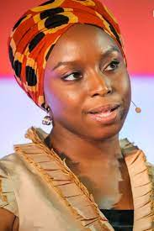
Doing History: Narrative Construction
“Power is the ability not just to tell the story of another person, but to make it the definitive story of that person. The Palestinian poet Mourid Barghouti writes that if you want to dispossess a people, the simplest way to do it is to tell their story and to start with, "secondly." Start the story with the arrows of the Native Americans, and not with the arrival of the British, and you have an entirely different story. Start the story with the failure of the African state, and not with the colonial creation of the African state, and you have an entirely different story.” – Chimamanda Ngozi Adichie
Periodization: where we start the story, where we end it, and what it tells us based on that framework
Notes:
The trouble with the oversimplified view of history is it leads us into the trap of periodization: starting and ending the story where it makes sense based on other stories we have. But it makes it hard for us to think complexly about the past, and it makes it easy for us to let the stories we tell about the past reinforce misunderstandings. As Adichie points out in “The Danger of the Single Story” it flattens our stories about each other, and makes it easy to think about other people as just one thing. This version of doing history always favors those in power and disadvantages those out of power.

Slide 7
Where History Comes From: Reality
Web of Narratives
Lenses of analysis
Secondary sources
Historiography
Discovering new sources
Primary sources
Notes:
In reality history is far more complex. The process of historical research is inconsistent, interrupted by discovering new sources, asking new questions of old sources, applying different lenses of analysis (labor history, environmental history, economic history, settler colonial history, etc), centering different historical subjects (both human and more than human subjects), and considering how other historical analysis and changing ways of thinking about history influence how we understand the sources. This produces a complex web of narratives rather than one single narrative or a pair of competing narratives.

Slide 8
Doing History: Narrative Construction
History as a palimpsest
“Given the obstacles to merging these fragile and diverse forms of storytelling into a single tale, it is, paradoxically, by venturing in the opposite direction—by listening for the silences between accounts; by discovering what each genre of recordkeeping cannot tell us—that we can capture most fully the human struggle to understand our elusive past.” – Karl Jacoby, Shadows at Dawn
Notes:
Palimpsest: “an artifact that, beneath its dominant text, retains other, less discernable forms of expression” (photo of the Archimedes palimpsest); rather than seeking to reconcile conflicting narratives into one unified narrative, we look for the silences between the conflicts and the reasons why they conflict to think about the many stories we have about each other and the past. Another analogy that works well: those children’s books where there are clear pages that each add a new layer to the image – the more questions we ask about the narrative, the fuller the picture gets. (In Shadows at Dawn, Karl Jacoby (JACK-uh-bee) writes about the 1871 Camp Grant Massacre involving Apache, Tonoho O’odham, Mexican, and US participants. Rather than reconcile the accounts into one narrative, he tells the story four times from the four different perspectives, pointing to the discrepancies and the different ways each group commemorates the event rather than trying to fit them together.)

Slide 9
Why We Expand Our Historical Narratives
“History has more than one truth. More often than not, history is written by a dominant culture. Their stories become known as “truth.” Our First American truths consider our beliefs and our perspectives. They are often in contrast to what the majority of us were taught in school and see in popular culture. We share our truths to expand what is remembered as history.” - First Americans Museum, Oklahoma City, OK
Notes:
Just like any time period, including our present, the past is complex and impossible to understand in all its complexity. Instead, we strive to make space for a web of narratives that inform each other, helping us lean into the contradictions to understand why we remember history so differently, and why our experiences of the events of the past and their legacies impact us all differently. The common narrative we strive for to make sense of these conflicting stories of the past is our shared understanding of those contradictions, and our ability to look at the past (and therefore our present) through different experiences. That’s not to say there aren’t false histories. There are! But it’s embracing complexity and contradiction that exposes them. Trying to simplify conflicting narratives into one unified narrative hides them.

Slide 10
Engaging with the Past
Questions to ask:
What is the context for this story?
What lens is the storyteller using to tell it?
Who is telling the story?
Why are they telling this story?
Is this their story to tell?
Why did they start where they did and stop where they did?
Who isn’t telling the story?
Why is this the story we have instead of other stories?
Does anything in this story challenge the story I expected to hear?
Notes:
These are guidelines for students as they engage with the interviews and other historical sources.

Slide 11
Class Wrap Up…
Questions and Answers

Slide 12
That’s all folks…
Thanks for your attention!
Stay Well…

