Slide 1
UCOL 1523: GATEWAY TO BELONGING
Week 10 – October 25 – 29, 2021
Assignment 2: Freewriting and Brainstorming

Slide 2
Brainstorming
Strategies for brainstorming keywords:
Look in your text for keywords
Brainstorm ideas with a partner or group
Create a mind map
Search the Web
Use names of people and organizations related to your topic

Slide 3
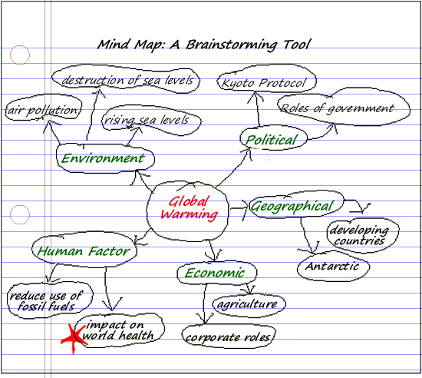

Slide 4
Brainstorming Example
To brainstorm, let your thoughts about a specific topic flow, and list those thoughts.
Example: squirrels
How to get them out of the garden
How to get rid of them ethically (without killing)
Squirrel traps
Repellents for squirrels
Types of squirrels
Brown vs. black vs. red squirrels
Flying squirrels
What they eat
Different types of play
Training squirrels
Hunting squirrels
Squirrels and cats
How they nest
Build nests in the same place each year

Slide 5
Brainstorming Cont.
So, what happens once you’ve brainstormed a topic? Look over the list. Are there items that group together? Are there items that catch your interest as a thinker, researcher, and writer—items you want to know more about? Are there items that seem unrelated or not useful? Use your list as a starting place; it creates ideas for you, as a writer, to work with.

Slide 6
Brainstorming for Your Assignment
Consider your interview of choice.
-Write the name of the community of your choice described in this interview in the middle of your page.
-From there, surround this word with three ideas from the interview that stood out to you.
-Then pull in three concepts from Ackert and the Vintage book.
-Draw lines between these concepts to show how they connect to each other or to show which connects with which.
-Maybe think about other ideas you can explore or examples that you can also add into your mindmap.

Slide 7
Example of Mindmap

Slide 8
Your Turn…
Take your time. Plan to spend 15 minutes on this.
- Pull up your Vantage book to take a look at the eflashcards and determine what concepts you can pull in.
Think about examples.
Re-watch your video interview or take a look at the transcript to refresh your memory.
Pull in some concepts discussed, maybe some phrases or words used.

Slide 9
Freewriting
Freewriting, a writing strategy developed by Peter Elbow in 1973, is similar to brainstorming but is written in sentence and paragraph form without stopping. Thus, it . . .
increases the flow of ideas and reduces the chance that you’ll accidentally censor a good idea.
helps to increase fluency second-language learners—i.e., the ability to produce written language easily (as opposed to accuracy, which is of course important but which is better addressed later in the process).

Slide 10
Like in Brainstorming
DO write down every idea you can think of about your topic, no matter how "crazy"; you can judge later! (And no one else is going to see it)
DON'T worry about correct grammar or spelling

Slide 11
Unlike in Brainstorming
DO write in sentence and paragraph form;
DO KEEP YOUR HANDS MOVING. If you can’t think of anything, just keep repeating your subject (e.g., “busy trap, busy trap”) or something like “I’m waiting for ideas to come and they will, I’m waiting for ideas to come and they will,” over and over until they do come. (They will!);
DO keep going for 15 or 20 minutes or until you feel you have enough to start to build your paper or research on.

Slide 12
Freewriting Example
Here’s a sample freewrite that could yield a number of topics for writing:
I don’t think this is useful or helpful in any way. This is stupid, stupid, stupid. I’m looking out of my window and it’s the end of may and I can see that white cotton stuff flying around in the air, from the trees. One of my aunts was always allergic to that stuff when it started flying around in the spring. Don’t know offhand what type of tree that comes from. That aunt is now 94 years old and is in a nursing home for a while after she had a bad episode. She seems to have one now every spring. It’s like that old tree cotton triggers something in her body. Allergies. Spring. Trying to get the flowers to grow but one of the neighbors who is also in his 90s keeps feeding the squirrels and they come and dig up everyone’s flowerbed to store their peanuts. Plant the flowers and within thirty minutes there’s a peanut there. Wonder if anyone has grown peanut bushes yet?
Don’t know . . . know . . .
Possible topics from this freewrite:
Allergy causes
Allergies on the rise in the U.S.
Consequences of humanizing wild animals
Squirrel behavior patterns and feeding habits
Growing your own food

Slide 13
Your turn…
For the next 15 minutes, take a look at your mind map and just write in paragraph and full sentence form. Write an entire page, just keep typing or writing.

Slide 14
Finding Scholarly Sources
Look at your mindmap again.
Mark (highlight, star, underline, etc.) ideas or connections on the mindmap that you need to learn more about before you write.
For each, make a list of some keywords that would help you search for sources.
Start your search using the OU Libraries website (review search processes here: https://guides.ou.edu/UCOL1523/Finding_Sources)

Slide 15
Using Public Scholarship
Who published this source? Why did they show interest in publishing this? Who is the intended audience and what are they hoping the audience does in response?
What editorial process did the author need to go through to publish this source? How was the argument and evidence fact-checked?
Who is the author? How can you know they are speaking from knowledge about this topic? Are they the person who should be speaking about this topic?

