Slide 1
UCOL 1523: GATEWAY TO BELONGING
Week 11 – November 1 – 5, 2021
Assignment 2: Writing Tips

Slide 2
Outline of your paper
Introduction
Summary of interview
(You may want to offer a brief history of this community)
Focus on 2 moments in the interview that stood out to you; explain why; unpack; use source(s)
Focus on 3 terms/concepts/ideas from class (Ackert AND Heintzen & Goodfriend); unpack, define, apply to the interview, explain how they don’t fit necessarily or how the speaker could have addressed these.
Propose one solution that can help the inclusion of this community in Oklahoma.
Conclusion

Slide 3
Introductions
Attract the Reader’s Attention
Begin your introduction with a "hook" that grabs your reader's attention and introduces the general topic. Here are some suggestions on how to create a “hook”:
State an interesting fact or statistic about your topic
Reveal a common misconception about your topic
Set the scene of your story: who, when, where, what, why, how?
Share an anecdote (a humorous short story) that captures your topic
State Your Focused Topic
After your “hook”, write a sentence or two about the specific focus of your paper. What is your paper about? Why is this topic important? This part of the introduction can include background information on your topic that helps to establish its context.
State your Thesis
Finally, include your thesis statement. The kind of thesis you include depends on the type of paper you are writing, but, in general, your thesis should include:
your specific topic
your main point about that topic
the points of discussion you will include in your paper
Your thesis should be clear, and easy to find. Most often, it is the last sentence of the introduction.

Slide 4
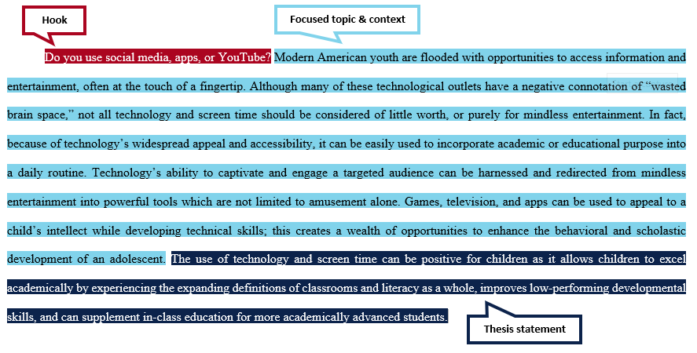
Example Introduction

Slide 5
Work on your introductory paragraphs (10 mins)
Attract the Reader’s Attention
Begin your introduction with a "hook"
State an interesting fact or statistic about your topic
Reveal a common misconception about your topic
Use a quote from either books
State Your Focused Topic
After your “hook”, write 3 sentences about the specific focus of your paper. What is your paper about? Why is this topic important?
State your Thesis
Include your thesis statement.
[a,b, and c concepts from class] contribute to belonging/overcomes barriers to belonging/forms barriers to belonging as exemplified in [x group experience].
In this paper, I will present the experience of [x group] in Oklahoma in order to suggest that [one specific action that can be taken] can foster a better sense of belonging for this group.

Slide 6
Summary
A summary is a shortened or condensed version of a text.
Only includes the most important concepts or ideas.
Used to explain the content of the text to someone who has not read it.
Written in your own words with a minimal use of direct quotes.
Three Tips for Writing a Summary:
In the first sentence, identify the author, the title of the work, and the thesis statement.
Write in paragraph form with clear transitions between major points.
Organize the ideas in the same order as the original.
What to Avoid when Writing a Summary:
Repetition of similar ideas.
Minor details (e.g., examples, anecdotes, descriptions, statistics, and dialogue).
Direct quotes (unless there is no other way to give the information).
Digressions from the main points.
Your own personal opinions or comments on the subject.

Slide 7
Example Summary
The foreword to Liam Chambers's autobiography is written in the form of "A Letter to My Children." In this introduction, Chambers establishes the spiritual tone that dominates the body of his book. He initially characterizes the Cold War in a more or less standard fashion, invoking the language of politics and describing the conflict as one between communism and freedom. But as the foreword progresses, Chambers introduces a religious element that serves to cast the struggle between communism and capitalism as a kind of holy war.

Slide 8
Summarize your interview (10 mins)
Use the first sentence as a version of this:
“In an interview for the Inclusive Excellence Series at the University of Oklahoma, [full name], professor/graduate student in the department/college [name of department], describes the history of [name community] in Oklahoma.”
In the next sentence, describe a brief background for this community.
In the next sentence, describe the main/overall argument your interviewee is making.
In the nest sentence, tell the reader what the main points the interviewee is making are.
In the next sentence tell the reader what the biggest struggle of this community is.
End your summary with a sentence explaining what the interview accomplishes.

Slide 9
Paraphrases
A paraphrase expresses the meaning of what someone else says or writes.
A paraphrase is written in your own words.
A paraphrase (unlike a summary) is about the same length as the original text you are paraphrasing.
Paraphrases also change the word order or the sentence structure of the original.

Slide 10
Paraphrases examples
Original sentence
“Symptoms of influenza include fever and nasal congestion.” (Dr. Tran, 2021)
Paraphrased sentence
Dr. Tran (2021) explains that a stuffy nose and elevated temperature are signs you may have the flu.
Original passage
“The number of foreign and domestic tourists in the Netherlands rose above 42 million in 2017, an increase of 9% and the sharpest growth rate since 2006, the national statistics office CBS reported on Wednesday” (DutchNews.nl, 2018).
Paraphrased version
According to the national statistics office, the Netherlands experienced dramatic growth in tourist numbers in 2017. More than 42 million tourists travelled to or within the Netherlands that year, representing a 9% increase, the steepest in 12 years (DutchNews.nl, 2018).

Slide 11
Paraphrase from our books (Ackert; Heintzman & Goodfriend)
For one of your concepts selected from this class that you are considering using in the Assignment 2, write a paraphrase of its definition.

Slide 12
Synthesis vs Summary
Synthesizing simply means combining. Instead of summarizing the main points of each source in turn, you put together the ideas and findings of multiple sources in order to make an overall point.
At the most basic level, this involves looking for similarities and differences between your sources. Your synthesis should show the reader where the sources overlap and where they diverge.

Slide 13
Synthesis vs Summary Cont.
Unsynthesized Example
Franz (2008) studied undergraduate online students. He looked at 17 females and 18 males and found that none of them liked APA. According to Franz, the evidence suggested that all students are reluctant to learn citations style. Perez (2010) also studies undergraduate students. She looked at 42 females and 50 males and found that males were significantly more inclined to use citation software (p < .05). Findings suggest that females might graduate sooner. Goldstein (2012) looked at British undergraduates. Among a sample of 50, all females, all confident in their abilities to cite and were eager to write their dissertations.

Slide 14
Synthesis vs Summary Cont.
Synthesized Example
Studies of undergraduate students reveal conflicting conclusions regarding relationships between advanced scholarly study and citation efficacy. Although Franz (2008) found that no participants enjoyed learning citation style, Goldstein (2012) determined in a larger study that all participants watched felt comfortable citing sources, suggesting that variables among participant and control group populations must be examined more closely. Although Perez (2010) expanded on Franz's original study with a larger, more diverse sample...

Slide 15
Conclusions
A conclusion works to remind your reader of the main points of your paper and summarizes what you want your reader to “take away” from your discussion. Consider these tips when writing your conclusion:
Begin with your rephrased thesis statement to remind your reader of the point of your paper.
Summarize the points you made in your paper and show how they support your argument; tie all the pieces of your paper together.
Tell your reader what the significance of your argument might be. Why is the discussion important?

Slide 16
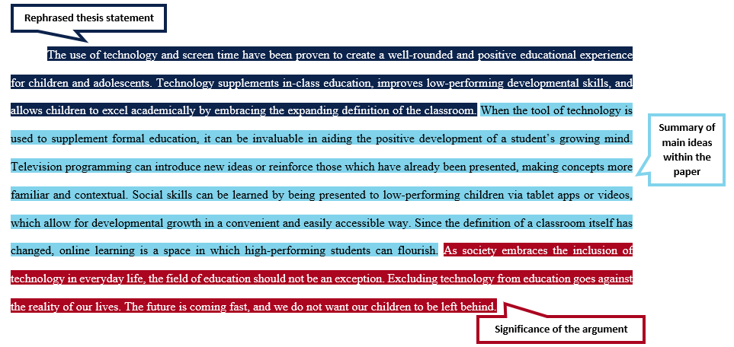
Example conclusion

