Slide 1
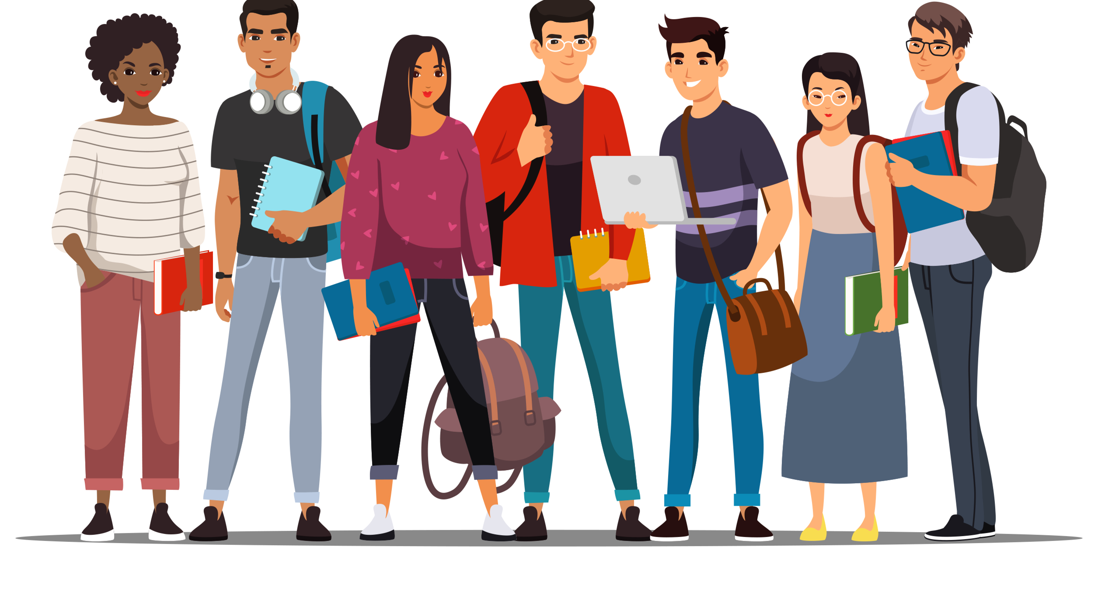
Week 12 –
Helping & Prosocial Behavior
Aggression
HEINZEN & GOODFRIEND CHAPTER 10 & 11
UCOL 1523: GATEWAY TO BELONGING

Slide 3
Land Acknowledgement
At the University of Oklahoma, we gather on, teach, learn, and engage with scholarship on land placed by its Creator in the care and protection of the Hasinai (Caddo) and Kitikiti’sh (Wichita) peoples and originally shared by many Indigenous Nations—including the Cáuigù (Kiowa), Nʉmʉnʉʉ (Comanche), Na i sha and Ndee (Apache), and Wahzhazhe (Osage) —as a place of gathering and exchange. Today, 39 Tribal Nations reside in what is currently known as Oklahumma (Oklahoma), many as a result of settler colonial policies of removal that were designed to erase Indigenous people. We acknowledge the University of Oklahoma’s historical connection to Indigenous peoples and its responsibility to the 39 sovereign Tribal Nations in this state. We acknowledge our connection to place and honor the land as a relative.

Slide 4
Part I: Aggression

Slide 5
Typologies of Aggression Behavioral Aggression
Physical aggression: intentionally causing harm to someone’s body or property
Verbal aggression: relying on communication to cause harm (name-calling, yelling, malicious gossip, etc.)
Relational aggression: harms others by damaging social networks or relationships with others

Slide 6
Typologies of Aggression Forms of Aggression
Aggression can be enacted either actively (punching someone in the nose) or passively (blocking someone’s path)
Aggression can also be direct (committing the act) or indirect (using others to commit the act or using negligence to commit it)

Slide 7
Typologies of Aggression Aggressive Motivations
Hostile-reactive aggression: impulsive, emotion-based reaction that harms others
Instrumental-proactive aggression: thoughtful, reason-based decision to harm others
Both reactive responses are cultivated through habits of mind, as well as explicit and implicit attitudes

Slide 8
Typologies of Aggression Microaggressions
Microaggressions: brief and “everyday” types of “verbal, behavioral, and environmental indignities… that communicate hostile, derogatory, or negative slights and insults.”
The result of subtle or covert prejudice and discrimination

Slide 9
Typologies of Aggression Microaggression (cont’d)
Microinsults: rude statements that demean someone’s heritage
Microassaults: behaviors meant to psychologically harm and/or insult someone
Microinvalidations: statements or behaviors that invalidate the target’s feelings on an individual or group level

Slide 10
Persistence of Aggression
Historical inertia contributes to continued aggressive behavior
Uninterrupted operation of prejudice and discrimination (especially institutional operations) reinforce aggressive behaviors
Single stories (stereotypes) reinforce aggressive behaviors at the individual and group levels (ex: Axis of Evil, sectarian violence)

Slide 11
Situational Influence on Aggression
Some factors can foster aggressive behavior: cultural expectations, alcohol, availability of weapons, partisan or nationalist rhetoric
Some factors can diffuse aggressive behavior: group-to-group cooperation, collective examination of shared patterns of aggression, intentional cultivation of cultures of peace

Slide 12
Aggression and Your Paper
Take a moment to search OU Daily for incidents of aggression directed at members of the identity group from your interview.
How did the OU community respond to those incidents?
Was the response sufficient to disrupt the pattern of those incidents?
What work remains to be done to disrupt that pattern of incidents?

Slide 13
Part II: Helping & Prosocial Behavior

Slide 14
Prosocial Behavior
AKA helping, or altruism
Any action performed to help others, either on an individual or group level
Core question: What motivates people to help each other?

Slide 15
Types of Altruism
Pure Altruism
Actions motivated only by the desire to help, with zero expectation for any kind of reward
Egoistic Altruism
Helping behavior done with an expectation of some kind of personal or group benefit

Slide 16
Why Do People Decide to Help? Evolutionary Perspective
Life is easier if you have good neighbors.
Because there are shared benefits to being in groups, people within groups are motivated to be altruistic.
If you help someone they are more likely to help you in return.
We are more likely to help people in our kinship groups.
(This perspective assumes the egoistic rationale for prosocial behavior.)

Slide 17
Why Do People Decide to Help? Social Norms
Social norms: unwritten rules about how members of a group are expected to behave
Belief in a just world suggests a cosmic yet practical sort of exchange. We help because we believe in the universe rewarding us.
Social responsibility norms assert that we each have a duty to improve our world by helping those in need.
(This approach assumes the egoistic rationale.)

Slide 18
Why Do People Decide to Help? Negative State Relief
Our prosocial behavior decreases a variety of negative emotions, like guilt.
Helping can relieve our discomfort over seeing others suffering.
We can have negative emotions about ourselves if we don’t help, and we want to think well of ourselves.
(This approach assumes the egoistic rationale.)

Slide 19
Why Do People Decide to Help? Empathy-Altruism Hypothesis
People help out of the goodness of their hearts.
When we see people who need help, we empathize with them and feel compassion.
Egoistic (or self/group-serving) altruism can coexist with pure altruism.
(This approach assumes a pure altruism rationale)

Slide 20
Why Do People Decide to Help? “The War” 1994
How would you analyze this scene based on the theories we just discussed?
Which theory best describes Stephen’s decision to give the Lipnicky kids the cotton candy?
Is there another explanation these theories don’t consider?

Slide 21
Prosocial Behavior and Your Paper
Go back to your OU Daily search. Knowing what you do now about why people/groups help each other, examine the response you found to incidents of aggression directed at your interview’s identity group.
How can we use the information about why people decide to help to plan more effective disruption of patterns of aggressive behavior at OU?
Use this thought process to craft your recommendation for changes OU needs to be a space of more authentic belonging for all members of our community.

