Slide 1
UCOL 1523: GATEWAY TO BELONGING
Week 13 – November 15 – 19, 2021
Chapter 5: Shift Your Mindset
Week 14 – November 22 – 26, 2021
Chapter 6: Work on Self-Care

Slide 2
SHIFT YOUR MINDSET
LEARNING OBJECTIVES (LO)
LO Wk 13.1: Explore the definition of a mindset, its function, and why having a flexible and growth-oriented mindset is linked to belonging.
LO Wk 13.2: Evaluate the purpose of establishing a growth mindset and how this can help us move forward to be the best versions of ourselves.
LO Wk 13.3: Explore the definition of self-care and its importance.
LO Wk 13.4: Learn how to build a self-care routine that works for you and your specific needs and learn how self-care helps us build better connections with others.

Slide 3
LO
Wk 13.1
Explore the definition of a mindset, its function, and why having a flexible and growth-oriented mindset is linked to belonging.

Slide 4
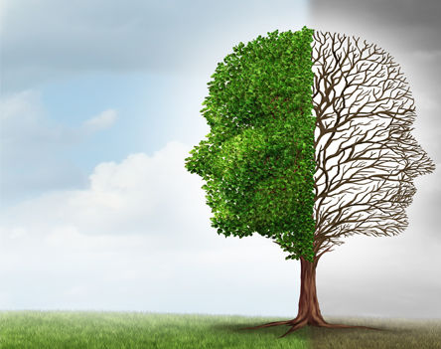
What is Your Mindset?
Mindset
A basic structure of beliefs.
Fixed Mindset
Holds firm to its beliefs and assumptions to the point of resistance.

Slide 5
What is Your Mindset?
Growth Mindset
Being flexible and open to other opinions, thoughts, experiences, and beliefs.
Differences in thought or opinion raise red flags in our minds.

Slide 6
Difficulty with a Growth Mindset
Fixed Mindset
Growth Mindset
Self-Reflection

Slide 7
LO
Wk 13.2
Evaluate the purpose of establishing a growth mindset and how this can help us move forward to be the best versions of ourselves.

Slide 8
Growth Mindset & Belonging
Growth mindset = general happiness
Acceptance of others = improved relationships
Reduces cognitive dissonance* and discomfort
*Cognitive dissonance: when one’s thoughts or beliefs do not match one’s actions

Slide 9
Growth Mindset & Belonging
A growth mindset is essential when it comes to cultivating belonging.
It moves us closer to our goals.
It challenges us to expand our comfort zone further.
Inspires us take the initiative and the risk.

Slide 10
Dealing with a Fixed Mindset
We all have the tendency to be fixed in certain things but not in others.

Slide 11
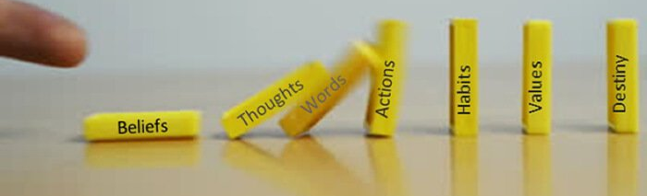
Dealing w/ a Fixed Mindset
Sometimes our beliefs won't change - and that’s okay.
The goal is to examine the beliefs that have kept us from progressing further.
We also want to ensure that our beliefs do not cause any harm to ourselves or others.

Slide 12
Dealing w/ a Fixed Mindset
One of the main reasons people keep a fixed mindset is that they can create a bubble for themselves.
By having a fixed mindset, we're just not our best selves, personally nor collectively, as a society.
We disregard growth because it's too uncomfortable or frightening.

Slide 13
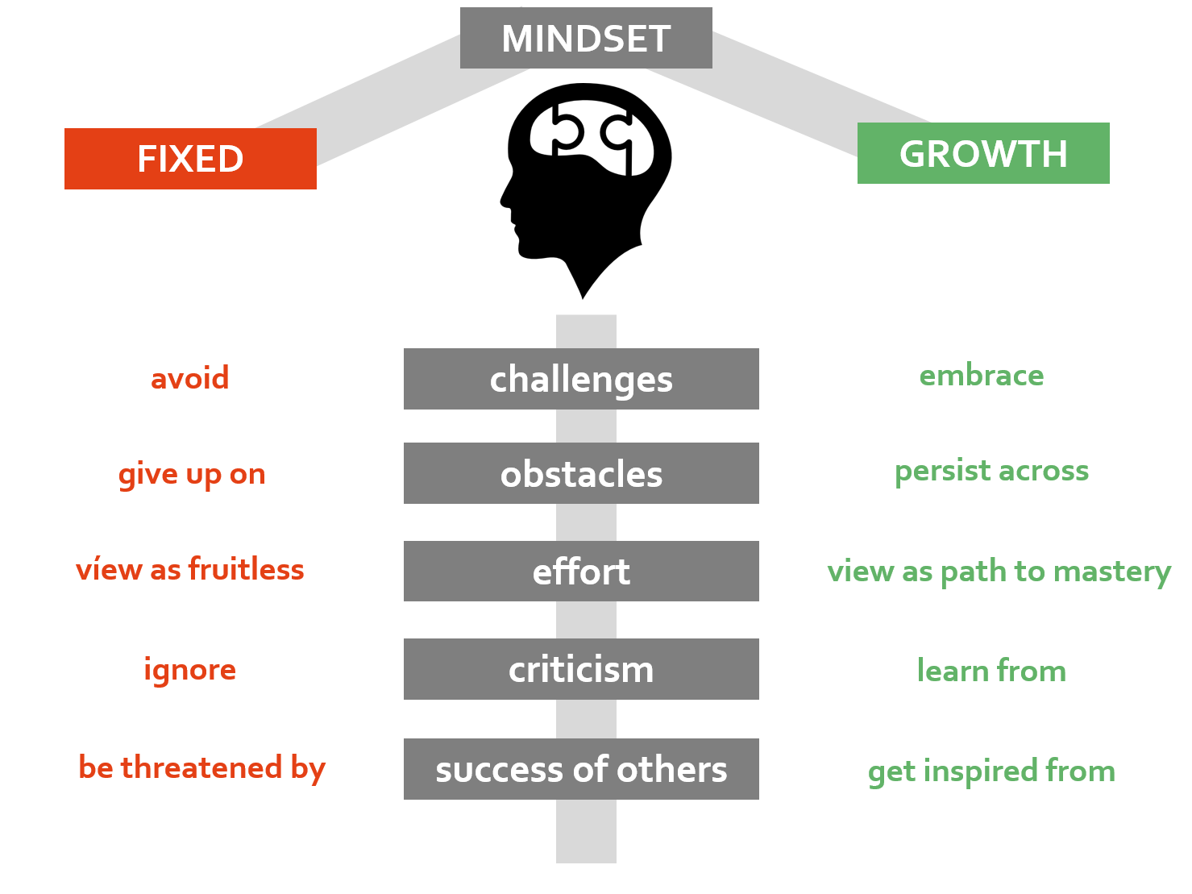

Slide 14
Fostering a Growth Mindset
Watch the language you are using.
Recognize your use of self-fulfilling prophecies.
Exercise curiosity.

Slide 15
LO
Wk 13.3
Explore the definition of self-care and its importance.

Slide 16
What Is Self-Care?
Anything that recharges our emotional battery.
It is a unique and personalized experience.

Slide 17
What Is Self-Care? Reflection:
What does caring for oneself look like in reality?
What specific areas of self-care do you need to address?

Slide 18
Why Self-Care Matters
It gives you a break.
You can care for yourself the way you care for others.
It must be a consistent, daily effort.

Slide 19
LO
Wk 13.4
Learn how to build a self-care routine that works for you and your specific needs and learn how self-care helps us build better connections with others.

Slide 20
Four Types (Domains) of Self-Care

Slide 21
Types of Self-Care & Reflection
Reflection:
What does our text reveal as the most neglected form of self care?

Slide 22
Self-Care & Coping
Coping Skills
Utilize when experiencing an acute problem or strong emotion
Benefits of maintaining self-care daily:
Restores emotional energy
Better managing acute situations
Less reliance on coping skills

Slide 23
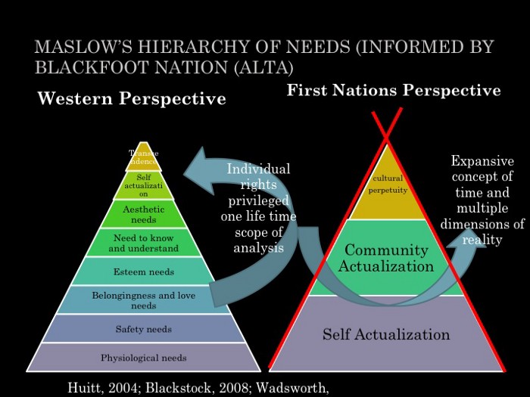
Build Inner Resiliency
Resiliency: our ability to bounce back from negative circumstances or events
Self-care increases emotional energy and self-attunement by building inner resiliency.

Slide 24
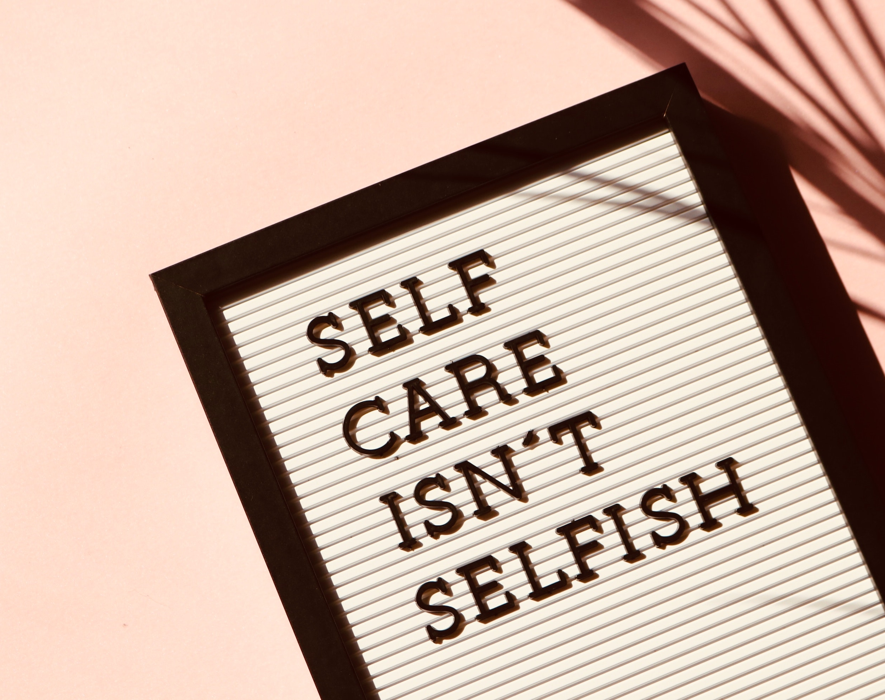
Everyday Self-Care
Prioritize a daily self-care routine.
Rest and self-care are rights that we all deserve.
Nothing is more important than your mental health.

Slide 25
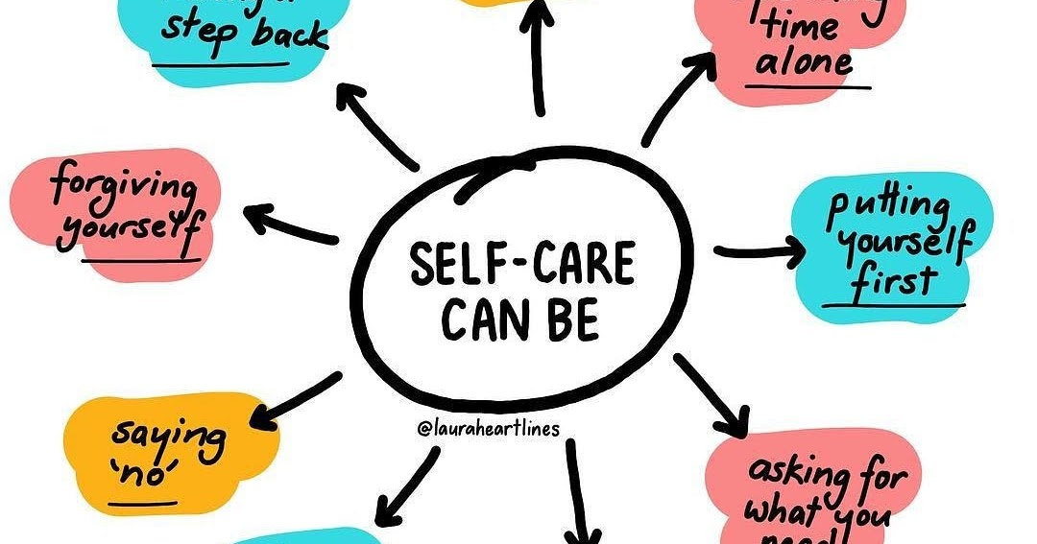

Slide 26
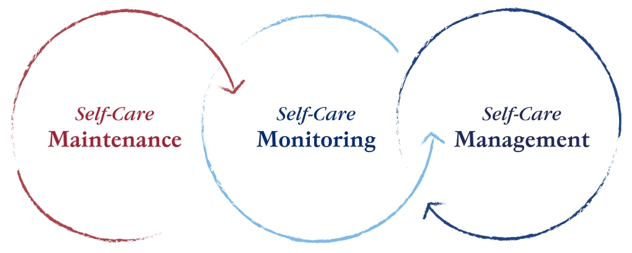
Everyday Self-Care
Reflection:
What are some examples of daily self-care routines?

Slide 27
Class Wrap Up…
Questions and Answers

Slide 28
Thank you for your attention and participation!
That’s all folks…
Keep OU Together and see you next time…

