Slide 1
UCOL 1523: GATEWAY TO BELONGING
Week 15 – November 29- December 3, 2021
CHAPTER 7 – Fostering Connection and
CHAPTER 8 – Everyday Belonging

Slide 2
Announcements
The Belonging Toolbox Open Book Online Test 2 …
is online, open book/notes, taken outside of class meetings.
will be posted on the Canvas course website, from 12:01am on Wed. (12/01/201) to 11:59pm on Thurs. (12/02/2021) of Week 15, see the instructor for details.
Has 50 multiple choice questions with unlimited attempts in 24 hours.
covers Chapters 5, 6, 7, & 8 from the Ackert’s Workbook.
is worth up to 50 points.

Slide 3
Announcements
Opportunities to complete the UCOL 1523 Student Experience Midterm Survey ended on Tuesday, 11/23/2021.
We did NOT reach our goal of an 85% student response rate.
All student responses play an important role in helping our faculty and staff evaluate and improve this course.
Thanks to those of you who provided comments, time, and participation!

Slide 4
Announcements
The Fall 2021 evaluation window for this course will be open from 12:00 AM on Monday, November 29th to 11:59 PM on Sunday, December 12th. The evaluation window will be open for 14 days. How does eValuate work? If you use Canvas, please add a link to http://eval.ou.edu on your home page.
All enrolled students will receive an instructional email from OU eValuate that provides a link to the eValuate website and the specific dates and times of the evaluation window.
Students will log on using their 4+4 and password to access their course evaluations.
It is not necessary to complete them all in one session.

Slide 5
Announcements
Can evaluations be completed in class? Yes! Students are encouraged to evaluate this course during class. Students can use their own laptops or other mobile devices to complete the evaluation form online and in class during a scheduled time.
The University is heavily promoting eValuate and is providing incentives to students who complete all of their evaluations.
Please review the New Guidelines for Administering OU's Course Evaluation memo for more information.

Slide 6
UCOL 1523: GATEWAY TO BELONGING
Week 15 – November 29- December 3, 2021
CHAPTER 7 – Fostering Connection

Slide 7
Chapter 7 (AW) Learning Objectives
Describe how exactly to cultivate a life conducive to fostering connection with others.
Explain why we need human relationships.
Discuss what benefits relationships bring to our lives.
Outline strategies for forming healthy, fulfilling relationships.
Identify the process for building connections with others.

Slide 8
Are Connections Important?
Connections are important for practical reasons
Humans survive and thrive being social creatures.
Connections are important for growth and development
Positive interactions help us become fully formed, healthy individuals.
Self-actualization through human relationships.

Slide 9
Are Connections Important?
Connections are important to function in this world
Having relationships teaches us basic skills.
Defines what makes a good friend, a bad partner, or
a trusted caretaker.
Connections are important to validate our experiences
Lessens feelings of loneliness.
Brings joy, adventure, unconditional love & support.
Normalizes and validates our thoughts, emotions, and experiences.

Slide 10
The Importance of Connection
“Our experience and connections with others, good and bad, allow us to learn and develop….[Our connections] educate and inform us on how to function…with other people.” (p. 114).

Slide 11
Making the Effort to Foster Connections with Other People
How to meet new people and build strong connections?
We need to make a conscious effort to create our relationships and follow these steps
Know Yourself
Interests
Likes & dislikes
Values
Find Your People
Volunteering
Social Media
Friendship Apps

Slide 12
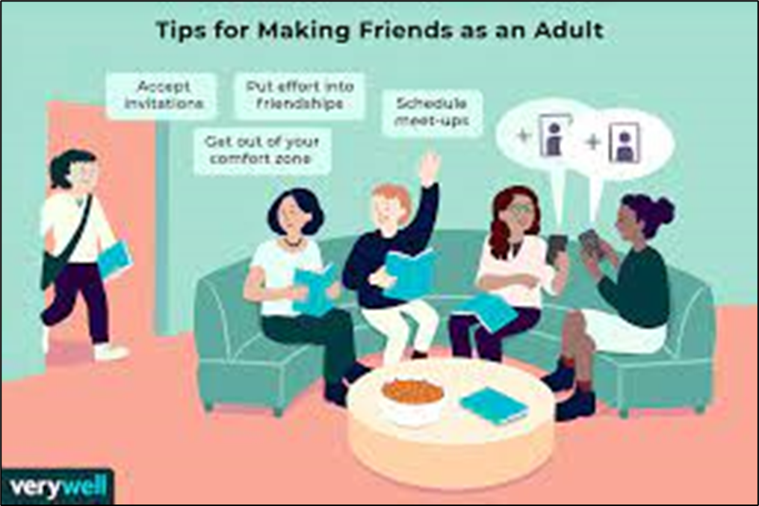
Making the Effort to Foster Connections with Other People
Building healthy, symbiotic relationships involves a process.
Start with surface-level connection and proceed inward
This step is necessary to build the foundation of connection and relationship.

Slide 13
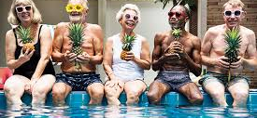
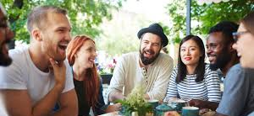
Making the Effort to Foster Connections with Other People…
Making friends as an adult involves making the effort to…
“Don’t be afraid to be yourself, quirks and all.” (Ackert 130).
Embrace awkwardness and be your authentic, real, genuine self.
Trust your gut & set the necessary boundaries,
Practice conversation skills.

Slide 14
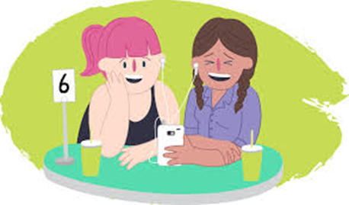
Making the Effort to Foster Connections with Other People
Building healthy, symbiotic relationships involves a process.
The more time we spend with the person, the more layers of our selves we peel back (self-discovery)
No forced connection & no artificial bridge.
Give & Take is mutual.
Requires persistence and effort to flourish.

Slide 15
Fostering Connections by Building Relationships Take Time…
Relationships are just like gardens:
We must tend to them and
cultivate a healthy environment
in order for them to grow.

Slide 16
If Connections with Others Fail..
Remember that we aren’t meant to connect with everybody.
When the effort is not reciprocated, it can feel very discouraging and trigger feelings of rejection.

Slide 17
If Connections with Others Fail…
What to do if this happens?
Keep in mind that the progression of a relationship cannot be forced.
You can open up room for different types of relationships
Brunch friends, work friends, casual friend, best friend & so on...

Slide 18
Making Everyday Connections with Other People
Why Know Yourself?
By having a secure sense of self and engaging in behavior that aligns with your true purpose, you can be confident in what you say and do and in who you are.
What hinders
connections?
Answer: Your FEAR…
Fear of rejection or judgement.
What can you do about it?
Be confident in your goals & values.
Understand who you are and what’s right for you.
Keep your sense of self & purpose secure.

Slide 19
Key Takeaways
As social beings, we need human relationships to survive and thrive.
Healthy relationships are built through patience and effort.
There are numerous in-person and online opportunities to build connections off campus and at OU.
Awareness of your own traits, behaviors and feelings and a sense of
self-worth are key to cultivating connection.

Slide 20
Class Wrap-up…
Questions and Answers

Slide 21
That’s all folks…
Thanks for your attention!
Stay Well…

Slide 22
UCOL 1523: GATEWAY TO BELONGING
Week 15 – November 29- December 3, 2022
CHAPTER 8 – Everyday Belonging

Slide 23
Chapter 8 (AW) Learning Objectives
Utilize the tools and concepts in the book to cultivate belonging
Put into use the following skills to foster a sense of belonging and improve connections with others:
Acceptance
Compassion
Positive thinking
Challenging negative thoughts
Self-care
Work towards building healthy relationship with others & ourselves

Slide 24
In this workbook, generally belonging…
“Belonging means being seen for your true self, accepted, and validated by another person or group for that self.” (p. 136)

Slide 25
The Concepts and Tools of Belonging…
Biggest obstacles to belonging:
Self-doubt, insecurity, or uncertainty about who we are (everyone has them)
The inability to express ourselves truthfully
Tools:
Compassion &
Self-care

Slide 26
How to practice self-care?
Challenge any negative views you hold about yourself and the world around you.
Practice gratitude.
Get out of your comfort zone; be open to difference and change.
Take concrete steps toward relationships and connection.
Acceptance is what underlies each of these practices. We can grow and foster connections only by embracing the uncomfortable and accepting ourselves, others, and our circumstances.

Slide 27
How to stay resilient?
Progress is not linear .
Setbacks, disappointments, fears, and worries are all natural
Meet yourself right where you are at.
Celebrate steps ahead and give yourself permission to feel negative & intrusive thoughts
Regularly practice the skills & tools in the book.

Slide 28
How can you tie all the concepts together to move forward?
Practice Introspection:
Observe and identify negative thinking patterns
Accept your shortcomings
Practice self compassion
Stay resilient

Slide 29
Communication Styles
Assertive communication
Firm, direct, clear, open, calm, nonjudgmental
Aggressive communication
Loud, demanding, controlling, criticizing, threatening
Passive communication
Soft-spoken/quiet, unconfident, prioritizes the needs of others
Passive aggressive communication
Indirect, powerless, stuck, resentful

Slide 30
You Belong…
It takes hard work and effort, but you have the ability to find your place in this world and find people who offer you love, support, and belonging.

Slide 31
How do you express your ideal self now vs. the start of the semester? What obstacles to belonging at OU do you encounter everyday?
Class Activity

Slide 32
Key Takeaways
The skills and concepts discussed in this book are essential for forming the foundation of belonging
Through regular practice, these skills create positive change in your life
Progress is not linear and demands patience, acceptance and compassion
There is a place for you here. You are important and you belong!

Slide 33
Class Wrap-up…
Questions and Answers

Slide 34
That’s all folks…
Thanks for your attention!
Stay Well…

