Slide 1
UCOL 1523: GATEWAY TO BELONGING
Week 6 – September 27-October 1, 2021
The Social Self
HEINZEN & GOODFRIEND CHAPTER 3

Slide 2
THE SOCIAL SELF LEARNING OBJECTIVES
MODULE 6.1: Think critically about how our self-perceptions and group affiliations influence how we think, feel, and behave.
MODULE 6.2: Explain how self-awareness and self-concept are defined.
MODULE 6.3: Describe the risks and rewards associated with positive self-illusions, moderate self-deceptions, and artificially boosting self esteem.

Slide 3
Think critically about how our self-perceptions and group affiliations influence how we think, feel, and behave.
LO M6.1

Slide 4
ACTUAL SELF
An individual’s current self-concept,
includes strengths + weaknesses.
Who we really are in the current moment, including things we appreciate and things we want to change.

Slide 5
IDEAL SELF
Who one wants to be in the future, including
maximized strengths and minimized weaknesses.
Who you imagine you will be in the future, when you imagine that you will be improved: the “new and better” you.

Slide 6
OUGHT SELF
Who one thinks others expect her/him/us to be.
This changes depending on the reference group.
What we believe others want us to be, such as our mother's desire that we become a classical musician.

Slide 7
ACTUAL, IDEAL, & OUGHT SELVES

Slide 8
THEORY & THE SOCIAL SELF
Four theories can help us to understand the Social Self:
Self-Perception Theory: Behaviors Tell Us Who We Are
Self-Discrepancy Theory: Our Goals Are Influenced By Others
Self-Expansion Theory: We Grow Through Our Relationships
Self-Presentation Theory: We Adapt to Fit Into the Situation
As we learn about each, think about what this looks like in your own life and self-concept.

Slide 9
SELF-PERCEPTION THEORY
The theory that individuals form their self-concept by observing their own behavior and trying to infer their own motivations, attitudes, values, and core traits.
Watching ourselves, as if we were on film, in order to determine how we feel and who we are; personally reflective observation.

Slide 10
SELF-DISCREPANCY
When a mismatch exists between an individual’s actual, ideal, and ought selves.
When our ideal self does not match our real self; the mismatch between what I think I should be at my "best" self, vs. what I really am.

Slide 11
SELF-EXPANSION THEORY
The idea that all humans have a basic motivation to grow, improve, and enhance our self-concept, specifically through close social relationships.
Our innate drive to grow, enhance ourselves, and change for the better, especially through our relationships.

Slide 12
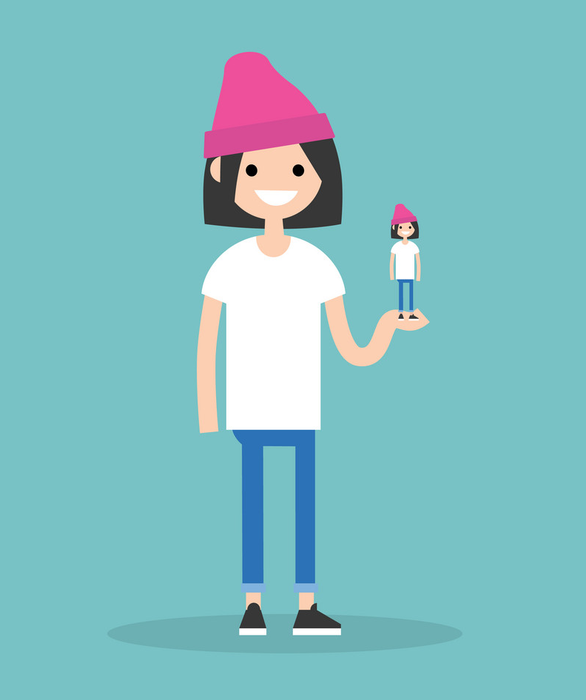
SELF-PRESENTATION THEORY
The idea that we present ourselves strategically to make an impression on others.
We are motivated to fit in and please our audience, because of our basic drives to be accepted in a social world.

Slide 13
Inclusion of the Other in the Self (IOS) scale
A scale used to measure psychological inclusion of others in the self-concept where people circle one of many pairs of circles with increasing overlap between “self” and “other” to indicate how much their self-concept includes a specified other person.
A self-report assessment of how much you include others in your definition of who you are.

Slide 14
Inclusion of the Other

Slide 15
SELF-MONITORING
Individuals’ ability to notice and adjust their own behavior in an attempt to fit in.
When wanting to be a part of the group, people notice how they differ, and evolve accordingly—like a chameleon. For example, we might change how we dress.

Slide 16
HOW DO WE KNOW THE SELF IS SOCIAL?
How much can you learn about yourself by observing your behaviors?
What can you learn about others by observing their behaviors?
Discuss
Inferences about others by observing their behaviors
Incorporate others’ observations about you into your self-concept

Slide 17
HOW DO WE KNOW THE SELF IS SOCIAL?
Do you think that you are a high or low self-monitor - and is that working well for you?

Slide 18
COLLECTIVE SELF-ESTEEM
Individuals’ evaluation of the worth of the social groups of which they are a member.
Our evaluation of the worth of the group we belong to, like how proud we are to be a member of a winning team's fan base.

Slide 19
COLLECTIVE SELF-ESTEEM
Groups Influence How We Feel About Ourselves
How we feel about our groups influences how we feel about ourselves.
You can experience collective self-esteem about the reputation of your college or university, religious and political affiliations, your nationality (for example during the Olympics), and more.
Think. Pair. Share.
Why does identifying with a sports team mean so much to so many people?
Notes:
Page 53 Our self-concept includes our group memberships (self-identity theory).

Slide 20
HOW DO WE KNOW THE SELF IS SOCIAL?
Self-perception theory proposes that we form our self-concept by observing our own behaviors, them make assumptions about our internal values, attitudes, and so on.
Think of at least two times when you realized something about your self-concept by observing your behaviors. Why did you not have this self-insight before you noticed your own behaviors?

Slide 21
HOW DO WE UNDERSTAND THE “SELF”?
Self-discrepancy theory suggests that instead of a single self, we all have three selves: actual self, ideal self, and the ought self. When these selves don’t match, we have negative emotional reactions.
Think about traits that make up your actual, ideal, and ought selves. How do you feel about traits that don’t match?

Slide 22
HOW DO WE UNDERSTAND THE “SELF”?
Self-expansion theory is the idea that we all want to grow and improve, and one way to do that is to cognitively include other people into our self-concept.
How do you cognitively include other people in your self-concept?

Slide 23
HOW DO WE UNDERSTAND THE “SELF”?
We can also change how we present our selves to others. This can happen through specific impression management techniques. People also vary in how much they monitor the social situation and adapt to it through their behaviors, an idea called self-monitoring.
Think about how that example of high self-monitoring worked out – was it entirely negative, entirely positive, or a mixture of both? Were you able to sustain that impression management over the long term?

Slide 24
Explain how self-awareness and self-concept are defined.
LO M6.2

Slide 25
HOW DO WE UNDERSTAND THE “SELF”?
How and when did you become aware of your “Self”?
Discuss
Self-awareness
Separate entity
Story we tell ourselves
It can change
Notes:
Using movie examples of page 41, students can discuss how the understand the “self” and how you become aware of the “self.”

Slide 26
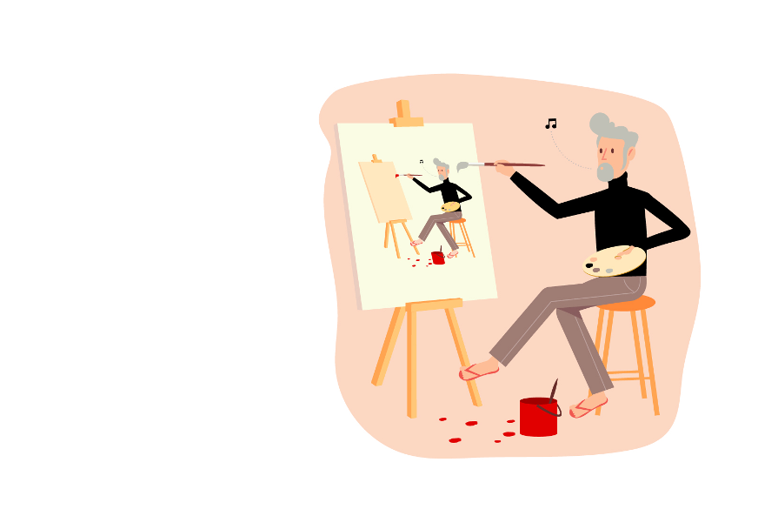
SELF-AWARENESS
Self-awareness is the understanding that we are a separate entity from other people and objects in our world.
When did you first realize you were separate from other people in your life?

Slide 27
MIRROR SELF-RECOGNITION TEST
A scientific paradigm where a mark is placed on an animal’s forehead and it is placed in front of a mirror. The animal is assumed to have self-recognition if it touches the mark on its forehead.

Slide 28
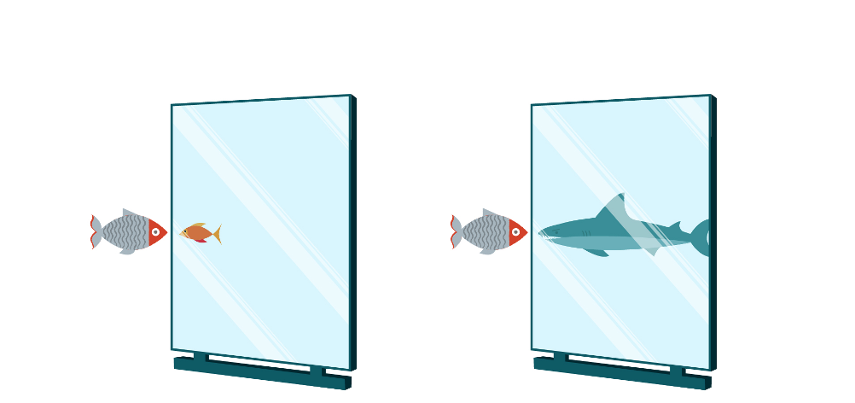
SELF-CONCEPT
The personal summary of who we believe we are, including our assessment of our positive and negative qualities, our relationships to others, and our beliefs and opinions.
“The self-concept is how we answer the question, “Who am I?” (p. 42)
Who we believe we are, and what people think of us, including the good and the bad.

Slide 29
HOW DO WE UNDERSTAND THE ”SELF”?
Self-concept is how we answer the question, “Who am I?” According to social psychologist, Henri Tajfel, self-concept is organized around a personal identity and a social identity.
Think about ways in which you perceive the world that you think might have been influenced by your regional, national, or specific social culture. How might your perceptions be different from the perceptions of people from different cultures?

Slide 30
SOCIAL COMPARISON THEORY
The use of social comparisons to construct the self-concept when no other objective standard is available.
When we have no other information, we use others as an example for how to evaluate ourselves.

Slide 31
UPWARD SOCIAL COMPARISON
When individuals compare themselves to someone who is better than they are, often to improve on a particular skill.
Evaluating our abilities/worth based on a superior individual's abilities.

Slide 32
DOWNWARD SOCIAL COMPARISON
When individuals compare themselves to someone who is worse than they are, often to help them feel better about themselves.
Evaluating our abilities/worth based on an inferior individual’s abilities, in order to possibly help us feel better about ourselves.

Slide 33
COMPARING THE SELF TO OTHERS
Notes:
Page 44
Who: We evaluate our abilities automatically by comparing ourselves to similar others.
Interpretation: How we interpret social comparisons influences our self-concept. Reminder: Self-concept (42) is the personal summary of who we are including our positive and negative qualities, relationships to others, group memberships, and beliefs. It’s how we answer the question, “Who am I?”
Direction: The direction of our social comparison influences our self-concept.
Esteem: Protecting our self-esteem influences our self-concept.

Slide 34
CRITICAL THINKING CHALLENGE
Identify three activities you enjoy doing such as sports, hobbies, and studying various subjects. Then, make one upward social comparison and one downward social comparison for each activity.
When you identified one person who was better than you and one person who wasn’t as advanced, what emotions resulted from each type of comparison?

Slide 35
HOW DO WE UNDERSTAND THE “SELF”?
Self-awareness is the understanding that we are a separate entity from other people and objects in our world.
How might this understanding impact our experience of feeling like we do not belong?

Slide 36
HOW DO WE UNDERSTAND THE “SELF”?
Our self-concept is the personal summary of who we believe we are, including both good and bad qualities. One way to know who we are is by comparing our self to those who are both better than us and worse than us.
Have you compared to yourself to others? What advantages are there to comparing yourself to to others? How might comparison to others be detrimental?

Slide 37
HOW DO WE UNDERSTAND THE “SELF”?
Social identity theory describes the self as a mixture of personal and social identities. An example of our social identity is from our culture; “Western” cultures tend to lead individualistic selves, whereas “Eastern” or Asian cultures often lead to collectivistic selves.
When have you interacted with someone who seemed to have a very different cultural perspective than you? How might your interaction have been affected by cultural assumptions or beliefs? In both good and challenging ways.

Slide 38
SOCIAL IDENTITY THEORY
The idea that individuals have an automatic tendency to categorize each other and to form ingroups and outgroups that validate their perceptions of themselves in flattering and useful ways.
Who we are personally vs. who we are socially; a definition of ourselves as an individual and as a member of a group.

Slide 39
INDEPENDENT SELF-CONSTRUAL
When an individual’s ideal self is largely based on internal, personal qualities.
Defining ourselves in terms of uniqueness--how we are different/special.

Slide 40
INTERDEPENDENT SELF-CONSTRUAL
When an individual’s ideal self is largely based on social qualities, especially relationships with others.
Defining ourselves in terms of belongingness; how we fit in and contribute to the needs of the group.

Slide 41
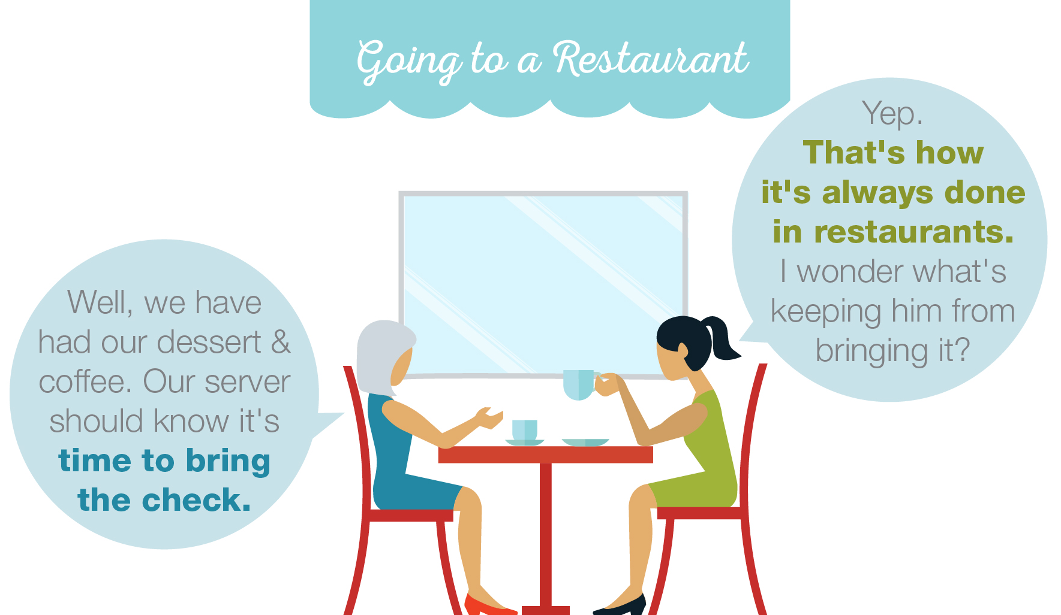
SCHEMA
A cognitive and memory structure for organizing the world.
Our organization of information about the world, such as how to behave and what to expect in a restaurant, from getting seated to paying the bill (i.e., a script).
A stereotype is another type of schema.

Slide 42
SELF
Individuals’ internal narrative about themselves.
Who I believe I am; how I would describe me.

Slide 43
GROUP MEMBERSHIPS AND CULTURE

Slide 44
GROUP MEMBERSHIPS AND CULTURE
TABLE 3.1 Some Examples of How Culture Affects Views of the Self
 | TO GUIDE GROUP BEHAVIOR | TO GET CHILDREN TO FINISH THEIR FOOD | TO IMPROVE WORKER PRODUCTIVITY
American culture recommends that… | …”the squeaky wheel gets the grease.” | …children think of the starving children in Ethiopia and how lucky they are to be American. | …workers stand in front of a mirror and repeat: “I am beautiful.”
Japanese culture recommends that… | …”the nail that stands up gets pounded down.” | …children think about the farmer who worked so hard to produce the rice for you and how disappointed they will be if it is not eaten. | …workers hold a coworker’s hand and repeat: “They are beautiful.”

Slide 45
Describe the risks and rewards associated with positive self-illusions, moderate self-deceptions, and artificially boosting self-esteem.
LO M6.3

Slide 46
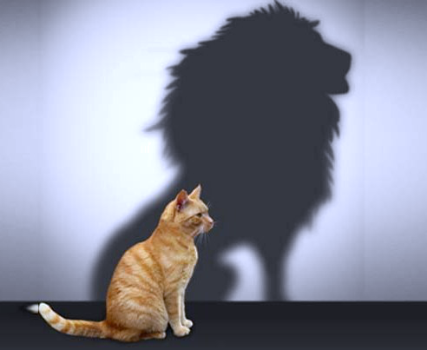
ARE WE HONEST ABOUT OURSELVES?
Sometimes, our view of our self isn’t quite accurate. But is that a bad thing?
Sometimes we lie to ourselves
Benefits of slight distortions of reality
Positive illusions
Detrimental self-deception

Slide 47
ARE WE HONEST ABOUT OURSELVES?
Impression management or social manipulation?
To be frank, impression management is social manipulation. Here are a few techniques:
ingratiation: behaviors intended to flatter and influence.
self-enhancement: statements about how your accomplishments are better or more frequent they actually are.
conspicuous consumption: displaying products specifically chose to show off how successful you are.

Slide 48
IMPRESSION MANAGEMENT/SELF-PRESENTATION THEORY
The tendency to adjust the self and perform in slightly different ways for varying others to gain social influence.
Performing in a way that will gain acceptance from an audience, and changing that performance depending on the audience.

Slide 49
OTHER-ENHANCEMENT
A short-term impression management tactic where people compliment another person and seem to admire them to increase liking and attraction and gain social influence.
Slathering compliments on others as a way to increase how much they accept you, like you, and are influenced by you

Slide 50
OPINION CONFORMITY
A short-term impression management tactic where people endorse the opinion of others to increase liking and attraction and gain social influence.
Temporarily endorsing the opinions of others in order to gain acceptance.

Slide 51
SELF-ENHANCEMENTS
The tendency to adjust the self and perform in slightly different ways for varying others to gain social influence.
Performing in a way that will gain acceptance from an audience, and changing that performance depending on the audience.

Slide 52
ENTITLEMENT
Taking credit for something in which you had little to no part.
A short-term impression management tactic where a person takes credit for positive events he or she was not a part of.

Slide 53
CONSPICUOUS CONSUMPTION
Publicly displaying the use of expensive products in an attempt to impress others.
Flaunting expensive items that you own.

Slide 54
SELF-INSIGHT
Individuals’ ability to self-observe and evaluate their own behavior.
The ability to acknowledge and reflect on how we think, act, and feel.

Slide 55
SELF-ESTEEM
Individuals’ subjective, personal evaluation of their self-concept, including judgments made about self-worth.
Our personal evaluation of our own worth.
Self-esteem is not:
Narcissism
Self-efficacy
Self-compassion

Slide 56
ARE WE HONEST ABOUT OURSELVES?
Self-esteem is out subjective evaluation of our self-concept. Optimal margin theory says slight distortions of reality (positive illusions) can improve psychological well-being.
Looking back on a time you had an elevated view of your own traits or talents, was it good or bad for you to maintain that illusion? How did it affect your in both positive and negative ways?

Slide 57
ARE WE HONEST ABOUT OURSELVES?
We engage in many forms of self-serving cognitive bias, such as believing that our positive traits are rare (while negative traits are common), taking credit for successes but not failures and only believing positive feedback about the self.
In what ways can this habit of self-deception be helpful? Harmful?

Slide 58
Class Wrap Up…
Questions and Answers

Slide 59
That’s all folks…
Thanks for your attention!
Stay Well…

