Slide 1
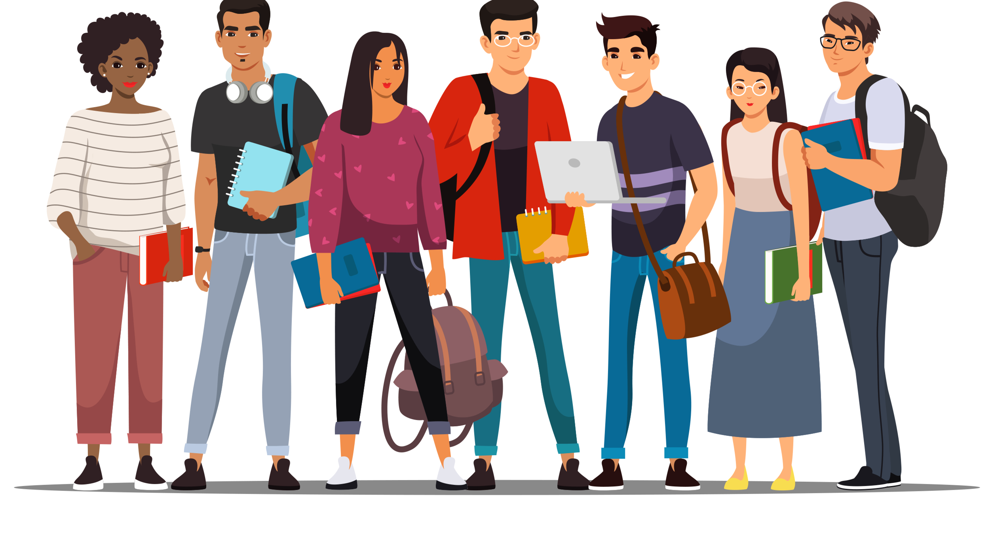
Week 12 – November 8 – 12, 2021
Aggression and Helping & Prosocial Behavior
HEINZEN & GOODFRIEND CHAPTER 11 & 10
UCOL 1523: GATEWAY TO BELONGING

Slide 2
ANNOUNCEMENTS
Assignment 2 – Group-Level Belonging in OK Assignment 2, Due 11/12/2021.
Exam 2 is Open Book Online, covering Stereotypes, Prejudice, Discrimination, Aggression, Helping, and Prosocial Behavior sections, is on 11/17/2021.
The Belonging Toolbox Open Book Online Test 2 on 12/01/2021
Exam 3 is Open Book. It will be available online from 8:00am on 12/13/2021 up to 4:00pm on 12/17/2021.

Slide 3
Work on Assignment 2 for 20 minutes

Slide 4
What is aggression?
Take 3 minutes to draw what aggression looks like, sounds like, and feels like.

Slide 5
Aggression
Behavior intended to harm others who do not wish to be harmed.

Slide 6
Typology 1: Aggression Content-Behavioral
Physical aggression: intentionally causing harm to someone’s body or property
Verbal aggression: relying on communication to cause harm
Relational aggression: harms others by damaging social networks or relationships with others

Slide 7
Typology 2: Forms of Aggression
Aggression can be enacted either actively or passively
Aggression can also be direct or indirect

Slide 8
Notes:
Aggression can be enacted either actively (punching someone in the nose) or passively (blocking someone’s path)
Aggression can also be direct (committing the act) or indirect (using others to commit the act or using negligence to commit it)

Slide 9
Typology 3: Aggressive Motivations
Hostile-reactive aggression: impulsive, emotion-based reaction that harms others
Instrumental-proactive aggression: thoughtful, reason-based decision to harm others
Both reactive responses are cultivated through habits of mind, as well as explicit and implicit attitudes

Slide 11
Typology 4: Microaggressions
Microaggressions: brief and “everyday” types of “verbal, behavioral, and environmental indignities… that communicate hostile, derogatory, or negative slights and insults.”
The result of subtle or covert prejudice and discrimination

Slide 13
General Aggression Model (GAM)
These (and other) typologies are integrated into a coherent understanding of aggression called the General Aggression Model (GAM). The GAM unites biological, social, and cognitive theories to explain aggression by recognizing that aggression is a developmental process.

Slide 15
Persistence of Aggression
Historical inertia contributes to continued aggressive behavior
Uninterrupted operation of prejudice and discrimination (especially institutional operations) reinforce aggressive behaviors
Single stories (stereotypes) reinforce aggressive behaviors at the individual and group levels (ex: Axis of Evil, sectarian violence)

Slide 16
Escalation of Aggression
The escalation of aggression effect is the tendency for aggression to spiral and increase in a situation

Slide 18
Why are humans aggressive?
In groups of 2-3, take 2 minutes to discuss why you believe humans are aggressive.

Slide 19
Week 12 – November 8 – 12, 2021
Aggression and Helping & Prosocial Behavior
HEINZEN & GOODFRIEND CHAPTER 11 & 10
UCOL 1523: GATEWAY TO BELONGING

Slide 20
ANNOUNCEMENTS
Assignment 2 – Group-Level Belonging in OK Assignment 2, Due 11/12/2021.
Exam 2 is Open Book Online, covering Stereotypes, Prejudice, Discrimination, Aggression, Helping, and Prosocial Behavior sections, is on 11/17/2021.
The Belonging Toolbox Open Book Online Test 2 on 12/01/2021
Exam 3 is Open Book. It will be available online from 8:00am on 12/13/2021 up to 4:00pm on 12/17/2021.

Slide 21
Objectives
Work on drafting Assignment 2
1
Review Monday’s lecture
2
Distinguish among biological, cultural, and situational explanation of human aggression
3
Discuss ideas for managing aggression
4

Slide 22
Work on Assignment 2 for 15 minutes

Slide 23
Kahoot! Review

Slide 24
Theories of Aggression
https://youtu.be/SNWW-pPmTsI

Slide 25
Which of the three theories of aggression do you believe is right?

Slide 26
Discussion board
In groups of 3-4, take 3 minutes to discuss possible biological, cultural, and situational influences on aggression (you can use the book). What are they and do you fully accept them as influences on aggression? Rank them in order of how likely you believe they influence aggression.

Slide 27
Influences on Aggression
Biological
Cultural
Situational
Notes:
Instinct, Low heart rates, Alcohol, Testosterone
Cultures of honor, Gender roles, Sports culture
War hysteria, copying role models, media violence, environmental cues

Slide 28
How can we manage or reduce aggression?
Catharsis hypothesis: releasing pressure will reduce aggression
Cultures can influence aggression in a positive or negative way; just as some cultures promote violence, other cultures discourage it and find alternative ways to solve problems
Modeling peacemaking and forgiveness has also successfully decreased aggression in observers
Peace journalism: focuses news reporting on the structural causes of conflict and the opportunities for conflict resolution

Slide 29
Situational Influence on Aggression
Some factors can foster aggressive behavior: cultural expectations, alcohol, availability of weapons, partisan or nationalist rhetoric
Some factors can diffuse aggressive behavior: group-to-group cooperation, collective examination of shared patterns of aggression, intentional cultivation of cultures of peace

Slide 30
Part II: Helping & Prosocial Behavior

Slide 31
ANNOUNCEMENTS
Assignment 2 – Group-Level Belonging in OK Assignment 2, Due 11/12/2021.
Exam 2 is Open Book Online, covering Stereotypes, Prejudice, Discrimination, Aggression, Helping, and Prosocial Behavior sections, is on 11/17/2021.
The Belonging Toolbox Open Book Online Test 2 on 12/01/2021
Exam 3 is Open Book. It will be available online from 8:00am on 12/13/2021 up to 4:00pm on 12/17/2021.

Slide 32
Objectives
Work on drafting assignment 2
Review Wednesday’s lecture
Investigate general motives for why helping behaviors occur
Discuss the connection between belonging and helping/prosocial behavior

Slide 33
Assignment 2
Work on Assignment 2 for 15 minutes

Slide 34
Review: Aggression
What are the three theories of aggression we discussed on Wednesday?
Whare are some of the influences on aggression?

Slide 35
Prosocial Behavior
AKA helping, or altruism
Any action performed to help others, either on an individual or group level

Slide 36
Types of Altruism
Pure Altruism
Actions motivated only by the desire to help, with zero expectation for any kind of reward
Egoistic Altruism
Helping behavior done with an expectation of some kind of personal or group benefit

Slide 37
Quick write
Think back to the last time you helped someone. Why did you decide to help? In general, what do you think motivates people to help each other?

Slide 38
Why Do People Decide to Help? Evolutionary Perspective
Life is easier if you have good neighbors.
Because there are shared benefits to being in groups, people within groups are motivated to be altruistic.
If you help someone they are more likely to help you in return.
We are more likely to help people in our kinship groups.
(This perspective assumes the egoistic rationale for prosocial behavior.)

Slide 39
Social exchange theory
The idea that people form dyads or larger groups because of mutually shared benefits

Slide 40
Kinship Selection
The evolutionary urge to favor those with close genetic relatedness

Slide 41
Hamilton’s inequality
(r x b)>c
A formula that predicts helping will occur when the benefits to ourselves or our genetic relatives outweigh the costs.

Slide 42
Why Do People Decide to Help? Social Norms
Social norms: unwritten rules about how members of a group are expected to behave
Belief in a just world suggests a cosmic yet practical sort of exchange. We help because we believe in the universe rewarding us.
(This approach assumes the egoistic rationale.)

Slide 43
Social responsibility norm
asserts that we each have a duty to improve our world by helping those in need.

Slide 44
Reciprocal Altruism
The expectation that our helpfulness right now will be “paid back” in the future

Slide 45
Why Do People Decide to Help? Negative State Relief
Our prosocial behavior decreases a variety of negative emotions, like guilt.
Helping can relieve our discomfort over seeing others suffering.
We can have negative emotions about ourselves if we don’t help, and we want to think well of ourselves.
(This approach assumes the egoistic rationale.)

Slide 46
Negative State Relief Model
The idea that seeing another person in need causes us emotional distress, and helping decreases those negative emotions.

Slide 47
Why Do People Decide to Help? Empathy-Altruism Hypothesis
People help out of the goodness of their hearts.
When we see people who need help, we empathize with them and feel compassion.
Egoistic (or self/group-serving) altruism can coexist with pure altruism.
(This approach assumes a pure altruism rationale)

Slide 49
In groups of 2-3, take 5 minutes to discuss whether you believe true altruism is possible.

Slide 50
Why Do People Decide to Help? “The War” 1994
How would you analyze this scene based on the theories we just discussed?
Which theory best describes Stephen’s decision to give the Lipnicky kids the cotton candy?
Is there another explanation these theories don’t consider?
https://youtu.be/UNG_ZjJsN9g

Slide 51
Discussion board
In groups of 3-4, find 2 examples of helping at OU on the OU Daily’s website. Summarize who was helped, what was done to help and why. Lastly, discuss how those examples could possibly contribute to a general sense of belonging at OU.

Slide 52
Wrap-up
The two theoretical reasons for helping are:
Pure altruism
Egoistic altruism
The egoistic explanations for prosocial behavior are:
The evolutionary perspective
Social norms
The negative state relief model
Helping/prosocial behavior can:
Lead to an increased sense of belonging at OU
Decrease aggression on campus

Slide 53
Any questions?

Slide 54
Coming up Week 13
How to Shift Your Mindset & Self-Care
Read pages 75 -110 and complete Belonging Toolbox exercises in Ackert’s Workbook (AW) on pp. 81, 82, 86, 87, 88, 103, 104,108, and 109 by 11/22/2021.

