Slide 1
UCOL 1523: GATEWAY TO BELONGING
Week 13 – November 15-19, 2021
CHAPTER 5 - SHIFT YOUR MINDSET and
CHAPTER 6 - WORK ON SELF-CARE

Slide 2
Announcements
Exam 2…
is online, open book/notes, taken outside of class meetings.
will be posted on the Canvas course website, in the Assignment section, on Wed. to Thurs. of Week 13, see the instructor for details.
Will be taken during the time window of 12:01am CT on Wednesday (11/17/2021) until 11:59pm CT on Thursday (11/18/2021).
covers Modules 9, 11, & 12 from the Heinzen & Goodfriend text.
is worth up to 75 points.

Slide 3
Announcements
For Exam 2, students…
will select and answer only 3 questions (worth 25 point each) from the list of 5 questions provided.
should answer each question in approximately 250 words.
should identify which question goes with which of their answers being provided, plus complete the cover sheet for the final document.
should save the final document as a WORD or PDF only, no other formats will be accepted.
upload and submit the final document as directed and before the deadline.

Slide 4
Announcements
UCOL 1523 Student Experience Midterm Survey…Thanks for your participation!
The student experience survey plays an important role in helping our faculty and staff evaluate and improve this course.
This is a new course and we want to know how it’s going for you. Your responses on the short, online survey will provide valuable input into how this course evolves for the remainder of this semester and for future semesters.
Please note: Your evaluations and comments are NOT connected to your login information. The ANONYMOUS evaluation data will not be distributed at the section levels.

Slide 5
Announcements
UCOL 1523 Student Experience Midterm Survey…
We are offering you class time to complete the online survey on your phone, tablet, or laptop. Your faculty instructor will let you know how best to access the survey. Opportunities to complete the survey end on Tuesday, 11/23/2021.
In exchange for your time, we are offering extra credit (amount to be determined) if we receive a student response rate of 85%. If we reach our minimum goal, then everyone gets extra points (TBD) added to their final points.
Thanks for your comments, time, and participation!

Slide 6
UCOL 1523: GATEWAY TO BELONGING
Week 13 – November 15-19, 2021
CHAPTER 5 - SHIFT YOUR MINDSET

Slide 7
Chapter 5 (AW) Learning Objectives
Learn how to foster a growth mindset.
Understand how a growth mindset can help us move forward to be the best version of ourselves.
Consider how a growth-oriented mindset is linked to belonging.

Slide 8
What is a Mindset?
“A mindset is a basic structure of beliefs, viewpoints, and assumptions around which we structure out thoughts and behavior” (p. 76).
There are two main types of mindsets: fixed and growth-oriented.

Slide 9
Fixed vs. Growth Mindset
In groups of 3-4, take 5 minutes to discuss how would you differentiate between fixed and growth mindset. Think of an example for each.

Slide 10
Discussion Board
In your groups, take 7 minutes to find 3 key/noteworthy pieces of information from the chapter and come up with 2 examples of how mindsets relate to college.

Slide 11
Discussion Board
What did you find?
What examples did you come up with?

Slide 12
Notes:
Fixed Mindset Vs. Growth Mindset Video 3:32 length
https://youtu.be/Xv2ar6AKvGc

Slide 13
What are some characteristics of a fixed mindset?

Slide 14
Fixed Mindset
Rigid
Holds firm to beliefs and assumptions
Open-mindedness is seen as a threat
Differences in thought and opinion raise red flags

Slide 15
What are some characteristics of a growth mindset?

Slide 16
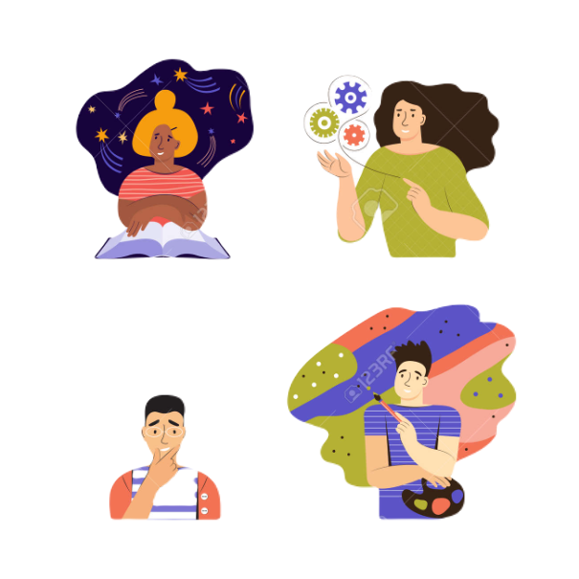
Growth Mindset
Flexible
Open to other opinions
Face rather avoid challenges
Always evolving into the best versions of ourselves

Slide 17
Fixed versus Growth Mindset
Fixed
Growth
Can be more difficult than compassion towards others
Set healthy boundaries
Try talking to yourself like you would your friend
You are always deserving of compassion!
Can be more difficult for unfriendly people
Offer a shoulder to cry on
Challenge your automatic thoughts about others
Everyone is deserving of compassion!

Slide 18
Belonging Toolbox: Thought Ranking
The objective of this exercise is to examine the thoughts that make up your mindset and to determine how you’re responding to those beliefs.
THOUGHT | BELIEF 0% to 100% | IDENTIFIED EMOTIONS | EMOTIONAL INTENSITY, 0% TO 100%
I am not good at my job. | 20% | Sad, discouraged, hopeless, feeling like a failure | 45%
My friends are just pretending to like me. | 10% | Lonely, worthless, insecure | 35%
Notes:
Page 81

Slide 19
How Growth Mindset Increases Belonging
When it comes to belonging, having a fixed mindset is not to our benefit.
To get the most out of our relationships and to find true belonging, we must allow ourselves to grow, to challenge those tired beliefs that keep us comfy, and to expand our mindsets beyond what is immediately in front of us.
Notes:
Page 85

Slide 20
Dealing with a Fixed Mindset
“To get the most our of our relationships and to find true belonging, we must allow ourselves to grow, to challenge those tired beliefs that keep us comfy, and to expand our mindsets beyond what is immediately in front of us” (p. 85).
In your groups, take 5 minutes to discuss some ways that you can challenge a fixed mindset.
Notes:
Page 85

Slide 21
Dealing with a Fixed Mindset
Notes:
Page 85

Slide 22
Belonging Toolbox: Challenging Our Inner Critic
The Socratic method is a way of politely arguing or challenging someone by asking questions. It is meant to challenge belief systems and to encourage critical thinking.
Step 1: Draw your Brain Gremlin – the little voice inside our minds that whispers all kinds of self-defeating nothings in our ears.
Name _______________________
Favorite saying _______________
Greatest fear ________________
Notes:
Page 86

Slide 23
Belonging Toolbox: Challenging Our Inner Critic
The second step is understanding that thoughts do not equal facts. Thoughts are simply words in our heads, and when we put stock in them and allow them to structure out mindset, they become beliefs.
Step 2: Using the Socratic method, write down some phrases that can challenge your Brain Gremlin. Some examples:
Would I say this to someone I care about?
Where is the evidence that this thought is true?
Is my evidence biased or reliable?
How would I feel if someone said this to me in person?
Whare are some alternative ways I could think about this?
Notes:
Page 86

Slide 24
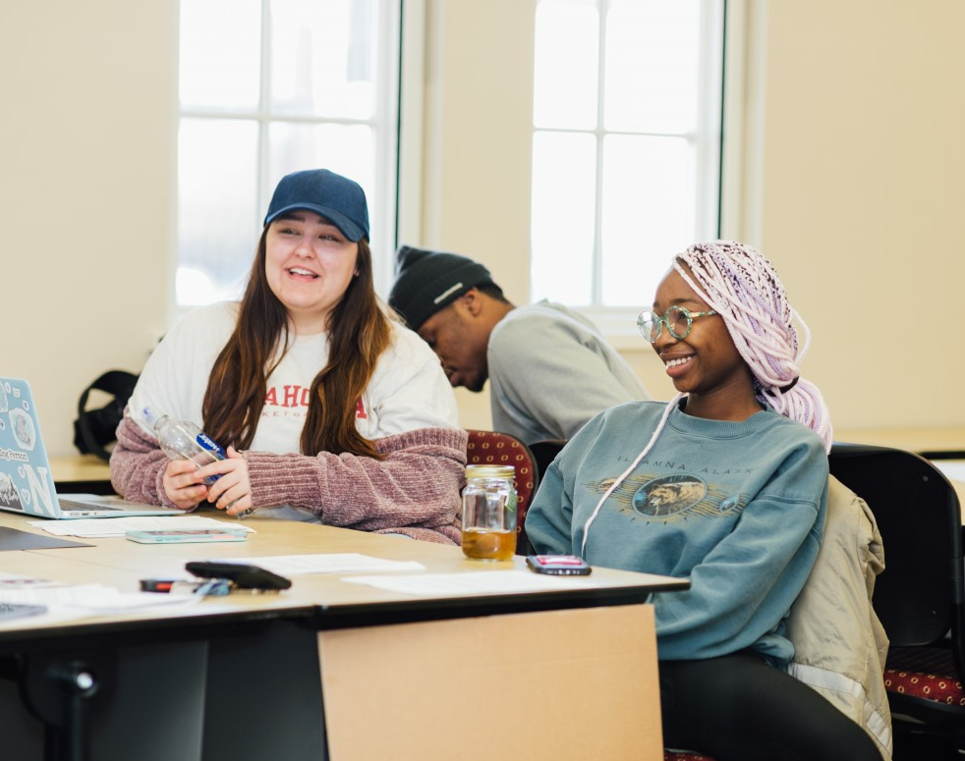
How can curiosity help you practice a growth mindset at OU? What words can you begin to eliminate from your vocabulary to foster a growth mindset?
Practicing Growth Mindset at OU
Notes:
Page 89 – Curiosity
Page 90-91 – Language and word choice

Slide 25
There are many ways to practice growth mindset on campus. Some examples include: Attend a meeting for a new organization Attend a “new to you” event - play/ballet or sporting event – BONUS: Invite a new friend to attend For one day, avoid using words like: “can’t” and “should” especially when learning new concepts in your classes
Opportunities to Practice
Growth Mindset at OU

Slide 26
Key Takeaways
A growth mindset is one in which we are flexible and open to embracing challenges that bring change.
A fixed mindset is a rigid way of thinking that keeps us stagnant and does not foster growth.
We can develop a growth mindset by challenging unhealthy beliefs or thought patterns and by using growth-centric language.
A growth mindset can help us genuinely connect better with others and accept ourselves more fully.

Slide 27
Chapter Wrap-up…
Questions and Answers

Slide 28
UCOL 1523: GATEWAY TO BELONGING
Week 13 – November 15-19, 2021
CHAPTER 6 - WORK ON SELF-CARE

Slide 29
Review (3-5 mins)
What is a mindset?
What are two types of mindsets?
What are some characteristics of the two?
How can overcoming a fixed mindset help you in college?

Slide 30
Chapter 6 (AW) Learning Objectives
Learn what self-care is and why it’s important.
Examine how to build a self-care routine.
Learn how self-care helps us build better connections with others.

Slide 31
Think-Pair-Share (10 mins)
Take 2 minutes to think (write) about self-care. What is it? What does it look like? Why does it matter? How can being good at it help you at OU?
Next, get into groups of 3/4 and take 3 minutes to discuss what you’ve thought.
Finally, share what’ve you’ve discussed with the class (5 mins).

Slide 32
What is Self-Care?
Self-care is anything that recharges our emotional battery.
Life can be draining, so the purpose of self-care is to regain the the energy we lose as we go about our daily life.
Can be physical, intellectual, emotional, and spiritual.

Slide 33
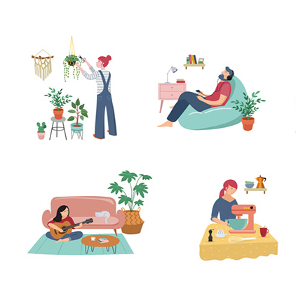
Self-Care… Beyond the Bubble Bath
What are some ways that you care for yourself?

Slide 34
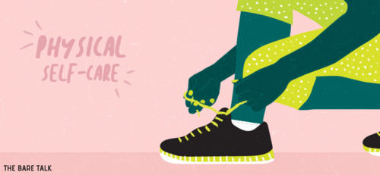
Physical Self-Care
Anything that exists in the physical realm of our being.
This could look like:
physical movement
quality sleep
tending to our finances
getting a haircut
healthy relationship with food
keeping a clean living environment
What’s one physical self-care action that could benefit you?
Notes:
Page 96

Slide 35
Intellectual Self-Care
Anything that stimulates our mind.
This could look like:
reading a good book
watching a documentary
being creative
What are some challenges of intellectual self-care for college students?
Notes:
Page 96

Slide 36
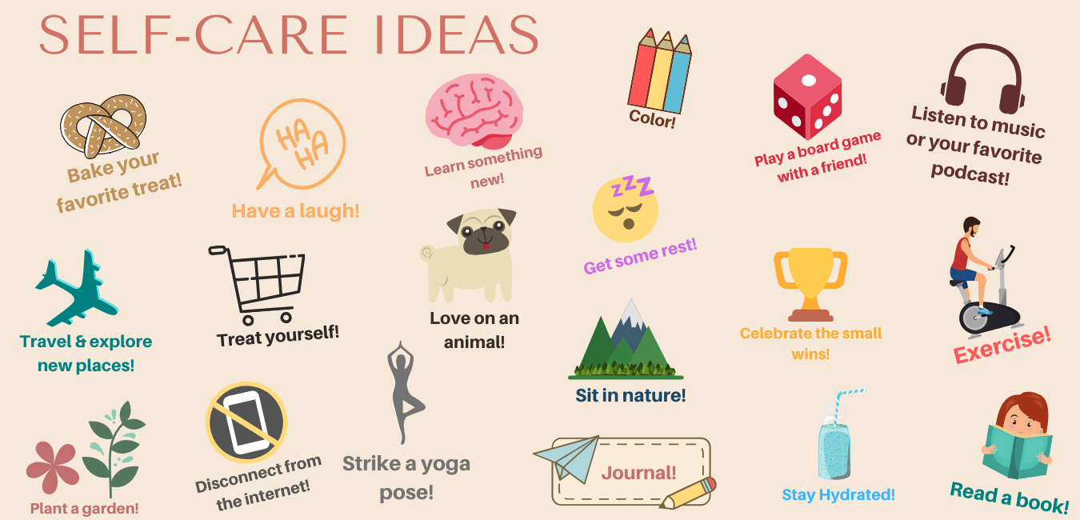
Emotional Self-Care
This is the broadest category and can overlap with other areas.
This could look like:
going to therapy
taking a bubble bath
spending time with friends
What are ways you could engage in emotional self-care?
Notes:
Page 96

Slide 37
Spiritual Self-Care
Often, the most neglected form of self-care. Focuses on on those things that are bigger than what is in our line of visions; transcends our mind and body and focuses on our spirit.
This could look like:
attending services at a place of worship
yoga, meditation, mindfulness
connect with nature
volunteering/connecting with people
How are you incorporating spiritual self-care into your life?
Notes:
Page 97

Slide 38
Why Self-Care Matters
more than giving ourselves a break
care for ourselves the way we care for others
value our own unique needs
avoid meltdowns
we take better care of those around us
Notes:
Page 97-98

Slide 39
Build Inner Resiliency
Resiliency is our ability to bounce back from negative circumstances or events.
Maslow’s hierarchy of needs can help us understand how self-care can help build resiliency.
Focus on what we can control.
Set appropriate and healthy boundaries on “energy withdrawals.”
How would you rate your inner resiliency?
Notes:
Page 101-102

Slide 40
Inner Resiliency and Maslow’s Hierarchy of Needs
We are at our most resilient when our needs are being met.
Which areas could use some attention in your life?
How might you meet those needs?
Notes:
Page 101-102

Slide 41
Belonging Toolbox: Emotional Energy Bank Account
Think about the things in your life that are withdrawals and those that are deposits.
Consider who much each of those withdrawals and deposits are worth.
WITHDRAWALS | DEPOSITS
Example: Having to clean my cat’s litter boxes $5 | Example: Meditating once in the morning and once at night $25
Notes:
Page 102 – “This exercise is to challenge you to think critically about what in your life drains you, what energized you, and where you might need to build better boundaries to control your spending.”

Slide 42
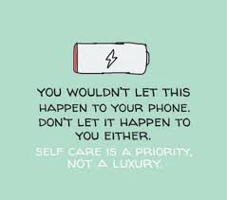
Everyday Self-Care
Many people say, “I don’t have time for self-care.”
Because of our fast-paced world, we believe that we must be doing and producing all.the.time!
Change your priorities!
Rest and self-care is right.
Some things can wait.
Nothing is more important than your mental health.
Notes:
Page 105

Slide 43
Belonging Toolbox: Self-Care Assessment
Think about the self-care practices that you have already established in your life.
Brainstorm self-care activities you could begin practicing.
Break down into: physical, intellectual, emotional, spiritual.
Write it all down! You never know what forms of self-care will work for you until you try them!
 | Physical | Intellectual | Emotional | Spiritual
Already Doing
Will Try
Notes:
Page 108

Slide 44
Practicing Self-Care at OU
Sometimes practicing self-care is what we “don’t do.” Think about how often you check emails and Canvas, or “doom scroll” on social media.
How can you set healthy boundaries with technology?
Notes:
Page 107

Slide 45
There are many ways to practice self-care on campus. Some examples include: Visit Goddard Health Services to take care of any health needs Visit with a therapist at University Counseling Services or attend a Group Counseling Session Take a walk around campus alone or with a friend Check out a new book at Bizzell Library Be crafty! Make something new in the Creativity Lab or 3D printer in Bizzell Library, Start Bullet Journaling
Opportunities to Practice Self-Care at OU
Notes:
Great Bullet Journaling post on the OU website” https://www.ou.edu/content/dam/goddard/documents/blog-posts/BuJo%20by%20Amy.pdf

Slide 46
Key Takeaways
Self-care is a way to build up emotional energy and resiliency, both of which can help bounce back more quickly and more effectively from adversity.
Self-care is best when it is consistent and tailored to our unique needs.
Personal attunement is necessary to help us understand our needs better and engage in more pointed self-care.
Self-care can help us build better relationships with ourselves and others.
Notes:
Page 110

Slide 47
Chapter Wrap Up…
Questions and Answers

Slide 48
That’s all folks…
Thanks for your attention!
Stay Well…

