Slide 1
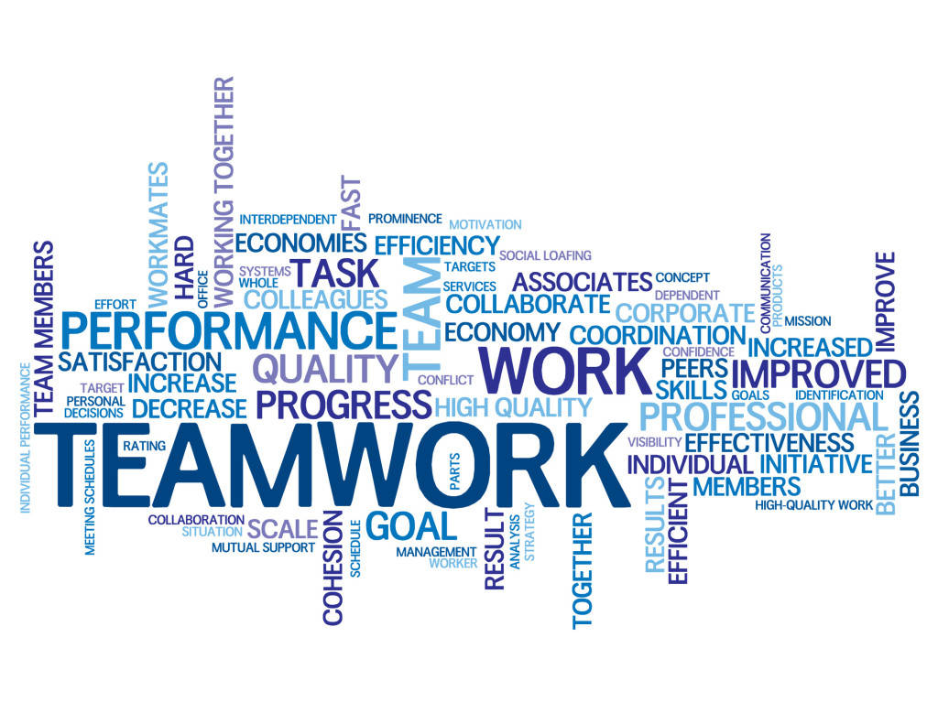
The Five Dysfunctions of a Team Lencioni

Slide 2
The Five Dysfunctions of a Team
Discuss the story:
Organizational/team context
Kathryn’s vision
Personnel challenges
Resolution
Model

Slide 3
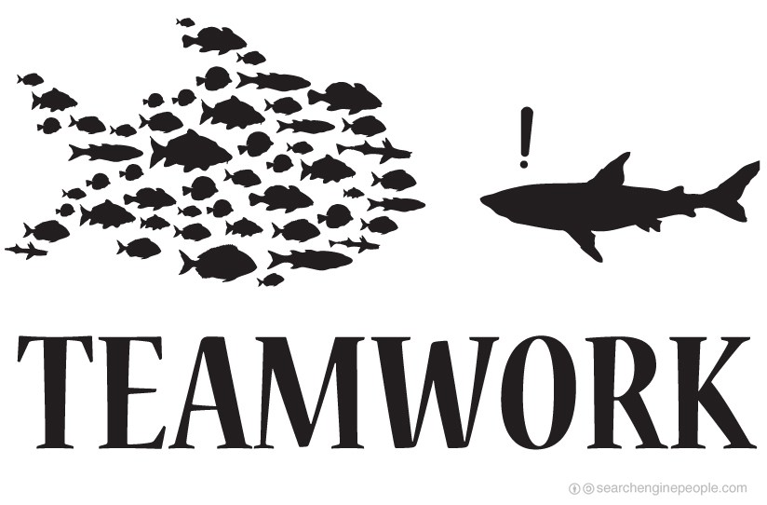
The Five Dysfunctions of a Team
“Not finance. Not strategy. Not technology. It is teamwork that remains the ultimate competitive advantage, both because it is so powerful and so rare.”

Slide 4
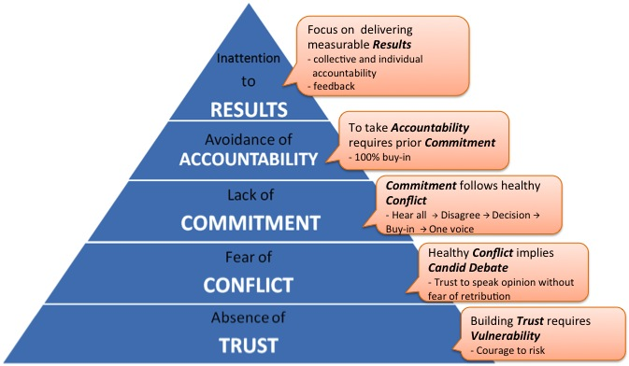
The Model

Slide 5
DecisionTech, Inc.
Kathryn Petersen – New CEO
Jeff Shanley – Business Development (past CEO)
Mikey (Michele) Bebe – Marketing
Martin Gilmore – Chief Technologist
JR Rawlins – Sales
Carlos Amador – Customer Support
Jan Mersino – CFO
Nick Farrell – COO

Slide 6
Trust
Being vulnerable within my team AND knowing I won’t be punished for it
Beyond predicting another’s behavior
Develop your ‘at work’ vulnerability
A healthy separation of work and personal life
In teams, called Psychological Safety
Difficult to build, not easy to maintain, but HUGE results are possible with it!
Two teams on Everest 1996 (Scott Fischer, Rob Hall)

Slide 7
Trust
Great leaders model vulnerability first AND fearlessly support it in others
Suggestions:
Personal histories
Team effectiveness exercise
Personality and behavioral preference profiles
360-Degree feedback
Experiential team exercises

Slide 8
Conflict
“All great relationships, the ones that last over time, require productive conflict in order to grow.”
Task conflict vs. relationship conflict
Why is conflict such a taboo?
Nature and nurture, in the eye of the beholder
“Healthy conflict is actually a time saver”
Great leaders model it and restrain from stifling it
Suggestions:
Acknowledge its value, and that most ITOs avoid it
Mining, Real-time permission, Other tools

Slide 9
Team Performance as a Function of Task Conflict and Psych Safety
Taken from Bradley, et al (2012) Reaping the benefits of conflict in teams: The critical role of team psychological safety climate. Journal of Applied Psychology. 97, 151-158.

Slide 10
Commitment
“Reasonable human beings do not need to get their way in order to support a decision, but only need to know that their opinions have been heard and considered.”
Why does psych safety and task conflict lead to the best performance?
All good ideas come out, are vetted, best chosen
Clarity and Buy-in ➔ Commitment
Desire for Consensus & Certainty ➔ lack of it

Slide 11
Commitment
Great leaders are comfortable with the fact that their decisions might turn out to be wrong
Suggestions:
Cascading messaging
Deadlines
Contingency & worst-case scenario analysis
Low-risk exposure therapy

Slide 12
Accountability
“The willingness of team members to call their peers on performance or behaviors that might hurt the team.”
Healthy ‘peer pressure’
Concertive control vs. bureaucratic control
Barker (1993, Administrative Science Quarterly)
Difference between content and delivery
“The Anatomy of Peace” (2008, Arbinger Institute)

Slide 13
Accountability
Great leaders encourage the team to serve as the primary accountability mechanism
Suggestions:
Publication of goals and standards
Specify who, what, when, how
Simple and regular progress reviews
Team rewards
If you fail, I don’t get the reward either
Motivates accountability!

Slide 14
Results
“The ultimate dysfunction of a team is the tendency of members to care about something other than the collective goals of the group.”
Team status, Individual status, Efficiency, Satisficing
Great leaders set the tone for a focus on results
Suggestions:
Public declarations of results
Results-based rewards

Slide 15
Results
“Teamwork ultimately comes down to practicing a small set of principles over a long period of time. Success is not a matter of mastering subtle, sophisticated theory, but rather of embracing common sense with uncommon levels of discipline and persistence.”

Slide 16
Persistence
“Noting in the world can take the place of perseverance. Talent will not; nothing is more common than unsuccessful men with talent. Genius will not; unrewarded genius is almost a proverb. Education will not; the world is full of educated derelicts. Persistence and determination alone are omnipotent.”
Calvin Coolidge

