Slide 1
INTRODUCTION TO BUSINESS INTELLIGENCE BIA 3713 Week 4
Naveen Kumar

Slide 2
Agenda
Know your Data
Descriptive Analytics
Hands on Practice with Graphical Summary Measures
Numerical Summary Measures and Business Applications
Discussion (Reading Materials)
Summary and Conclusion

Slide 3
Types of Analytics
Analytics
Predictive Analytics
Prescriptive Analytics
Inferential Analytics/
Statistics
Descriptive Analytics
Numerical Techniques
Graphical Techniques (histograms, bar charts, pie charts, etc.)

Slide 4
Descriptive Analytics
Arranging, summarizing, and presenting data in a convenient and informative way
Simple, yet powerful techniques for uncovering patterns that offer insights
Examples:
Determining the sales performance in different regions of a company
Categorizing customers by their likely product preferences
Identifying the performance of the call center teams in different locations etc.
Monitoring Covid-19 trends

Slide 5
Descriptive Analytics
Graphical Techniques
Presents data in ways that make it easy to extract useful information
Numerical Techniques
To summarize data

Slide 6
Analytics: Graphical Techniques
Analytics
Predictive Analytics
Prescriptive Analytics
Inferential Analytics/
Statistics
Descriptive Analytics
Numerical Techniques
Graphical Techniques

Slide 7
Graphical Techniques
Presents data in ways that make it easy to extract useful information
Objectives
Understand and use appropriate graphical methods suitable for a given set of data
Transform raw data into information through graphical display using prominent graphical methods
Describe the relationship between two variables

Slide 8
Categorical Data: Nominal
Typically, the permissible calculation on nominal data is to count the frequency of each value or variable
Can be visualized with bar graph or pie chart

Slide 9
Graphical Measures: Interval Data
Histogram
To graphically describe interval data
Construct a frequency distribution from which a histogram can be drawn
Create sets of intervals (called bins) that cover the complete range of observations and count the number of observations that fall into each set

Slide 10
Histogram Shapes
Symmetric: draw a vertical line down the center of the histogram and the sides should be identical in shape and size
Skewed: a long tail extending either to the right or left
Modality: A unimodal histogram has a single peak, while a bimodal histogram has two peaks
Bell shaped: a special type of symmetric unimodal histogram is one that is bell shaped
Many analytical techniques require that the population be bell shaped
Drawing the histogram helps to verify the shape of the distribution of a variable in a population

Slide 11
Histogram Shapes
Bell-shaped: A bell-shaped usually presents a normal distribution (symmetric unimodal)
Bimodal: A bimodal shape has two peaks. This shape may show that the data has come from two different systems. If this shape occurs, the two sources should be separated and analyzed separately.
Skewed Right: A distribution skewed to the right is said to be positively skewed.
Skewed Left: A distribution skewed to the left is said to be negatively skewed.

Slide 12
Bar Chart vs Histogram
Difference between a Bar Chart and Histogram?
Histograms do not have gaps between adjacent columns because columns represent continuous, quantitative data

Slide 13
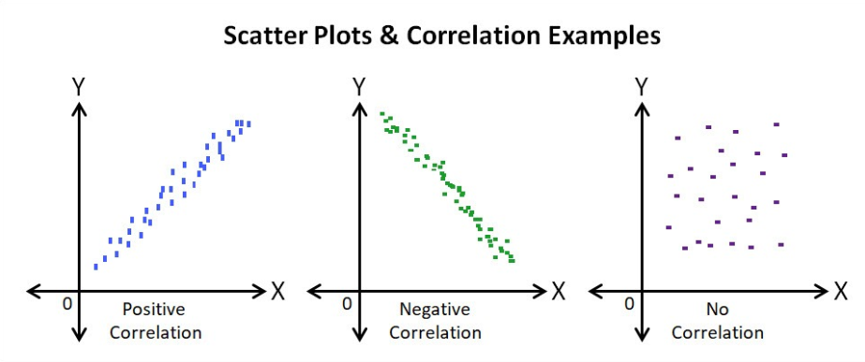
Relationship Between Two Variables
Scatter Diagram
Plot two continuous variables against one another
Independent variable is labeled X: plotted on the horizontal axis
Dependent variable is labeled Y: plotted on the vertical axis
We are interested in the linearity and direction of the scatter
Perfect positive linear relationship
Perfect negative linear relationship
No linear relationship

Slide 14
Histogram
Class Interval Widths (General Guidelines)
Number of Observations Number of Classes
Less than 50 5–7
50–200 7–9
200–500 9–10
500–1,000 10–11
1,000–5,000 11–13
5,000–50,000 13–17
More than 50,000 17–20

Slide 15
Practice Exercise
A student enrolled in a business intelligence program is attending the first class of the required statistics course. The student is somewhat apprehensive because he believes the myth that the course is difficult. To alleviate his anxiety the student asks the professor about last year’s scores. The professor provides a list of the final scores, which is composed of term work plus the final exam. What information can the student obtain from the list?

Slide 16
Practice Exercise
As part of a larger study, a long-distance company wanted to acquire information about the monthly bills of new subscribers in the first month after signing with the company. The company’s marketing manager conducted a survey of 200 new residential subscribers and recorded the first month’s bills. He planned to present his findings to senior executives. What information can be extracted from these data?

Slide 17
Practice Exercise
The marketing manager of a major brewery wanted to analyze the light beer sales among college and university students who do drink light beer. A random sample of 285 graduating students was asked to report which of the following is their favorite light beer:
1= Bud Light, 2 = Busch Light, 3 = Coors Light, 4 = Michelob Light, 5 = Miller Lite, 6 = Natural Light, 7 = Other brands
Construct a frequency and relative frequency distribution for these data and graphically summarize the data by producing a bar chart and a pie chart.

Slide 18
Practice Exercise
A real estate agent wanted to know to what extent the selling price of a home is related to its size. To acquire this information, he took a sample of 12 homes that had recently sold, recording the price in thousands of dollars and the size in hundreds of square feet. Use a graphical technique to describe the relationship between size and price.

Slide 19
Numerical Techniques

Slide 20
Measures of Central Location
Mean (Average)
Sum all observations and divide by the number of observations
Appropriate for describing measured data e.g. height, test scores, etc.
Sensitive to extreme values (outliers)
Example: When a billionaire moves into a neighborhood, the average household income increases beyond what it was previously
Median
Sort the data in order and find the value of the middle observation
In case of an even number of observations, find the mean of the two middle values
Not sensitive to outliers

Slide 22
Histogram: Outliers and Skewness
Outliers in data will cause a histogram to be skewed
Mean = Median = Mode results in a normal distribution with no skewness
Mean > Median, will skew the histogram to the right – positively or “Right” skewed (long tail points right)
Mean < Median, will skew the histogram to the left – negatively or “Left” skewed (long tail points left)
Mean > Median
Mean < Median

Slide 23
Measures of Central Location
Mode
Most frequent data observation
A set of data may have more than one mode
For large datasets, finding a modal class is much more relevant than a single-value mode

Slide 24
Measures of Central Location
Which of the three measures should we choose?
The mean is usually our first selection. However, there are instances when the median is better
The mode is seldom the best measure of central location
Median has an advantage in not being sensitive to outliers
Variable | Best Measure of Central Location
Nominal | Mode
Ordinal | Median
Interval (not skewed) | Mean
Interval (skewed) | Median

Slide 25
Summary and Questions

