Slide 1
INTRODUCTION TO BUSINESS INTELLIGENCE BIA 3713 Week 5
Naveen Kumar

Slide 2
Agenda
Know your Data
Descriptive Analytics
Numerical Summary Measures and Business Applications
Discussion (Reading Materials)
Summary and Conclusion

Slide 3
Types of Analytics
Analytics
Predictive Analytics
Prescriptive Analytics
Inferential Analytics/
Statistics
Descriptive Analytics
Numerical Techniques
Graphical Techniques (histograms, bar charts, pie charts, etc.)

Slide 4
Descriptive Analytics
Arranging, summarizing, and presenting data in a convenient and informative way
Simple, yet powerful techniques for uncovering patterns that offer insights
Examples:
Determining the sales performance in different regions of a company
Categorizing customers by their likely product preferences
Identifying the performance of the call center teams in different locations etc.
Monitoring Covid-19 trends

Slide 5
Descriptive Analytics
Graphical Techniques
Presents data in ways that make it easy to extract useful information
Numerical Techniques
To summarize data

Slide 6
Analytics: Graphical Techniques
Analytics
Predictive Analytics
Prescriptive Analytics
Inferential Analytics/
Statistics
Descriptive Analytics
Numerical Techniques
Graphical Techniques

Slide 7
Numerical Techniques

Slide 8
Measures of Central Location
Mean (Average)
Sum all observations and divide by the number of observations
Appropriate for describing measured data e.g. height, test scores, etc.
Sensitive to extreme values (outliers)
Example: When a billionaire moves into a neighborhood, the average household income increases beyond what it was previously
Median
Sort the data in order and find the value of the middle observation
In case of an even number of observations, find the mean of the two middle values
Not sensitive to outliers

Slide 10
Histogram: Outliers and Skewness
Outliers in data will cause a histogram to be skewed
Mean = Median = Mode results in a normal distribution with no skewness
Mean > Median, will skew the histogram to the right – positively or “Right” skewed (long tail points right)
Mean < Median, will skew the histogram to the left – negatively or “Left” skewed (long tail points left)
Mean > Median
Mean < Median
Notes:
Alan

Slide 11
Measures of Central Location
Mode
Most frequent data observation
A set of data may have more than one mode
For large datasets, finding a modal class is much more relevant than a single-value mode

Slide 12
Measures of Central Location
Which of the three measures should we choose?
The mean is usually our first selection. However, there are instances when the median is better
The mode is seldom the best measure of central location
Median has an advantage in not being sensitive to outliers
Variable | Best Measure of Central Location
Nominal | Mode
Ordinal | Median
Interval (not skewed) | Mean
Interval (skewed) | Median

Slide 13
Measures of Variability
How are the observations spread out around the central location?
Range:
Advantage: Simplest measure of variability
Range = largest observation – smallest observation

Slide 14
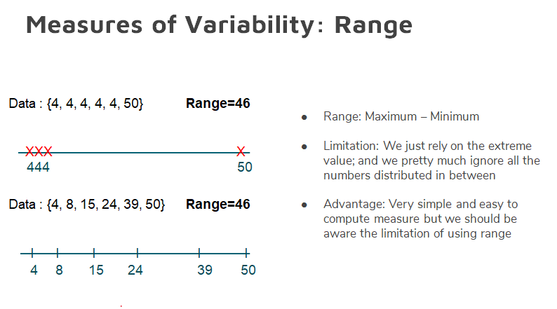
Range does not address data spread; a lot of information is missed by using only the extreme values

Slide 15
Measures of Variability
Standard Deviation
The standard deviation and variance measure the amount of variation (dispersion) of a set of values
Variance: The arithmetic mean of the squares of the deviations of all values in a set of numbers from their arithmetic mean
Standard Deviation: Simply the square root of the variance and
Stdev. =
$$\sqrt{Variance}$$

Slide 16
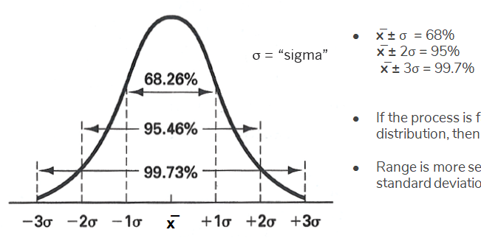
Measures of Variability
Suppose test scores have a mean of 70 and standard deviation of 5
If the distribution is bell shaped, Empirical Rule states:
Approximately 68% of observations fall between 65 and 75
Approximately 95% fall between 60 and 80
Approximately 99.7% fall between 55 and 85

Slide 17
Measures of Variability
Interquartile Range (IQR)
Prerequisites:
Percentiles
Quartiles

Slide 18
Measures of Variability
Percentile
P^{th} percentile is the value at which P percent of the observations are less than that value and (100-P)% are greater than that value
Example: if you score in the 60th percentile on the GMAT, then 60% of the other scores are below your score while 40% are above
50th percentile = median

Slide 19
Measures of Variability
Quartiles
Divide data into 4 parts
3 quartiles: Q1 (25th percentile), Q2 (50% percentile = median), Q3 (75th percentile)
The first quartile (Q1 = 25th percentile) is the middle value between the lowest value and the median
The second quartile (Q2 = 50th percentile) is also the median
The third quartile (Q3 = 75th percentile) is the middle value between the median and highest value

Slide 20
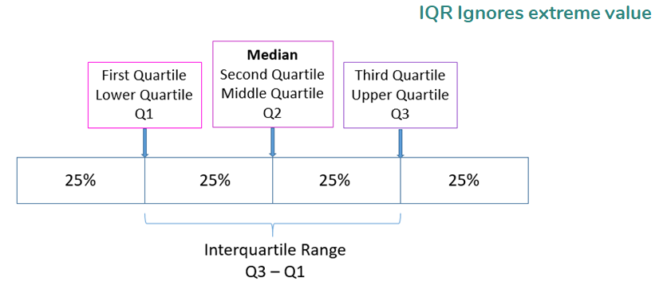
Measures of Variability
Interquartile Range (IQR)
Interquartile range is = Q3 – Q1
Measures the spread of the middle 50% of the data
Large interquartile range values imply Q1 and Q3 are far apart indicating a high level of variability
Not sensitive to outliers
Example: Telephone Bill Data: Interquartile Range = Q3 – Q1= 75.78

Slide 21
Quantitative Measures of Linear Relationship
Numerical measures of the linear relationship that provide information on the strength and direction of a linear relationship between two variables (if one exists)
Correlation Coefficient
When two variables move in the same direction (both increase or decrease), the correlation coefficient will be a large positive number
When two variables move in opposite directions, the correlation coefficient is a large negative number
When there is no particular pattern the correlation coefficient is a small number

Slide 22
Quantitative Measures of Linear Relationship
Correlation Coefficient
It has a fixed range from -1 to +1
If two variables are very strongly positively related, the correlation coefficient is close to +1 (strong positive linear relationship)
If two variables are very strongly negatively related, the correlation coefficient is close to -1 (strong negative linear relationship)
No straight linear relationship has a correlation coefficient close to zero
Note:
If two variables are linearly related it does not mean that X is causing Y
It may mean that another variable is causing both X and Y or that Y is causing X

Slide 23
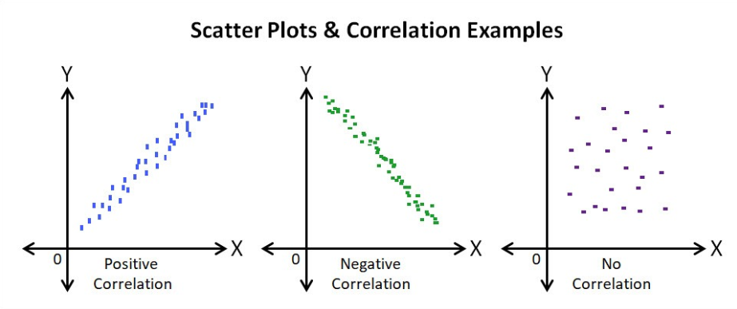
Quantitative Measures of Linear Relationship
Reminder: Scatter Diagram
We are interested in the linearity and direction of the scatter
Perfect positive linear relationship
Correlation coefficient = 1
Perfect negative linear relationship
Correlation coefficient = -1
No linear relationship
Correlation coefficient = 0

Slide 24
Quantitative Measures of Linear Relationship
Correlation is not causation
If two variables are linearly related it does not mean that X is causing Y
It may mean that another variable is causing both X and Y or that Y is causing X

Slide 25
Summary and Questions

