Slide 1
INTRODUCTION TO BUSINESS INTELLIGENCE BIA 3713 Week 6
Naveen Kumar

Slide 2
Agenda
Know your Data
Descriptive Analytics
Wrap up -Numerical Summary Measures
PivotTables and Business Applications
Discussion (Reading Materials)
Summary and Conclusion

Slide 3
Numerical Techniques

Slide 4
Measures of Variability
How are the observations spread out around the central location?
Range:
Advantage: Simplest measure of variability
Range = largest observation – smallest observation

Slide 5
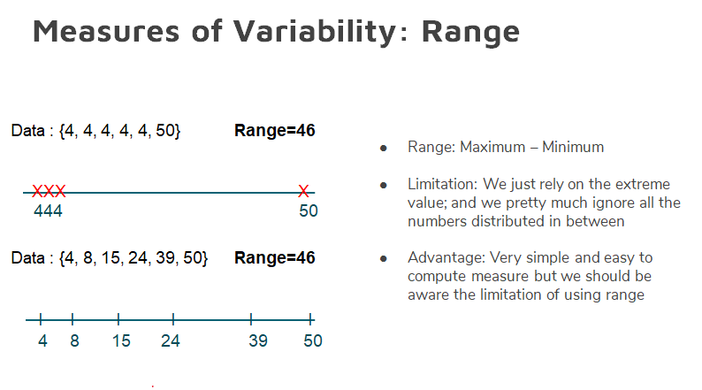
Range does not address data spread; a lot of information is missed by using only the extreme values

Slide 6
Measures of Variability
Standard Deviation
The standard deviation and variance measure the amount of variation (dispersion) of a set of values
Variance: The arithmetic mean of the squares of the deviations of all values in a set of numbers from their arithmetic mean
Standard Deviation: Simply the square root of the variance and
Stdev. =
$$\sqrt{Variance}$$

Slide 7
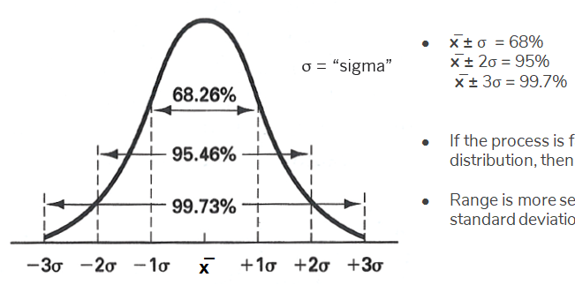
Measures of Variability
Suppose test scores have a mean of 70 and standard deviation of 5
If the distribution is bell shaped, Empirical Rule states:
Approximately 68% of observations fall between 65 and 75
Approximately 95% fall between 60 and 80
Approximately 99.7% fall between 55 and 85

Slide 8
Measures of Variability
Interquartile Range (IQR)
Prerequisites:
Percentiles
Quartiles

Slide 9
Measures of Variability
Percentile
P^{th} percentile is the value at which P percent of the observations are less than that value and (100-P)% are greater than that value
Example: if you score in the 60th percentile on the GMAT, then 60% of the other scores are below your score while 40% are above
50th percentile = median

Slide 10
Measures of Variability
Quartiles
Divide data into 4 parts
3 quartiles: Q1 (25th percentile), Q2 (50% percentile = median), Q3 (75th percentile)
The first quartile (Q1 = 25th percentile) is the middle value between the lowest value and the median
The second quartile (Q2 = 50th percentile) is also the median
The third quartile (Q3 = 75th percentile) is the middle value between the median and highest value

Slide 11
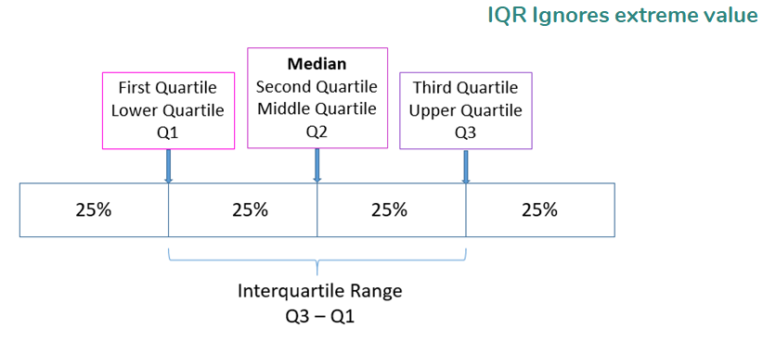
Measures of Variability
Interquartile Range (IQR)
Interquartile range is = Q3 – Q1
Measures the spread of the middle 50% of the data
Large interquartile range values imply Q1 and Q3 are far apart indicating a high level of variability
Not sensitive to outliers
Example: Telephone Bill Data: Interquartile Range = Q3 – Q1= 75.78

Slide 12
Quantitative Measures of Linear Relationship
Numerical measures of the linear relationship that provide information on the strength and direction of a linear relationship between two variables (if one exists)
Correlation Coefficient
When two variables move in the same direction (both increase or decrease), the correlation coefficient will be a large positive number
When two variables move in opposite directions, the correlation coefficient is a large negative number
When there is no particular pattern the correlation coefficient is a small number

Slide 13
Quantitative Measures of Linear Relationship
Correlation Coefficient
It has a fixed range from -1 to +1
If two variables are very strongly positively related, the correlation coefficient is close to +1 (strong positive linear relationship)
If two variables are very strongly negatively related, the correlation coefficient is close to -1 (strong negative linear relationship)
No straight linear relationship has a correlation coefficient close to zero
Note:
If two variables are linearly related it does not mean that X is causing Y
It may mean that another variable is causing both X and Y or that Y is causing X

Slide 14
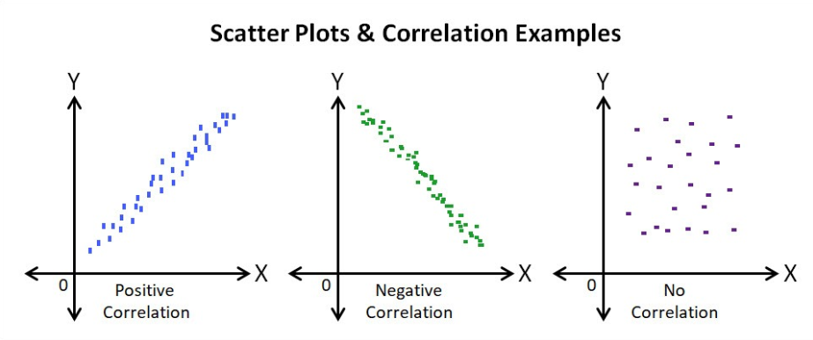
Quantitative Measures of Linear Relationship
Reminder: Scatter Diagram
We are interested in the linearity and direction of the scatter
Perfect positive linear relationship
Correlation coefficient = 1
Perfect negative linear relationship
Correlation coefficient = -1
No linear relationship
Correlation coefficient = 0

Slide 15
Quantitative Measures of Linear Relationship
Correlation is not causation
If two variables are linearly related it does not mean that X is causing Y
It may mean that another variable is causing both X and Y or that Y is causing X

Slide 16
Pivot Tables

Slide 17
What is a Pivot table?
A pivot table is used to summarize a dataset by numerous dimensions.
PivotTables are often used to summarize sales transaction data by salesperson, by store location, by month or week, by product, by brand, etc.

Slide 18
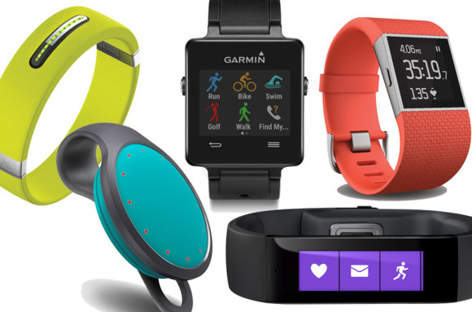
Scenario
Alex, the Athlete's Foot store manager has extended his product line to include “wearable technologies”
His product line now includes activity trackers, smart watches, and sports watches.
Alex carries three manufacturer’s brands: FitBit, Garmin, and Polar.

Slide 19
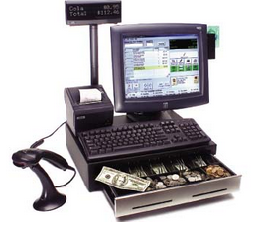
Scenario (continued)
Alex would like to create PivotTables to summarize his sales activity for this new product line.
He has a dataset that includes all the sales transactions for the first six months of 2016.

Slide 20
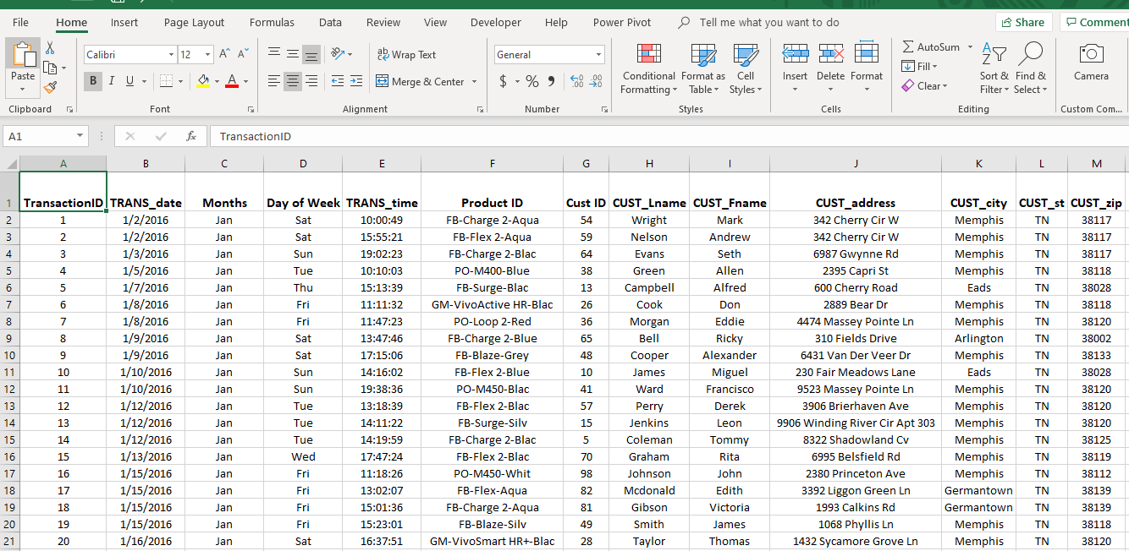
Data Table

Slide 21
1: How many items were sold by brand?

Slide 22
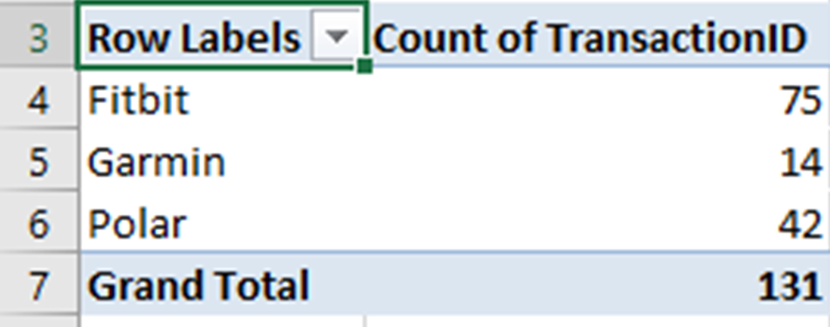
1: How many items were sold by brand?

Slide 23
Rename the worksheet

Slide 24
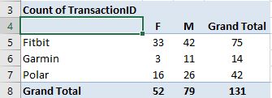
2. How many items were sold by Brand and by Gender?

Slide 25
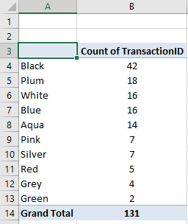
3. How many items were sold by color?

Slide 26
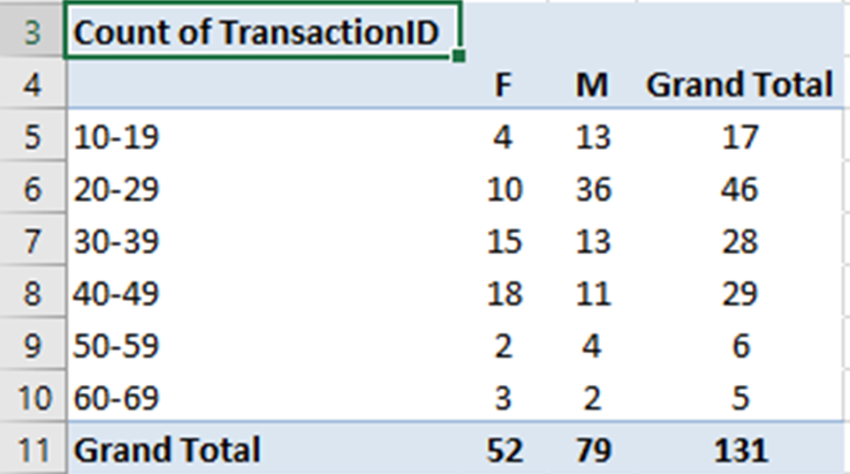
4. How many items were sold by Age Group and by Gender?

Slide 27
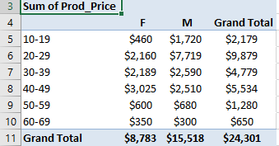
5. What are total sales by Age Group and By Gender?

Slide 28
6. What is the average price paid by Age Group and By Gender?

Slide 29
Summary and Conclusion

