Slide 1
Week 4 Summary
Jack Dibble
Zach Dillon
Michaela Stark

Slide 2
Main Points Covered
Know Your Data
Know your data enough to clearly arrange and summarize it in a way that is digestible for any user. Present the data in a way that is easy to read and grasp
Descriptive Data
Know what kind of graphical technique to use with different kinds of data. This will make visualized data easier to understand.

Slide 3
Graphical Techniques
Categorical Data: Visualized with bar graphs or pie charts
Graphical Measures: Histograms can be used to describe and visualize interval data
Histograms different shapes- Symmetric, Skewed, Modality and Bell Shaped.
Scatter Diagram: Plot two continuous variables against each other

Slide 4
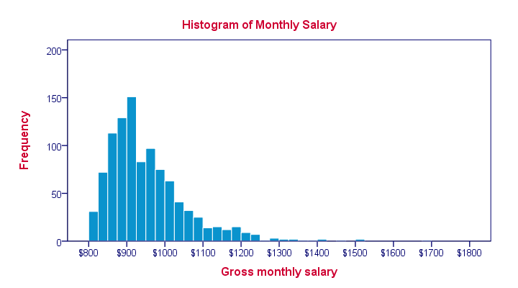
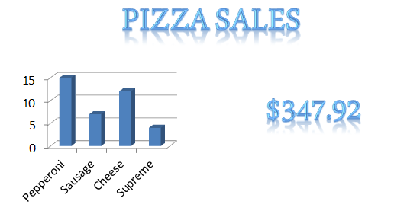
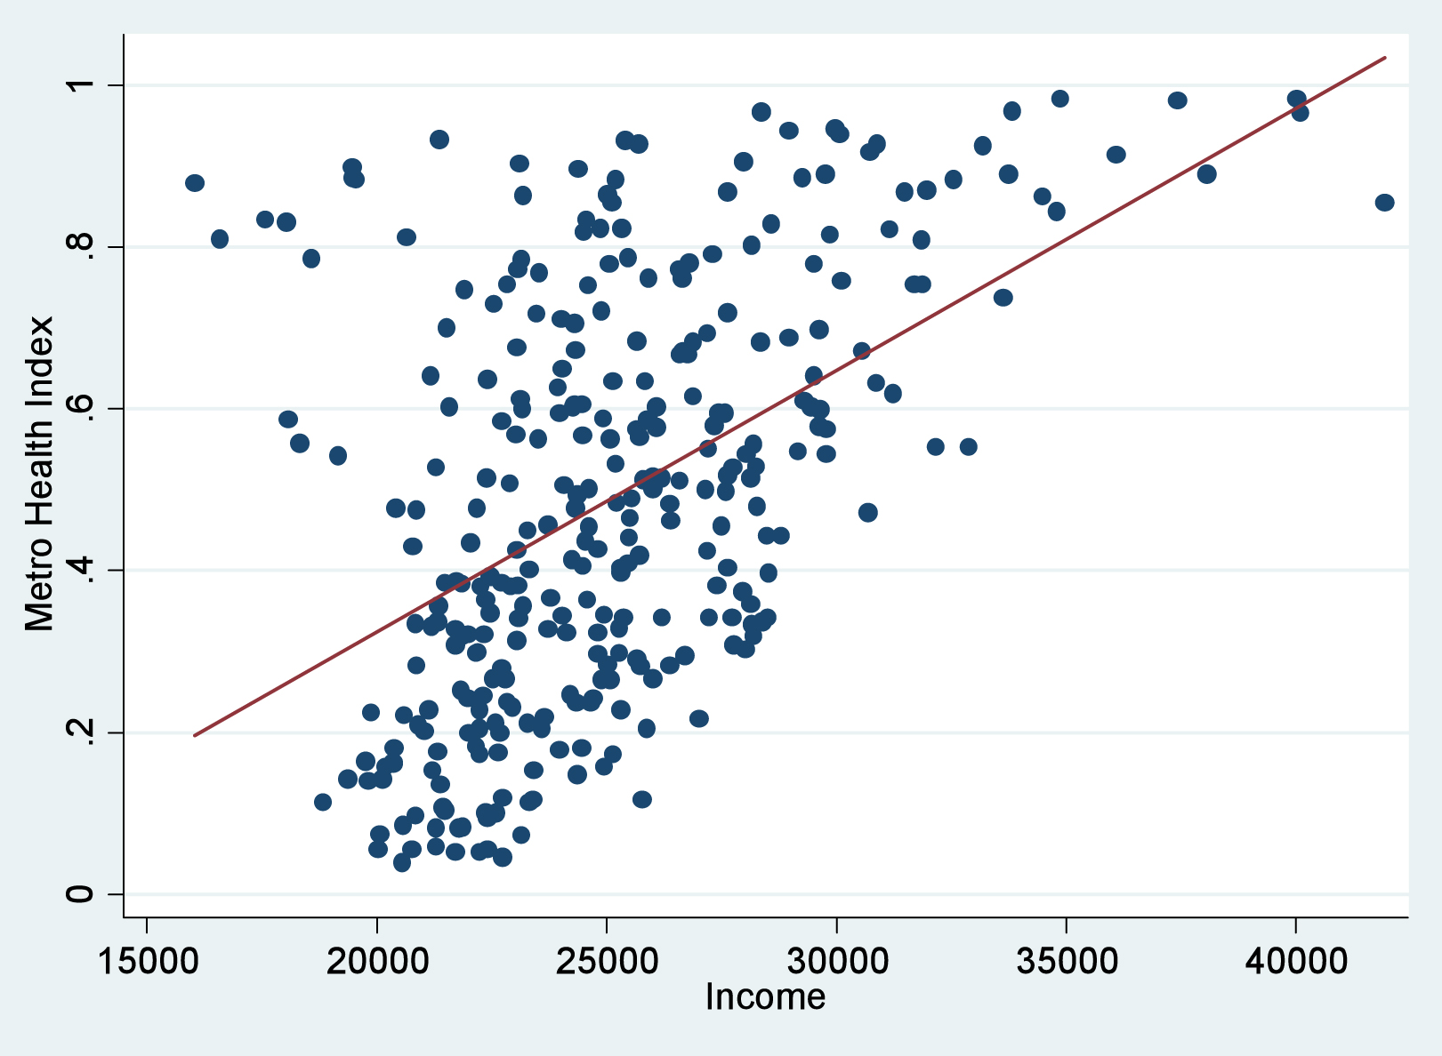
Examples of Graphical Techniques

Slide 5
Types of Data
Categorical Data: Nominal
Counts the frequency of each variable in a sample
Normally represented by a bar graph or pie chart
Interval Data
Data type which is measured along a scale
Represented by histograms

Slide 6
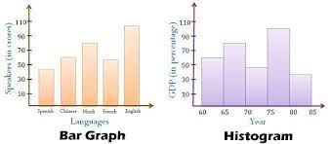
Bar Charts vs. Histograms
Bars further apart
Displays data that is counted
Bars closer together
Displays data that is measured
Use of bins

Slide 7
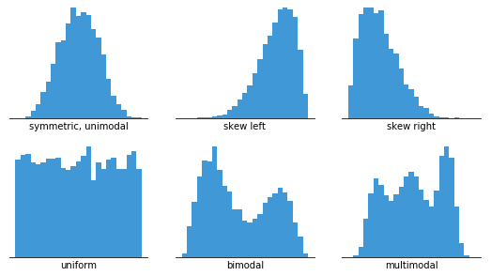
Histograms Continued
Terms to remember:
Symmetric
Skewed
Modality
Bell Shaped

Slide 8
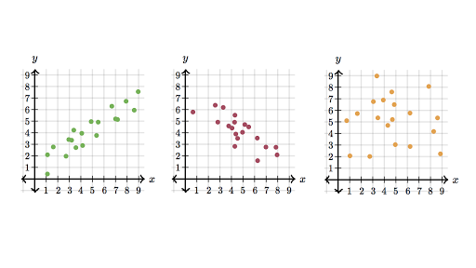
Scatter Plots
Two variables plotted against each other
Independent vs. Dependent Variables
Trying to find linearity and direction of the scatter
Positive Correlation
Negative Correlation
No Correlation

Slide 9
Numerical Techniques
In order to identify some key points from graphical techniques that were talked about previously, we must understand:
Mean
Median
Mode
These will help us measure the central location of the data.

Slide 10
Mean and Median
The general summarization of the mean is that it helps us find the average of the graphed data. The mean is found by adding together all the data, then dividing by the count of data variables.
*Is heavily affected by outliers.
The median is the chronological order of data, with the middle number representing the central location. In some cases, there can be an odd amount, to we then would add together the two points that fall in the middle, and divide by 2.

Slide 11
Mode
The mode is the most frequent data variable that shows up in a given set of data. It IS possible for there to be more than one mode in certain scenarios.

Slide 12
When to use each measure of central location
Mean
The mean is most often used to accurately find the central location. It is the best measure when we are dealing with interval data that does not deal with outliers.
Median
When the mean is affected heavily by outliers, we would resort to the median. Ordinal data and interval data that is skewed are when we typically apply the median.
Mode
The mode is the best option to find the central location when we are looking at nominal data.

