Slide 1
Week 5 Summary and Business Apps
Group D: Abby Chaffin, Alec Amend, & Dillon Cain

Slide 2
Numerical Techniques
Measures of Central Location
Mean
Median
Mode
Measures of Variability
Range
Standard Deviation
IQR

Slide 3
Measures of Central Location
Mean
Averages all available data
Appropriate for describing measured data
Sensitive to outliers
Median
Finds the value of the center of a dataset
Not sensitive to any outliers
Mode
Most frequent type of data observation
A data set can have more than one mode

Slide 4
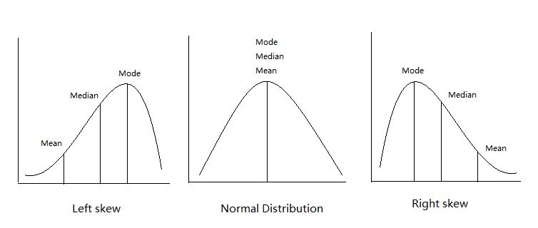
Examples
e.g. death by natural causes e.g. grades on a bell curve e.g. salary

Slide 5
Real-Life Usage
Mean
Median
Salaries are often calculated as a median to determine what an average salary is in a profession without being skewed by top earners.
Mode
Mode is basically a count of how many times a thing occurs; this makes it easily observable, but it is rarely the best method to use.
Grades are a relevant example of an average taken with mean that we encounter on a regular basis

Slide 6
Reflection on Measures of Central Location
Without even realizing it, we typically use or interpret at least one of these three forms of data daily
We tend to understand summarized data more easily than raw data in a spreadsheet or chart
These measures of central location allow for quick, accessible ways to compare data with each other

Slide 7
Measures of Variability
Range
Most simple measure of variability
Variance (Standard Deviation)
Measures the amount of variation in a dataset
IQR
Divides the data into percentiles or quartiles
However, it is limited by its reliance on extreme values
The square root of the variance is the standard deviation
Quartiles are divided into four parts by three quartiles, equal to the 25th percentile, 50th percentile, and 75th percentile

Slide 8
Quantitative Measures of Linear Relationships
What is it?
Correlation Coefficient
"Numerical measures of the linear relationship that provide information on the strength and direction of a linear relationship between two variables (if one exists)"
Large Positive Number: When 2 variables move in the same direction (both increase or both decrease)
Large Negative Number: When 2 Variables move in opposite directions (one decreases, and one increases)
Small Number: No particular pattern

Slide 9
Quantitative Measures of Linear Relationships
- Correlation Coefficient is close to +1: If two variables are very strongly positively related (strong positive linear relationship)
- Correlation Coefficient is close to –1: If two variables are very strongly negatively related (strong negative linear relationship)
- Correlation Coefficient close to zero: No straight linear relationship
Correlation Coefficient has a fixed range from –1 to +1

Slide 10
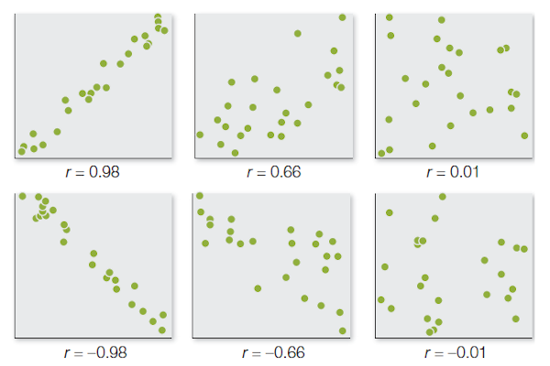
Quantitative Measures of Linear Relationships
Scatter Plots and Correlation examples

