Slide 1
INTRODUCTION TO BUSINESS INTELLIGENCE BIA 3713 Week 7
Naveen Kumar

Slide 2
Agenda
Know Your Data
PivotTables and Business Applications
Adding slicers to PivotTables
PivotCharts and Applications
Summary and Conclusion

Slide 3
What is a Pivot table?
A pivot table is used to summarize a dataset by numerous dimensions.
PivotTables are often used to summarize sales transaction data by salesperson, by store location, by month or week, by product, by brand, etc.

Slide 4
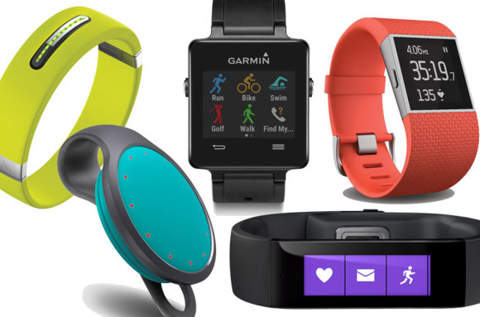
Scenario
Alex, the Athlete's Foot store manager has extended his product line to include “wearable technologies”
His product line now includes activity trackers, smart watches, and sports watches.
Alex carries three manufacturer’s brands: FitBit, Garmin, and Polar.

Slide 5
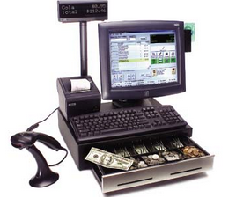
Scenario (continued)
Alex would like to create PivotTables to summarize his sales activity for this new product line.
He has a dataset that includes all the sales transactions for the first six months of 2016.

Slide 6
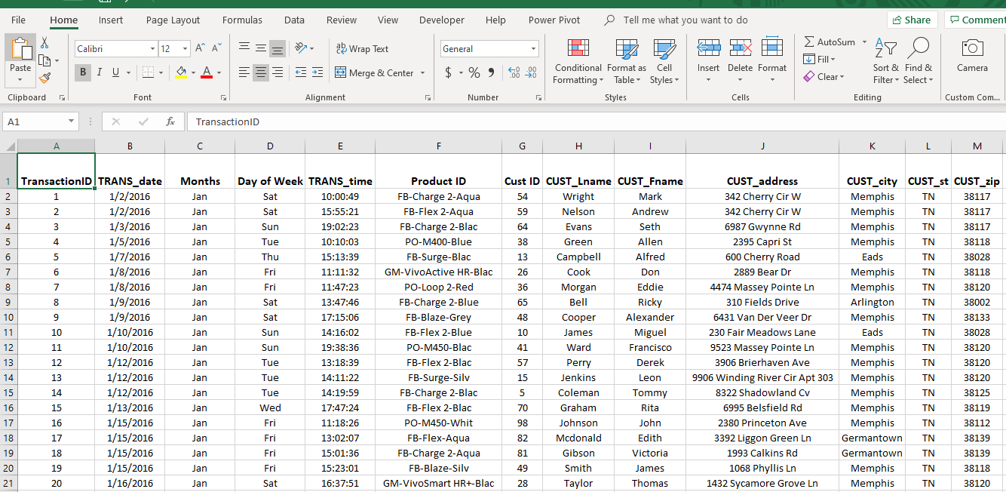
Data Table

Slide 7
1: How many items were sold by brand?

Slide 8
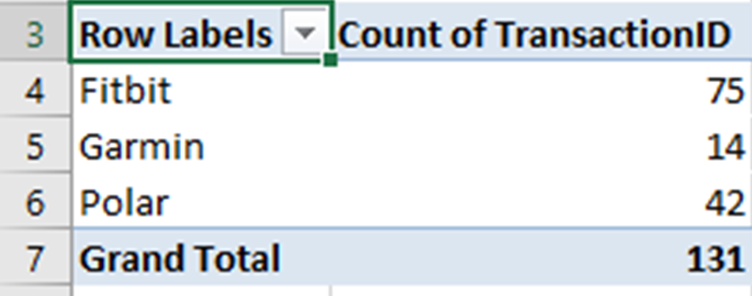
1: How many items were sold by brand?

Slide 9
Rename the worksheet

Slide 10
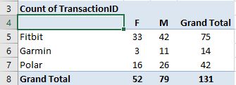
2. How many items were sold by Brand and by Gender?

Slide 11
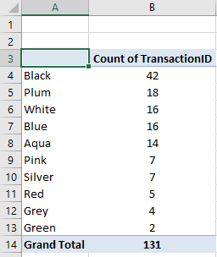
3. How many items were sold by color?

Slide 12
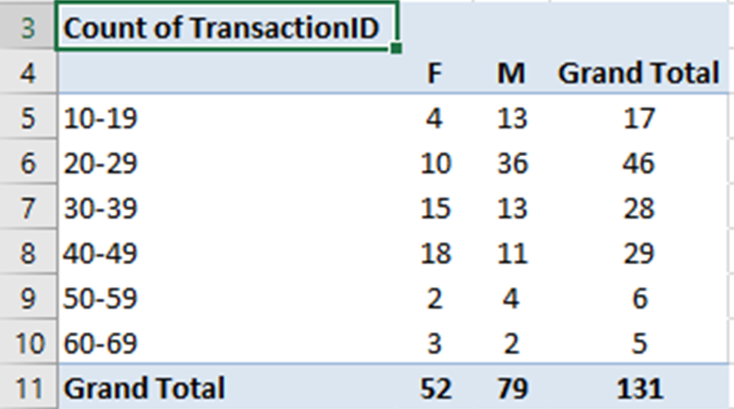
4. How many items were sold by Age Group and by Gender?

Slide 13
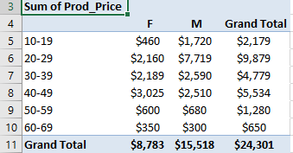
5. What are total sales by Age Group and By Gender?

Slide 14
6. What is the average price paid by Age Group and By Gender?

Slide 15
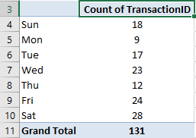
7. How many items did we sell by Day-of-Week?

Slide 16
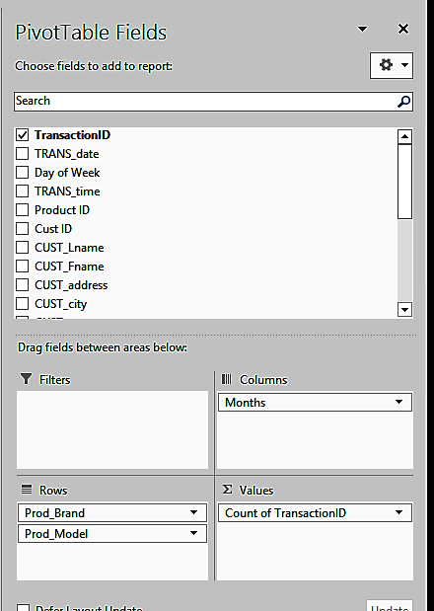
8. Adding Slicers to a Pivot Table

Slide 17
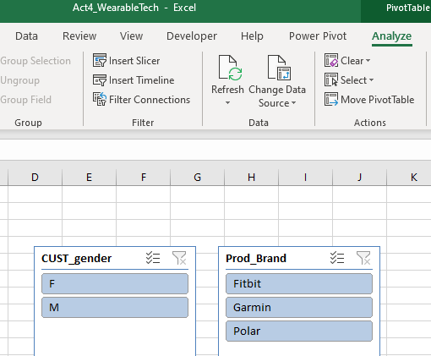
8. Add Slicers to Pivot Table

Slide 18
8. Experiment with the slicers

Slide 19
9. Create a Pivot Chart

Slide 20
9. Create a Pivot Chart

Slide 21
Summary and Conclusion

