Slide 1
INTRODUCTION TO BUSINESS INTELLIGENCE BIA 3713 Week 8
Naveen Kumar

Slide 2
Agenda
Business Decision Making
Dashboards and Business Applications
Week 6-7 Summary Presentation (Live Session on Friday)
Quiz 2 (Live Session on Friday)
Guest Speaker (Live Session on Friday)
Summary and Conclusion

Slide 3
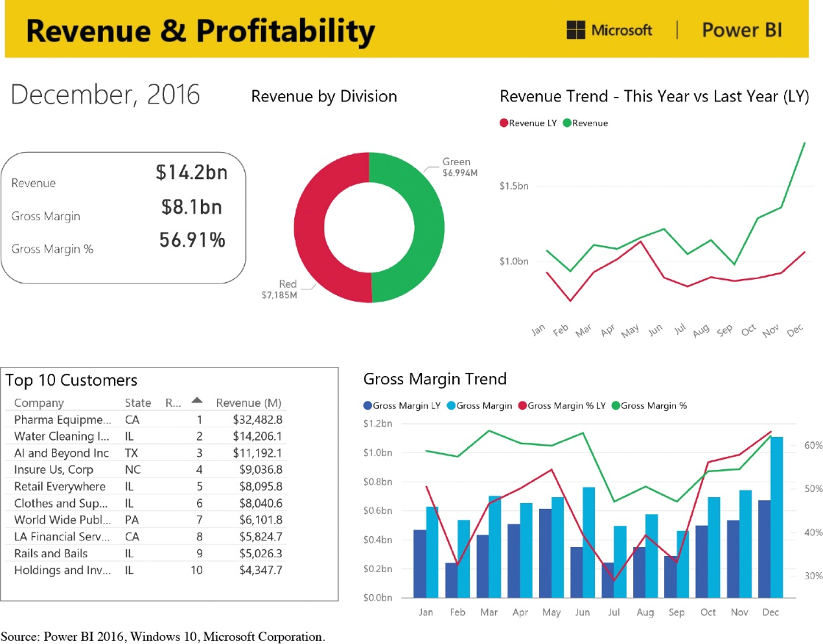
Information Visualization(Digital Dashboards)
Digital dashboards are used to visually present key performance indicators used by management
Data usually highly aggregate
They use a variety of design elements to present data in a user friendly way
Source: Power B I 2016, Windows 10, Microsoft Corporation.

Slide 4
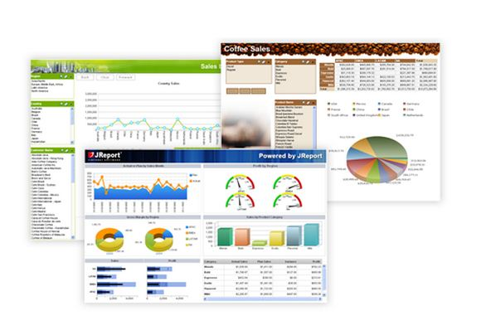
Dashboards
Displays summarized data graphically
Provides metrics of key performance indicators
Conveys a readily-understood message "

Slide 5
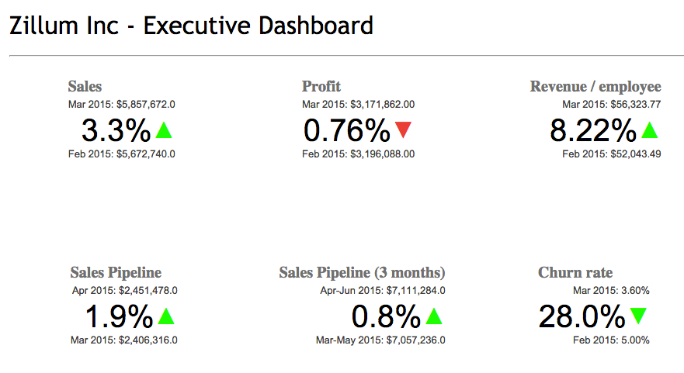
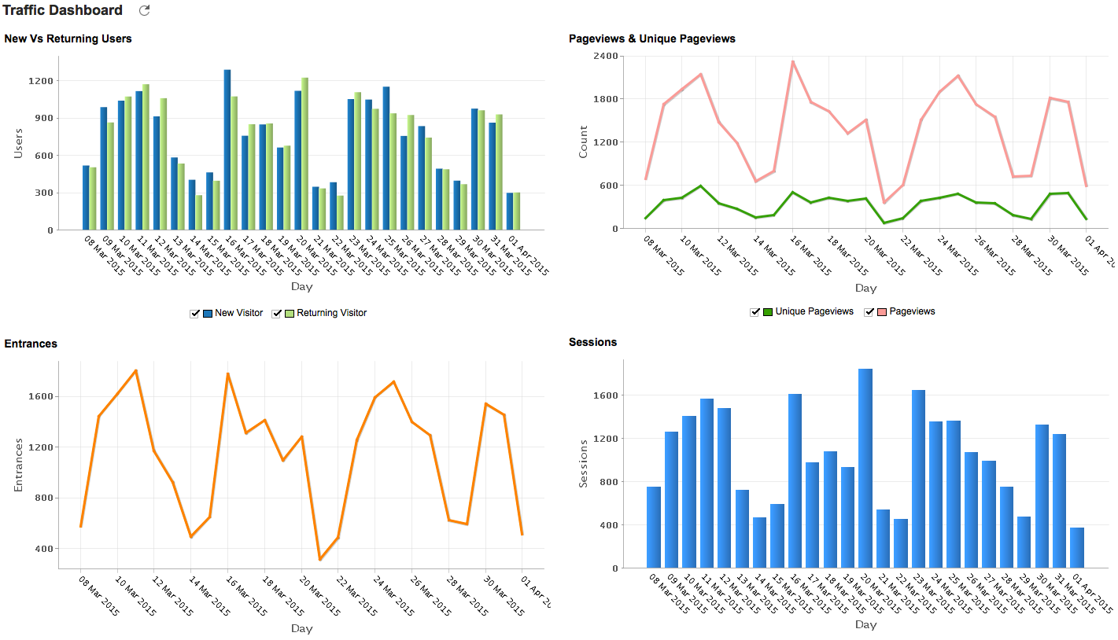
Types of Dashboards
Strategic - focus on high level measures of performance
Analytic– focus on comparisons, and historical data that may be used in analyses.

Slide 6
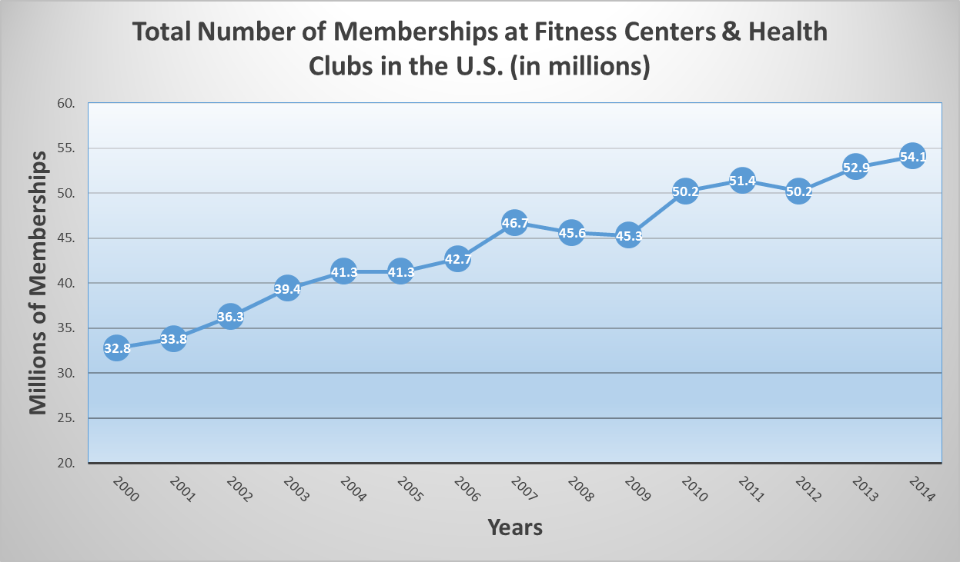
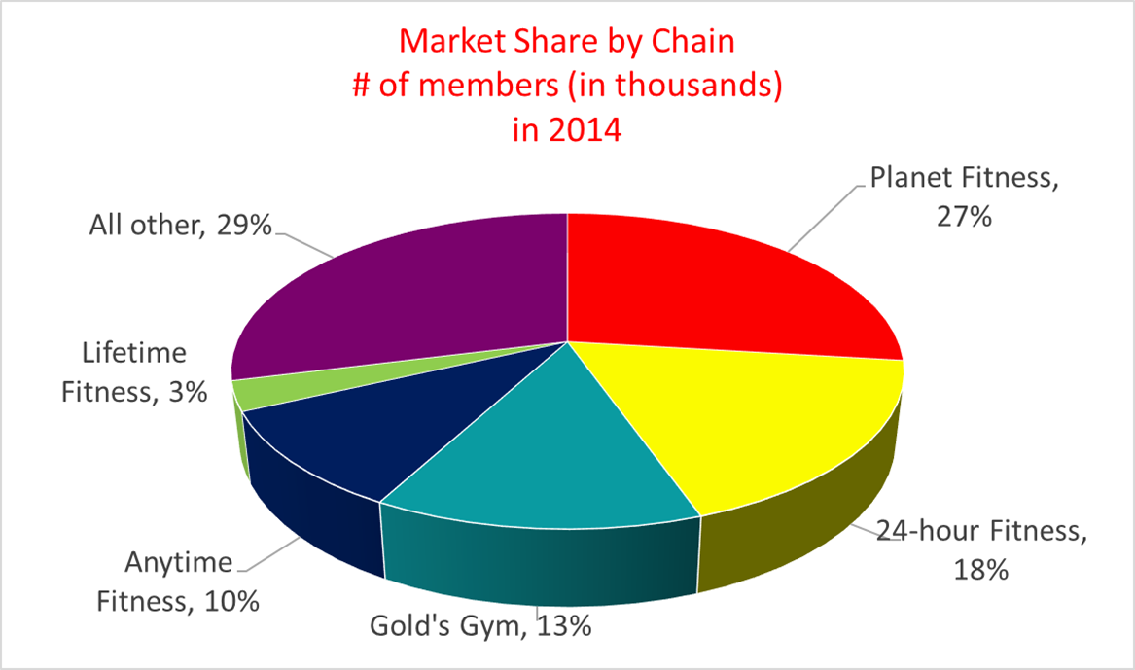
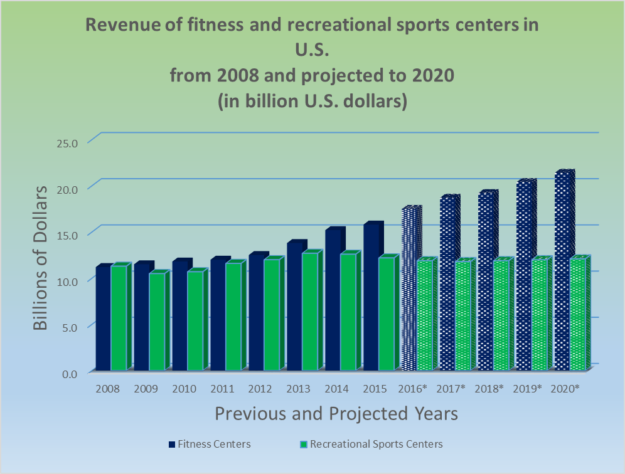
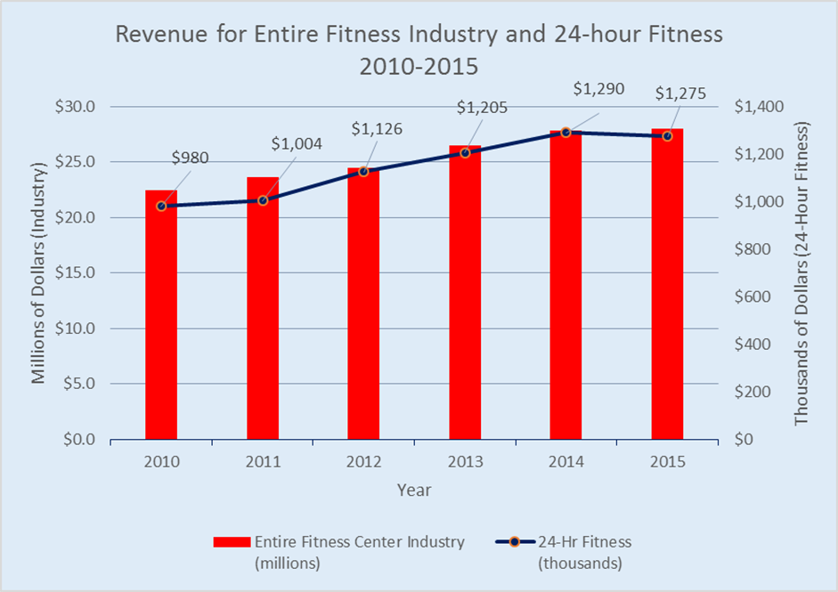
Create Your Own Dashboard
Just copy and paste your visuals side-by-side!

Slide 7
Advanced Charts
Information conveyed by charts
Show changes over time
Line & Column charts
Show how one category compares to another
Column & Bar charts
Show how parts contribute to a whole
Pie charts & stacked bar or column charts
Show progress toward a goal
Usually a column chart

Slide 8
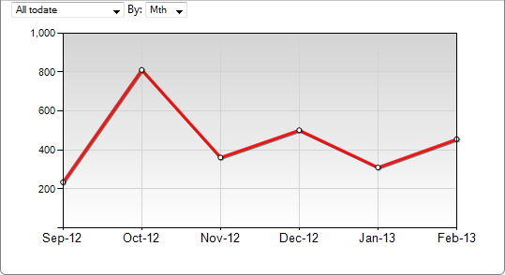
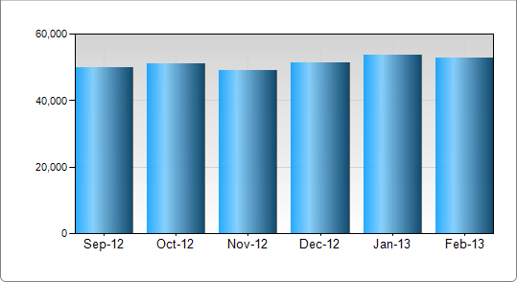
Charts that show trends over time

Slide 9
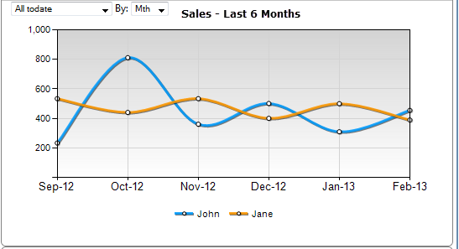
Comparing Trends – plotting two lines

Slide 10
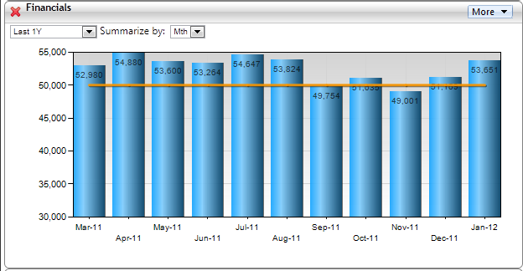
Trend chart with a benchmark line

Slide 11
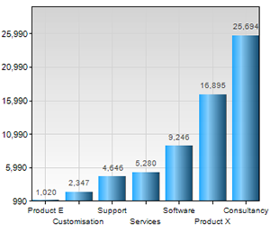
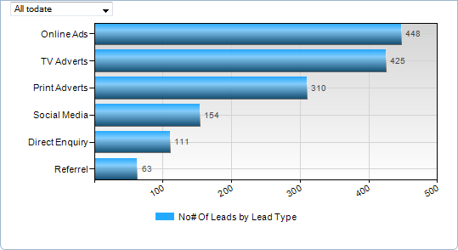
Charts showing comparisons (column and bar charts)

Slide 12
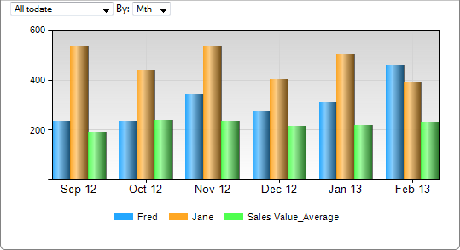
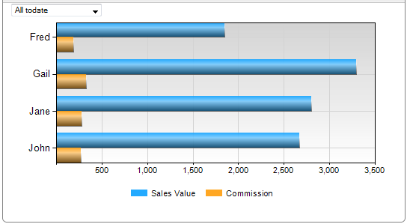
Clustered Column & Bar Charts

Slide 13
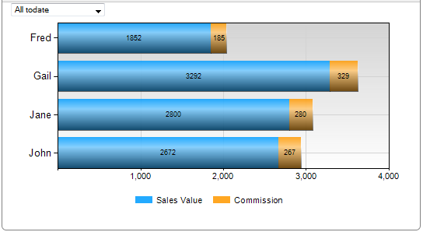
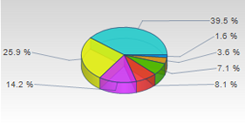
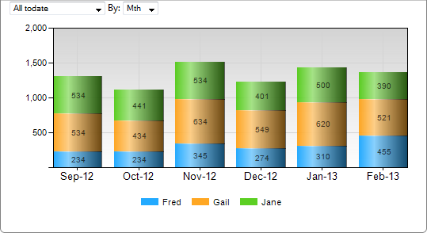
Charts showing parts contributing to a whole
Pie Chart
Stacked Bar and Column Charts

Slide 14
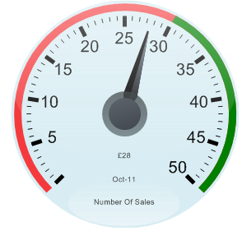
Charts showing progress toward a goal

Slide 15
Creating charts
Remember Alex from the Athlete’s Foot? He was considering opening a fitness center by his shoe store.
Let’s help him obtain information that will help him learn more about growth and trends in the fitness industry.

Slide 16
The four things you need to know to create a chart
What type of a chart is it? (Line, Column, Bar, Pie etc.,)
What data do you have and need for the chart? (understand the columns properly)
What is on the X-axis?
What is on the Y-axis?

Slide 17
Total number of memberships at fitness centers / health clubs in the U.S. from 2000 to 2014 (in millions)
Year | Millions of Memberships
2000 | 32.8
2001 | 33.8
2002 | 36.3
2003 | 39.4
2004 | 41.3
2005 | 41.3
2006 | 42.7
2007 | 46.7
2008 | 45.6
2009 | 45.3
2010 | 50.2
2011 | 51.4
2012 | 50.2
2013 | 52.9
2014 | 54.1

Slide 18
Revenue of fitness and recreational sports centers in U.S. from 2008 and projected to 2020 (in billions of dollars)
Year3 | Fitness Centers | Recreational Sports Centers | Total
2008 | $11.2 | $11.3 | $22.5
2009 | $11.5 | $10.5 | $22.0
2010 | $11.8 | $10.7 | $22.5
2011 | $12.0 | $11.6 | $23.6
2012 | $12.5 | $12.0 | $24.5
2013 | $13.8 | $12.7 | $26.5
2014 | $15.2 | $12.6 | $27.8
2015 | $15.8 | $12.2 | $28.0
2016* | $17.5 | $11.9 | $29.4
2017* | $18.7 | $11.8 | $30.5
2018* | $19.2 | $11.9 | $31.1
2019* | $20.4 | $12.0 | $32.4
2020* | $21.4 | $12.1 | $33.5

Slide 19
Market Share of Major Fitness Center Chains # of members (in thousands) in 2014
Major Chain | Number of Members
Planet Fitness | 6,085
24-hour Fitness | 4,000
Gold's Gym | 3,000
Anytime Fitness | 2,300
Lifetime Fitness | 684
All other | 6,542
TOTAL | 22,611

Slide 20
Revenue for Entire Fitness Industry and 24-hour fitness 2010-2015
 | Revenue 2010-2015
Year | 24-Hr Fitness (thousands) | Entire Fitness Center Industry (millions)
2010 | $980 | $22.5
2011 | $1,004 | $23.6
2012 | $1,126 | $24.5
2013 | $1,205 | $26.5
2014 | $1,290 | $27.8
2015 | $1,275 | $28.0

Slide 21
Summary and Conclusion

