Slide 1
INTRODUCTION TO BUSINESS INTELLIGENCE BIA 3713 Week 11
Naveen Kumar

Slide 2
Learning Objectives
Define Web Analytics
Describe the four types of web traffic
Explain the four different Web Metrics
Understand Google Analytics and Its Applications

Slide 3
Definition of Web Analytics
The art and science of collection, measurement, analysis and reporting of website usage for the purposes of redesign and traffic optimization
It has two main components viz., Web Metrics and KPIs

Slide 4
The five W’s of Web Analytics
What
Who
Where
Why
When

Slide 5
The five W’s of Web Analytics
What data do you need to collect?
- Defines the scope of your analytics initiative
Who are they?
- Measures the demographics of the
audience
When are they visiting?
- Measures the timing
Where are they visiting?
- Measures the popular links/parts of the website
Why are they doing this?
- Analyzes the motivations behind the actions

Slide 6
Types of Web Traffic
Direct
Type the URL in the browser
User already knows your business
Organic
Traffic through search engines, directories and third party websites
Un paid search results
Referral
Traffic directly from other websites
Facebook, Google+, Twitter etc
Campaign
Traffic through Pay Per Click, e-mail and internet marketing.
Paid traffic

Slide 7
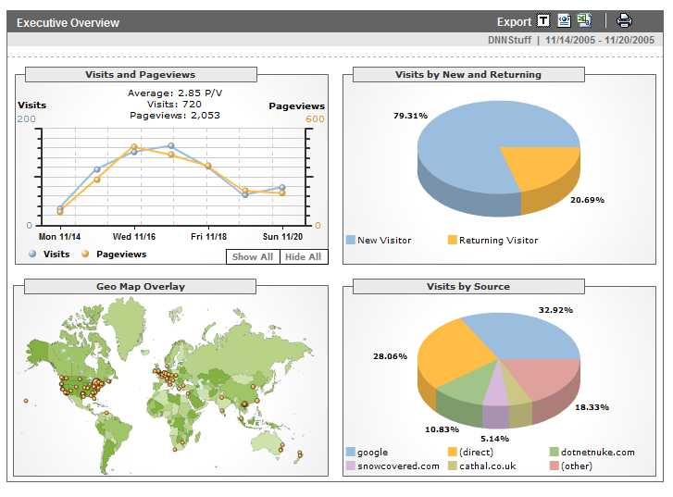
Web Metrics
Measures of a website usage
Can be a count or a ratio
Can be aggregate, segmented or individual
Sample Metrics
- Number of Visitors
- Number of Visits
- Exit Rate
- Bounce Rate
For More Refer to http://www.makeuseof.com/tag/web-metrics-101-what-do-all-these-terms-mean/

Slide 8
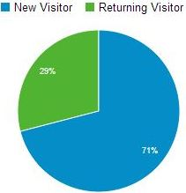
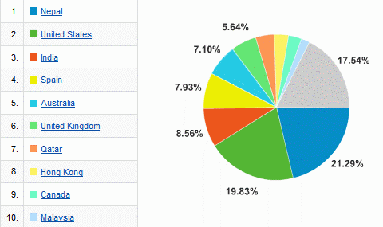
Number of Visitors
Indicates the number of unique visitors over a specified time
Can be new or returning
Can be segmented by geography, OS, browser used, language etc.,

Slide 9
Number of Visits
A Group of interactions on a website that take place within a time frame
Can be for the same visitor or new visitors
Can be a few seconds or several hours

Slide 10
Exit Rate
The fraction of visitors who leave the site from a specified web page (can also be expressed as a percentage)
Calculated for a particular web page

Slide 11
Calculating Exit Rate
Step 1 : Calculate the number of sessions which had Page A. This is the denominator.
Number of Sessions with Page A = 3 (Monday, Wednesday, Friday)
Step 2 : Out of the Sessions in Step 1, how many sessions had Page A as the last page during the visit i.e., exit page. This is the numerator
Number of Sessions with Page A as last Page = 1 (Friday Session)
Step 3 : Exit Rate for Page A = 1/3

Slide 12
Review Questions
What is the Exit rate for a Website?
Calculate the Exit Rate for Pages B and C

Slide 13
Bounce Rate
Fraction of visitors who leave the website from a particular page for single page view visits
Based on visits that start with a particular page

Slide 14
Calculating Bounce Rate
Step 1 : Calculate the number of sessions that started with page B. This is the denominator.
Number of Sessions that started with page B = 3 (Monday, Tuesday, Friday)
Step 2 : Out of the Sessions in Step 1, how many sessions were single page visits i.e., visited only page B and left the site. This is the numerator.
Number of Sessions with single page visits= 1 (Tuesday Session)
Step 3 : Bounce Rate for Page B = 1/3

Slide 15
Review Questions
How do you calculate the Bounce rate for the Website?
Calculate the Bounce Rates for Pages A and C.

Slide 16
What is Google Analytics?
A “freemium” service offered by Google that tracks and reports information about website traffic
It is the most widely used web analytics service on the Internet
Google allows you to use their free demo account to learn how to use Google Analytics
The demo site is a real Google e-commerce site – called the Google Merchandise Store

Slide 17
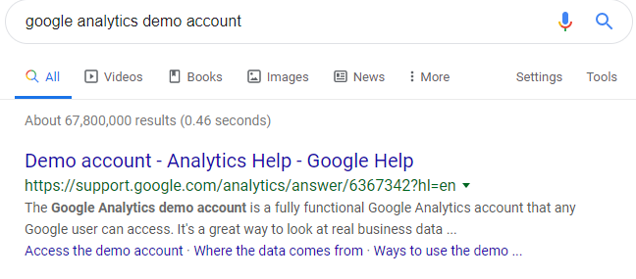
Using Google Analytics
Google “Google Analytics demo account”

Slide 18
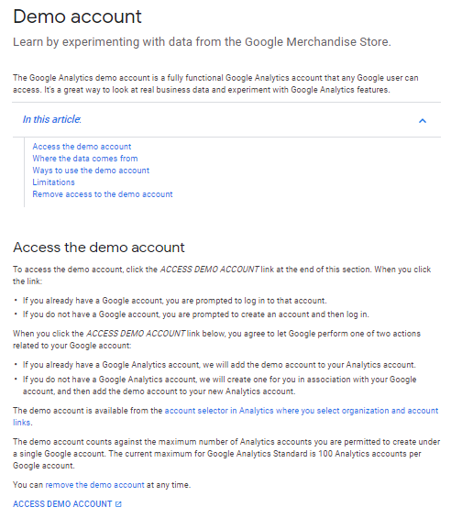
Analyze the Google Store’s Web Site
Click here to access the demo site

Slide 19
The Overview Report
Site Name (aka “Property Name”
Currently Viewing
Play This Video
All the Report Options

Slide 20
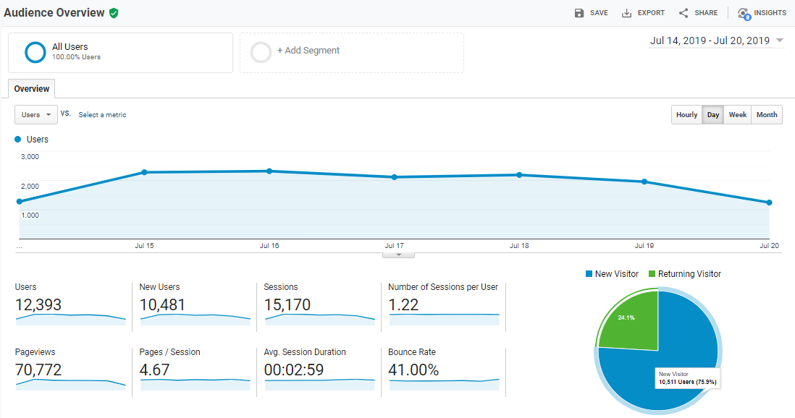
Audience Overview Metrics
Users
New Users
Sessions
No.of Sessions/User
Page Views
Pages per Session
Average Session Duration
Bounce Rate

Slide 21
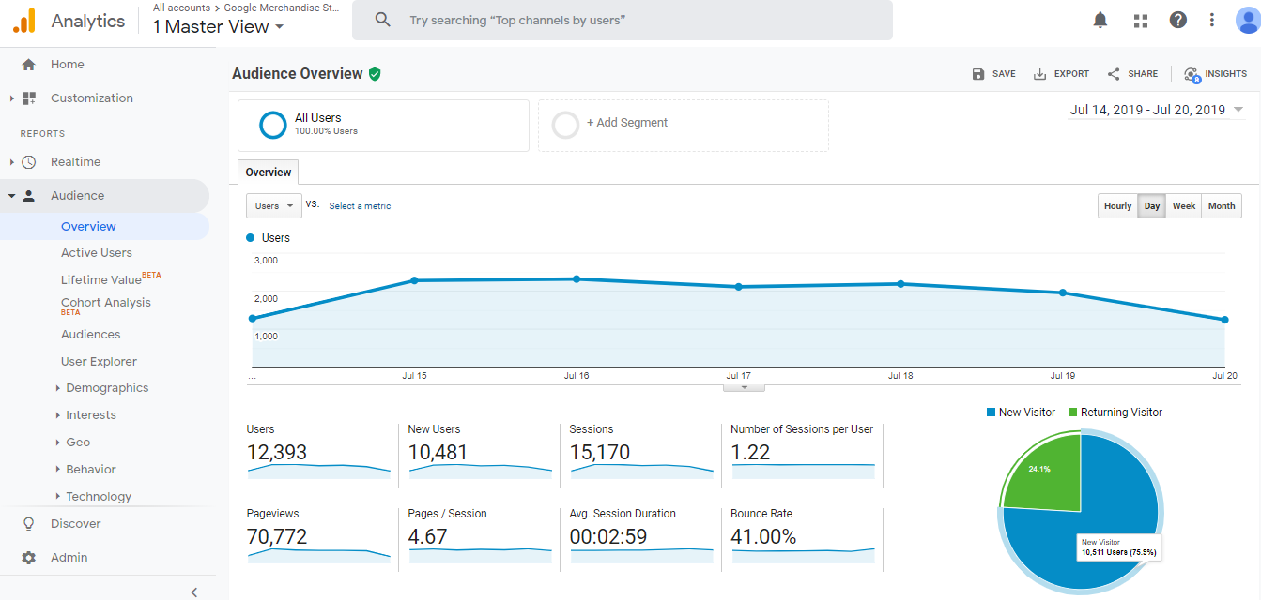
Users
Site Visitor is called a “user”: both “first time” and “returning” visitors are users

Slide 22
New Users
The number of first time visitors

Slide 23
Sessions
A session is the period time a user is actively engaged with your site
When a visitor lands on a site, a session starts
The session ends when the visitor leaves or after an extended period of no activity

Slide 24
Number of Sessions per User
The number of sessions per user is essentially the average visits per unique visitor

Slide 25
Page Views
The total number of pages landed on by all users during the time period being reviewed.

Slide 26
Pages/Session
The average number of pages viewed during a session
Repeated views of a single page are counted as views

Slide 27
Average Session Duration
The average length of a Session

Slide 28
Bounce Rate
The percentage of visits in which the user left the site from the entrance page without interacting with the page

Slide 29
New vs Returning Rate
This pie chart shows the breakdown by new vs returning visitors
You can hover the mouse over the pie pieces to see the numeric values
Scroll down

Slide 30
Breakdown of Session by Dimensions
Click on each dimension to see the breakdown

Slide 31
Breakdown of Sessions by Country

Slide 32
Breakdown by City
Click Here

Slide 33
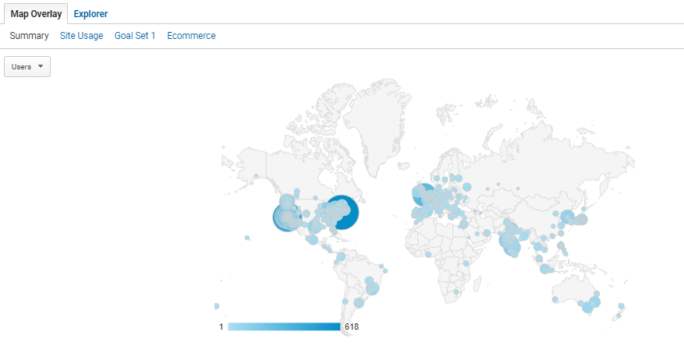
See Breakdown of sessions by City in Map View

Slide 34
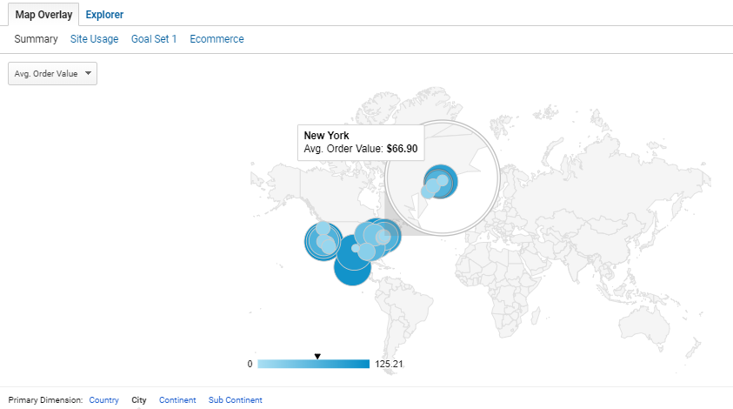
Hover over Bubbles to see the city name

Slide 35
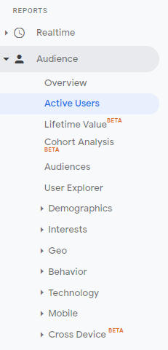
Select “Active Users” Report

Slide 36
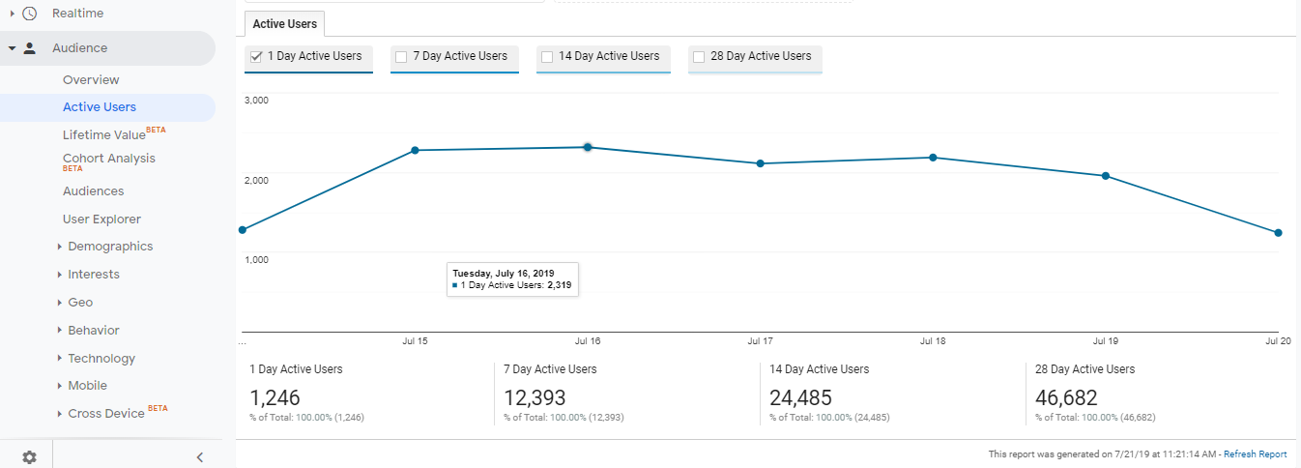
Activity Users Report Number of visitors over the last X days
How many users (site visitors) have you had over the last X days?

Slide 37
Select “Demographics”

Slide 38
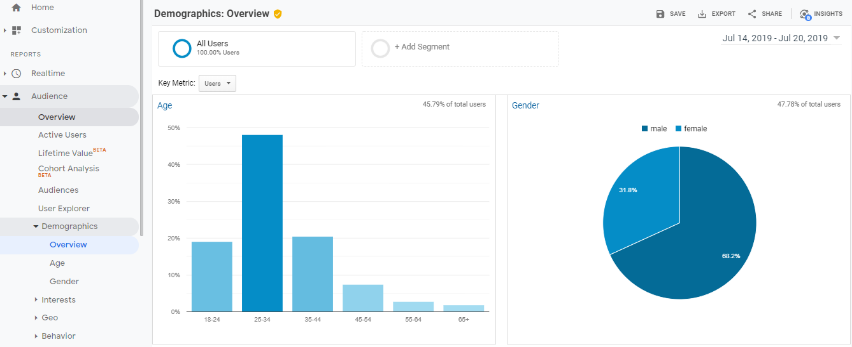
See Your Users’ Age Groups & Gender Groups

Slide 39
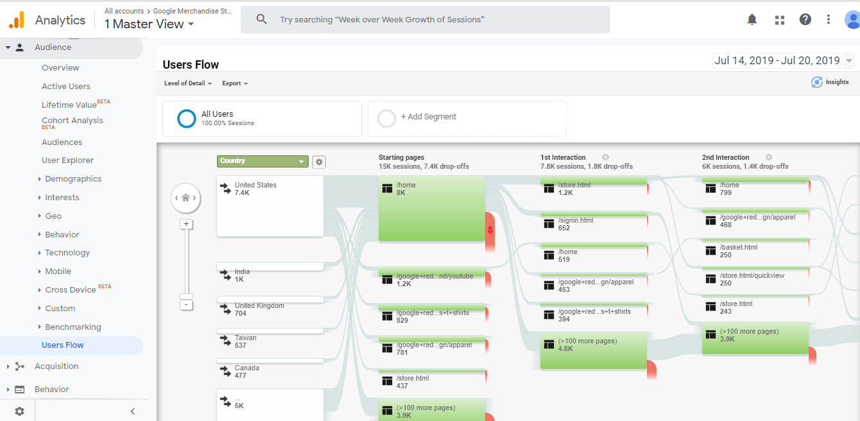
The User Flow Report
The Users Flow report gives you an insider’s look into what pathways your visitors take to land on your website

Slide 40
Summary
We have learned how Google Analytics can be used by website owners to see what is happening on their website
Using Google Analytics (free site tracker), a site owner can see how many users are viewing his/her site, what pages they are looking at, how long they are looking at pages, where the users come from, and much more

