Slide 1
INTRODUCTION TO BUSINESS INTELLIGENCE BIA 3713 Week 12
Naveen Kumar

Slide 2
Agenda
Supervised Learning Process
Introduction to Unsupervised Learning
Cluster Analysis
Guest Speaker (Live Session)
Assignment 4 Due
Summary and Conclusion

Slide 3
Machine Learning
Multi-disciplinary field that uses scientific methods, processes, algorithms and systems to extract knowledge and insights from structured and unstructured data.

Slide 4
Churn Prediction
CRM System
Data about your customer
Churn Prediction
Upselling Likelihood
Product Propensity /NBO
Campaign Management
Customer Segmentation
…
Demographics
Behavior
Revenues
Model

Slide 5
Customer Segmentation
CRM System
Data about your customer
Churn Prediction
Upselling Likelihood
Product Propensity /NBO
Campaign Management
Demographics
Behavior
Revenues
Customer Segmentation
…
Model

Slide 6
Credit Risk Assessment
Risk Prognosis
High Risk
Low Risk
High Risk
Very High Risk
Very Low Risk
Medium Risk
…
Customer History
Model

Slide 7
Demand Prediction
How many taxis do I need in NYC on Wednesday at noon?
Model

Slide 8
Sentiment Analysis

Slide 9
Key Applications
Customer Lifetime Value Modeling
Predict the future revenue that a customer can bring to the business.
Focus on marketing efforts to attract more customers.
Image Classification
Classify an image from a fixed set of categories.
Social media photo tagging and medical image analysis.
Recommendation Engines
Predict how likely a customer is to purchase or enjoy a good and then recommends the items to the customers.
Netflix and Amazon are big users of recommendations engines.

Slide 10
Types of Machine Learning
Supervised
Unsupervised

Slide 11
Types of Machine Learning
Class
Label
Target
Output feature/attribute
Dependent variable
Input features
Input attributes
Independent variables
𝑦
Model
Groups or segments
Input features
Input attributes
Model

Slide 12
Supervised Learning
A training set with many examples of (𝑿, 𝑦)
The model learns on the examples of the training set to produce the right value of y for an input vector 𝑿
x₂
𝑿 Age Money
Temperature Speed Number of taxi
...
model
𝑦
Sunny vs. Cloudy Healthy vs. Sick Churn vs. Remain Increase vs.
Deacrease
...
x₁

Slide 13
Supervised Learning: Classification vs. Numerical Predictions
Classification
y = {yellow, gray}
y = {churn, no churn}
y = {increase, unchanged, decrease}
y = {blonde, gray, brown, red, black}
y = {job 1, job 2, ... , job n}
Numerical Predictions
y = temperature
y = number of visitors
y = number of kW
y = price
y = number of hours

Slide 14
Training vs. Testing: Partitioning
Training phase: the algorithm trains a model using the data in the training set
Testing phase: the algorithm measures how well the model is performing on data in a new dataset (the test set)
Training Set
Test Set

Slide 15
Supervised Machine Learning Process
Train and apply model
Evaluate performance
Partition data
Training Set
Train Model
Original Data Set
Apply Model
Score Model
Test Set

Slide 16
Unsupervised Learning
A training set with many examples of (𝑿)
The model learns to group the examples 𝑿 of the training set based on similarity
(closeness) or probability
model
x₂
𝑿 Age Money
Temperature Speed Number of taxi
...
x₁

Slide 17
Cluster Analysis
Discover hidden structures in unlabeled data (unsupervised)
Clustering identifies a finite set of groups (clusters) in the dataset such that:
Objects within the same cluster shall be as similar as possible
Objects of different clusters shall be as dissimilar as possible

Slide 18
Clustering Applications
Find “natural” clusters
Find useful and suitable groups
Find unusual data objects
Methods
K-means
Hierarchical
Examples
Customer segmentation
Anomaly detection

Slide 19
k-Means-Algorithm
Given k, the k-Means algorithm is implemented in four steps:
1. Partition objects into 𝑘 non-empty subsets, calculate their centroids (i.e.,
mean point, of the cluster)
Assign each object to the cluster with the nearest centroid
Compute the centroids from the current partition
Go back to Step 2, repeat until the updated centroids stop moving significantly
Euclidean distance

Slide 20
Visualizing k-Means Algorithm
Interactive simulation
http://tech.nitoyon.com/en/blog/2013/11/07/k-means/

Slide 21
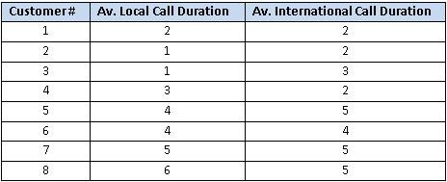
Customer Segmentation Example
You are head of customer insights and marketing at a telecom company, ConnectFast Inc.
You need to have different strategies to attract different customers.
You want to create customer segments/groups for an effective marketing strategy.
For a small start, you decide to collect a sample of eight customers with t heir average call duration, locally and internationally.

Slide 22
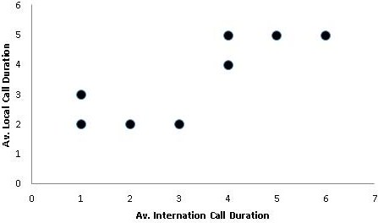
Customer Segmentation Example
The scatter plot shows there might be two clusters.
Next, you need to find the location of centroids. But first, you will choose two random coordinates for the centroids.
C1 (1,1) and C2 (3,4)
Now, you find the distance between the two centroids and all the data points using the Euclidean Distance Formula.

Slide 23
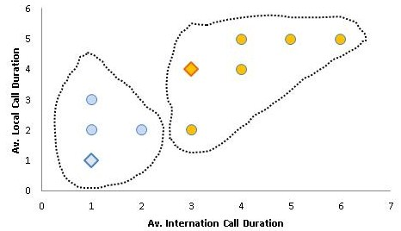
Customer Segmentation Example
You measure the distance from C1 and C2 for all the customers. Then, you assign which cluster the customers belong to using the closeness to clusters.
In the scatter plot, the customers have been marked based on their closeness to the centroids.

Slide 24
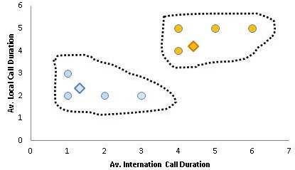
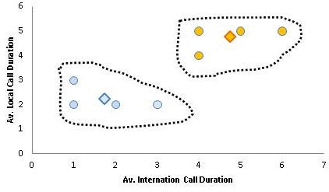
Customer Segmentation Example
Before, you had chosen random coordinates for the centroids. Now, you will have new positions for the centroids by taking the average of members points for the centroid.
For the first centroid, customers 1, 2 and 3 are members. For instance, for the average for x-axis, you will have (2+1+1)/3 = 1.33.
Next step, you find the customers distance to the new centroid coordinates, and repeat the same process of assigning cluster to customers.
Last, you find the new coordinates for the centroids again. You should end up with the image in the bottom right.

Slide 25
Comments of the k-Means Method
Advantages:
Relatively efficient
Simple implementation
Weaknesses:
Need to specify k, the number of clusters, in advance

Slide 26
Summary and Conclusion

