Slide 1
INTRODUCTION TO BUSINESS INTELLIGENCE BIA 3713 Week 13
Naveen Kumar

Slide 2
Agenda
Introduction of Machine Learning
Introduction to KNIME
Unsupervised Learning and Business Applications
K-Means Clustering using KNIME
Career in Analytics (Guest Speaker)
Summary and Conclusion

Slide 3
INTRODUCTION TO KNIME
Produces high quality analysis and graphics
Open-source
Free
Runs on any operating system
Helps to design the data in suitable forms and helps to visualize it
Integrates various components for machine learning and data mining through modular data pipelining.

Slide 4
WHAT DOES KNIME DO?
Helps in understanding the data and designing the data science with the use of various tools and work interface.
Platform built for powerful analytics on a GUI based workflow.
No need not to know how to code.
Supports data manipulation, transformation and data mining.
Allows users to visually create data flows, execute analysis steps, helps inspect the results, and create models with the help of interactive tools and views.

Slide 5
NODE
Individual tasks are represented by nodes.
Each node is displayed as a colored box with input and output ports.
Nodes can perform tasks, including reading/writing files, transforming data, training models, creating visualizations, and so on.

Slide 6
NODES
A node can have 4 states:
Not Configured:
The node is waiting for configuration or incoming data.
Configured:
The node has been configured correctly and can be executed.
Executed:
The node has been successfully executed. Results
may be viewed and used in downstream nodes.
Error:
The node has encountered an error during execution.

Slide 7
NODE CONFIGURATION
Most nodes require configuration
To access a node configuration window:
Double-click the node
Right-click -> Configure

Slide 8
WORKFLOW
A series of interconnected nodes.
Nodes can be connected via their input and output ports to form a workflow.
Once a workflow is executed, the data inside the workflow flows from left to right through the connections either step by step or entirely.

Slide 9
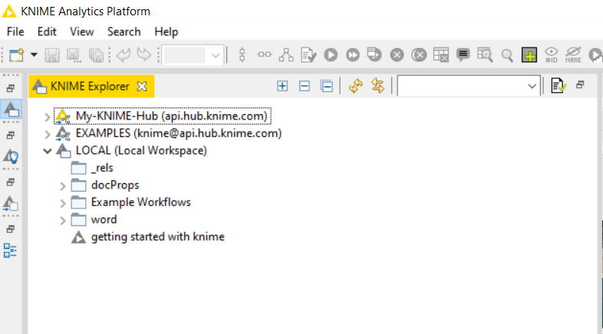
KNIME EXPLORER
Part of the open source KNIME analytics platform application
Supports browsing workflows and performing actions upon them
Supports mounting the workflow repositories we want to work with

Slide 10
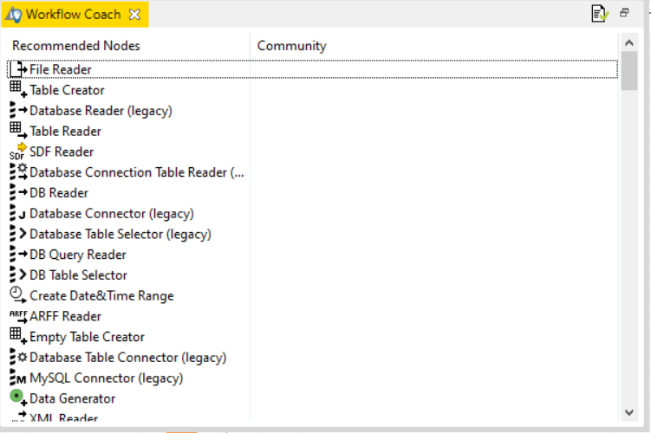
WORKFLOW COACH
Provides node recommendations.
If you have selected a node in the workflow editor, the workflow coach shows the most popular nodes to follow the selected node.
If you have not selected any node, the recommendations represent the most popular nodes to start a workflow.
The recommendations are based on KNIME’s community usage statistics.

Slide 11
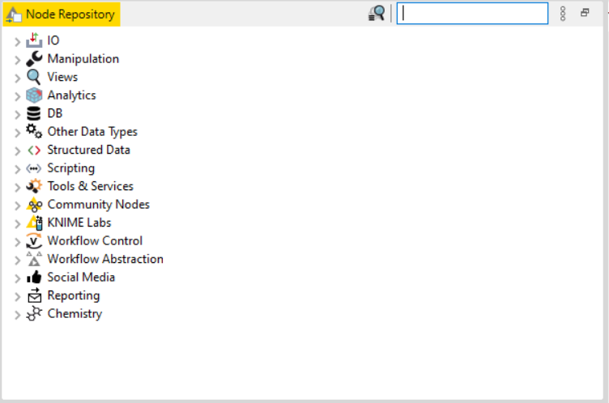
NODE REPOSITORY
Currently installed nodes are available in the node repository
Organized under different categories.
We can add a node by expanding the categories or by typing a search term in the search field on top of the node repository.

Slide 12
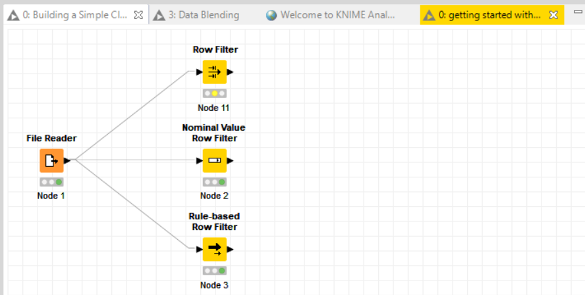
WORKFLOW EDITOR
Place where workflows are assembled.
Made up of individual tasks that are represented by Nodes.
Create a workflow by dragging nodes from the node repository to the Workflow Editor, then connecting, configuring and executing them.

Slide 13
Comments & Annotations
Double-click to write Use the panel to change properties
Double-click to write Use the panel to change properties

Slide 14
KNIME File Extensions
Dedicated file extensions for workflows and workflow groups associated with KNIME Analytics Platform
*.knwf for KNIME Workflow Files

Slide 15
Tool Bar
The buttons in the toolbar can be used for the active workflow. The most important buttons are:
Execute selected and executable nodes (F7) Execute all executable nodes
Execute selected nodes and open first view
Cancel all selected, running nodes (F9) Cancel all running nodes
▪
▪
▪
▪
▪

Slide 16
Importing Data
Accessing Files and Databases

Slide 17
CSV Reader
Reads either one or multiple
Advanced settings
.csv and .txt files
Further tabs to
limit the rows
select encoding
File system
File path
Basic settings
Help button
Preview

Slide 18
Connecting to Other File Systems
Add file system connection port to connect to another file system
Click on the three dots on the lower left to add or remove a dynamic port.
Supported file systems
Microsoft Azure
Google
Amazon
Databricks
BigData file systems (hdfs, httpFS, …)
On-premise (e.g. ssh, ftp, …)

Slide 19
Google Sheets
Access your data stored in Google Services
Read data from Google Sheets
Write data to new sheets
Modify existing sheets
Makes collaboration and sharing of data easy
(especially vs. sending Excel sheets via email...)
Authenticate via pop-up window (Oauth2)

Slide 20
Google Sheets
Select from available sheets on Google Drive
Transform data in KNIME, or enrich with new data
Create new sheet or update existing sheets
Allows to read from / write to specific range of sheet (e.g. A1:G10)
Authenticate via pop- up window (Oauth2)
Select from available sheets, open in browser for preview
Specify target sheet, select which columns to write, etc.

Slide 21
Other Data Sources
KNIME Analytics Platform provides many more options to access data:
PMML Reader – reads standard predictive models
XML Reader with XPATH support
Python/R Source nodes
Tika Parser – extracts textual data from 200+ file types
REST Web Services, and many more

Slide 22
CSV Reader
Reads either one or multiple
Advanced settings
.csv and .txt files
Further tabs to
limit the rows
select encoding
File system
File path
Basic settings
Help button
Preview

Slide 23
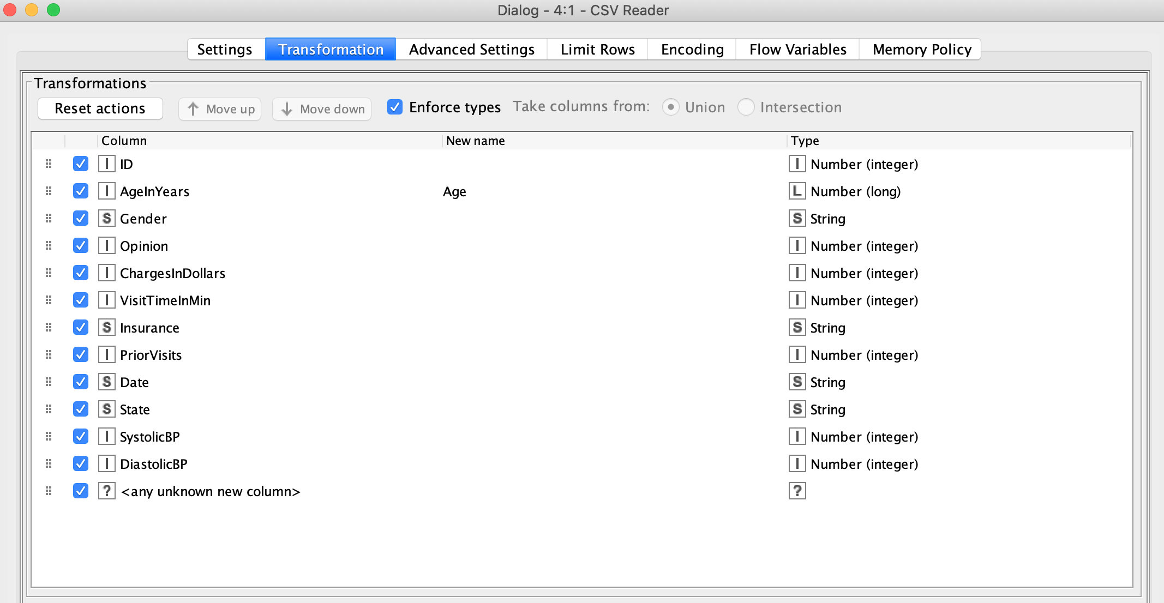
Transformation Tab (Under CSV Reader Node)
Supported operations
Column filtering
Column sorting
Column renaming
Column type mapping
Select between union or intersection of columns (in case of reading many files)

Slide 24
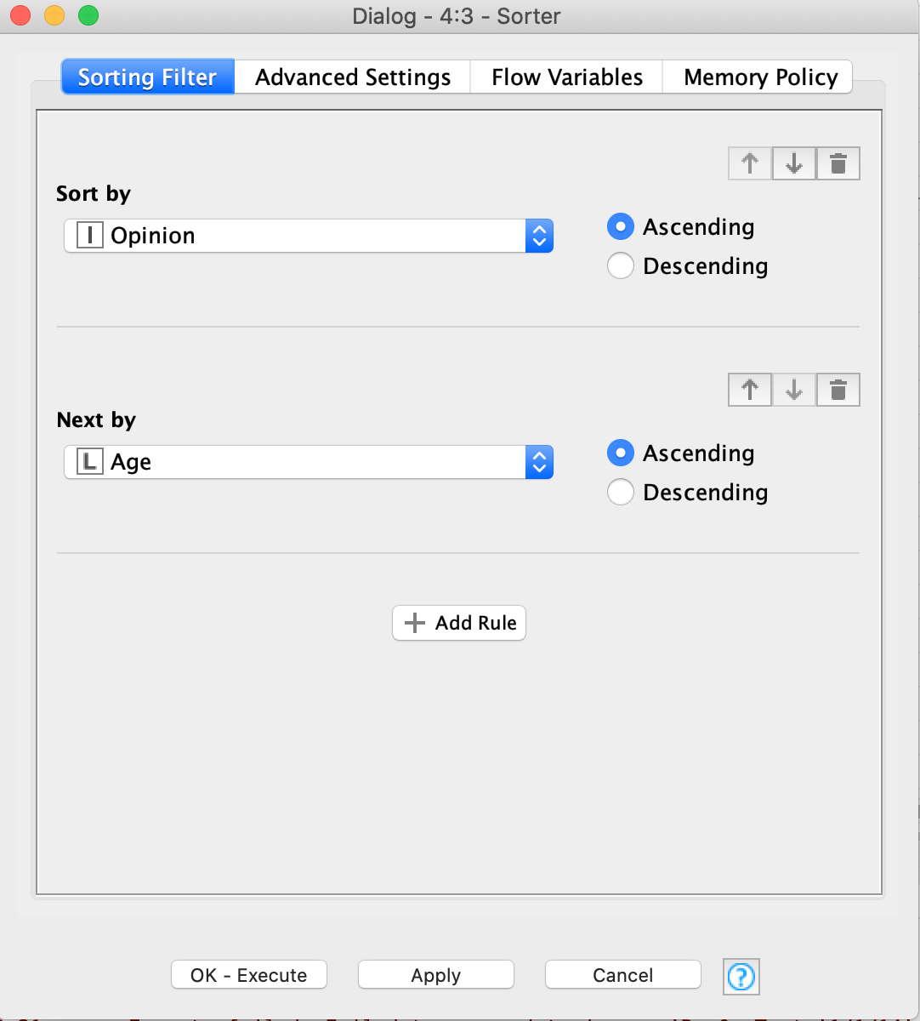
Data Sorting
Sorts a table!
Choice of ascending or descending
Sort by multiple columns

Slide 25
Unsupervised Learning

Slide 26
Unsupervised Learning
A training set with many examples of (𝑿)
The model learns to group the examples 𝑿 of the training set based on similarity
(closeness) or probability
model
x₂
𝑿 Age Money
Temperature Speed Number of taxi
...
x₁

Slide 27
Customer Segmentation
CRM System
Data about your customer
Churn Prediction
Upselling Likelihood
Product Propensity /NBO
Campaign Management
Demographics
Behavior
Revenues
Customer Segmentation
…
Model

Slide 28
Cluster Analysis
Discover hidden structures in unlabeled data (unsupervised)
Clustering identifies a finite set of groups (clusters) in the dataset such that:
Objects within the same cluster shall be as similar as possible
Objects of different clusters shall be as dissimilar as possible

Slide 29
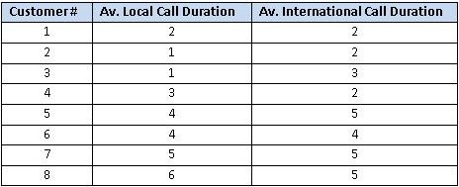
Customer Segmentation Example
You are head of customer insights and marketing at a telecom company, ConnectFast Inc.
You need to have different strategies to attract different customers.
You want to create customer segments/groups for an effective marketing strategy.
For a small start, you decide to collect a sample of eight customers with their average call duration, locally and internationally.

Slide 30
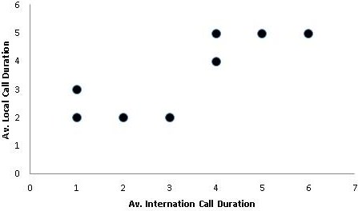
Customer Segmentation Example
The scatter plot shows there might be two clusters.
Next, you need to find the location of centroids. But first, you will choose two random coordinates for the centroids.
C1 (1,1) and C2 (3,4)
Now, you find the distance between the two centroids and all the data points using the Euclidean Distance Formula.

Slide 31
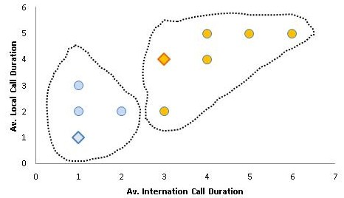
Customer Segmentation Example
You measure the distance from C1 and C2 for all the customers. Then, you assign which cluster the customers belong to using the closeness to clusters.
In the scatter plot, the customers have been marked based on their closeness to the centroids.

Slide 32
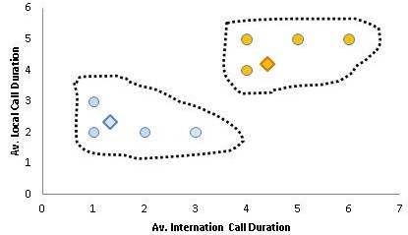
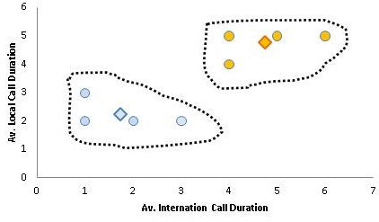
Customer Segmentation Example
Before, you had chosen random coordinates for the centroids. Now, you will have new positions for the centroids by taking the average of members points for the centroid.
For the first centroid, customers 1, 2 and 3 are members. For instance, for the average for x-axis, you will have (2+1+1)/3 = 1.33.
Next step, you find the customers distance to the new centroid coordinates, and repeat the same process of assigning cluster to customers.
Last, you find the new coordinates for the centroids again. You should end up with the image in the bottom right.

Slide 33
Comments of the k-Means Method
Advantages:
Relatively efficient
Simple implementation
Weaknesses:
Need to specify k, the number of clusters, in advance

Slide 34
K-Means using KNIME

Slide 35
Summary and Conclusion

