Slide 1
Week 11 Summary
Group H: Edward Reali, Paul Trinh

Slide 2
Web Analytics Recap
The act of collecting data of website usage for the purposes of optimization, traffic boosting and advertising.
Key metrics: Number of visits, number of visitors, bounce rate, exit rate
5 W’s of web analytics: What, who, when, where, why

Slide 3
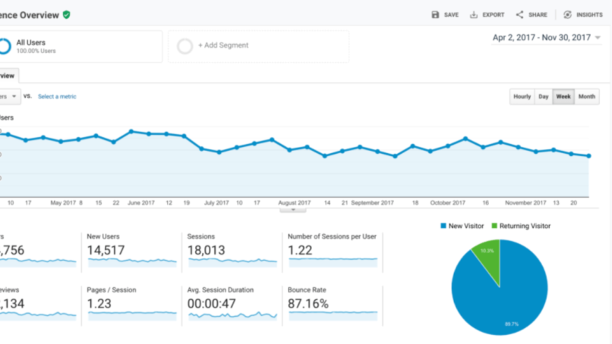
Google Analytics
Powerful freemium web suite for analyzing website traffic
Most widely used web analytics platform
Ability to connect to virtually any website
Demo feature with a real google merchandise website
Demographic analysis such as location, gender, device type
Historical and live data options

Slide 4
Audience Overview Metrics
Users
New Users
Sessions
No. of Sessions per User
Page Views
Pages per Session
Average Session Duration
Bounce Rate

Slide 5
Machine Learning
Inter-disciplinary field using computer science and algorithmic processes to gain insights from structured and unstructured data.
Companies use machine learning models every day to predict consumer behavior, risk, retention, demand and more.
Models
Models take in parameters and data and output results based off specific training for the data being analyzed

Slide 6
Types of learning
Supervised machine learning
A training set with several examples of x,y to train off pre-existing results as well as inputs and outputs to get desired results. Can have a classification or numerical prediction
Unsupervised machine learning
Compared to supervised learning there are no output variables. Input data is grouped or formed into different segments or clusters. Much more unstructured but still effective way of organizing data based off the need.

Slide 7
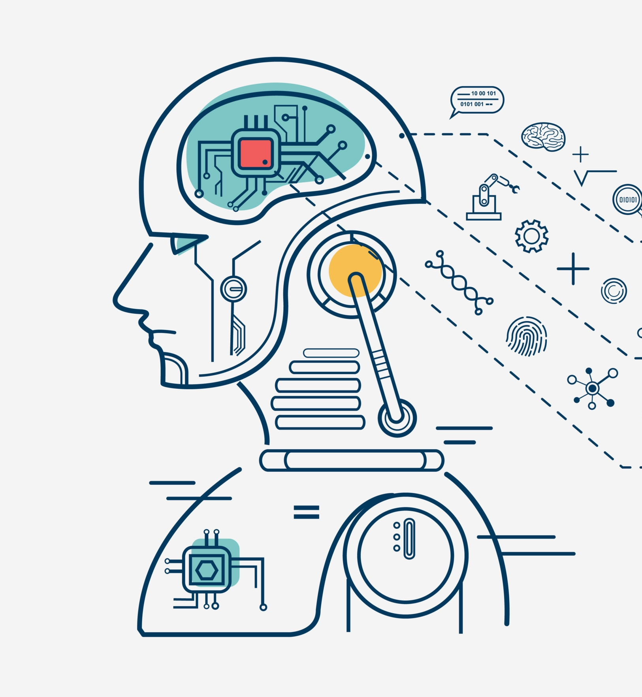
Discussion of the reading material
6 Common Machine Learning Applications for Business
Consumer lifetime modeling, can help businesses to understand their most loyal customers, to predict revenue and targeted advertising
Churn modeling, can help to identify customers that might stop engaging, can be employed with a retention strategy of targeted rebound campaigns
Recommendation engine, companies like Netflix and Amazon are built off this and revenue and engagement can be increased by recommending what someone wants based off patterns which then results in less churn and more engagement

Slide 8
Summary/Conclusion
Google Analytics is a powerful web suite for tackling large web analytics and understanding site behavior
Google analytics has great metrics such as pages per session and bounce rate.
Companies all over are using machine learning for gaining consumer insight and increasing retention
The 2 main types of machine learning are supervised and unsupervised

