Slide 1
INTRODUCTION
TO
BUSINESS INTELLIGENCE
BIA 3713
Week 14
Naveen Kumar

Slide 2
Agenda
Introduction of Machine Learning
  Supervised Learning and Business Applications
  Introduction to Linear Regression
    Simple Linear Regression Model
      Coefficient of Determination
    Multiple Linear Regression Model
    Interpretation of Coefficients
    Testing the Validity of the Model and Coefficients
    Examples
Review
  Quiz 3
  Assignment 4
Summary and Conclusion
Wrap up

Slide 3
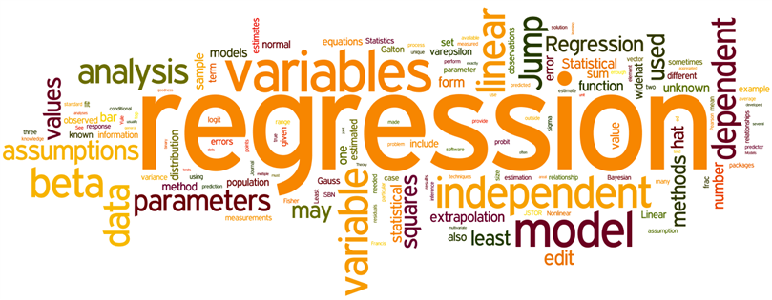
Regression Analysis
Predicting the value of one variable (the dependent variable) on the basis of another variable(s) (the independent variable(s))
Dependent variable denoted as Y
Independent variable(s) denoted as X₁, X₂, X_{3 ,}…,X_{k}

Slide 4
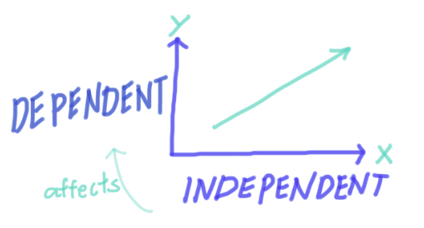
Regression Model
Mathematical equations describing the relationship between house size (X or Independent variable, and house price (Y or dependent variable)
Example:
The cost of building a new house is about $100 per square foot, and most lots sell for about $100,000. Hence, the approximate selling price (Y) would be:

Slide 5
Simple Linear Regression Model
A straight-line model with one independent variable.
In this chart, the independent variable (X) is Square Feet, and the dependent variable (Y) is House Price.

Slide 6
R²
Coefficient of Determination
Measure of the “fit” of the line to the data
R² = The % of the variation in Y that is explained by the variation in X.
The remaining % is unexplained, i.e. – due to error.
The value of R² will be between 0 and 1
A value of 0 indicates no fit
A value of 1 indicates a perfect fit and all data points would lie on the line
The coefficient of determination does not have a critical value that enables us to draw conclusions. However, in general, the larger the value of R²,the better the model fits the data.

Slide 7
The US Bureau of Labor Statistics produces consumer price indexes for several different categories. The dataset shows the consumer price indexes over a period of 20 years. Develop a model that attempts to predict all commodities index by other indexes. Comment on the result of this analysis.
All | Food | Shelter | Apparel | Fuel Oil
0.9 | 1.0 | 2.0 | 1.6 | 3.7
0.6 | 1.3 | 0.8 | 0.9 | 2.7
0.9 | 0.7 | 1.6 | 0.4 | 2.6
0.9 | 1.6 | 1.2 | 1.3 | 2.6
1.2 | 1.3 | 1.5 | 0.9 | 2.1
1.1 | 2.2 | 1.9 | 1.1 | 2.4
2.6 | 5.0 | 3.0 | 2.5 | 4.4
1.9 | 0.9 | 3.6 | 4.1 | 7.2
3.5 | 3.5 | 4.5 | 5.3 | 6.0
4.7 | 5.1 | 8.3 | 5.8 | 6.7
4.5 | 5.7 | 8.9 | 4.2 | 6.6
3.6 | 3.1 | 4.2 | 3.2 | 6.2
3.0 | 4.2 | 4.6 | 2.0 | 3.3
7.4 | 14.5 | 4.7 | 3.7 | 4.0
11.9 | 14.3 | 9.6 | 7.4 | 9.3
8.8 | 8.5 | 9.9 | 4.5 | 12.0
4.3 | 3.0 | 5.5 | 3.7 | 9.5
5.8 | 6.3 | 6.6 | 4.5 | 9.6
7.2 | 9.9 | 10.2 | 3.6 | 8.4
11.3 | 11.0 | 13.9 | 4.3 | 9.2

Slide 8

Multiple Linear Regression Model
Allows for any number of independent variables
We now have k independent variables (X) potentially related to the one dependent variable. This relationship is represented in this first order linear equation:
where Y is the dependent variable, X₁…X_{k} are the independent variables, β₀ is the intercept, and β₁... β_{k} are the regression coefficients.

Slide 9
β₀
Intercept
Average Y when all of the independent variables (X) are 0.
It can be misleading to try to interpret this value, particularly if 0 is outside the range of the values of the independent variables.

Slide 10
X_{i}
Independent Variable
The relationship between Y and X₁ is described by β₁
For each additional unit of X₁, Y increases on average by ___, assuming that the other independent variables (X) in this model are held constant.

Slide 11

Testing the Validity of the Model
Analysis of Variance (ANOVA) Technique
H₀: β₁ = β₂ = β_{k} = 0 Independent variable does NOT explain dependent variable (slope = 0)
H₁: At least one β_{i} ≠ 0 Independent variable DOES explain dependent variable (slope ≠ 0)
If the null hypothesis is true, none of the independent variables is linearly related to y
So, the model is invalid.
If at least one of the coefficients is not equal to 0, the model does have some validity. You must reject the H₀ and conclude that the slope is not equal to 0.

Slide 12
Testing the Validity of the Model
If the null hypothesis is true, none of the independent variables is linearly related to Y,
so the model is invalid.
If at least one of the coefficients is not equal to 0, the model does have some validity. You must reject H₀ and conclude that the slope is not equal to 0.
A large value of F indicates that most of the variation in Y is explained by the regression equation and that the model is valid. A small value of F indicates that most of the variation in Y is unexplained.
Once we’re satisfied that the model fits the data as well as possible, and that the required conditions are satisfied, we can interpret and test the individual coefficients and use the model to predict and estimate.

Slide 13

Testing the Coefficients
β_{1,}β_{2,…}β_{k}
For each independent variable, we can test to determine whether there is enough evidence of a linear relationship between it and the dependent variable for the entire population.
H₀: β_{i} = 0 Independent variable does NOT explain dependent variable
H₁: β_{i} ≠ 0 Independent variable DOES explain dependent variable
This hypothesis is used for each coefficient in the model. Test i = 1, 2, …, k using the test of β_{i} below:
P-Value for β_{i} = 0.01 (hypothetical value used for this example)
Test Statistic for β_{i} = 0.05 (typically test statistic value = alpha of 0.05)
If P-Value > Test Statistic: Do Not Reject H₀: Conclude β_{i} is NOT significant to the model.
If P-Value < Test Statistic: Reject H₀. Conclude β_{i} IS significant to the model.

Slide 14
Multiple Regression Steps
Build a regression model with all available independent (X) variables. Evaluate the Adjusted R2.
Identify the independent variable (X) with the highest P-Value. If P-Value > Test Statistic, remove that variable from the model.
Run the model again after removing the independent variable (X) above. Do not remove all variables where the P-Value > Test Statistic at the same time. Remove them one at a time.
Continue this process until all independent variables (X) left in the model are significant (P-Value < Test Statistic).

Slide 15
Regression Examples

Slide 16

Summary and Questions
Student Talk
John James

