Slide 1
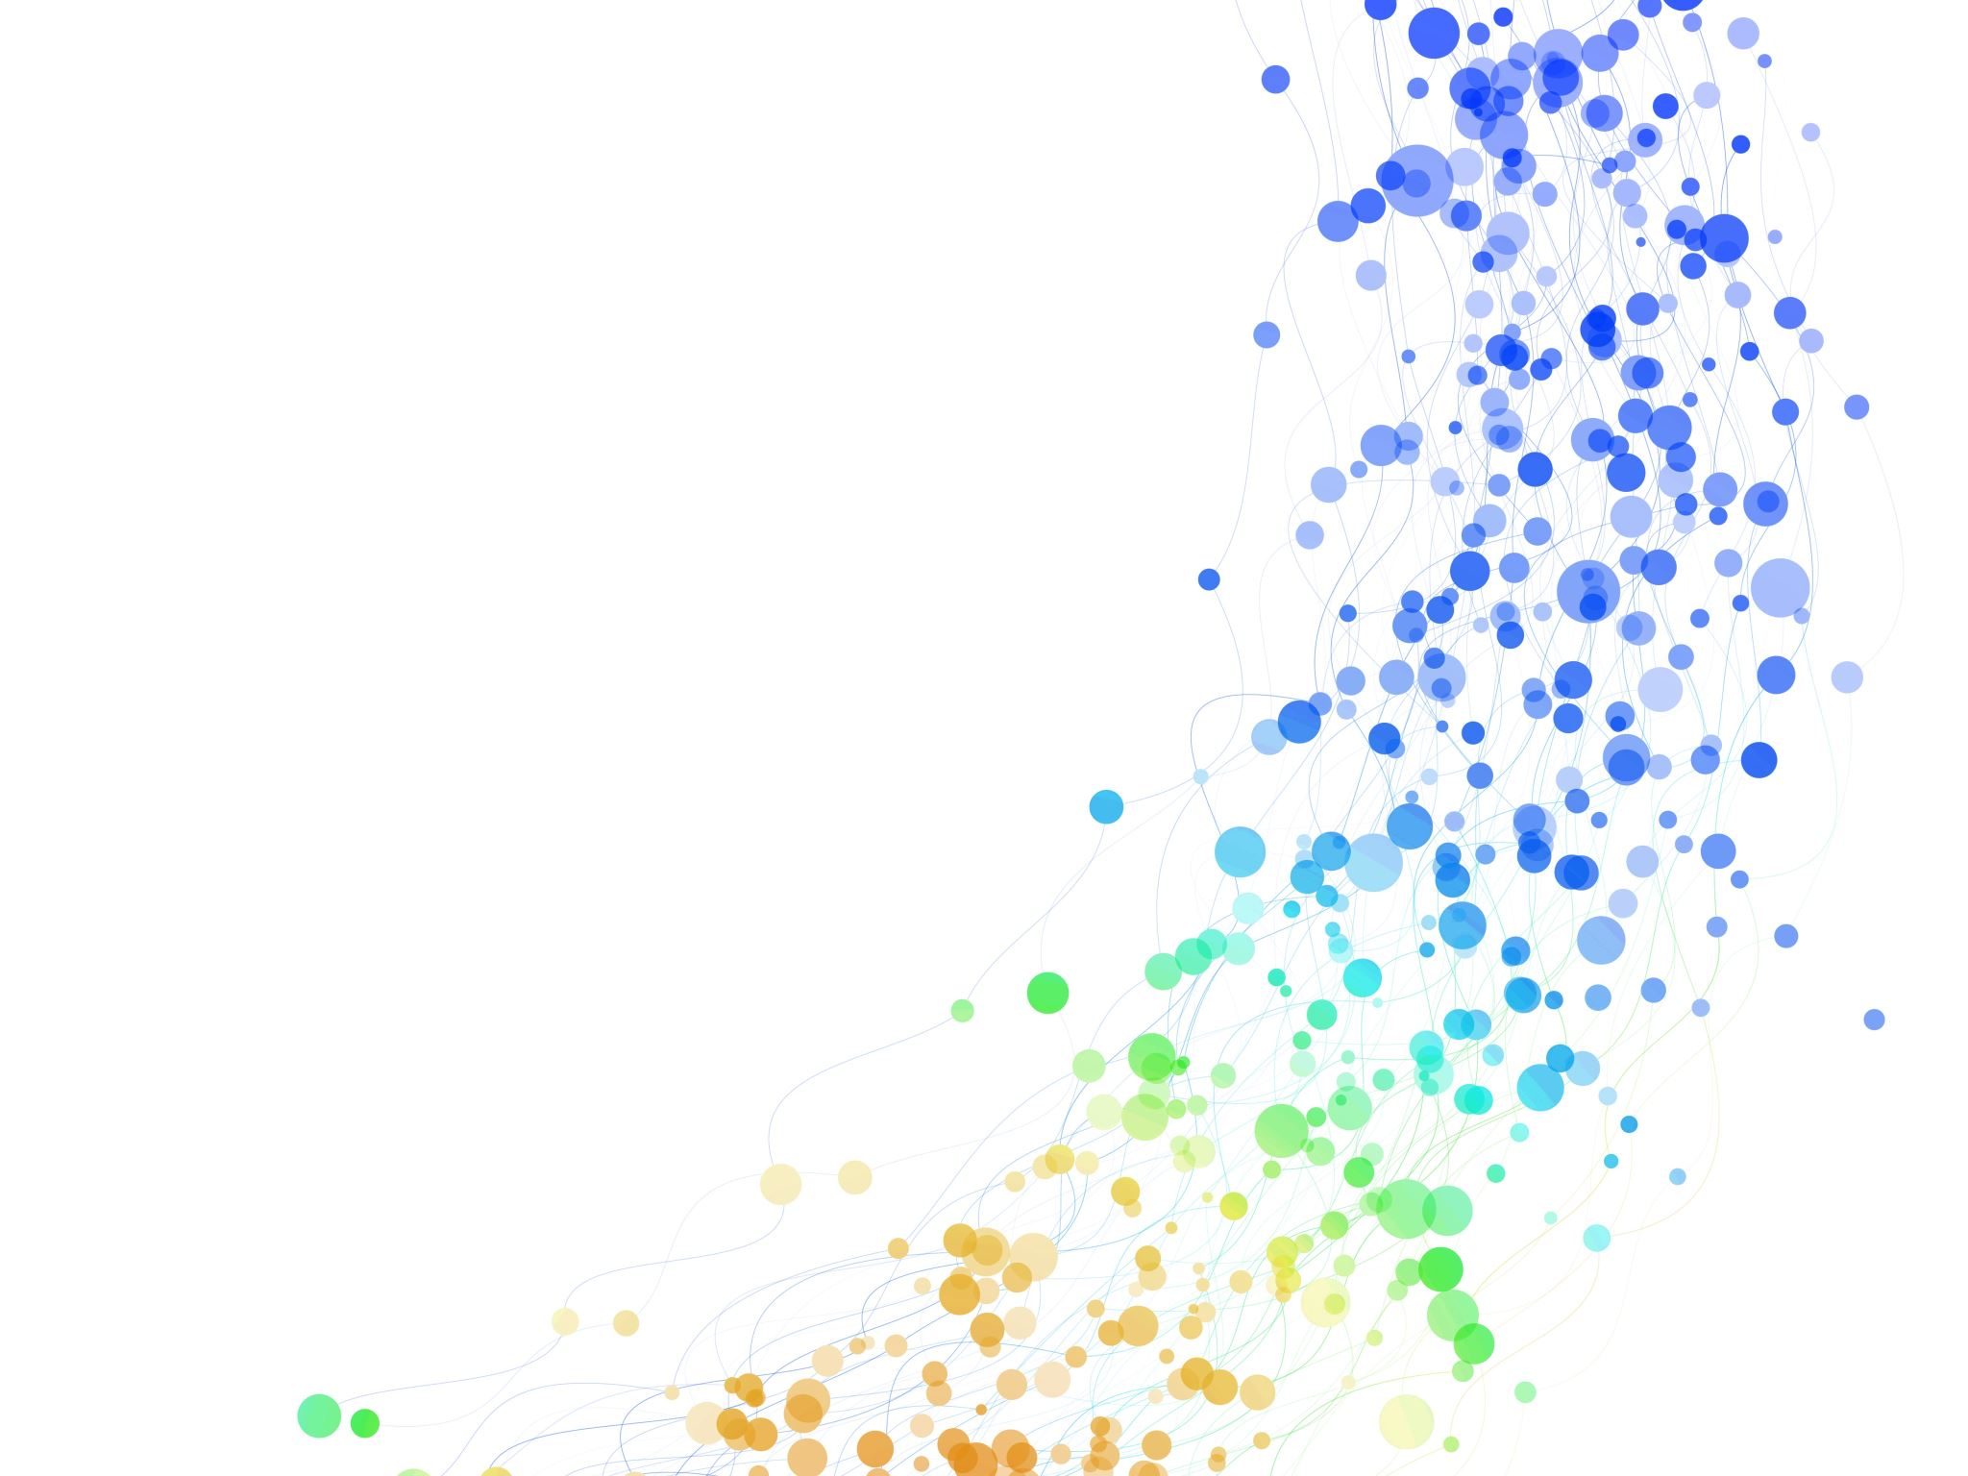
EMAD 5472
Data Management and Security in Aerospace & Defense
Dr. Alexandra Durcikova

Slide 2
What Is MIS About?
Data
Storing and Retrieving Data
Analyzing and Visualizing Data
Automating Data Operations
Protecting Data
CALCULATE

Slide 3
How Does MIS Deliver These Four Core Capabilities?
Enterprise Architecture as Strategy
Build your foundation & define your operating model
Building a digitized platform
Exploiting the platform for profitable growth
Storing and Retrieving Data
Analyzing and Visualizing Data
Automating Data Operations
Protecting Data
Data Communications and Networking
Clients and Servers
Network technologies
Network security and management

Slide 4
Enterprise Architecture = type of sandwich
Security = condiment
Infrastructure = base/wrap

Slide 5
Class Goals
Define and understand how different kinds of databases (flat file, spreadsheet, relational, data warehouse, NoSQL, blockchain) work
01
Describe various cybersecurity threats against different types of data and how to select controls
02
Understand how these concepts apply to your organization
03

Slide 6
Class Structure
Lectures & Guest Lectures (5%)
Quizzes (you get 3 attempts) (15%)
In-Class Problems (15%)
Discussion (15%)
Homework (15%)
Team Project (15%)
Final Exam (20%)
Learning by doing!

Slide 7
Required Reading
Notes:
https://www.akamai.com/visualizations/enterprise-threat-monitor
https://www.akamai.com/visualizations/visualizing-akamai

Slide 8
Enterprise Threat
Akamai – Breakdown of Threat Type
Akamai – Type of Attack
What do these attacks have in common? What are they after?

Slide 9
Notes:
http://online.wsj.com/news/articles/SB124027491029837401

Slide 10
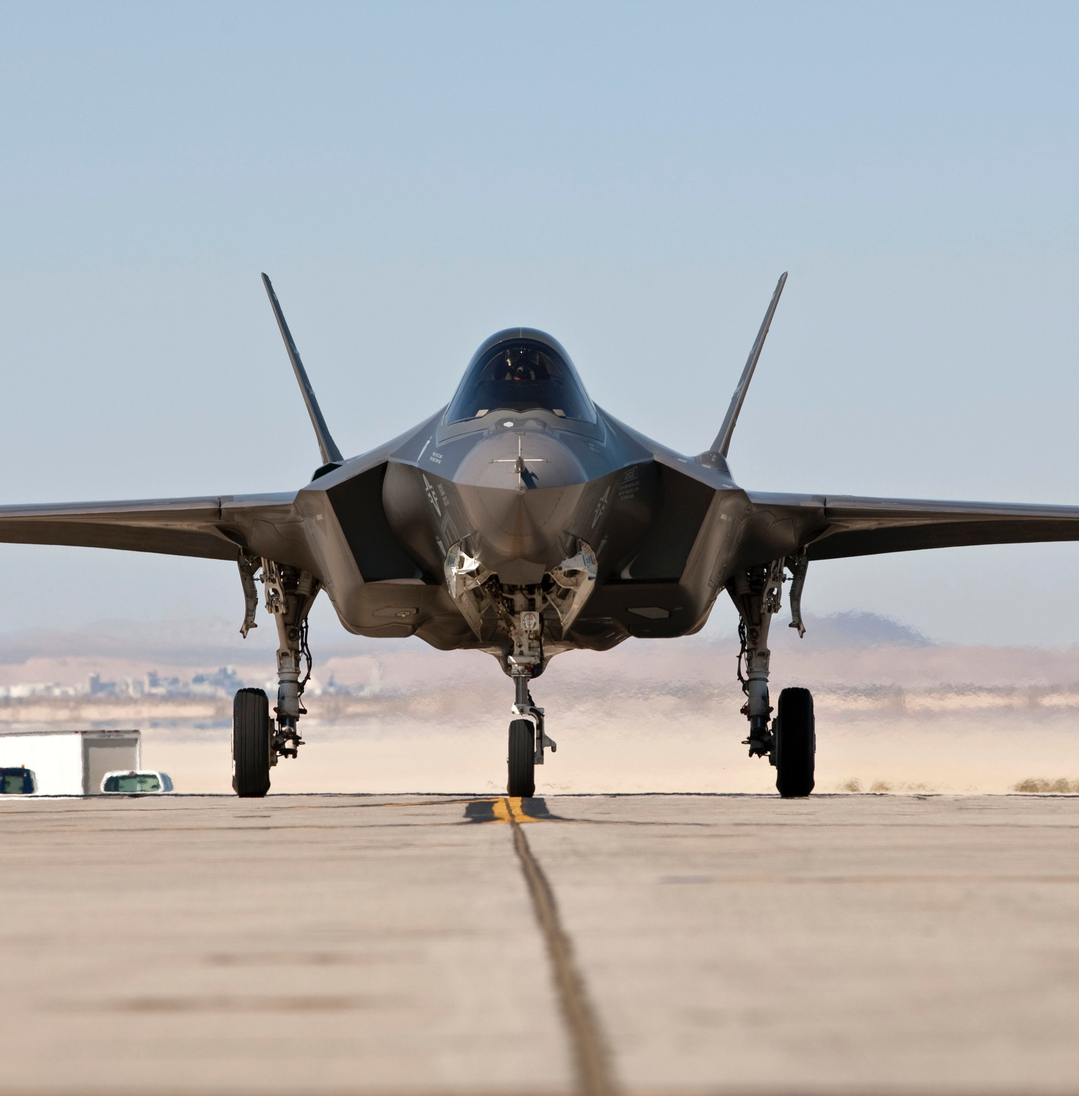
Lockheed Martin F-35
Chinese J-20
Notes:
Lockheed Martin F-35 vs. Chinese J-20

Slide 11
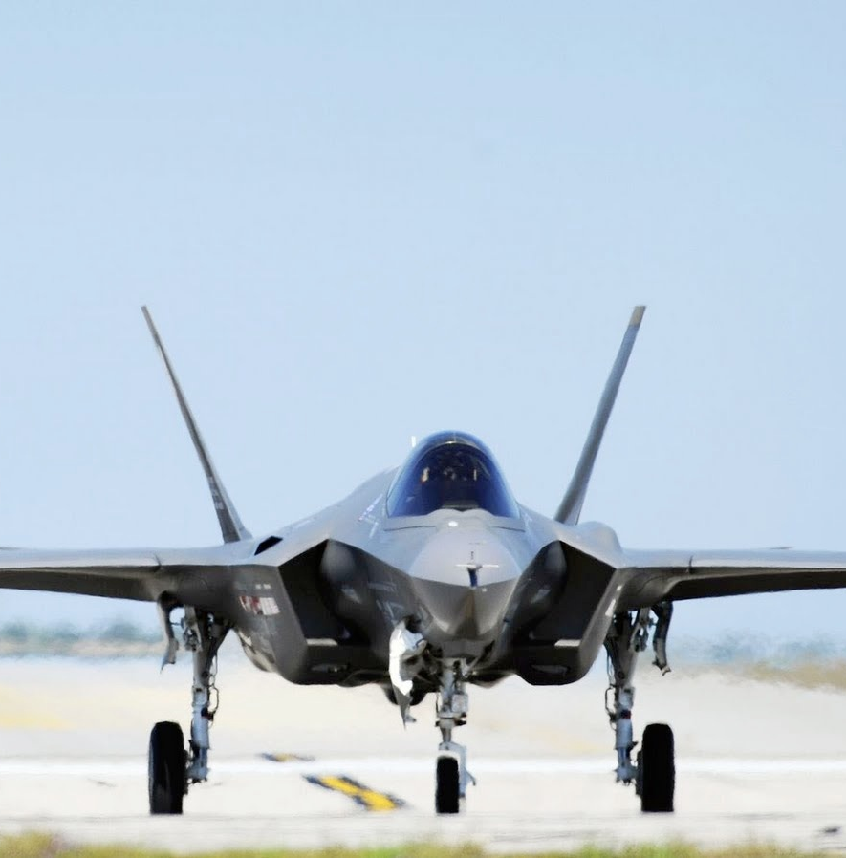
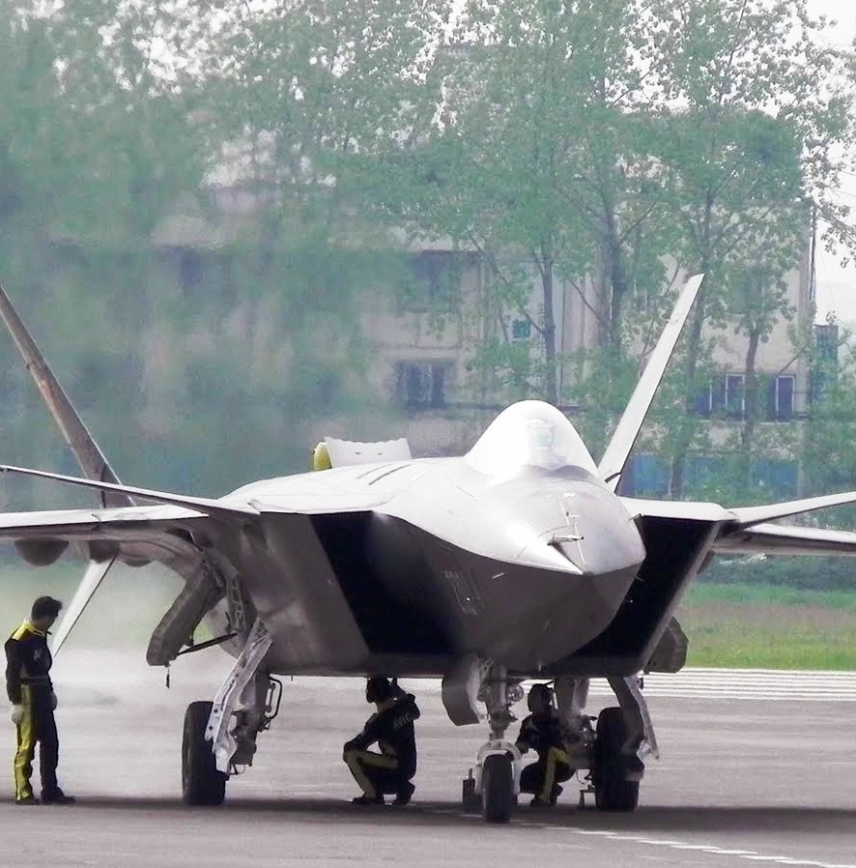

Slide 12
1. Introduction
Offense
defense
Defensive | Controls
Vs.
Offensive | Attacks
Offense | Attacks
Vs.
Defense | Controls
Cybercriminals
Insiders – malicious & non-malicious
Nation-States
Corporations
Hacktivists
Cyber-Fighters
Cyberterrorists
Script Kiddies
Risk Assessment
Ensuring Business Continuity
Intrusion Prevention

Slide 13
Offense
Cyberweapons range from psychologically manipulative to highly destructive
Cyberweapons are used by Nation-State everyday
Our society rests on the bedrock of IT – we keep our secrets in the cyber domain
We are inventing new vulnerabilities faster than we can eliminate old ones
We are somewhere around WWI in the cyber world today
US has Cyber Mission Forces (133 teams; 6000 troops)
No modern military can live without cyberspatialities
Cybercriminals
Activists
Insiders
Nation-State
Caveat: cyberweapons are a great leveler
Notes:
- Cybercriminal – is after your money
- Insider - Snowden & every employee
- Nation-State – cyberwarfare
- Activists – Anonymous and others
- Script Kiddies

Slide 14
Seven Sisters of Cyber Conflicts
This Photo by Unknown Author is licensed under CC BY-SA
This Photo by Unknown Author is licensed under CC BY-SA
This Photo by Unknown Author is licensed under CC BY-SA
Notes:
USA, Russia, China, UK,
North Korea, Iran, and Israel

Slide 15
David Sanger: The Perfect Weapon
Preface
Prologue – From Russia, With Love
What are your reactions to Sanger’s arguments?

Slide 16
Why is the knowledge of storing and accessing data important in management?
Efficient Way of Handling
Large amounts of data
Multiple types of data
Make informed decisions quicker

Slide 17
And…
Must know best practices to defend your data/information
Understand the dynamics of cyber threats to do so

Slide 18
Guest Speakers
Whom would you like to see give a guest lecture?
What topics in the data/cybersecurity interest you?

Slide 19
Class Schedule

Slide 20
How To Succeed In This Class?
Notes:
We will practice a lot in-class. You will have to practice at home. If stuck, ask for help from me and classmates.
It is okay to struggle – nothing of value comes without struggle (Dalai Lama).
The material in this class cannot be learned over night

Slide 21
People in This Class

Slide 22
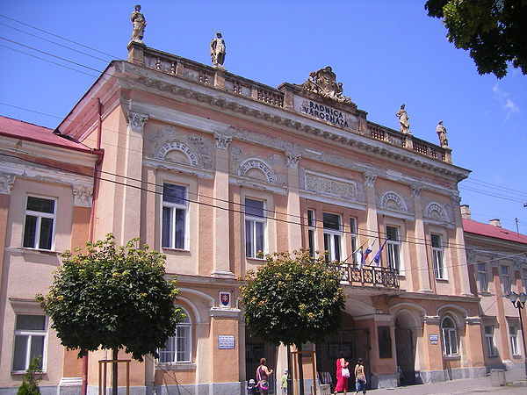
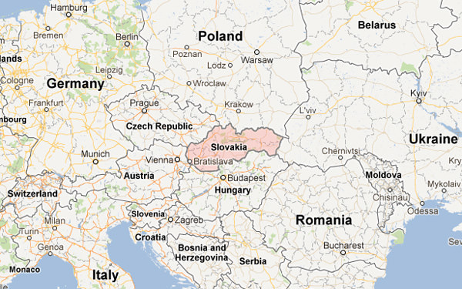
Something About Me…
Notes:
https://leanin.org/about - Sheryl Sandberg’s non-profit - - Mission to empower women to achieve their ambitions

Slide 23
What is EMAD 5472 About? Data
Enterprise Architecture as Strategy
Build your foundation & define your operating model
Building a digitized platform
Exploiting the platform for profitable growth
Storing and Retrieving Data
Analyzing and Visualizing Data
Automating Data Operations
Protecting Data
Data Communications and Networking
Clients and Servers
Network technologies
Network security and management

Slide 24
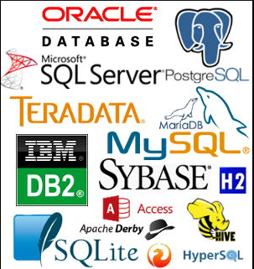
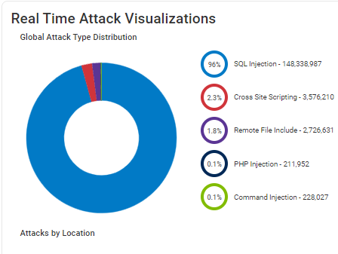
We will explore three aspects of data…
Storage
Information Security
Cybersecurity Landscape
Notes:
https://www.akamai.com/visualizations/visualizing-akamai

Slide 25
Let’s get started!

