Slide 1
SWK 5313 Module 5 Dr. Pharris
The Policy Process

Slide 2
MLK Letter from a Birmingham Jail

Slide 3
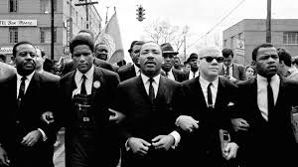
The Context
“I am in Birmingham because injustice is here” – MLK
“Injustice anywhere is a threat to justice everywhere. We are caught in an inescapable network of mutuality, tied in a single garment of destiny. Whatever affects one directly affects all indirectly.”

Slide 4
Who are we Now?
“when you are forever fighting a degenerating sense of ‘nobodiness’-then you will understand why we find it difficult to wait”
“We know from painful experiences that freedom is never voluntarily given by the oppressor; it must be demanded by the oppressed”

Slide 5
Thought Questions
What are the comparisons of MLK's warnings to today's public policy issues?
MLK warns the lukewarm are his greatest disappointment- more than the nationalistic, or the KKK? Why does he feel this way? What do you think? Who are the most dangerous citizens in a public policy formation?
Can we point to extreme views as the cause of our current and historical social unrest? Is this the nationalistic issue? Is this an issue of the extreme or the middle

Slide 6
Notes:
Final Slide

