Slide 1
Child Welfare Policy
SWK 5313
Notes:
What is it that you want for your own children as they grow? How much government support, help and intervention are you willing to accept to ensure your child achieves your goals of parenting? Is there a limit to that intervention?
What are your rights as a parent? Where does your right to make decisions about parenting cross over into a sense that your children are your “property”?
Children have been central to almost all development of welfare programs and the focus of much of the public policy you have disucsseed to date in this course. Child welfare, and the protection of vulnerable children is largely a bi-partisan issue. Both sides agree that protection of children is vita and a priority for policy and funding (in as much as they can take action). But- CW is certainty political! Challenged by the realities that public policy tends to try to create a one-size-fits-all approach to very extensive and variated needs of children from their developmental, health, education and ultimately their protection and rights to a health childhood.

Slide 2
Child Abuse Data
4.1 million reports of child abuse representing 7.4 million children
676,000 substantiated reports
Estimated number of children who died from abuse/neglect = 1,700
Every 2 minutes a report of child abuse occurs in the US
Every 11 minutes, child protective services substantiates, or finds evidence for a claim of child sexual abuse

Slide 3
Oklahoma reporting
Child Welfare Services received 80,598 reports of alleged child abuse in FY 2018, representing 138,061 children
Of those reports, 36,64 investigations were completed on 65,172 children victims
15,951 Child victims confirmed
Notes:
Intensive Safety Services

Slide 4
Safety Services
Intensive Safety Services
767 children
611 remained in home
Family Centered Services
749 Open Family-Centered Services cases
Notes:
Wiiver demonstration project targets families where the removal risk is higher and therefore not appropriate. ISS is 3-5 times a week of in-home services

Slide 5
Foster Care Data
442,000 in Foster Care on September 30th
269,000 entered foster care
248,000 exited foster care
126,000 returned to family of origin
57,000 legally adopted
690,500 served in foster care in FY 2018
Mean age 8.7 years
52% boys; 48% girls
32% placed with family
45% placed in foster home
6% live in a group home
7% in institution
1% runaway status
118,000 children in the US waiting for adoption

Slide 6
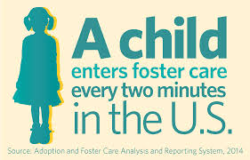
Oklahoma Foster Care
At the end of FY 2018 9,277 children were placed in out-of-home care
92% are placed in a family setting
4,660 entered foster care
2,328 exited with reunification
8,434 in foster care at the end of FY 2018
Foster Care exits = 5,236
-2,328 reunified with family
-2,144 adopted

Slide 7
History of Child Protection
Early 20th century interventions for children in private sector, focused on orphan care
1870’s estimated 150 children a month abandoned, more malnourished, left unattended or fending for themselves on the streets
Start of congregate care institutions
Practice of “placing out” with families emerges in 1850 (ish)
New York Children’s Aid Society

Slide 8
Orphan Trains
1853-1929 Emigration Department , or the Placing-Out Department (Foster Home Dept)
Sent tens of thousands of children to country to live with farm families.

Slide 9
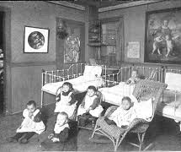
Hull House
1889 Jane Adams Founded Hull House in Chicago
Settlement Houses provided social services including education, health and temporary foster care
Adams advocated for child labor laws and protections
The Children’s Bureau formed and first two Chiefs Julia Latrhop & Grace Abbot were both from Hull House

Slide 10
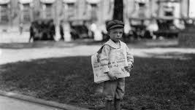
Child Labor Reform
Keating-Own Act 1916
Fair Labor Standards Act 1938
Restricted number of hours
Prevented work in harsh/dangerous conditions
Difficult to enforce
Human Trafficking

Slide 11
“The bones tell the story”
1960’s battered child syndrome defined by US and UK pediatricians
“discovery” of child abuse leads to rapid legislation and attention of government to become involved in the protection of children

Slide 12
Child Abuse Prevention and Treatment Act 1974
Provided funds to states to develop programs to prevent, investigate, prosecute and treat child abuse.
Set a definition of abuse of child in federal law
Currently called Keeping Children And Families Safe Act 2003

Slide 13
Adoption and Safe Families Act 1997
Designed to address permanency
Requires states to file for the termination of parental rights once children have been in care for 15 months
States must make “reasonable efforts” for reunification
Mandates states document efforts to find adoptive or permanent placements
Allows for concurrent planning for reunification/adoption

Slide 14
Indian Child Welfare Act 1978
25%-35% of Native Children were being separated from parents and families
85% of Native children placed outside of tribe
Promote the best interest of the Indian child and promote the stability and security of Indian tribes and families
Tribes exercise their sovereign authority over child custody proceedings
Protects the existence of Indian cultures
Active Supreme Court Challenges, lobbying and legal pursuits to overturn ICWA (Goldwater Institute)
Notes:
https://goldwaterinstitute.org/indian-child-welfare-act/
Notification to tribes, active effots to the family, identify placement in ICWA preferences, working to involved the tribe in proceedings or to transfer jurisdiction to tribes.

Slide 15
Chaffee/ Foster Care Independence Act 1999
Authorizes use of child welfare funds to assist youth who are “likely” to age out of foster care
Educational Vouchers
Independent Living services
23,000 kids age out every year

Slide 16
Fostering Connections to Success and Increasing Adoptions Act 2008
Encouraged states to provide foster care to youth up to age 21
Support for kinship caregivers
Extends Medicaid to kinship caregivers
Can reimburse kinship caregivers as foster homes
Extended adoption incentive programs
Allowed recognized tribes to apply for Title IV-E funds

Slide 17
Families First Prevention Services Act 2018
Authorizes states to use Title IV-E & Medicaid funds to provide services for families with children at risk of entering foster care
Substance abuse & mental health treatment
Requires standards for congregate care
Requires treatment planning and intensive monitoring for children in institutional care

Slide 18
Preventing Sex Trafficking and Strengthening Families Act 2014
CW and/or law enforcement collect data on victims or children at-risk of sex/human trafficking
Allowed CW agencies to intervene for trafficking
Required data tracking for victims and suspected victims
“normalcy” in foster care by a standard of “reasonable, prudent parenting”
Requires states to involve children over age 14 in the development of their plans

Slide 19
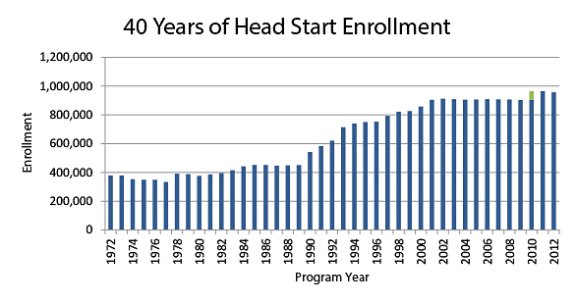
Head Start Act
Integrated education, social and parenting services for low-income pre-school families
One of the most successful policy interventions in child welfare history, to date

Slide 20
Child Abuse Statues OK
(2) "Abuse" means harm or threatened harm to a child's health, safety, or welfare by a PRFC including non-accidental physical or mental injury or sexual abuse or sexual exploitation; however, nothing prohibits a parent from using ordinary force as a means of discipline including, but not limited to, spanking, switching, or paddling

Slide 21
Failure to Protect
(16) "Failure to protect" means failure to take reasonable action to remedy or prevent child abuse or neglect, and includes the conduct of a non-abusing parent or guardian who knows the identity of the abuser or the person neglecting the child, but lies, conceals, or fails to report the child abuse or neglect, or otherwise take reasonable action to end the abuse or neglect.

Slide 22
Challenges in CW Policy
Day care
Prevention
Poverty
Food Insecurity
WIC/Maternal Health
Family/Marriage Focused Policy

Slide 23
Challenges in CW Policy
Workforce & Trauma in CW
Trauma focused interventions
Access to treatment & counseling for victims of abuse
Protection of ICWA

