Slide 1
Policy Practice in SWK, SWK 5313
Module 3: Taxes, Budgets and Income Distribution

Slide 2
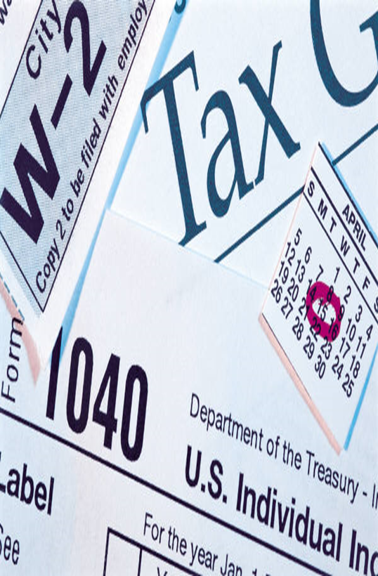
TAXES
Regressive Tax: everyone pays the same amount of tax regardless of income. Fees, taxes on gas, food, goods, etc. are regressive
Proportional Tax: each individual/household pays a fixed rate
Progressive Tax: Tax income based on earnings, progressively increasing tax responsibility. Federal income rates of 10% for lower earners, and up to 30% for high earners.

Slide 3
Earned Income Tax Credit
EITC is a tax credit and refundable portion
28 million families claim EITC
Average Claim (2015) was $2,440
States have the option to extend EITC

Slide 5
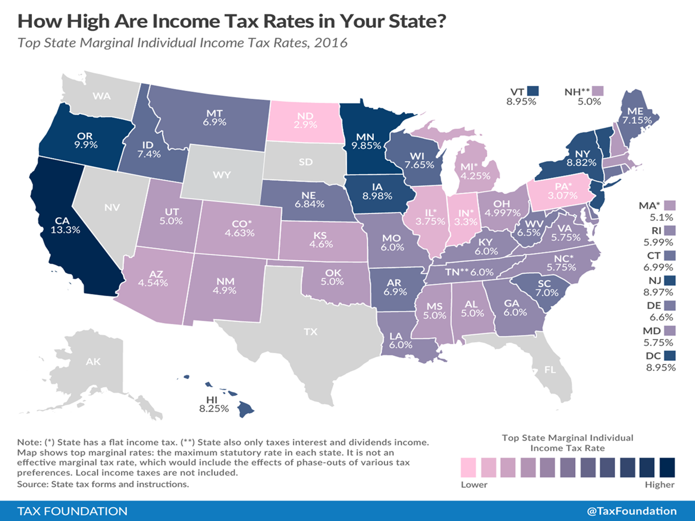

Slide 6
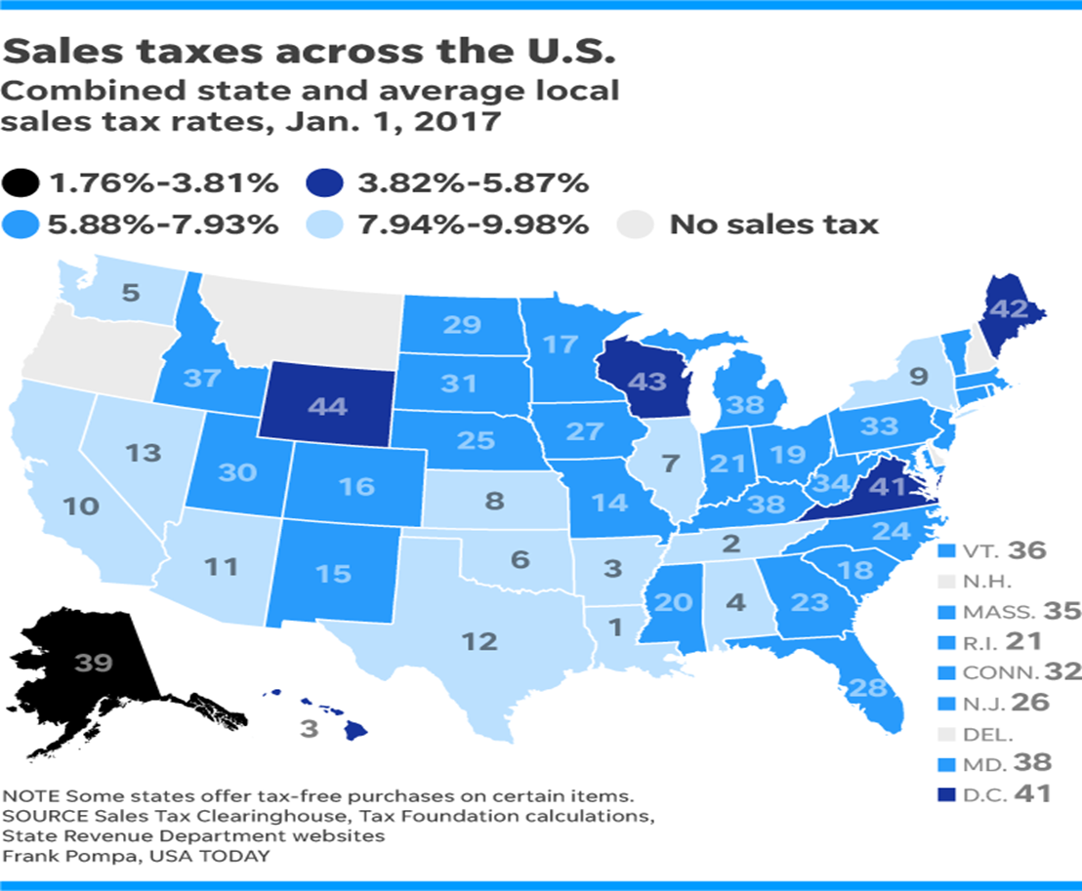

Slide 7
Income Inequality
Income is revenue from wages, salary, interests on saving, dividends from investments or profits
Income inequality- the extent income is distributed in an uneven manner across the population. The gap between the wealthy and everyone else
Notes:
?

Slide 8
US Weekly Wages, 1979-2016
The US weekly wages, after accounting for inflation
Wage gains for lower income have been stagnate for three decades
Almost no wage growth in the real weekly wages

Slide 9
Wealth & Asset Accumulation

Slide 10
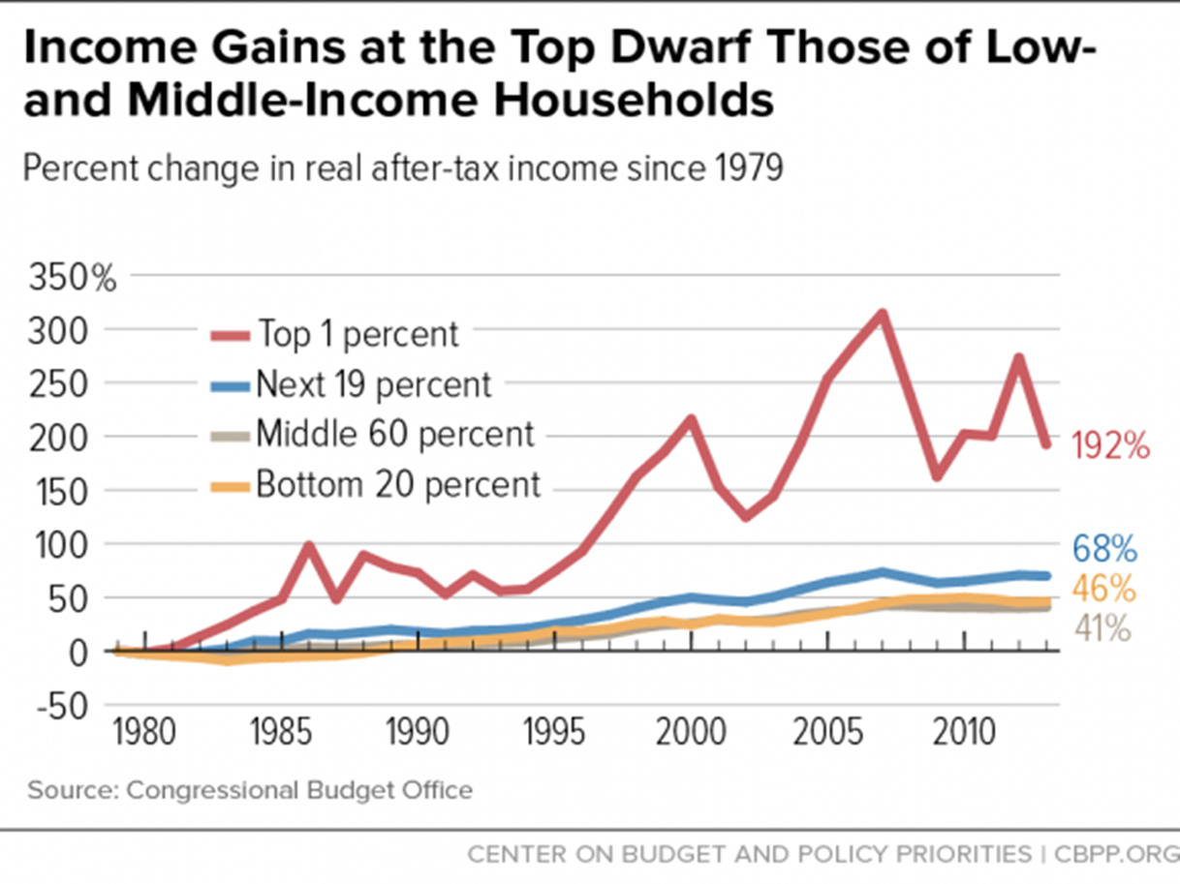

Slide 11
Wealth Inequality
Net worth, the sum total of your assets minus liabilities
Notes:
.

Slide 12
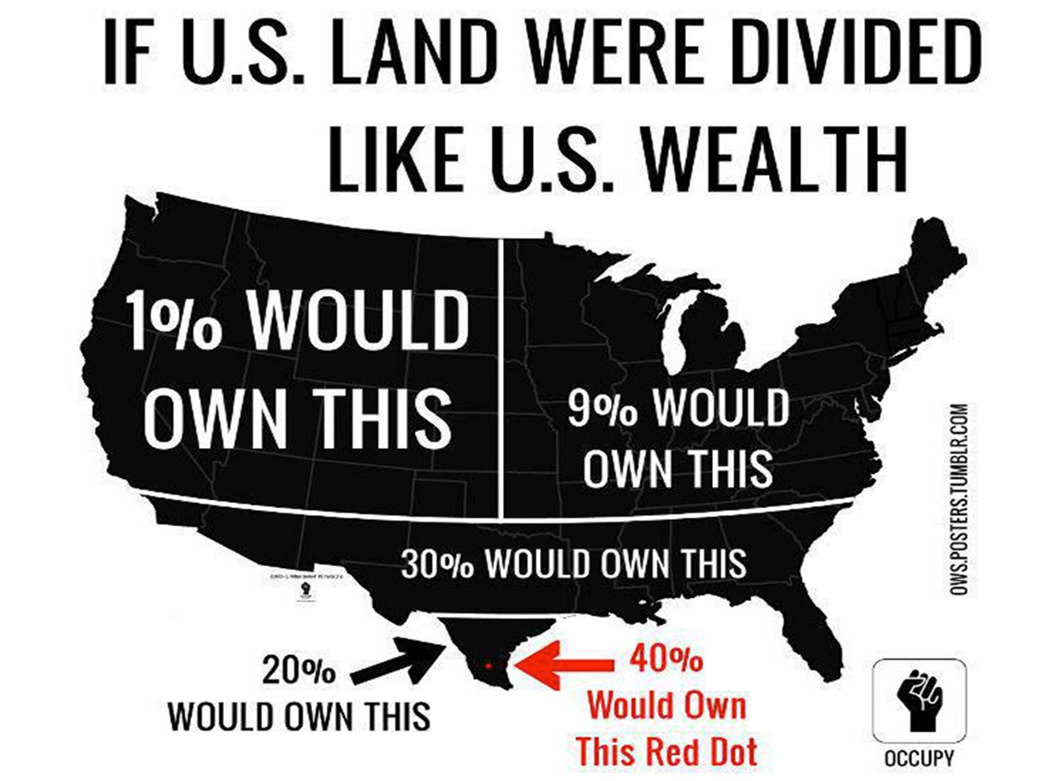

Slide 13
Federal Tax Policy
Tax policy is main contributor to the US skewed income distribution
Welfare state with a low tax rate cannot provide opportunity redistribution through social programs
Provides the structure for increased wealth and sustained poverty
The role of assets in overall wealth:
Savings, real estate, stocks and bonds and related assets
Liquidate in times of economic adversity
Appreciate in values

Slide 14
Would you be willing to pay…??
$63.00 year for children in poverty?
$13 year for elderly with low income pay for utilities
$88 year to provide lunch to kids at school who can’t afford to pay
$64 a year for children to have health insurance
$188 year to Lockeed Martin to build for defense

Slide 15
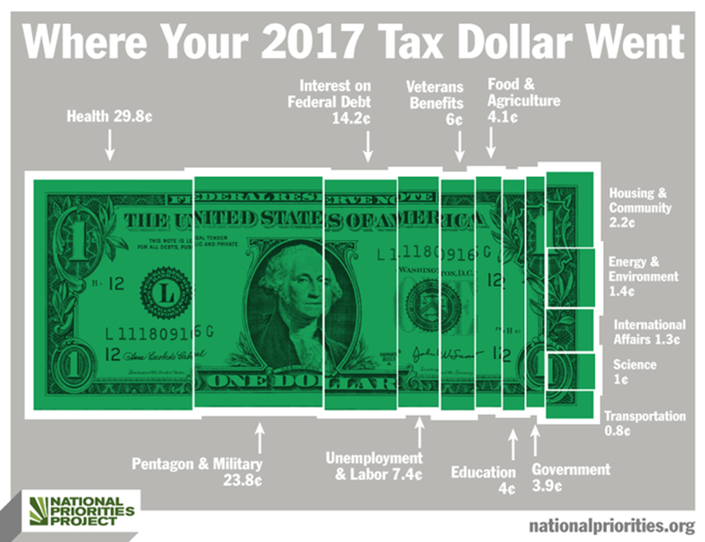

Slide 16
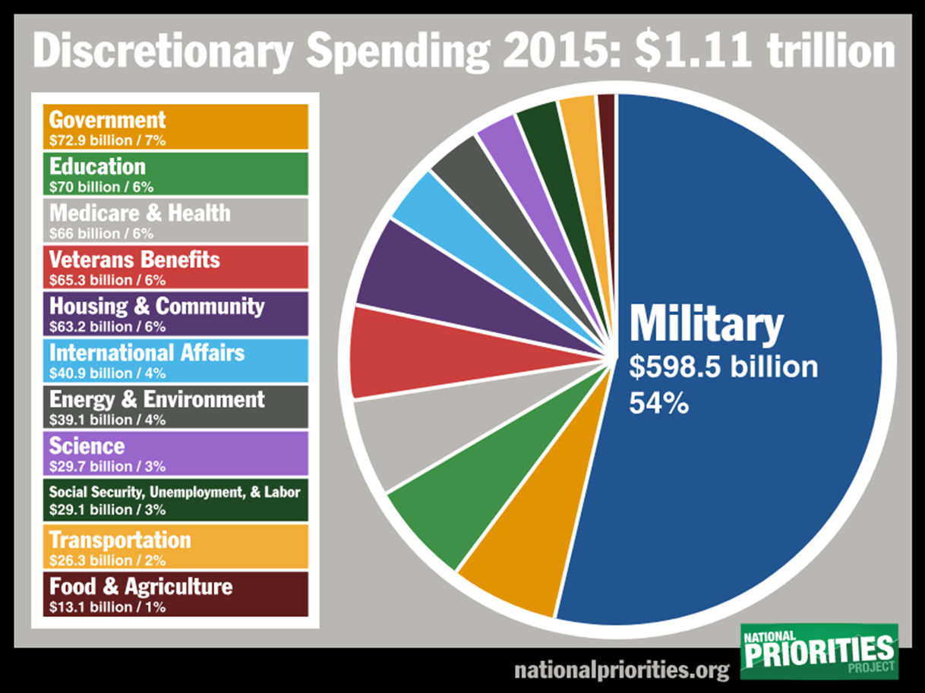

Slide 17
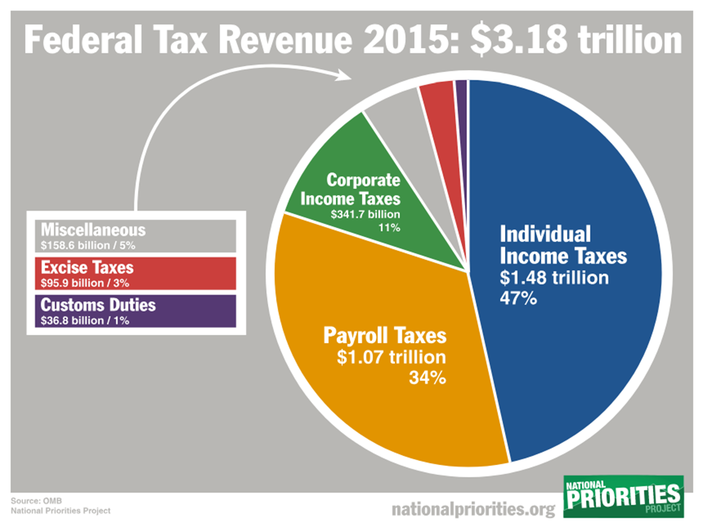
Notes:
!

Slide 18
State Budget
2019 Oklahoma $7.567 billion budget
Increase of 10% compared to previous year spending, but when adjusted to inflation the 2019 budget remains 9.4% below the budget of 2009
Dept of Education- 25% below 2009
Arts Council- 45.7% below 2009
Dept. of Environmental Quality 33.2% less than 2009

Slide 19
Oklahoma Department of Human Services

