Slide 1
Draw-a-scientist results
HSCI 3023.995 Fall 2016

Slide 2
Categories
Men with symbols of science (flasks, beakers, lab coats, computers, books, glasses, etc.) (76)
Women (22)
Einstein (7)
Mad scientists (2)
Scientists from popular media (6)
Others (4)

Slide 3
Women scientists

Slide 15
Mad scientists

Slide 17
Einstein

Slide 22
Scientists from popular media

Slide 23
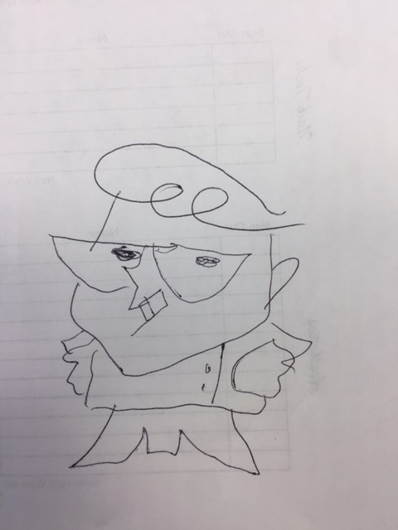
Dexter

Slide 24
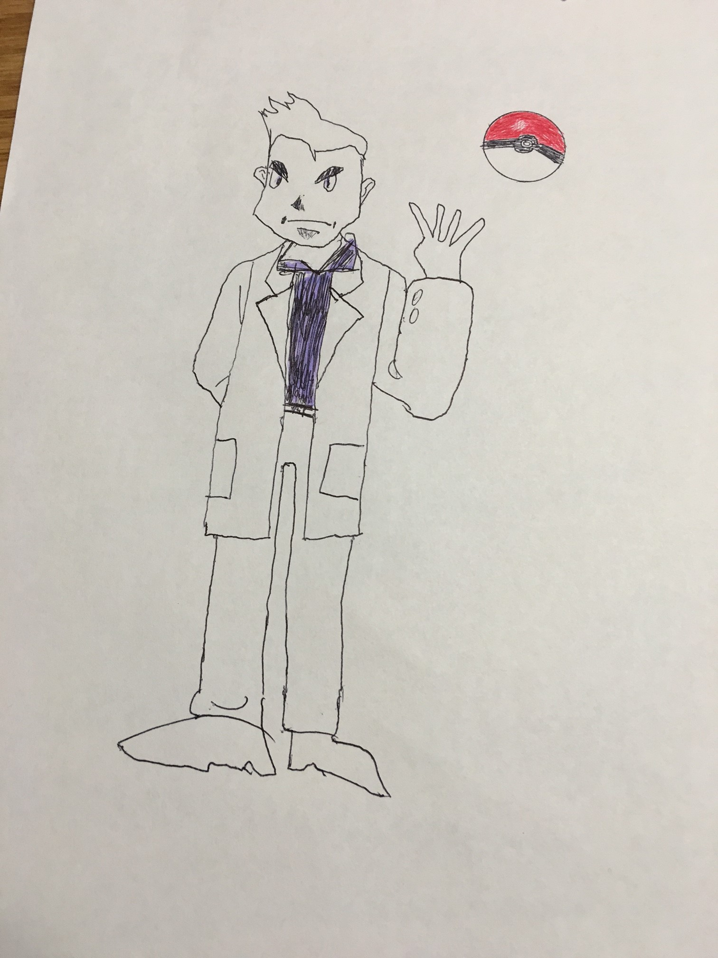
Professor Oak

Slide 25
Beaker

Slide 26
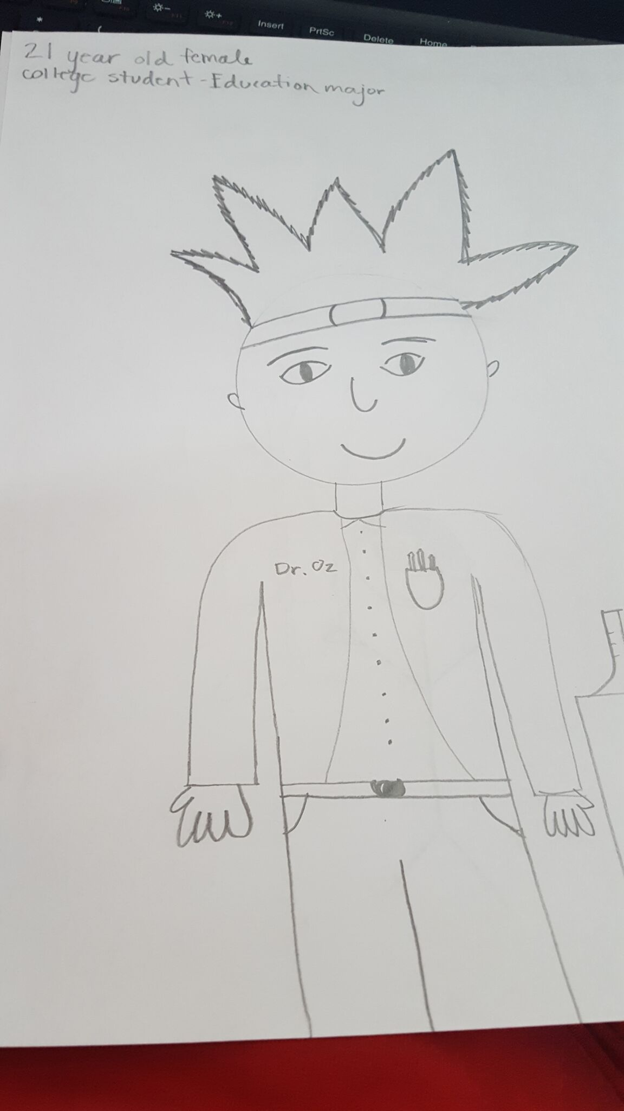
Dr. Oz

Slide 27
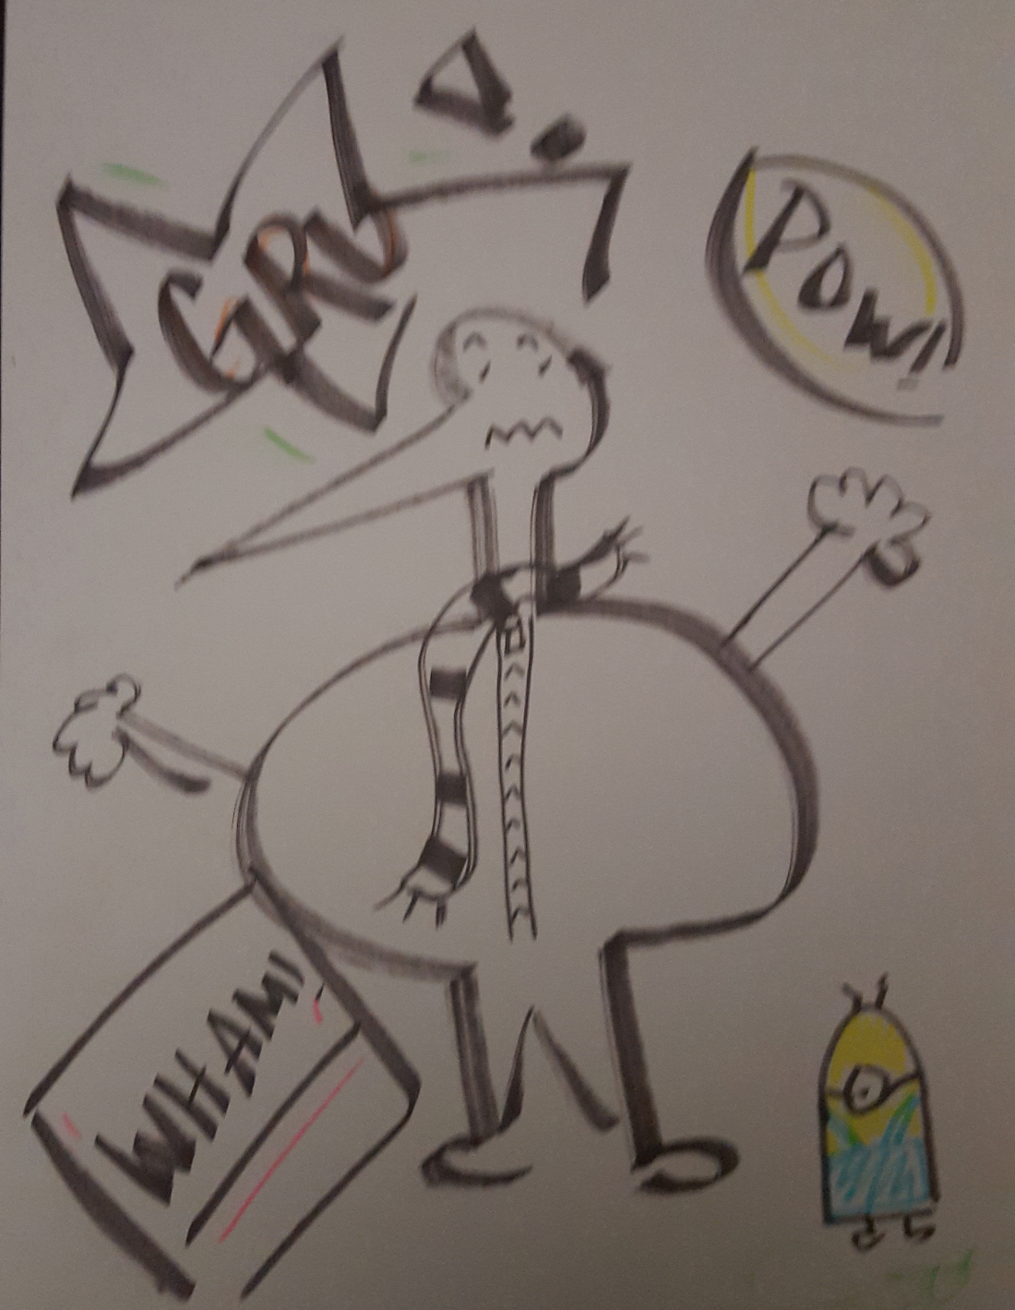
Gru

Slide 28
Others

