Slide 1
Passing the Clean Water Act of 1972

Slide 2
Reinventing the Corps of Engineers
Nixon creates the Refuse Act Permit Program by executive order in December 1970.
The Rivers and Harbors Act of 1899 is reinvented as a means of environmental regulation.
  Post Civil War mandate to maintain navigable waters.
  Section 13 makes it unlawful to “throw, discharge or deposit … Any refuse matter of any kind of description whatever ... into any navigable water of the United States…”
Authority of the COE revived by Supreme Court rulings of the Warren Court to include pollution.
Bypasses more cumbersome regulatory efforts.

Slide 3
the Congress of the 1970s
Growing restlessness by the rank-and-file with the long-serving and powerful committee chairs.
Pressure is growing to democratize the process.
The Nixon Administration also assumes more and more power, earning the label the “imperial presidency.”
The electorate turns to new faces who demand to be heard in the Congress.

Slide 4
Committee on Public Works
92nd Congress
Jan. 21, 1971 - Oct. 18, 1972
Democrats (majority) | Republicans (minority)
*Jennings Randolph, West Virginia, Chr | *John Sherman Cooper, Kentucky, RM
*Edmund S. Muskie, Maine | *J. Caleb Boggs, Delaware
B. Everett Jordan, North Carolina | *Howard H. Baker, Jr., Tennessee
*Birch Bayh, Indiana | *Robert J. Dole, Kansas
*Joseph M. Montoya, New Mexico | J. Glenn Beall, Maryland
Thomas F. Eagleton, Missouri | *James L. Buckley, New York
Mike Gravel, Alaska | Lowell P. Weicker, Connecticut
*John V. Tunney, California | *Robert T. Stafford, Vermont
*Lloyd M. Bentsen, Texas | Karl E. Mundt, South Dakota
Elaine S. Edwards, Louisiana | * Member of Subcommittee on Air and Water Pollution

Slide 5
Scanning the Political Horizon
An array of interest groups
  Emerging environmental lobby and ecologists
  Sanitarians and public health engineers
  State policymakers and agency administrators
  Local government officials
  Industrialists
  Business leaders
  College students
  Civic and community organizations
  Dueling bureaucracies – COE, EPA,PHS,GAO

Slide 6
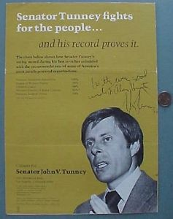
A New Kind of Politician
Son of heavyweight boxing champion Gene Tunney and wealthy socialite Polly Lauder;
Law school roommate and friend of Ted Kennedy;
In the 1970, U.S. Senate campaign, he openly compared himself to Robert F. Kennedy, largely through haircuts and poses.
Champions “swimmable, fishable” waters

Slide 7
Two Other Contending Powers
Lloyd Bentsen
Howard Baker
Four-term United States Senator (1971–1993) (D-TX)
Democratic Party nominee for Vice President in 1988 on the Michael Dukakis ticket.
Conservative Democrat
Advocates that economic and social benefits must exceed the costs of pollution regulation.
The first Republican senator from Tennessee since Reconstruction, elected 1966.
Served eight years as GOP leader, in minority and majority.
Moderate Republican
Champions “best available treatment” technology.

Slide 8
The First Hurdle
Consensus in the subcommittee
Muskie’s starting point
  Extend ambient water quality standards to all navigable waters;
  Require state implementation plans with enforceable limits;
  Expedite federal enforcement where necessary.
Muskie considers statutory alternatives:
  “chemical, physical and biological integrity of all waters.”
  “zero discharge” as a regulatory goal.

Slide 9
The Nixon Administration
The “swimmable” standard is “unachievable and irrational.”
EPA opposes a single national standard because of the administrative headaches and legal issues associated with different dischargers.
The Nixon Administration prefers utilizing the COE permit authority to avoid any new national regulatory apparatus.

Slide 10
The Committee Report (September 1971)
Tunney’s amendment and ambient standards are rejected.
Effluent limitations are defined by “best available treatment” technology and applied to new pollution permits.
Deadlines are established for industrial polluters (1976) and municipalities (1980) to install higher technology.
Zero discharge is the policy goal established for 1985, but Bentsen wins a commitment for “midcourse” review prior to 1985, thus making the goal unenforceable.
The intergovernmental grant program contains requirements that apply the entire regulatory apparatus to funding.
Full Senate passes S. 2770 November 1971.

Slide 11
The Conference Committee Process
At the heart of legislative give-and-take.
Technical limits of a conference committee:
  The Speaker appoints House conferees. The Senate almost always decides, by unanimous consent, to authorize the Presiding Officer to appoint.
  Instructions to conferees are never binding; a point of order cannot be raised if a conference report is inconsistent with House or Senate instructions.
  The chairman and ranking minority Member of the committee or subcommittee that reported the bill are almost always conferees and play a major part in deciding who else is appointed.
Who has influence when traceability is absent?

Slide 12
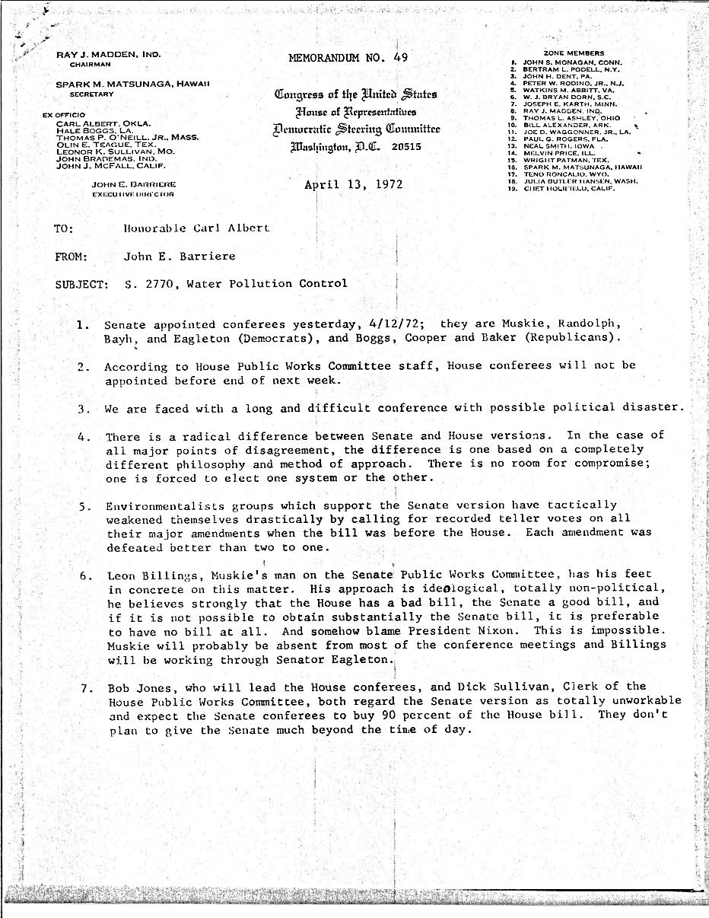
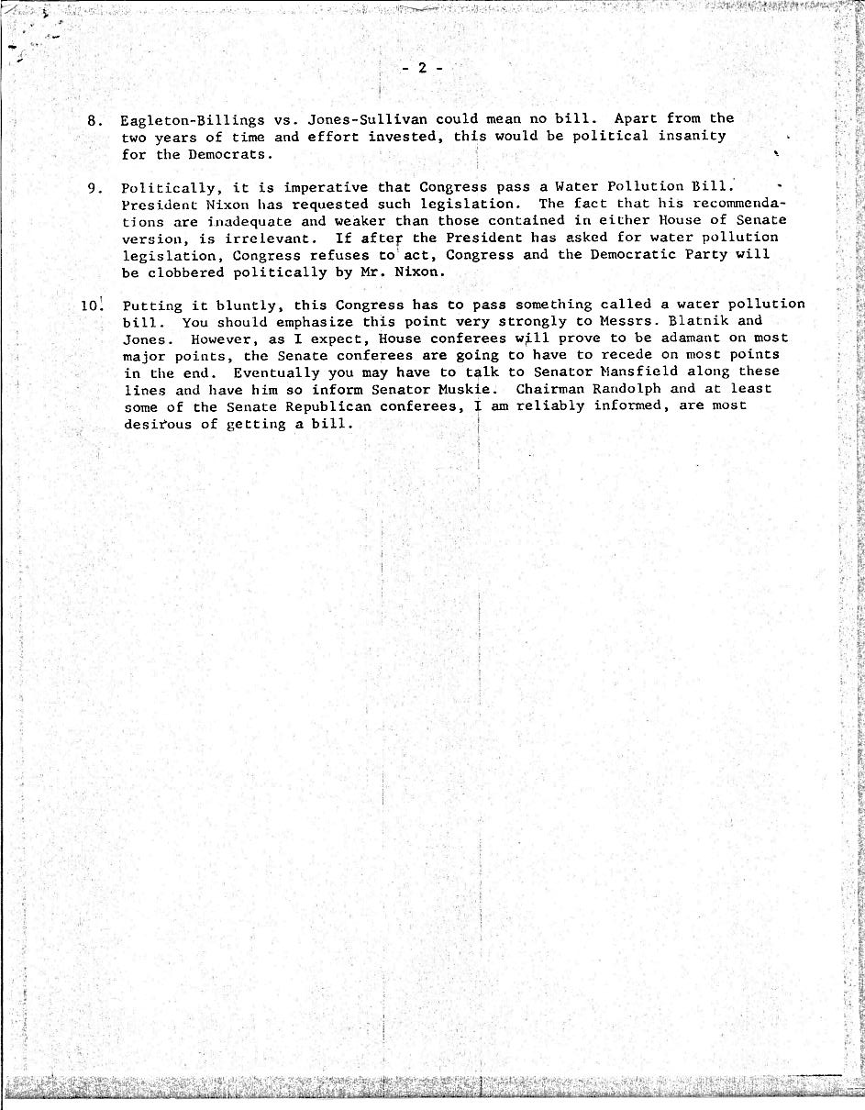
Conference Committee Convened
Interest group assessment
Interbranch rivalries
The role for the Speaker
Carl Albert Collection, Legislative Series, Box 238, Folder 10

Slide 13
Progress on the Easy Stuff
The Conference Committee meets almost 40 times from May to September.
Planning grants and distributive politics prove to be early compromises. Senate accepts the House grant program, and the House agrees to the Senate regional planning program.
Senate yields on economic tests and House relents on cost balancing tests.
Deliberations bog down over ambient standards (H) versus technology standards (S).

Slide 14
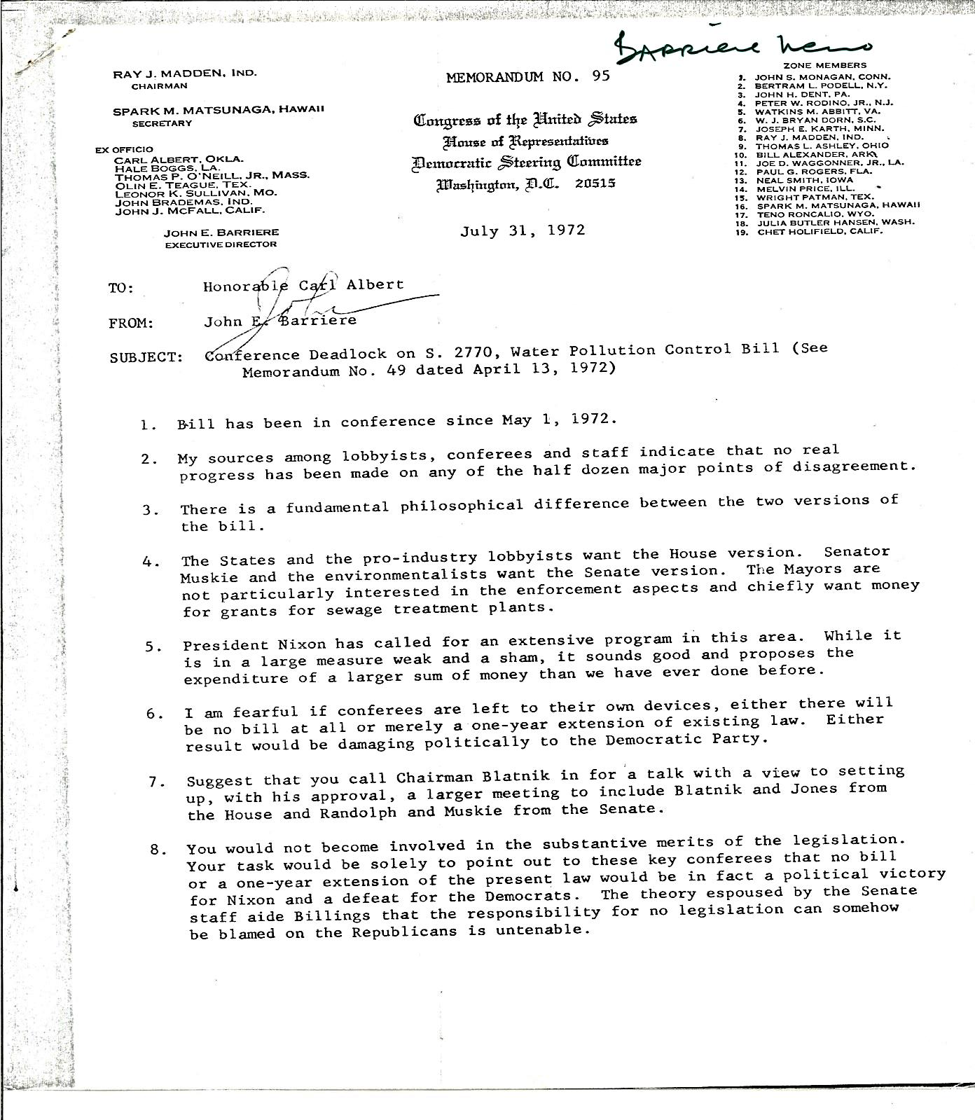
Trouble in River City
No real progress
Who is lobbying whom
Pressure from the White House
The role for the Speaker
Carl Albert Collection, Legislative Series, Box 238, Folder 10

Slide 15
The Political Stream – Summer-Fall 1972
June 17-- burglars including a GOP aide are arrested inside the office of the Democratic National Committee (DNC), in the Watergate building in Washington, D.C.
July 11 -- Muskie withdraws completely from the presidential race.
August 1 -- A $25,000 cashier’s check, apparently earmarked for the Nixon campaign, winds up in the bank account of a Watergate burglar.
September 29 – Attorney General John Mitchell controlled a secret fund to finance intelligence-gathering operations against the Democrats, The Post reports.
October 10 -- FBI agents establish that the Watergate break-in is part of massive political spying conducted by the Nixon reelection effort, The Post reports.
October 4 -- Senate (74-0) and House (366-11) approve a conference committee report containing a final compromise amendment offered by Muskie and Baker.
October 17 -- Just 40 minutes before the bill was to become law without his signature, President Nixon vetoes the bill saying it is “a bill whose laudable intent is outweighed by its unconscionable $24 billion price tag.”
October 18 – Both houses by wide margins easily override Nixon’s veto.
November 11 -- Nixon is reelected in one of the largest landslides in American political history, winning more than 60 percent of the vote and crushing Democrat Sen. George McGovern of South Dakota.

