Slide 1
Intercultural Competence
5033: Leadership in Organizations

Slide 2
Recap
Case Memo: Individualized Celebration For Your Team Members Matter
How did you utilize interpersonal awareness in this case study?

Slide 3
Theory of Intercultural Learning
Intercultural learning can aim to:
Deepen understanding of and respect for other cultures
Enable people to learn more about their own culture
Deepen roots and reaffirms identity
Raise awareness of the need for global cooperation to tackle today’s global problems
Notes:
When learners represent different cultural backgrounds and take part in an exchange of learning among one another, learners have the opportunity for personal growth. Through this exchange, the intercultural learning can aim to • Deepen understanding of and respect for other cultures; • Enable people to learn more about their own culture, to deepen their cultural roots and to reaffirm their identity; • Raise awareness of the need for international cooperation to tackle today’s global problems.

Slide 4
Intercultural Competences (Deardorff, 2006)
Understanding of different cultural groups
Knowledge
Declarative, procedural
Respect for different cultural groups
Attitudes
Based on feelings, beliefs
Dialogue between different cultural groups
Skills
Application of knowledge
Notes:
Understanding of different cultural groups
Knowledge
Declarative, procedural
Respect for different cultural groups
Attitudes
Based on feelings, beliefs
Dialogue between different cultural groups
Skills
Application of knowledge
To develop intercultural competence, the first step is to know oneself and understand one’s cultural identity; specifically cultural self-awareness is the ability to understand how one’s culture influences behaviour, identity and point of view. Being self-aware enables people to understand the world from other cultural perspectives or world views once they learn culture specific knowledge of other communities. Culture specific knowledge is the deep understanding of ideas, customs, and social behaviours of other cultural groups. In particular, socio-linguistic awareness is important because knowing when certain vernacular or body language is appropriate enables people to communicate more effectively.

Slide 5
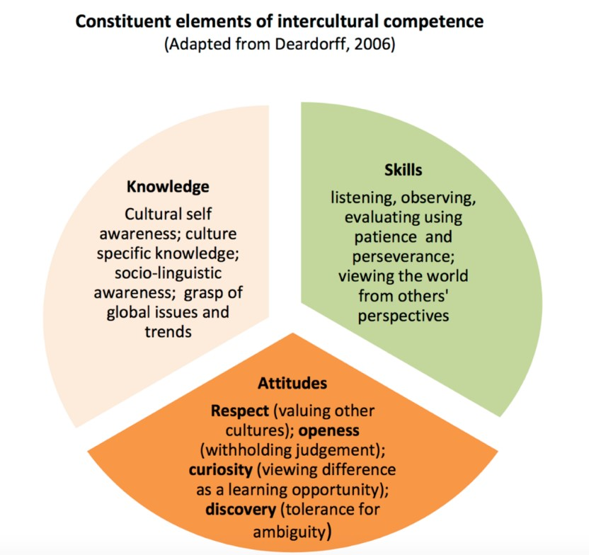
Notes:
A leading theorist, Darla K. Deardorff, worked with international scholars in intercultural education to develop the following model on intercultural competence. In her model, Deardorff explores the necessary KSAs to be able to communicate, cooperate and learn effectively together with people from different cultural backgrounds
Knowledge to develop understanding of different cultural groups - Cultural self-awareness - Culture specific knowledge, - Socio-linguistic awareness - Grasp of global issues and trends

Slide 6
Inclusive Leaders are Good
Six traits of behaviors that distinguish inclusive leaders from others:
Visible commitment
Humility
Awareness of bias
Curiosity about others
Cultural Intelligence
Effective Collaboration
Notes:
Visible commitment: They articulate authentic commitment to diversity, challenge the status quo, hold others accountable and make diversity and inclusion a personal priority.
Humility: They are modest about capabilities, admit mistakes, and create the space for others to contribute.
Awareness of bias: They show awareness of personal blind spots as well as flaws in the system and work hard to ensure meritocracy.
Curiosity about others: They demonstrate an open mindset and deep curiosity about others, listen without judgment, and seek with empathy to understand those around them.
Cultural intelligence: They are attentive to others’ cultures and adapt as required.
Effective collaboration: They empower others, pay attention to diversity of thinking and psychological safety, and focus on team cohesion.

Slide 7
Energy & Effort
Know your inclusive-leadership shadow
Be visible and vocal
Deliberately seek out difference
Deliberately seek out difference
Notes:
Know your inclusive-leadership shadow: Seek feedback on whether you are perceived as inclusive, especially from people who are different from you. This will help you to see your blind spots, strengths, and development areas. It will also signal that diversity and inclusion are important to you. Scheduling regular check-ins with members of your team to ask how you can make them feel more included also sends the message.
Be visible and vocal: Tell a compelling and explicit narrative about why being inclusive is important to you personally and the business more broadly. For example, share your personal stories at public forums and conferences.
Deliberately seek out difference: Give people on the periphery of your network the chance to speak up, invite different people to the table, and catch up with a broader network. For example, seek out opportunities to work with cross-functional or multi-disciplinary teams to leverage diverse strengths.
Check your impact: Look for signals that you are having a positive impact. Are people copying your role modeling? Is a more diverse group of people sharing ideas with you? Are people working together more collaboratively? Ask a trusted advisor to give you candid feedback on the areas you have been working on.

Slide 8
Inclusive Leader Competencies
Belief
Do you wholeheartedly believe everyone is created equal?
Awareness
Are you aware of the conscious and unconscious biases you had (or have) towards others?
Boldness
Are you honest with others about your shortcomings or misperceptions?
Curiosity
Are you open to unlearning and relearning from others?
Action
Are your behaviors and actions towards others aligned with your beliefs in equality?
Commitment
Do you consistently hold yourself and others accountable to a culture of inclusion?

Slide 9
Four Dimensions
Embrace Difference (self)
HIGH degree of self (interpersonal) – awareness
Empower diverse talent (others)
View people through a HUMAN lens
Enable diversity thinking teams (Teams)
Create psychological safety
Embed diversity and inclusion across the organization (Organization)
Integrate diversity/inclusion measures into POLICY, PRACTICES, and PROCEDURES

Slide 10
Module to Do
Here's everything you need to do and remember for this module:
Week 6 Readings and
Week 6 Case Memo #4
Week 6 Critical Reflection
Week 6 Discussion Board
Notes:
A high-quality analysis is one that steps back from a situation, identifies key events and processes, uses course concepts to help structure the analysis, and does so in a well-written fashion. The analysis should be no longer than two pages typed (double-spaced, Times New Roman, 12-point). (5pts for submission) 5tps

